Slide 1

AMD Professional Graphics
Updated Amd fIREpRO™ S-series
Server GPUs for HPC

Slide 2
AMD FirePro™ S-Series Assets – As of 10/6/14
Product Shots
  S9150: https://amdfirepro.sharefile.com/d/s4daa48e814f48eab
  NEW S9100: https://amdfirepro.sharefile.com/d/sefa1ae662da41938 (Don’t use Birdseye Angle, will be updated ASAP)
  S9050 & S9000 (same for both): https://amdfirepro.sharefile.com/d/sc7032283108425fa
  S10000 (6GB/12GB passive): https://amdfirepro.sharefile.com/d/sa963f816b2c45709
Data Sheets
  S9150: https://amdfirepro.sharefile.com/d/s9fd41570b1c475db
  NEW S9100: https://amdfirepro.sharefile.com/d/s1bb768e402a4ea88
  S9050: https://amdfirepro.sharefile.com/d/sca001a53a4d4424a
  S9000 (updated): https://amdfirepro.sharefile.com/d/s9075f38465549bd9
  Updated S10000 (6GB/12GB passive details only): https://amdfirepro.sharefile.com/d/s9c88720c6ff4ca98
S-Series Family Quick Reference Guide
  Updated, includes S9150, S9100 and S9050: https://amdfirepro.sharefile.com/d/s7e647d69dc14b8ea

Slide 3
Web Assets – As of 10/6/14
S9150 & S9050 Press Release: http://www.amd.com/en-us/press-releases/Pages/worlds-most-powerful-2014aug06.aspx
NEW S9100 Blog Post: http://community.amd.com/community/amd-blogs/amd-business/blog/2014/10/06/why-amd-gpus-are-right-for-the-data-center-a-closer-look-at-amd-firepro-s9100
Fireprographics.com HPC Pages (S9150/S9100/S9050 still need to be added in some cases)
  AMD STREAM technology: http://fireprographics.com/gc/tech/stream/index.asp
  HPC: http://fireprographics.com/gc/overview/overview/index.asp
  S-series: http://fireprographics.com/ws/products/sseries/index.asp
  OpenCL: http://fireprographics.com/ws/tech/opencl/index.asp
AMD.com Product Pages
  S9150: http://www.amd.com/en-us/products/graphics/workstation/firepro-remote-graphics/s9150#
  NEW S9100: http://www.amd.com/en-us/products/graphics/workstation/firepro-remote-graphics/s9100#
  S9050: http://www.amd.com/en-us/products/graphics/workstation/firepro-remote-graphics/s9050#
  S9000: http://www.amd.com/en-us/products/graphics/workstation/firepro-remote-graphics/s9000#
  Updated S10000: http://www.amd.com/en-us/products/graphics/workstation/firepro-remote-graphics/s10000#

Slide 4
Web Assets Continued
New AMD.com HPC Pages
  NEW AMD STREAM Technology: http://www.amd.com/en-us/innovations/software-technologies/firepro-graphics/stream
  NEW HPC: http://www.amd.com/en-us/solutions/professional/hpc
  NEW OpenCL: http://www.amd.com/en-us/solutions/professional/hpc/opencl
Virtualization Web Pages (S9150 and S9100 pure HPC plays, not part of AMD SKY technology)
  AMD SKY technology on FPG.com (S9050 to be added): http://fireprographics.com/vdi/tech/sky/index.asp
  Virtualization on FPG.com (S9050 to be added): http://fireprographics.com/vdi/solutions/virtualized/
  NEW AMD SKY on AMD.com (S9050 to be added): http://www.amd.com/en-us/innovations/software-technologies/firepro-graphics/sky
  New Virtualization Page on AMD.com (S9050 needs to be added): http://www.amd.com/en-us/solutions/professional/virtualization

Slide 5
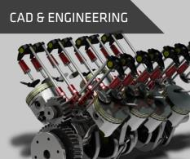







The professional graphics market
Professional graphics is a >$1 Billion Market*
New areas of growth include Cloud and HPC
Traditional Professional Graphics Markets
New Areas of growth
* Source: Jon Peddie Research, Market bulletin: workstations and professional graphics in Q3'13, December 2013.
Notes:
These are other areas we focus on that require a “professional graphics class” solution

Slide 6
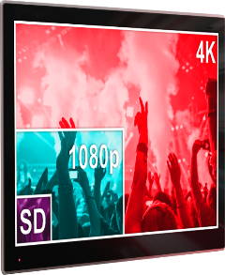

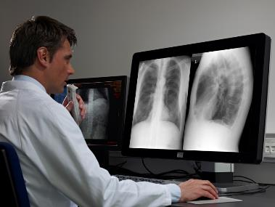


AMD PROFESSIONAL GRAPHICS ADVANTAGE
INNOVATION
PERFORMANCE
RELIABILITY
Simultaneous render & compute
Up to six 4K displays¹
Intelligent power technologies
Application optimizations
Latest API support
PCIe® 3.0 support
100+ app certifications
Rock-solid drivers
Three year warranty
Medical imaging photo courtesy of Barco.

Slide 7
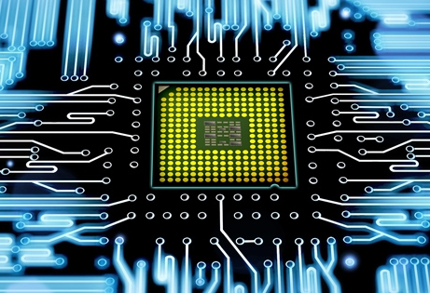
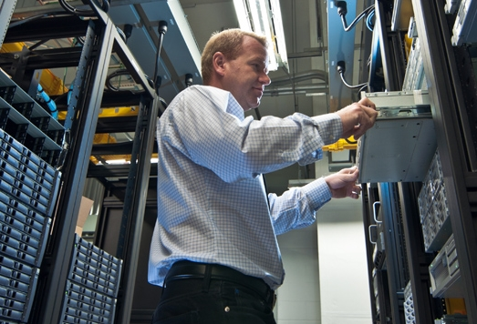

High Performance Computing Market Trends & Needs
Heterogeneous Compute
Environmentally Responsible Computing
Extends to Big Business
Increasing mix of CPUs, GPUs and co-processors
Per IDC, 77% of HPC sites use GPUs and co-processors, vs 28% in 2011
4 of top 10 on June 2014 Top500™ List are heterogeneous
Maximize power budgets
Lower power HW with high performance/watt
Top 15 systems on June 2014 Green500™ List are heterogeneous
Worldwide droughts, need to reduce water used for cooling servers
Cloud computing and on-demand HPC services
Big data analytics, IDC forecasts $16.1 billion in 2014
http://www.hpcmagazine.eu/news/hpc-in-2014-the-major-trends-according-to-idc/
http://www.green500.org/ and http://www.top500.org/

Slide 8

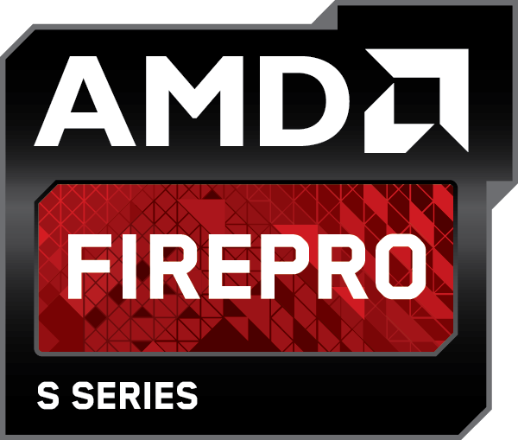
a new era of Supercomputing
Double precision leadership
Memory size leadership
High performance-per-watt
OpenCL™ support
PCIe® 3.0 support

Slide 9
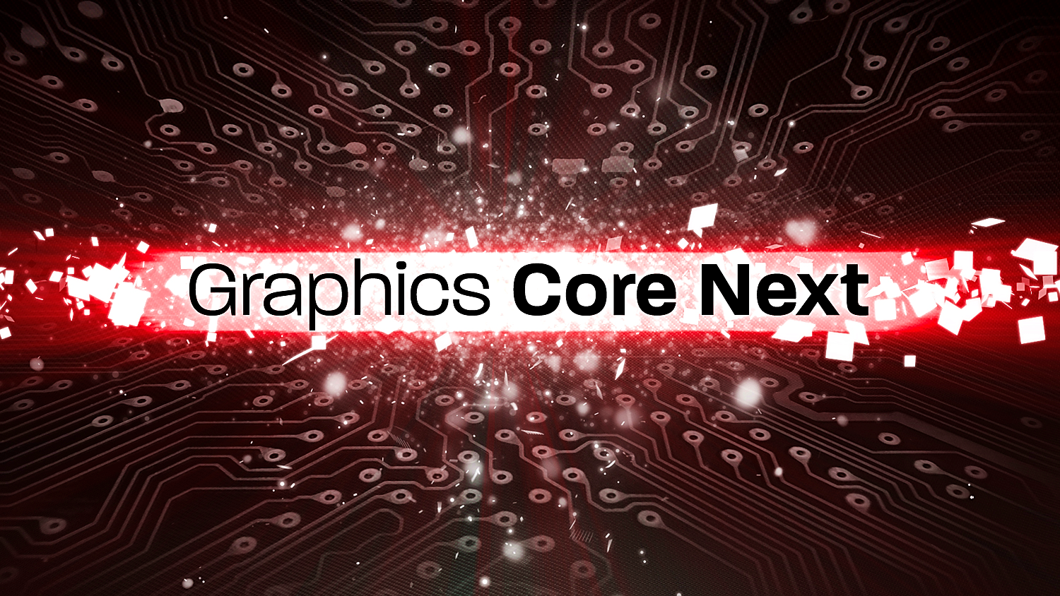
The Cornerstone of visual & High Performance computing
From tablets & Game consoles, to the Mac Pro, Workstations, Servers & SUpercomputers
Simultaneous
Render & Compute
Energy Efficiency
High Performance
Compute

Slide 10
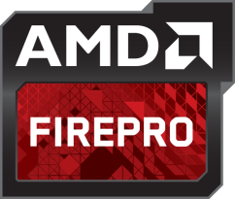
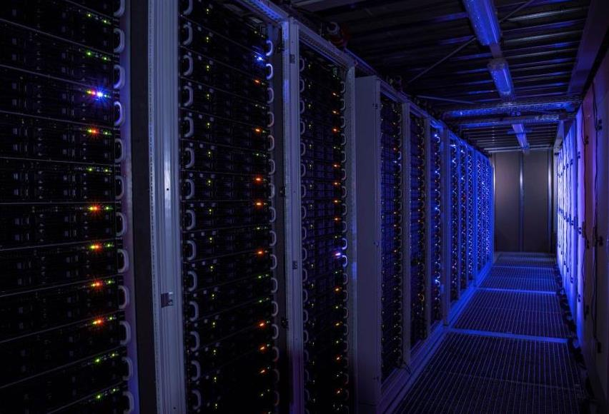
The Power of AMD FIrePRo™ GPUs
SANAM SUPERCOMPUTER, University of Frankfurt
Frankfurt Institute for Advanced Studies
Uses 420 AMD FirePro™ S10000 server cards
Sustains up to 421 TFLOPS at 180kw
#2 Rank on Green500™ List, Nov. 2012
“…delivering this performance without GPUs would run up an electricity bill of about 750,000 Euros per year, whereas the annual power cost for SANAM is expected to be about 250,000 Euros.”
Dr. Volker Lindenstruth, Goethe University
http://fireprographics.com/ws/resources/casestudies/resources/53681A%20AMD_FirePro_SANAM_CaseStudy%20FNL_A4.pdf
http://www.green500.org/
Notes:
The University of Frankfurt selected AMD to create the SANAM Supercomputer, used for antiproton and ion research
A generic supercomputer delivering this performance without GPUs would run up an electricity bill of about 750,000 Euros per year, whereas the annual power cost for SANAM is expected to be about 250,000 Euros

Slide 11

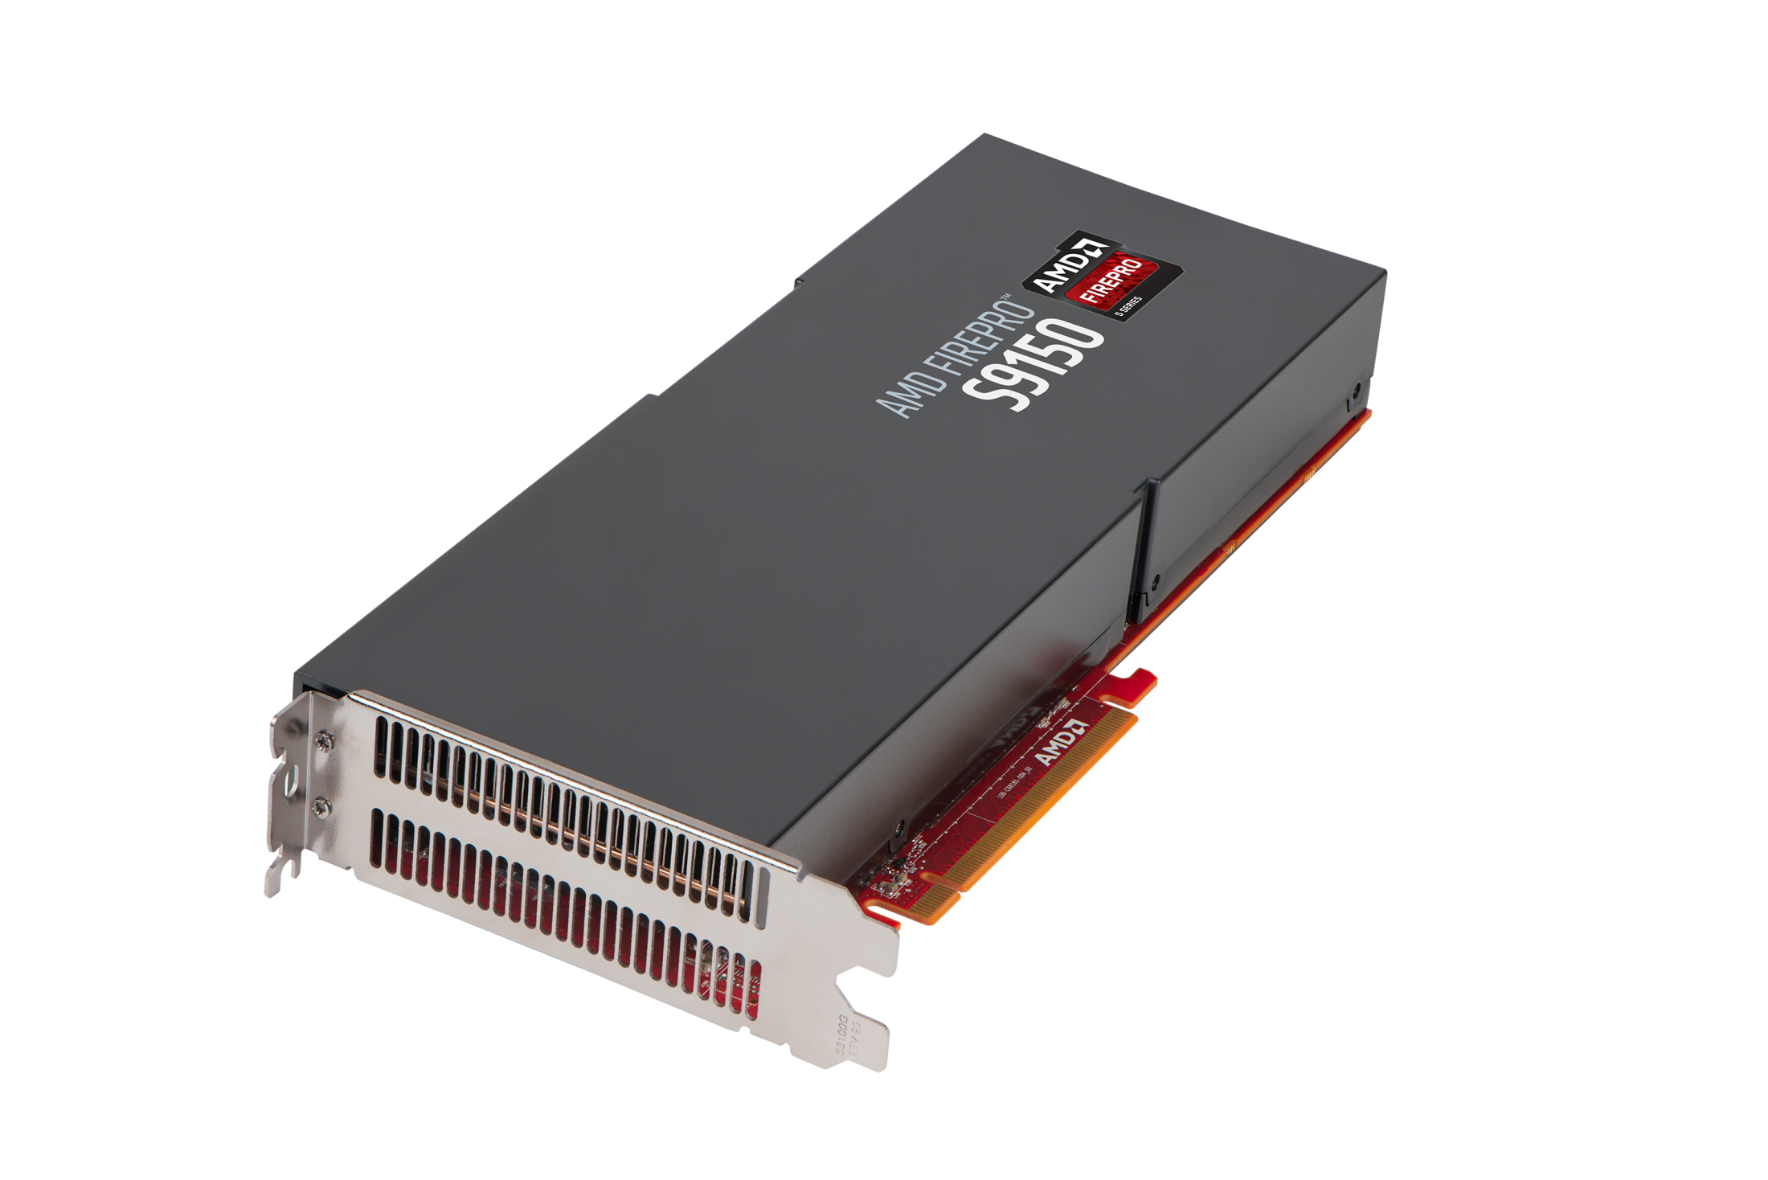
THE
AMD FIREPRO
TM
S9150
SERVER GPU
Unmatched Performance
11
| AMD FIREPRO™ Graphics | MARCH 2014 | AMD Confidential: NDA REQUIRED

Slide 12
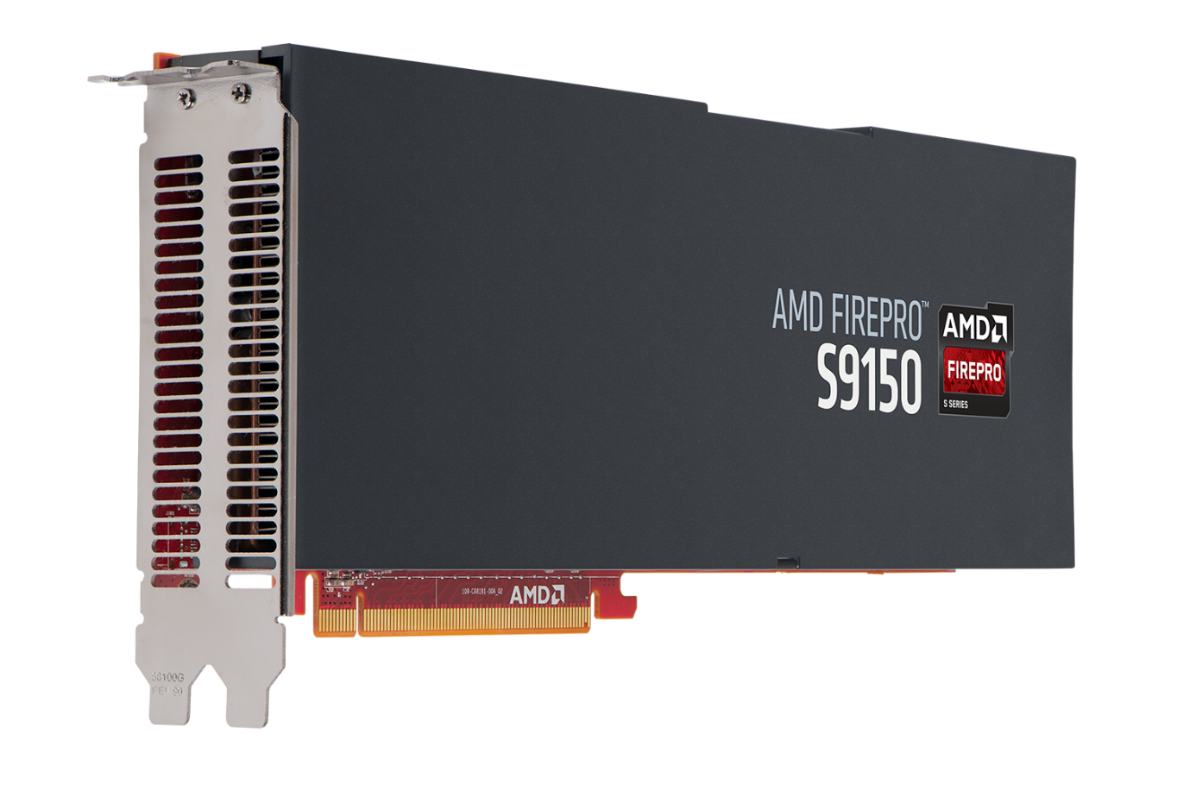
The Most Powerful server GPU ever built¹
First server card to break 2.0 TFLOPS barrier²
77% more peak double precision than K40²
Industry leading performance/watt¹
Industry leading memory configuration – 33% more³
OpenCL™ 2.0 support⁴

Slide 13
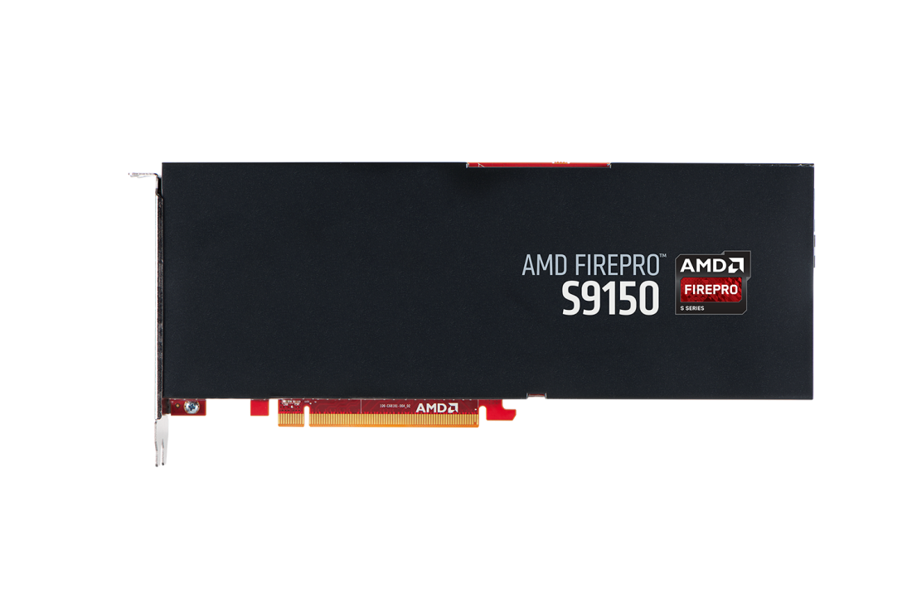
Designed for OEM System Power & Mechanical requirements
5.07
Up to
2816
16GB
235W
2.53
10.8
TFLOPS Peak
Double Precision
TFLOPS Peak
Single Precision
GFLOPS/Watt Peak
Double Precision
Floating Point
GCN Stream Processsors
GDDR5 Memory
Maximum power

Slide 14
AMD FIREPRO™ S9150 Server GPU vs. Tesla k40 server GPU
Industry leading Compute performance¹
 | Nvidia Tesla K40 | AMD FirePro™ S9150 | AMD Advantage
OpenCL™ Support | 1.1 | 1.2 & 2.0 planned⁴ | YES
Peak Single Precision | 4.29 TFLOPS | 5.07 TFLOPS | 18%
Peak Double Precision | 1.43 TFLOPS | 2.53 TFLOPS | 77%
Performance/watt DPFP | Up to 6.09 GFLOPS/W | Up to 10.8 GFLOPS/W | Yes
Performance/watt SPFP | Up to 18.3 GFLOPS/W | Up to 21.6 GFLOPS/W | Yes
Performance/$ DPFP* | .286 GFLOPS/dollar | .603 GFLOPS /dollar | Yes
Double Precision Rate | 1/3 | 1/2 | Yes
Memory Size & Bandwidth | 12GB GDDR5 and 288 GB/s | 16GB GDDR5 and 320 GB/s | Yes
Maximum Power | 235W | 235W | -
Nvidia Tesla K40 data source: http://www.nvidia.com/object/tesla-servers.html
*Perf/dollar based on S9150 $4199 MSRP and $5000 street price for K40

Slide 15
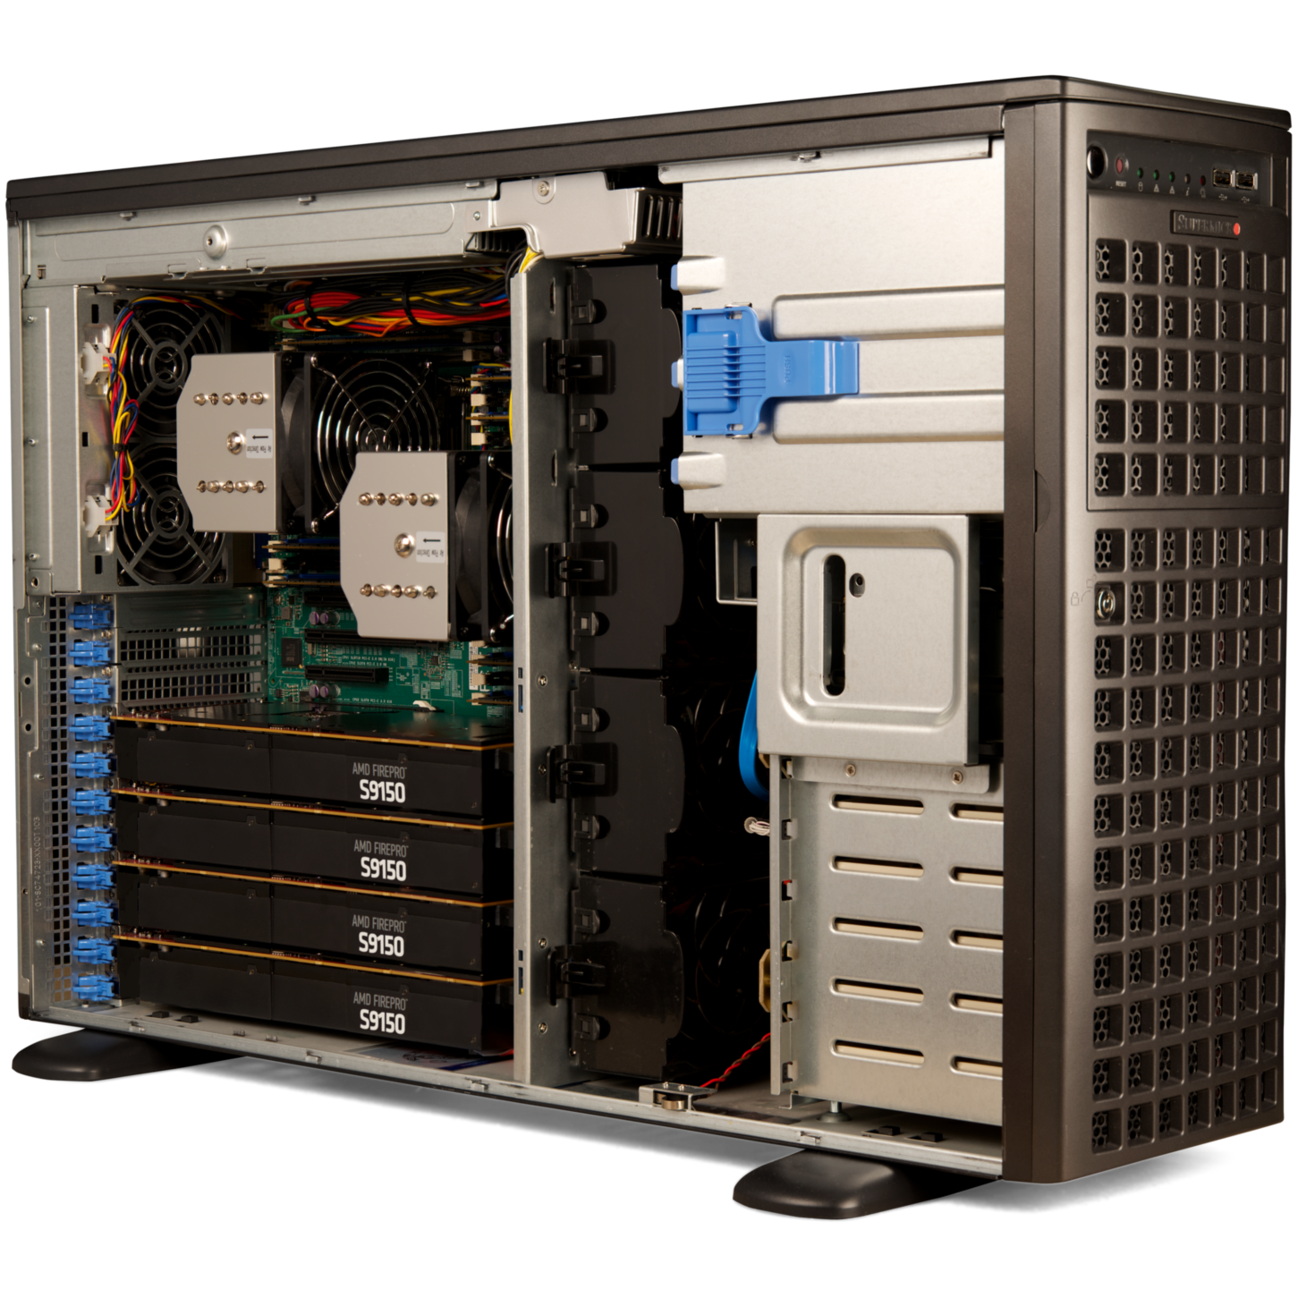
AMD FIrePro™ S9150 Demo at ISC 2014
sciGPGPU Enhanced Numerical computation
Side-by-side dataset comparison
  Scilab and CPU
  Scilab and sciGPGPU with OpenCL™
Super Micro SuperServer 7047GR-TPRF
  4U Rackmountable / Tower
  Four AMD FirePro™ S9150 GPUs
  Super X9DRG-QF motherboard
  1620W high-efficiency redundant PSU
  Four PCIe® 3.0 x16 slots (double width)
No longer limited to CUDA, gpuBUILD function now OpenCL™ accelerated

Slide 16
Prospect & Partner Perspectives
“Having developed a supercomputer that ranked number two on The Green500 list, it takes exceptional compute performance and efficiency to achieve that status – we couldn’t have done it without AMD FirePro S-Series server GPUs. We’ve been putting the AMD FirePro S9150 through its paces and we’re blown away by the performance-per-watt. Any supercomputer that leverages massive compute power with the AMD FirePro S9150 and makes a run for the top of the Green500 list stands a very good chance of succeeding.” – Dr. Volker Lindenstruth, FIAS, Goethe University
“We’re currently testing the AMD FirePro™ S9150 server card and hands down it’s the fastest HPC GPU accelerator we’ve ever tested. We’re even more excited by the prospects of combining its raw compute performance with OpenCL 2.0 later this year. Our research benefits from an open and royalty-free API, and we’re committed to OpenCL™ to accelerate our computations. We applaud AMD’s planned support for OpenCL 2.0. New features such as Shared Virtual Memory and Nested Parallelism will allow us to make even better use of GPUs to increase performance and efficiency.” – Simon McIntosh-Smith, Head, Microelectronics Research Group, University of Bristol
“Pathscale’s ENZO Compiler with OpenMP 4.0 and support for C, C++, and Fortran is used by customers in the Oil and Gas, Computational Science, Computer Aided Engineering, and other HPC segments. Our support for the AMD FirePro S9150 will enable these customers to benefit from the tremendous compute performance of AMD’s new server GPU
while leveraging their existing investment in OpenMP software.” – Christopher Bergstrom, CTO, Pathscale
  http://www.amd.com/en-us/press-releases/Pages/worlds-most-powerful-2014aug06.aspx

Slide 17
Prospect & partner Perspectives continued
“Supermicro offers the industry’s widest range of GPU server solutions optimized for HPC and supercomputing in 1U, 2U, 3U, 4U SuperServer and 7U SuperBlade platforms. Supermicro Green Computing solutions, featuring AMD’s latest AMD FirePro S9150 and AMD FirePro S9050, enable extreme compute density with support for up to 6x GPUs per node in 4U dual node, dual processor configurations, maximizing performance per watt, per dollar, per square foot.” – Don Clegg, VP, Marketing and Business Development, Supermicro
“ASUS is pleased to feature AMD FirePro S9150 accelerators to enable server workstations with dedicated and reliable functionality matched with double precision floating point performance. We’re dedicated to offering our customers solutions that deliver the most performance possible, and the energy efficiency and performance-per-watt of the AMD FirePro S9150 are an added bonus our customers will greatly appreciate.” – Tom Lin, GM, ASUS
“AMD FirePro S9150 delivers exceptional double- and single-precision floating point performance. Unlike other GPU accelerators, AMD FirePro S9150 features enhanced double precision, eliminating the need to buy a more expensive accelerator to get similar performance. Together with AMD, our product delivers the right solution for the market to enable power-efficient performance for supercomputer-class results.” – Etay Lee, GM, Network & Communications Division, GIGABYTE
“AMD FirePro S9150 GPU accelerators will be an outstanding addition to our product line, allowing us to offer our customers solutions that deliver maximum performance. During testing and evaluation of the AMD FirePro S9150 with TYAN servers, our team was impressed with the sheer horsepower. It far exceeded our expectations and our customers will be anxious to take advantage of that horsepower to accelerate their compute-intensive workloads.” – Albert Mu, VP, MiTAC International Corp., TYAN BU
  http://www.amd.com/en-us/press-releases/Pages/worlds-most-powerful-2014aug06.aspx

Slide 18
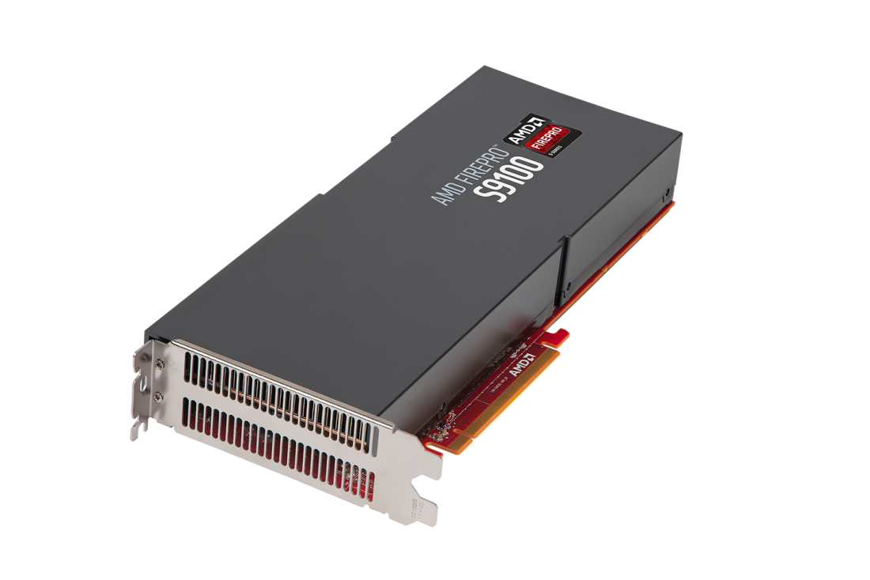
THE NEW
AMD FIREPRO
TM
S9100
SERVER GPU
PURPOSE BUILT FOR HPC
18
| AMD FIREPRO™ Graphics | MARCH 2014 | AMD Confidential: NDA REQUIRED

Slide 19

Class-leading Performance
OpenCL™ 2.0 support⁴
61% more peak double precision than K20X⁵
Class-leading performance-per-watt⁶
Class-leading memory configuration - 50% more⁷

Slide 20
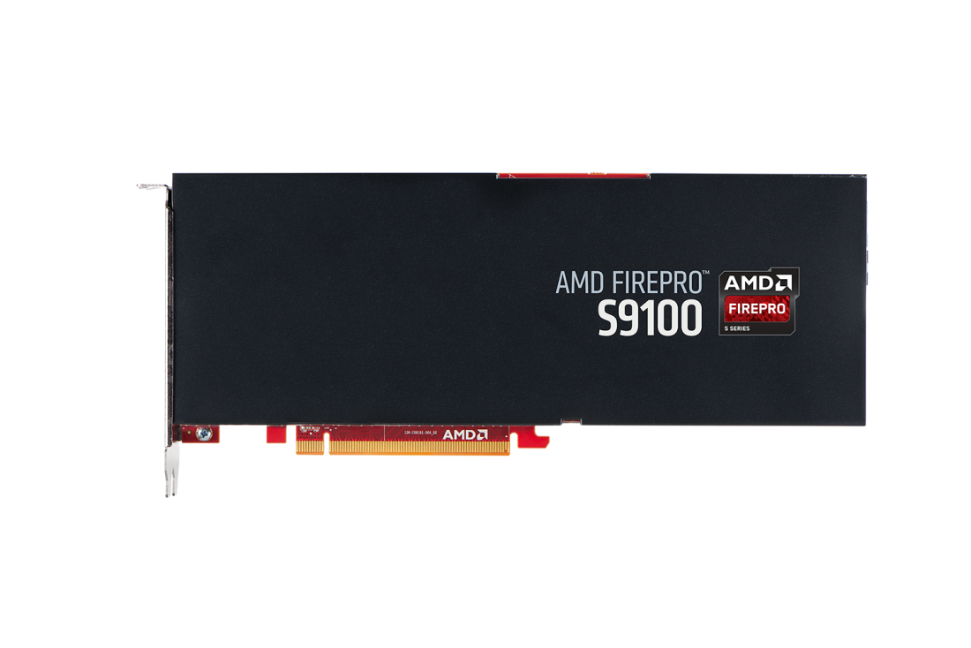
Ideal for Compute intensive, Budget conscious Deployments
4.22
Up to
2560
12GB
225W
2.11
9.4
TFLOPS Peak
Double Precision
TFLOPS Peak
Single Precision
GFLOPS/Watt Peak
Double Precision
Floating Point
GCN Stream Processsors
GDDR5 Memory
Maximum power

Slide 21
AMD FIREPRO™ S9100 Server GPU vs. Tesla k20X server GPU
Purpose built for HPC
 | Nvidia Tesla K20X | AMD FirePro™ S9100 | AMD Advantage
OpenCL™ Support | 1.1 | 1.2 & 2.0 planned⁴ | YES
Peak Single Precision | 3.95 TFLOPS | 4.22 TFLOPS | 6%
Peak Double Precision | 1.31 TFLOPS | 2.11 TFLOPS | 61%
Performance/Watt SPFP | Up to 17.6 GFLOPS/W | Up to 18.8 GFLOPS/W | Yes
Performance/Watt DPSP | Up to 5.6 GFLOPS/W | Up to 9.4 GFLOPS/W | 68%
Performance/$ DPFP* | .452 GFLOPS/dollar | .844 GFLOPS/dollar | 46%
Double Precision Rate | 1/3 | 1/2 | Yes
Memory Size & Bandwidth | 6GB GDDR5 and 250 GB/s | 12GB GDDR5 and 320 GB/s | Yes
Maximum Power | 235W | 225W | Yes
Nvidia Tesla K20X data source: http://www.nvidia.com/object/tesla-servers.html
*Perf/dollar based on S9100 $2499 MSRP and online $2899 retail price for K20X as of 9/5/14

Slide 22

opencl™ Support: 1.2 Today, ready for 2.0
New features give GPUs more freedom to do the work they are designed to do
Shared Virtual Memory
Nested Parallelism
Generic Address Space
Enables host and device kernels to directly share complex pointer-based data structures, eliminating explicit transfers between the host and devices while increasing programming flexibility.
Updated for improved programmability and increased application efficiency.
Enables functions to be written without named address spaces which increases flexibility and saves time by eliminating the need for multiple functions to be written.
AMD FirePro™ Graphics is Ready…
…Driver Coming Q4 2014
2.0
OpenCL 1.2 conformance expected. AMD plans to release OpenCL 2.0 drivers for enabled AMD FirePro S9150 and S9100 server cards in Q4 2014; conformance testing is planned at that time. Previous generation AMD FirePro products may not support OpenCL 2.0.

Slide 23

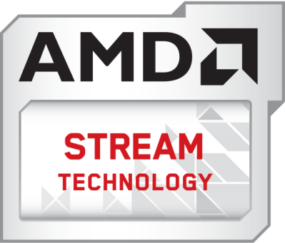
Accelerating Compute Workloads
Enabling Key Use Cases
High Performance Computing
Compute Intensive Engineering and Media & Entertainment applications
Robust Features & Ecosystem
GPU optimized OpenCL™ libraries
P2P multi-GPU support
Bi-directional PCIe® data transfers
ECC memory support
Fast compute performance

Slide 24
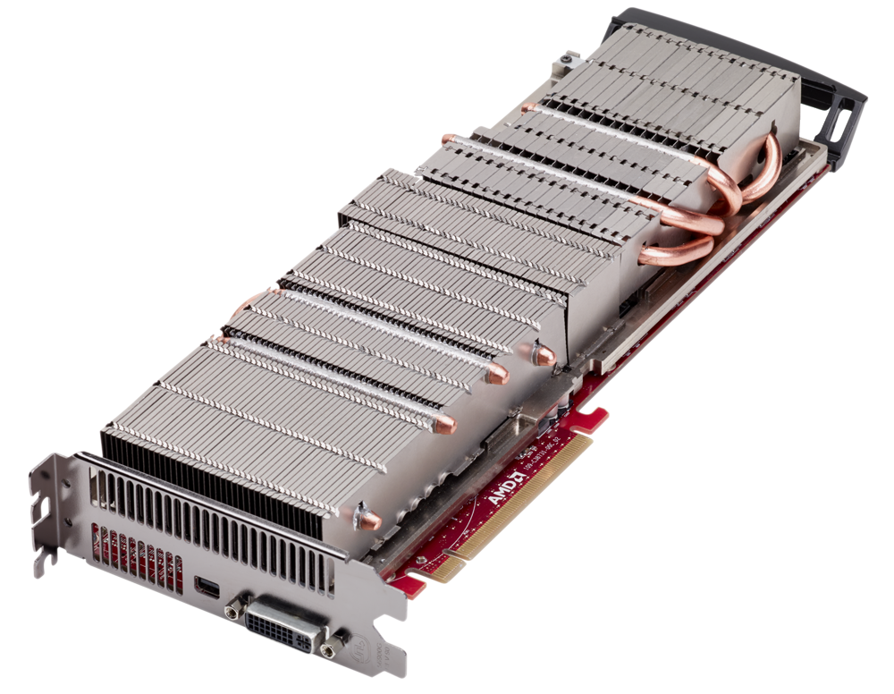
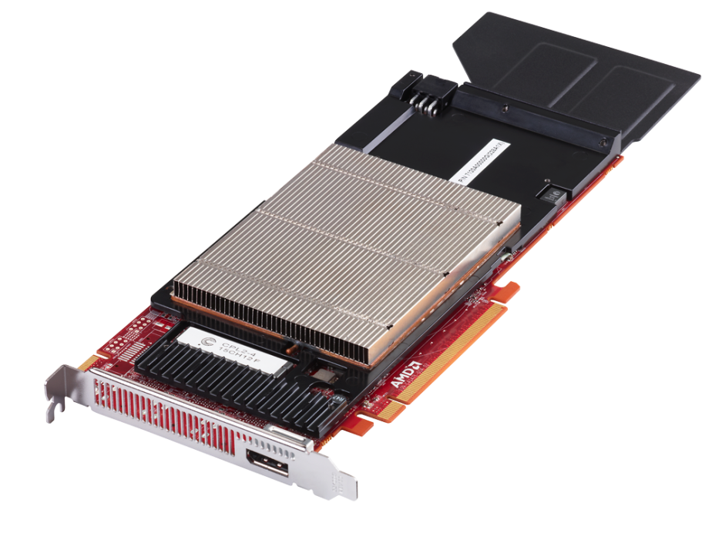
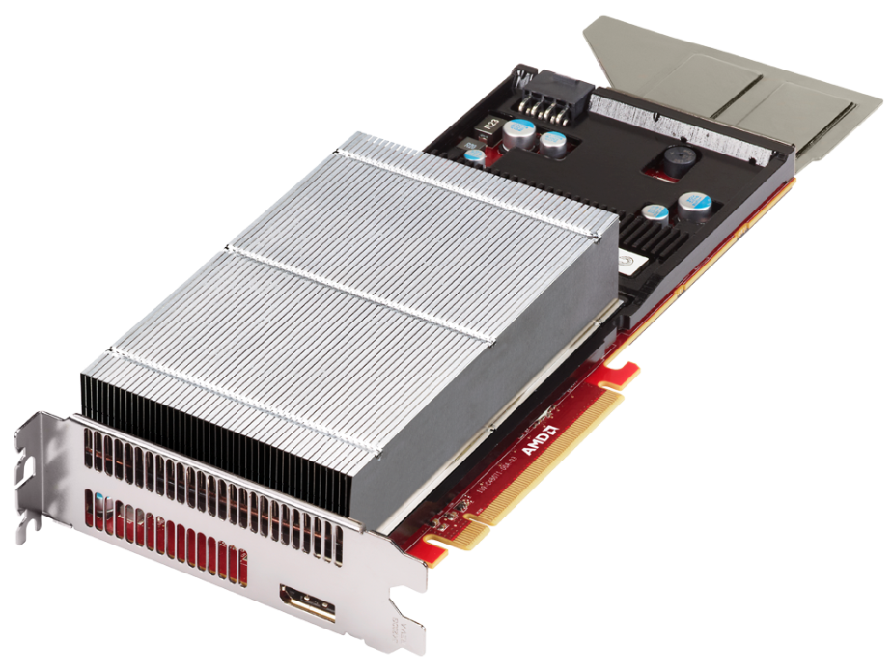
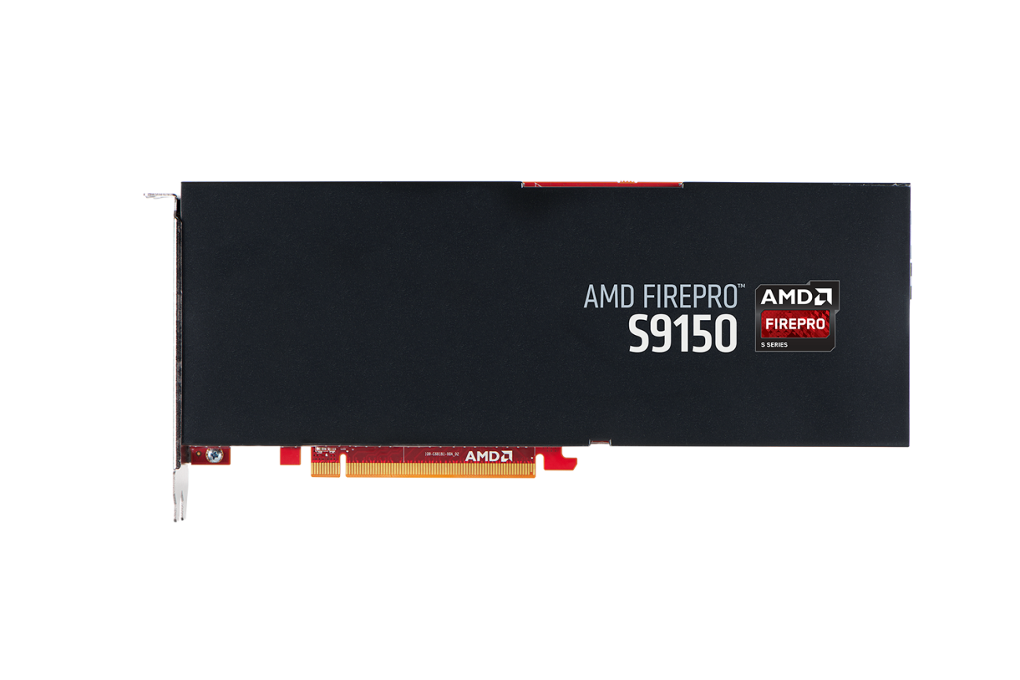

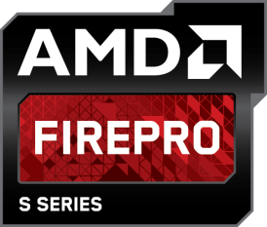
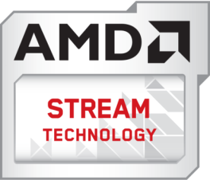
SUPPORTED AMD FirePro™ S-Series Server Cards TODAY
AMD FirePro™ S7000 GPU
AMD FirePro™ S9000/S9050 GPUs
AMD FirePro™ S10000 GPUs
AMD STREAM technology is a set of features offered with select AMD FirePro graphics cards for the acceleration of compute-intensive workflows. Not all products have all features and
full enablement of some capabilities may require complementary software. Check with your system manufacturer for specific capabilities and supported technologies.

Slide 25
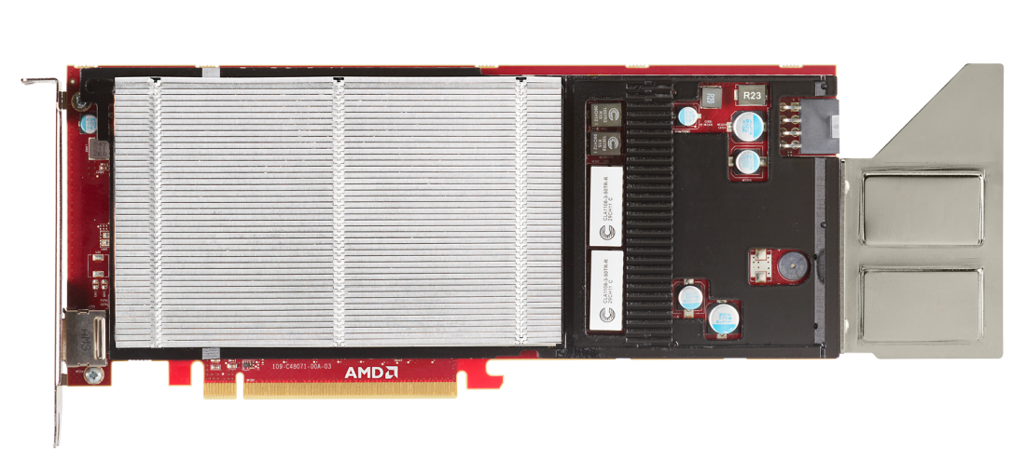
AMD FirePro™ S9050 Server GPU
806
3.23
ECC
1792
12GB
225W
Memory Support (Internal & External)
GDDR5 Memory
Maximum power
GFLOPS Peak
Double Precision
TFLOPS Peak
Single Precision
GCN Stream Processors

Slide 26
AMD FIREPRO™ S9050 server GPU vs. Tesla k20 server GPU
Better customer value with Highest performance /$
 | Nvidia Tesla K20 | AMD FirePro™ S9050 | AMD Advantage
OpenCL™ Support | 1.1 | 1.2 | Yes
Peak Single Precision | 3.52 TFLOPS | 3.23 TFLOPS | -
Peak Double Precision | 1.17 TFLOPS | 806 GFLOPS | -
Performance/Watt DPFP | Up to 5.2 GFLOPS/W | Up to 3.58 GFLOPS/W | -
Performance/Watt SPFP | Up to 15.6 GFLOPS/W | Up to 14.4 GFLOPS/W | -
Performance/$ DPFP* | .366 GFLOPS/dollar | .403 GFLOPS/dollar | Yes
Performance/$ SPFP* | 1,100 GFLOPS | 1,620 GFLOPS | Yes
Memory Size & Bandwidth | 5 GB GDDR5 and 208 GB/s | 12 GB GDDR5 and 264 GB/s | Yes
Maximum Power | 225W | 225W | -
Nvidia Tesla K20X data source: http://www.nvidia.com/object/tesla-servers.html
*Perf/dollar based on $1999 S9150 MSRP and $3199 lowest retail price for K20X

Slide 27
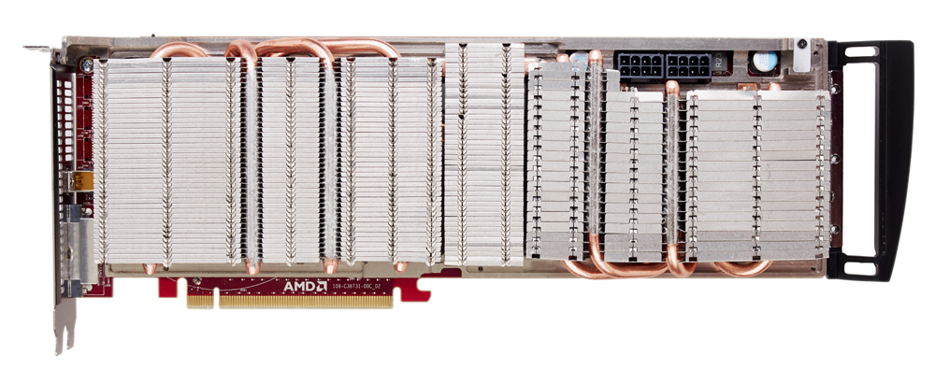
AMD FirePro™ S10000 12GB Edition Server GPU
Most Powerful dual-GPU server card ever created⁸
1.48
5.91
ECC
1792x2
12GB
375W
GFLOPS Peak
Double Precision
TFLOPS Peak
Single Precision
Memory Support (Internal & External)
GCN Stream Processors
GDDR5 Memory
(6GB Option)
Maximum power

Slide 28
AMD FIREPRO™ S10000 server GPU vs. Tesla k10 server GPU
World’s First Pro graphics card to exceed one TFLOP Peak Double Precision Floating Point⁹
 | Nvidia Tesla K10 | AMD FirePro™ S10000 | AMD Advantage
OpenCL™ Support | 1.1 | 1.2 | Yes
Peak Single Precision | 4.58 TFLOPS | 5.91 TFLOPS | 29%
Peak Double Precision | 190 TFLOPS | 1.48 TFLOPS | 640%
GPU Architecture | SMX Architecture | GCN Architecture | Yes
Performance/Watt DPFP | Up to .84 GFLOPS/W | Up to 3.95 GFLOPS/W | 4.7x
Memory Size | 8GB GDDR5 | 12GB GDDR5* | 50%
Memory Bandwidth | Up to 320 GB/s | Up to 480 GB/s | 50%
ECC Memory | Internal and External | Internal and External | -
Maximum Power | 225W | 375W | -
Nvidia Tesla K10 data source: http://www.nvidia.com/object/tesla-servers.html
*6GB option card available

Slide 29
AMD FirePro™ S9000 Server GPU
806
3.23
ECC
1792
6GB
225W
Memory Support (Internal & External)
GDDR5 Memory
Maximum power
GFLOPS Peak
Double Precision
TFLOPS Peak
Single Precision
GCN Stream Processors

Slide 30
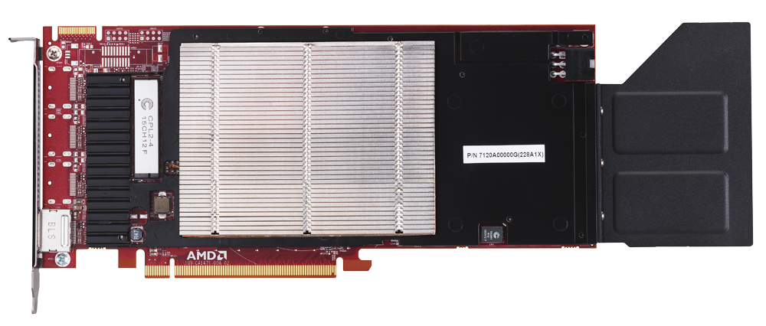
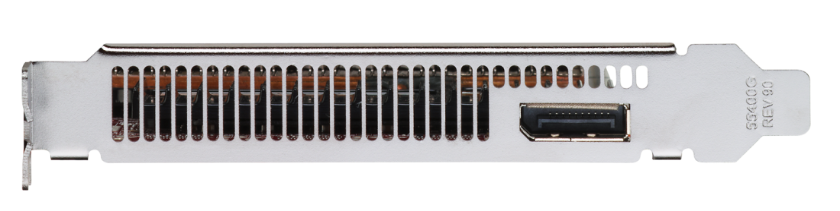
AMD FirePro™ S7000 Server GPU
Designed for high density environments
One
2.4
16
1280
4GB
150W
GFLOPS Per Watt Peak Single Precision
GCN Stream Processors
GDDR5 Memory
Maximum power
Slot Form
Factor
TFLOPS Peak
Single Precision

Slide 31
AMD FirePro™ S-Series family At-a-Glance
 | AMD FirePro™ S9150 | AMD FirePro™ S9100 | AMD FirePro™ S9050 | AMD FirePro™ S10000 | AMD FirePro™ S9000 | AMD FirePro™ S7000
ASIC Model | Hawaii GL44 | Hawaii GL40 | Tahiti | Tahiti (2x) | Tahiti | Pitcarin
Form Factor | FH/FL, Dual-slot | FH/FL, Dual-slot | FH/FL, Dual-slot | FH/FL, Dual-slot | FH/FL, Dual-slot | FH/FL, Single-slot
Core Clock Speed | 900 Mhz | 824 Mhz | 900 Mhz | 825 Mhz | 900 Mhz | 950 Mhz
Stream Processors | 2816 | 2560 | 1792 | 3584 (1792x2) | 1792 | 1280
Max Power | 235W | 225W | 225W | 375W | 225W | 150W
Peak Single Precision | 5.07 TFLOPS | 4.22 TFLOPS | 3.23 TFLOPS | 5.91 TFLOPS | 3.23 TFLOPS | 2.4 TFLOPS
Peak Double Precision | 2.53 TFLOPS | 2.11 TFLOPS | 806 GFLOPS | 1.48 TFLOPS | 806 GFLOPS | 152 GFLOPS
Double Precision Rate | 1/2 | 1/2 | 1/4 | 1/4 | 1/4 | 1/16
ECC Memory Support | External | External | Internal & External | Internal & External | Internal & External | No
Memory Size / Type | 16GB GDDR5 | 12GB GDDR5 | 12GB GDDR5 | 12GB or 6GB GDDR5 | 6GB GDDR5 | 4GB GDDR5
Memory Interface | 512-bit | 512-bit | 384-bit | 384-bit | 384-bit | 256-bit
Memory Bandwidth | Up to 320 GB/s | Up to 320 GB/s | Up to 264 GB/s | Up to 480 GB/S | Up to 264 GB/s | Up to 154 GB/s
PCI Express® | 3.0 | 3.0 | 3.0 | 3.0 | 3.0 | 3.0
Display Output | Headless display support only | Headless display support only | 1x DisplayPort | 1x DisplayPort 1x DVI | 1x DisplayPort | 1x DisplayPort
API Support | OpenCL™ 1.2, 2.0 planned⁴ DirectX®11.1, 12 | OpenCL™ 1.2, 2.0 planned⁴ DirectX 11.1, 12 | OpenCL 1.2⁴ DirectX 11.1, 12 | OpenCL 1.2 DirectX 11.1, 12 | OpenCL 1.2 DirectX 11.1, 12 | OpenCL 1.2 DirectX 11.1, 12

Slide 32



Thank You

Slide 33
Footnotes
¹AMD FirePro™ S9150 max power is 235W and delivers up to 2.53 TFLOPS peak double and up to 5.07 peak single precision floating point performance. Nvidia’s highest performing server cards in the market as of June 2014 are the Tesla K40, max power of 235W, with up to 1.43 TFLOPS peak double and up to 4.29 peak single, and the K10, max power 225W, with up to 4.58 TFLOPS peak single and 190 GFLOPS peak double precision. Visit http://www.nvidia.com/object/tesla-servers.html for Nvidia product specs. FP-97
²AMD FirePro™ S9150 delivers up to 2.53 TFLOPS peak double precision floating point performance, and Nvidia’s highest server GPU in the market as of June 2014 is the Tesla K40 with up to 1.43 TFLOPS peak double precision. Visit http://www.nvidia.com/object/tesla-servers.html for Nvidia product specs. FP-95
³AMD FirePro™ S9150 features 16GB GDDR5 memory, and Nvidia’s highest performance server GPU in the market as of June 2014 is the Tesla K40 with 12GB GDDR5 memory. Visit http://www.nvidia.com/object/tesla-servers.html for Nvidia product specs. FP-98
⁴OpenCL 1.2 conformance expected for S9150 and S9050. AMD plans to release OpenCL 2.0 drivers for enabled AMD FirePro S9150 server cards in Q4 2014; conformance testing is planned at that time. Previous generation AMD FirePro products may not support OpenCL 2.0.
⁵ AMD FirePro™ S9100 delivers up to 2.11 TFLOPS peak double precision floating point performance, and Nvidia Tesla K20X delivers up to 1.31 TFLOPS peak double precision. Visit http://www.nvidia.com/object/tesla-servers.html for Nvidia product specs. FP-108
⁶AMD FirePro™ S9100 max power is 225W and delivers up to 2.11 TFLOPS peak double and up to 4.22 TFLOPS peak single precision floating point performance. Nvidia Tesla K20X max power is 235W and delivers up to 1.31 TFLOPS peak double and up to 3.95 TFLOPS peak single. Visit http://www.nvidia.com/object/tesla-servers.html for Nvidia product specs. FP-109
⁷AMD FirePro™ S9100 features 12GB GDDR5 memory, and Nvidia Tesla K20X features 6GB GDDR5 memory. Visit http://www.nvidia.com/object/tesla-servers.html for Nvidia product specs. FP-110
⁸AMD FirePro™ S10000 and S1000 12 GB Edition deliver up to 5.91 TFLOPS of peak single precision and 1.48 TFLOPs of peak double precision floating point performance, compared to Nvidia Tesla K10 that is capable of up to 4.58 TFLOPS of peak single precision and 190 GFLOPs double precision peak floating point performance. Visit http://www.nvidia.com/object/tesla-servers.html for Nvidia product specs. Comparison as of 10/31/12. FP-65
⁹AMD FirePro™ S10000 delivers 1.48 TFLOPS peak dual-precision floating point performance – no other AMD or Nvidia professional graphics card has exceeded one TFLOP before. Prior to the launch of AMD FirePro™ S10000, AMD’s highest performing professional graphics cards for double precision was the AMD FirePro™ W9000 with 1.0 TFLOP, and Nvidia’s highest performing card in market as of 10/31/12 is the Tesla M2090 with 665 GFLOPs of double precision. Visit http://www.nvidia.com/object/tesla-servers.html for Nvidia product specs. FP-72

Slide 34
Disclaimer & Attribution
The information presented in this document is for informational purposes only and may contain technical inaccuracies, omissions and typographical errors.
The information contained herein is subject to change and may be rendered inaccurate for many reasons, including but not limited to product and roadmap changes, component and motherboard version changes, new model and/or product releases, product differences between differing manufacturers, software changes, BIOS flashes, firmware upgrades, or the like. AMD assumes no obligation to update or otherwise correct or revise this information. However, AMD reserves the right to revise this information and to make changes from time to time to the content hereof without obligation of AMD to notify any person of such revisions or changes.
AMD MAKES NO REPRESENTATIONS OR WARRANTIES WITH RESPECT TO THE CONTENTS HEREOF AND ASSUMES NO RESPONSIBILITY FOR ANY INACCURACIES, ERRORS OR OMISSIONS THAT MAY APPEAR IN THIS INFORMATION.
AMD SPECIFICALLY DISCLAIMS ANY IMPLIED WARRANTIES OF MERCHANTABILITY OR FITNESS FOR ANY PARTICULAR PURPOSE. IN NO EVENT WILL AMD BE LIABLE TO ANY PERSON FOR ANY DIRECT, INDIRECT, SPECIAL OR OTHER CONSEQUENTIAL DAMAGES ARISING FROM THE USE OF ANY INFORMATION CONTAINED HEREIN, EVEN IF AMD IS EXPRESSLY ADVISED OF THE POSSIBILITY OF SUCH DAMAGES.
ATTRIBUTION
© 2014 Advanced Micro Devices, Inc. All rights reserved. AMD, the AMD Arrow logo, FirePro and combinations thereof are trademarks of Advanced Micro Devices, Inc. in the United States and/or other jurisdictions. OpenCL and the OpenCL logo are trademarks of Apple Inc. used by permission by Khronos. PCI Express is a registered trademark of PCI-SIG. Other names are for informational purposes only and may be trademarks of their respective owners.

