Slide 1
Professional Graphics
Master OEM Deck
December 2013

Slide 3



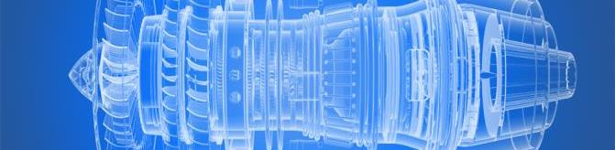

AMD FIREPRO STRATEGY
LEAD IN CONTENT CREATION & ANALYTICS
ENGINEERING
MEDIA & ENTERTAINMENT
EDUCATION & RESEARCH
CLIENT
CLOUD
CONTENT
COMPUTE
MEDICAL
DISPLAY WALLS
FINANCE

Slide 4
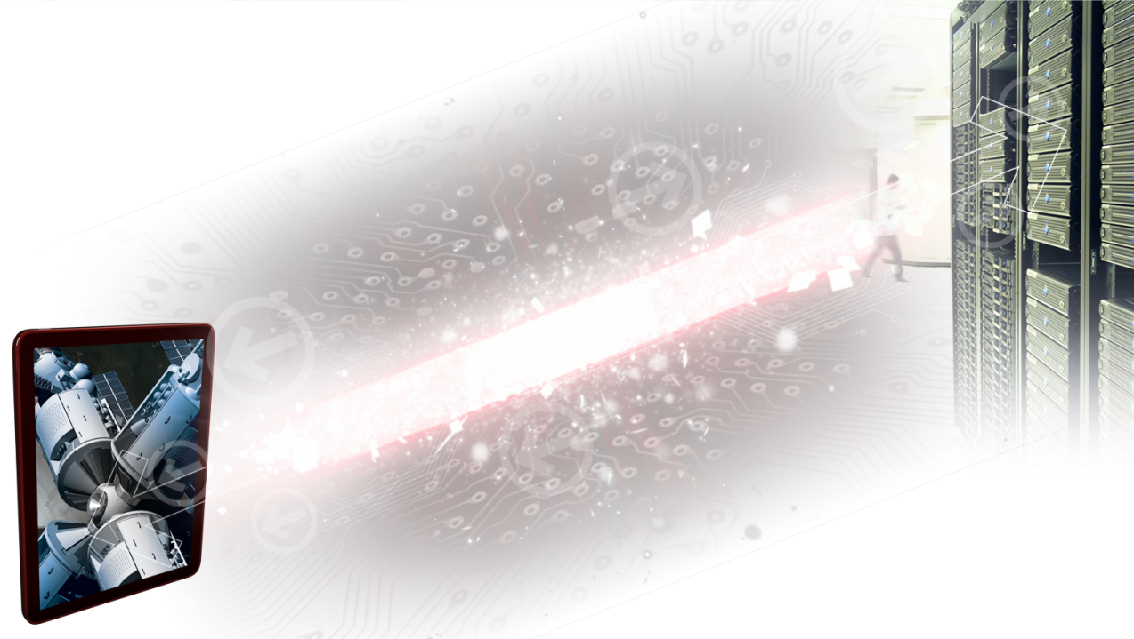
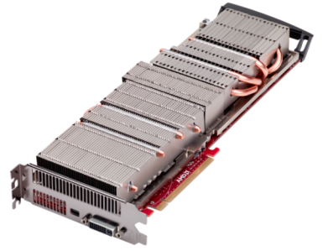
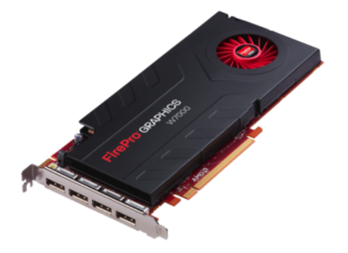
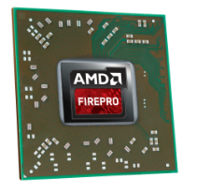
Scalable Professional GPU Solutions
Servers
Desktop Workstations
Mobile Workstations &
Thin Clients

Slide 5
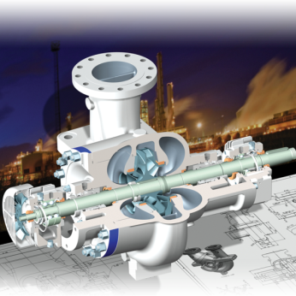
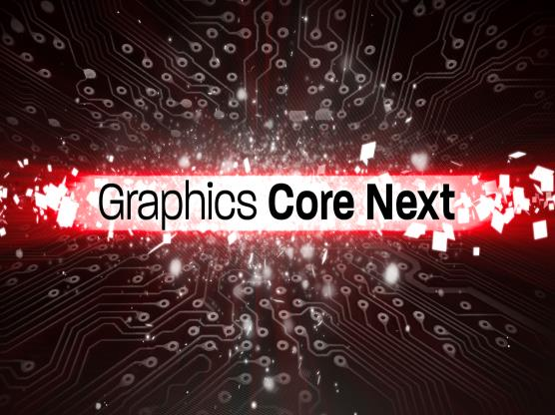
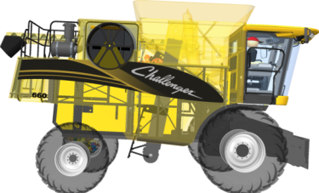
The Power of AMD Professional Graphics
INNOVATION
PERFORMANCE
RELIABILITY
Simultaneous render & compute
AMD Eyefinity: up to six 4K displays¹
PCIe® 3.0 across product stack
Leading app certifications
Exclusive PTC OIT feature
Optimized for OpenCL™
Leading memory bandwidth
Long term availability
Three-year limited warranty
24x7 Support
Notes:
Approved by Kelly 9/6

Slide 6
Graphics Core Next

Slide 7
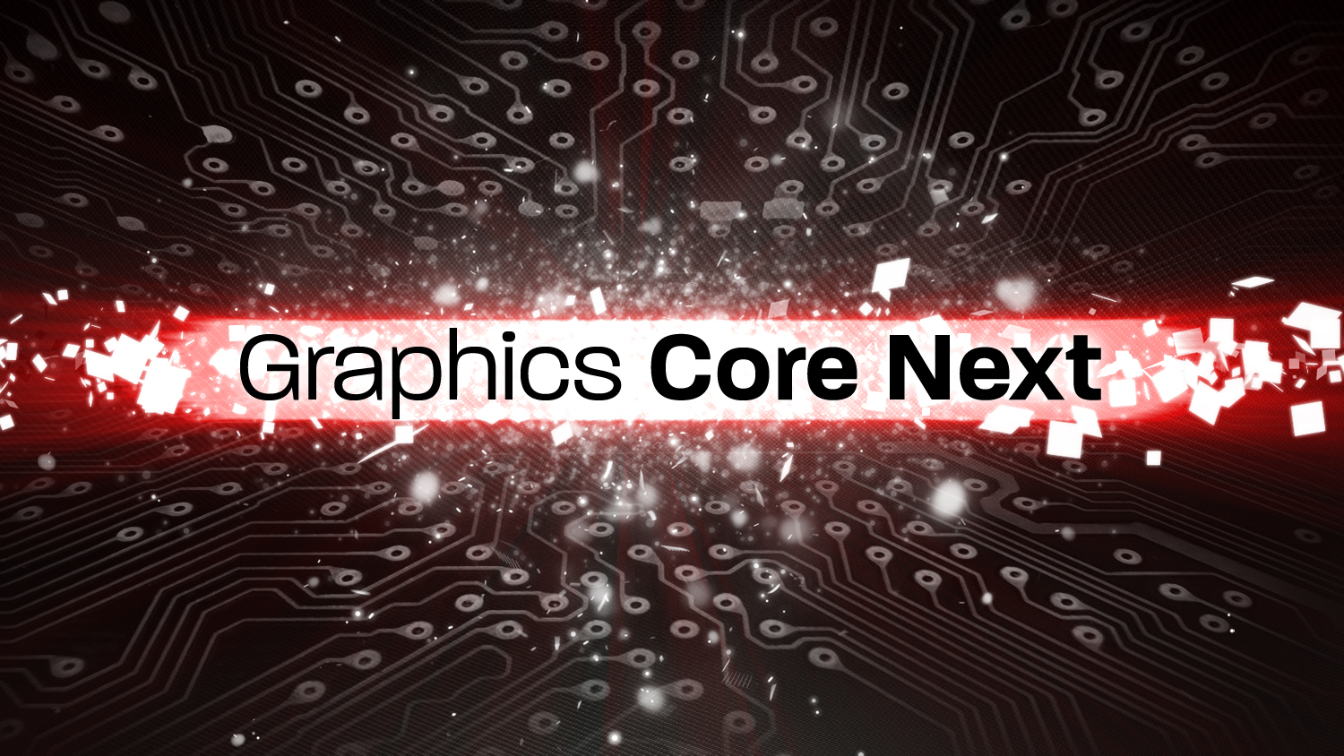
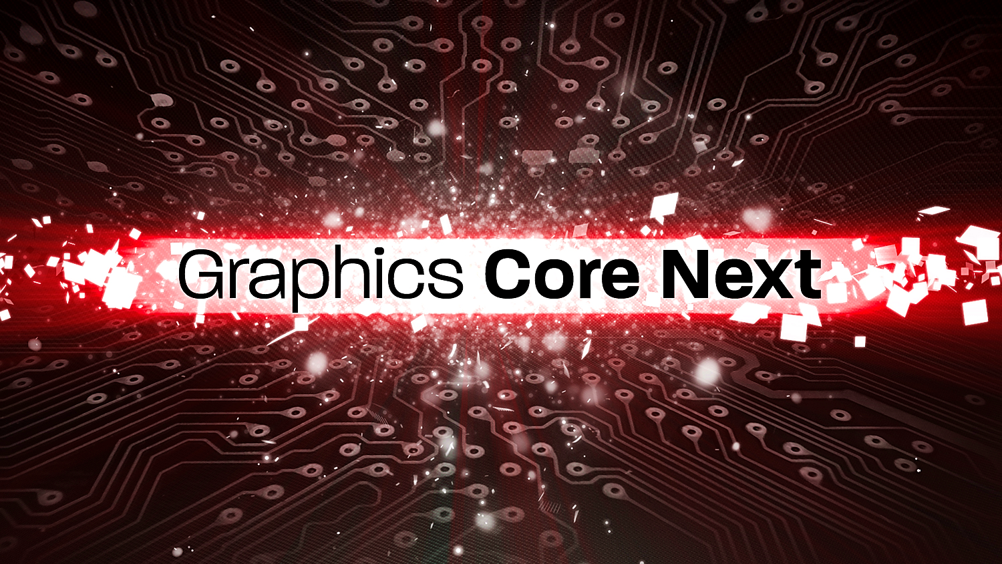
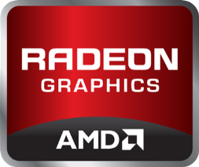
Technology: Graphics Core Next Architecture
Render and compute at the same time!
Notes:
GCN at its core is the basis of a GPU that performs well at both graphical and computing tasks.

Slide 8
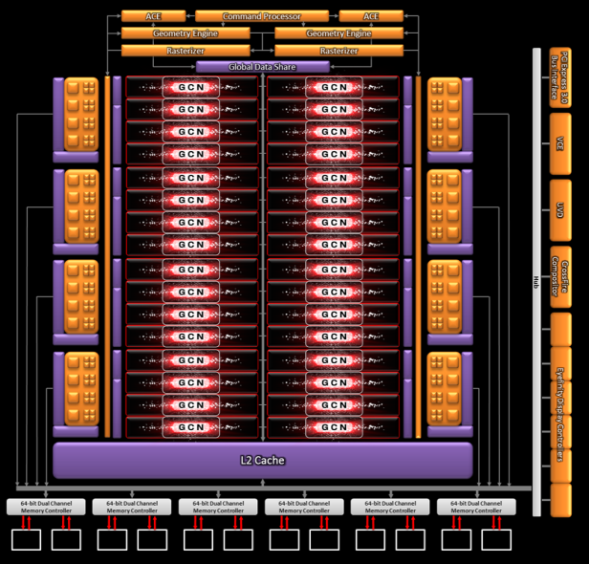
AMD GCN Architecture
AMD FirePro™ S9000 and S10000
    Up to 28 Compute Units
    ¼ Rate Double Precision Floating Point
    Up to 1.48 TFLOPS DPFP on a single board
    384-bit GDDR5 memory interface
    Up to 12GB video memory*
    4.3 billion transistors
    28nm process node
Introduced
    Dual Asynchronous Compute Engines (ACE)
Features
    Dual DMA engines
Notes:
Last year AMD brought to market the first instance of GCN with our Tahiti/Southern Islands architecture. This has revolutionized the compute landscape - …
Dual Asynchronous Compute Engines (ACE)
Independent scheduling and work item dispatch for efficient multi-tasking
Operate in parallel with graphics command processor
Fast context switching
Command Processor is time shared
GCN are Space shared
Dual DMA engines
Can saturate PCIe 3.0 x16 bandwidth
(16 GB/sec bidirectional)

Slide 9
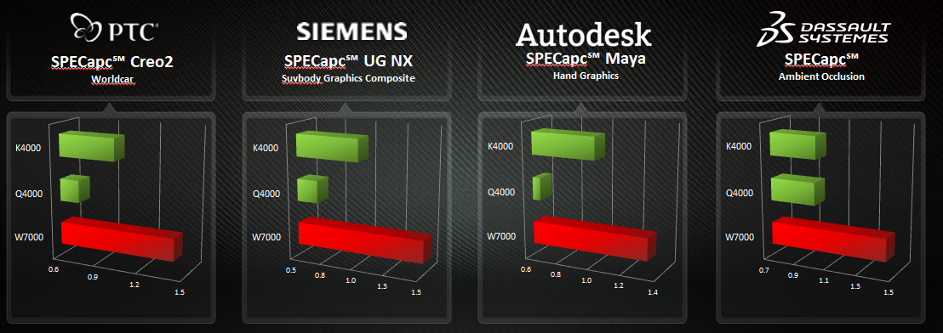
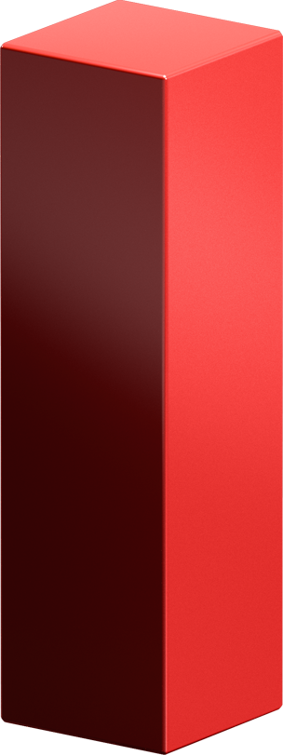
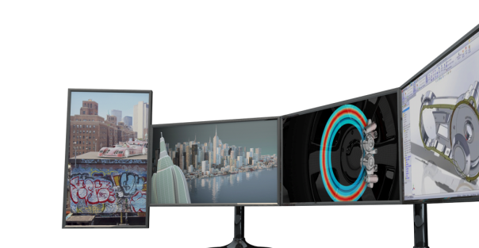


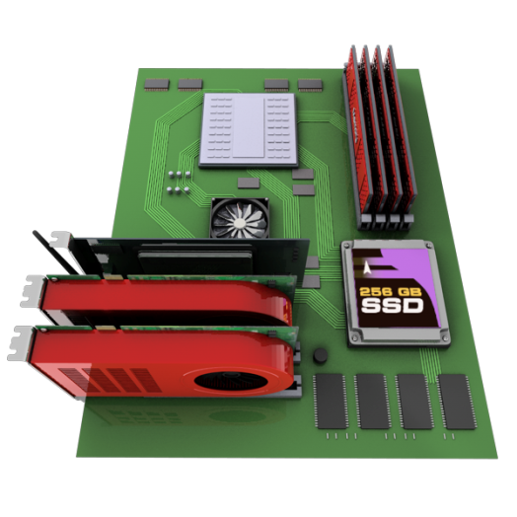


AMD FIREPRO™ Performance Advantage
32
GB/s
Normalized to K4000/Q4000 = 1. System Config: HP Z420, Intel Xeon E5-1660 @ 3.30GHz, 16GB RAM, Windows® 7 64-bit SP1. AMD driver v2.8, NV v311.35.
Direct GMA
4K Ultra HD Resolution
9
Notes:
PCIe 3.0 support on all W-Series, not just the high end card
Still only company that can support up to six 4K displays from 1 GPU
Also have unique technologies like ZeroCore Power and PowerTune

Slide 10
AMD ZeroCore Power Technology
Enabling Power Efficient GPUs
Greater than 95% idle power reduction by shutting down GPU
Powered off during long idle (blanked screen) state
Core GPU functional blocks consume 0W while rest of PC remains in idle state
Fan off for zero noise
AMD exclusive innovation
Enabled via new AMD ZeroCore Power hardware state
Leverages AMD FirePro™ notebook graphics low idle power technologies
Long Idle Power
Illustration is for demonstration purposes only.
Massively Extending AMD’S IDLE POWER LEADERSHIP
10

Slide 11



AMD PowerTune Technology
Key Details & Advantages
Power State Diagram of a 225W GPU
AMD PowerTune allows a higher top p-state without raising TDP
Ultra-fast power calc. on order of
µs intervals
Fine grain clock control ensures max performance within TDP
Highest
P-State
Highest
P-State
Highest
P-State
Highest
P-State
Unique Advantages
All digital; no reliance on analog sensors
Avoids sample-to-sample variance
Driver and profile independent
Can be tweaked to meet user needs
Intermediate
P-State
Intermediate
P-State
Traditional
With AMD PowerTune
Lower max clocks
Thermal throttling forces to much lower p-state for peak applications
Higher max clocks
Peak apps enjoy much higher clocks; not throttling
Notes:
Fine grain control refers to both the quickness of PowerTune over very small time intervals and the granularity of very fine clock stepping's (X MHz for Cayman and/or Tahiti for example). Internal power calculations within the GPU on the order of microseconds

Slide 12
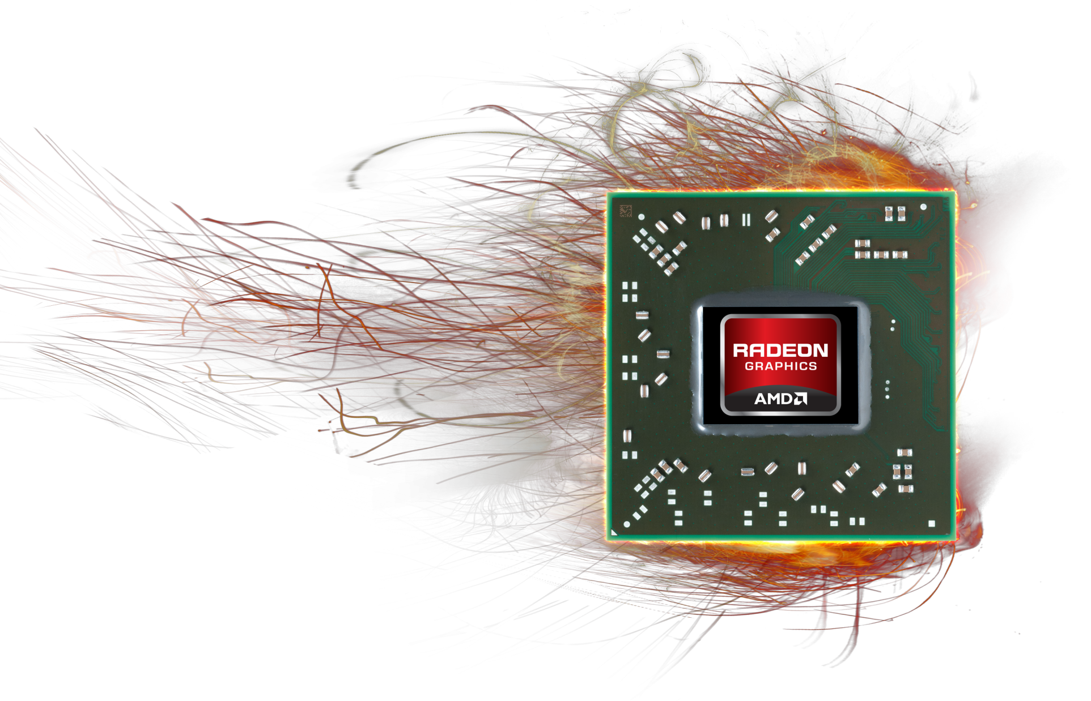

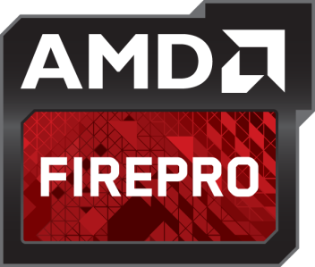

AMD’s power gating technology¹
Intelligent adjustment of power for AMD FirePro™ GPUs
Greater power reduction by shutting down idle GPU cores
Engine powered off/on depending on graphics requirements
Inactive portions of GPU turned off during static screen and light workloads to maximize power efficiency
AMD Extending battery life
Available with AMD FirePro™ M6100, M5100 and M3100 mobile workstation GPUs
Leverages leading AMD FirePro™ notebook graphics technologies

Slide 13
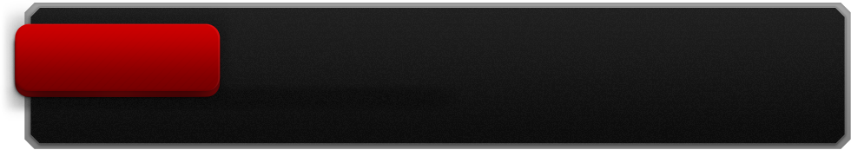
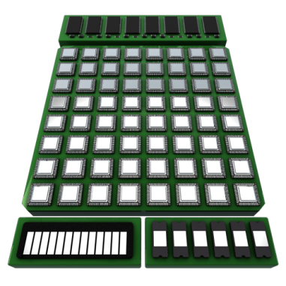
AMD Power Management technologies
How AMD Power technologies work together¹
3D Apps/
Compute
AMD PowerTune delivers faster peak engine clocks to maximize performance at TDP
Exclusive AMD technology
Manage power for incredible performance & long battery life
AMD PowerTune:
Power sensing and management built into ASIC
Calculates active power to utilize thermal headroom
Light 3D/
Video
As GPU workload changes, AMD PowerGate changes the amount of time the GPU is fully powered
Increases energy efficiency without sacrificing performance
AMD PowerGate:
Unused parts of engine core powered down
Dynamically adjusts to active workloads
Static
Screen
AMD PowerGate technology powers down inactive portions of gpu during static screen mode and light workloads to maximize power efficiency
Helps to reduce static-screen power
AMD ZeroCore Power:
GPU Powered off during long idle (blanked screen) power state
Tiny portion of GPU remains visible to OS
Idle
When AMD FirePro™ GPU not in use, AMD ZeroCore Power technology shuts off GPU core
GPU core consumes 0W
Exclusive AMD technology
The AMD FirePro™ mobile GPU core

Slide 14
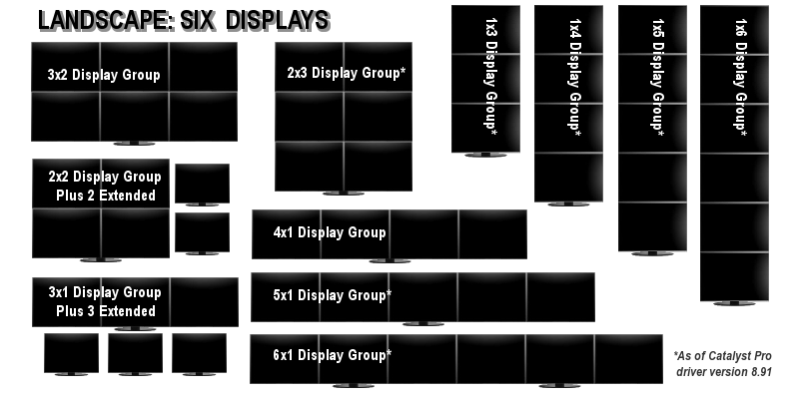
AMD Eyefinity Technology Update
New LANDSCAPE Grid Configurations
*
*
*
*
*
*
*
*
Not all products support all of these configurations. Check with your component or system manufacturer for specific model capabilities.

Slide 15
Content

Slide 16
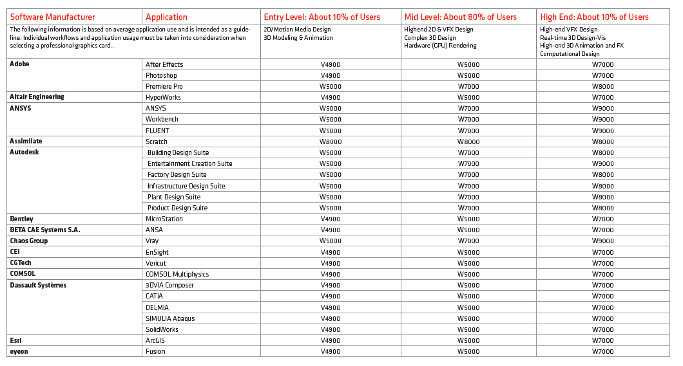
Application Certifications

Slide 17
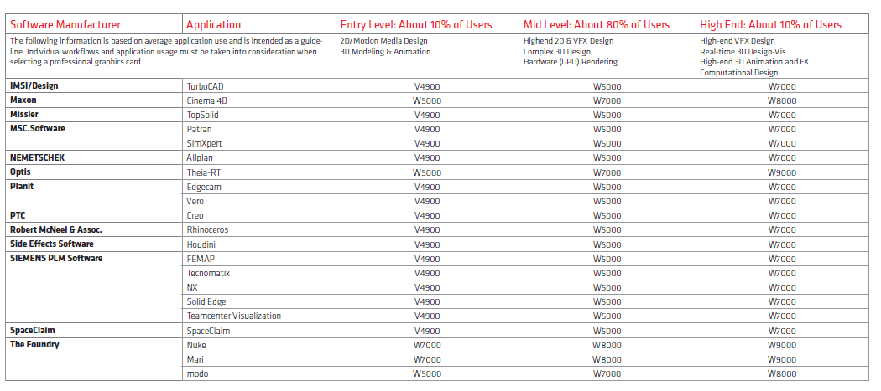
Application Certifications Continued
HP Application Certifications can be found at http://h20331.www2.hp.com/hpsub/cache/288634-0-0-225-121.html
Dell HP Application Certifications can be found at http://www.dell.com/content/topics/global.aspx/solutions/en/isv_certifications?c=us&l=en&cs=04

Slide 18






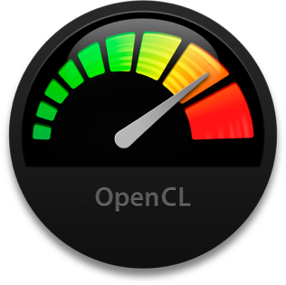
OpenCL™ Gains Momentum
“OpenCL continues to gather momentum on both desktop and mobile devices. In addition to enabling application developers it is providing foundational, portable acceleration for middleware libraries, engines and higher-level programming languages that need to take advantage of heterogeneous compute resources including CPUs, GPUs, DSPs and FPGAs.”
Neil Trevett, chair of the OpenCL™ Working Group and President of the Khronos Group
https://www.khronos.org/news/press/khronos-releases-opencl-2.0

Slide 19



Why OpenCL™?
OpenCL™ vs. CUDA¹
AMD FirePro™ GCN vs. Quadro¹
UP TO
40% FASTER
UP TO
45%
MORE EFFICIENT
AMD FirePro™ W5000
AMD FirePro™ W5000
Nvidia Quadro K2000
Nvidia Quadro K2000
Render to disk time (Normalized, %)
Normalized GPU Utilization
Faster processing - ability to do more, quicker time to market

Slide 20



Why AMD FirePro™ & OpenCL™ for Compute? luxmark
Open source
100% OpenCL™
Complex/real world code used as GPU computing benchmark
AMD FirePro™ S9000
AMD FirePro™ S9000
AMD FirePro™ S9000
Tesla K10
Tesla K10
Tesla K10
K20X
K20X
K20X
UP TO 2.3X FASTER²

Slide 21

Adobe® Accelerates applications with OpenCl™
Extends OpenCL™ Support to Windows users
Adobe® Premiere® Pro CC and Photoshop® CC support OpenCL™
  AMD FirePro™ accelerates 40+ features in Premiere Pro CC and enables real-time editing workflows in 4K
Photoshop CC includes more than 2 dozen GPU-accelerated features, including new Smart Sharpen and enhanced Blur Gallery, leveraging OpenCL™ and AMD graphics to enable fast performance and new capabilities
“While we already support OpenCL on the Mac, today’s announcement gives creative professionals the opportunity to tap into the massive compute resources of AMD APUs and GPUs on Windows-based PCs, broadening the type of accelerated experience they can have with our upcoming software.”
Simon Williams, Director of Strategic Relations, Adobe, April 2013
http://goo.gl/HrqSGm
http://goo.gl/xrpqum

Slide 22
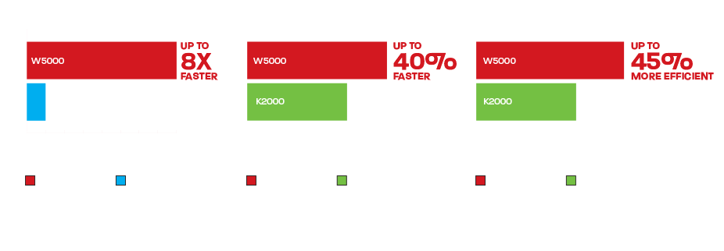
GPU Acceleration of Adobe® Premiere Pro® Creative Cloud
http://www.fireprographics.com/adobe/index.asp

Slide 23
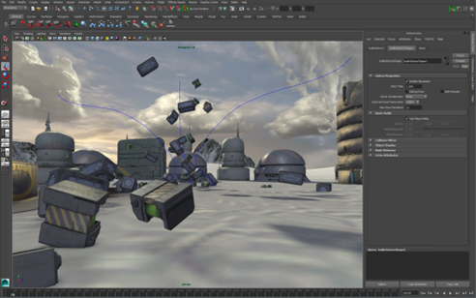

AMD Firepro™ Accelerates Autodesk® Maya® 2014 with OpenCL™
Bullet Physics is an open source library GPU accelerated with OpenCL™
"The new enhancements to the Bullet Physics engine in the Extension for Autodesk® Maya® 2014, empower artists to create large-scale, highly realistic dynamic and kinematic simulations. Plus the AMD FirePro™ accelerates the Bullet plug-in for increased capability for compound collision shapes from multiple meshes, additional collisions with concave shapes, along with rigid set support for increased scalability."
Rob Hoffmann, Senior Product Marketing Manager,
Autodesk Media & Entertainment

Slide 24
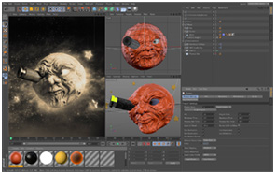

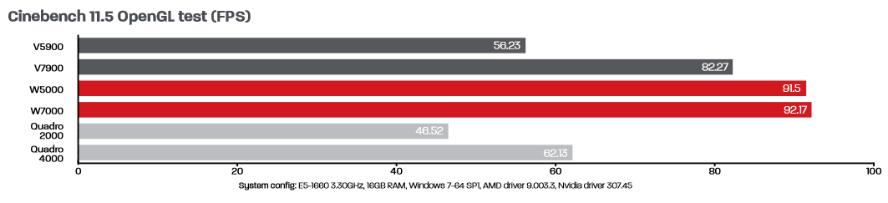
GPU Accelerated MAXON Cinema 4D with OpenCL™
  Cinema 4D uses OpenCL™ accelerated Bullet engine for physical calculations
  AMD FirePro™ drivers have special tuning to give excellent performance
    AMD GeometryBoost technology and leading-edge graphics memory bandwidth help users take new sculpting, physics and global illumination capabilities to the max in Cinema 4D
http://www.fireprographics.com/maxon/index.asp

Slide 25
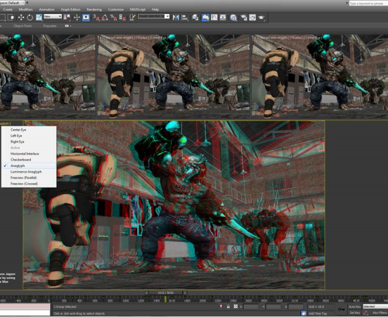

Autodesk® 3ds max® Extension: active stereo
Exclusively for AMD FirePro™ Users
First time a complete integrated stereo workflow available in 3ds Max
Requires subscription and HD3D supported stereo display
“The new 3ds Max extension with Stereo camera support gives added functionality for increased productivity to AMD FirePro™ users on Autodesk Subscription. Active Stereo is also available and only supported on AMD FirePro™ graphics cards. Artists can begin to take advantage of the new functionality for 3ds Max with AMD hardware to enable a broader set of tasks for creating exceptional content."
Rob Hoffmann, Senior Product Marketing Manager,
Autodesk Media & Entertainment

Slide 26
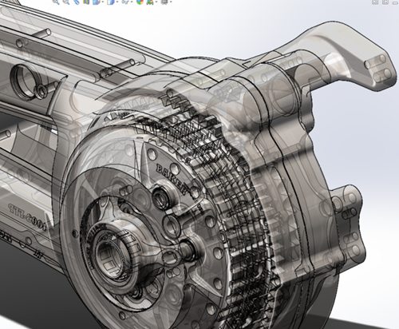
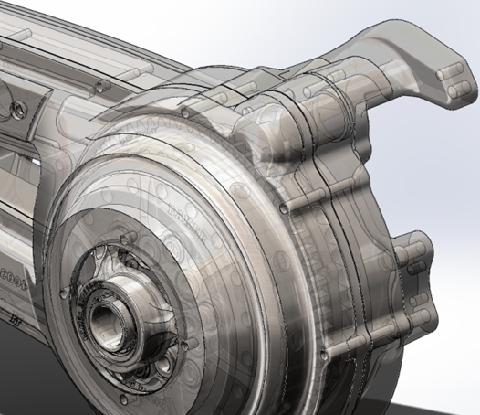
Solidworks® 2014 PrevieW
With OIT
  GPU accelerated OIT
  Order Independent Transparency (OIT) assembles a “pixel-accurate” representation of the model and its surrounding geometry in the GPU memory
  Users can see objects closer to the screen more accurately
  Helps improve the designer’s sense of “design intuition” and aids in better decision-making throughout the product development stages
Without OIT
Images Courtesy of Dassault Systemès

Slide 27
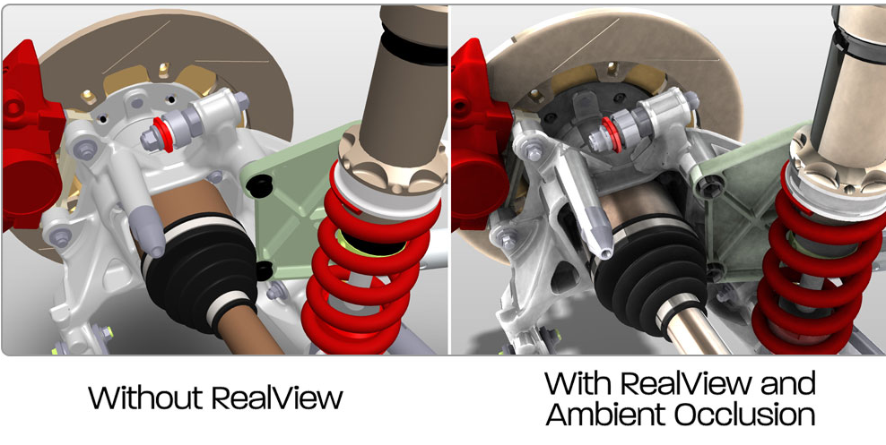
Solidworks® 2013
Powerful Real-time previews with Realview™
www.fireprographics.com/solidworks
Workstation with dual Intel CPUs E5-1660 @ 3.30GHz, 16GB RAM, Win7 64-bit SP1, AMD driver 9.003.3.3

Slide 28
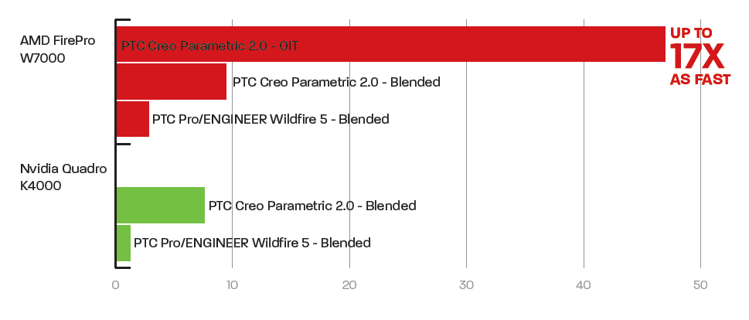

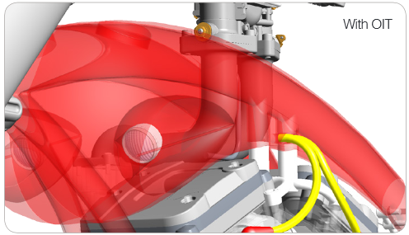
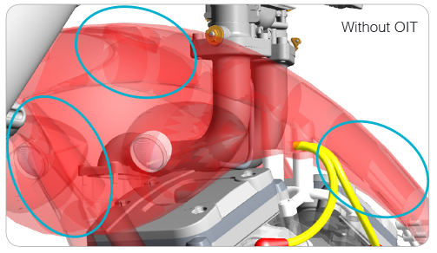
AMD FirePro™ Pro graphics Accelerate OIT in PTC® Creo® 2.0
AMD FirePro™ provides certified workflow performance gains for PTC Creo Parametric 2.0 using the new and exclusive GPU-accelerated Order Independent Transparency mode (OIT)
  Provides greater “design intuition” for faster insight
  Up to 17x as fast as blended mode and no visual artifacts² (with an AMD FirePro W7000)
  AMD Catalyst™ Pro drivers optimized and certified for PTC Creo Parametric 2.0
Exclusively for AMD FirePro™ Users
Benchmarking graph showing up to 17x faster viewport performance with PTC Creo®Parametric® 2.0 "OIT" accelerated transparency mode²
Without OIT
With OIT

Slide 29

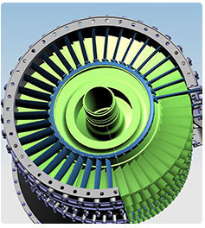
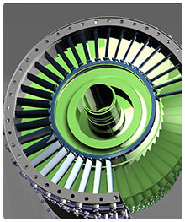
AMD Firepro™ Accelerates Siemens PLM Software NX Workflows
  Support for the new Advanced Studio mode for realistic representations of designs without losing interactivity
    28nm AMD GCN architecture delivers high in-app shader performance
    AMD Catalyst™ Pro drivers certified and optimized for NX 8.5
    AMD Eyefinity technology ideal for PLM workflows using multiple apps
Studio Mode with True Shading
Advanced Studio Mode
http://www.fireprographics.com/siemens/index.asp

Slide 30
Client Mobile

Slide 31
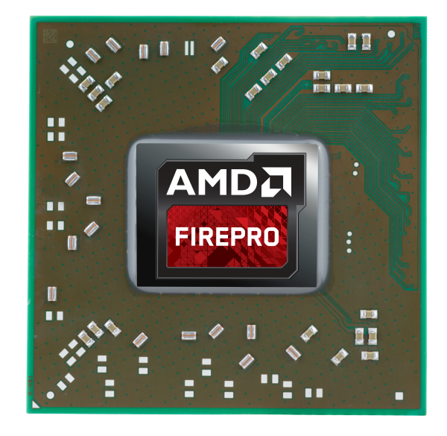
Introducing
The next generation AMD FirePro™ M4100, M5100 and M6100 mobile workstation graphics
Bringing the Power of AMD’s Graphics Core Next (GCN) GPU architecture to engineering and creative professionals on the go

Slide 32
Introducing
The latest generation AMD FirePro M-Series mobile workstation graphics features:
Higher graphics and compute performance thanks to AMD GCN architecture
  Increased application performance and realism with larger models
Smart power features with AMD Enduro™ and AMD PowerGate technologies³
  Intelligent power usage for maximum performance at your desk and longer battery life on the go
Beyond HD resloution and multi-montior configurations
  Helps professionals to work more effectively and see designs and enviroments more clearly

Slide 33
Next Generation Mobile Workstation Graphics
AMD FirePro™ M6100
  768 stream processors
  1.651 TFLOPS peak single precision floating point
  103 GFLOPS peak double precision floating point
  2GB GDDR5 memory
  128-bit memory interface
  88 GB/s memory bandwidth
  1.375 GHz memory clock (5.5 GB/s)
AMD FirePro™ M5100
  640 stream processors
  992 GFLOPS peak single precision floating point
  103 GFLOPS peak double precision floating point
  2GB GDDR5 memory
  128-bit memory interface
  72 GB/s memory bandwidth
  1.125 GHz memory clock for GDDR5 (4.5 GB/s)
AMD FirePro™ M4100
  384 stream processors
  514 GFLOPS peak single precision floating point
  32 GFLOPS peak double precision floating point
  1GB GDDR5 memory*
  128-bit memory interface
  64 GB/s memory bandwidth
  1.0 GHz memory clock (4.0 GB/s)
*M4100 can be configured with 2GB but HP opted for 1GB

Slide 34
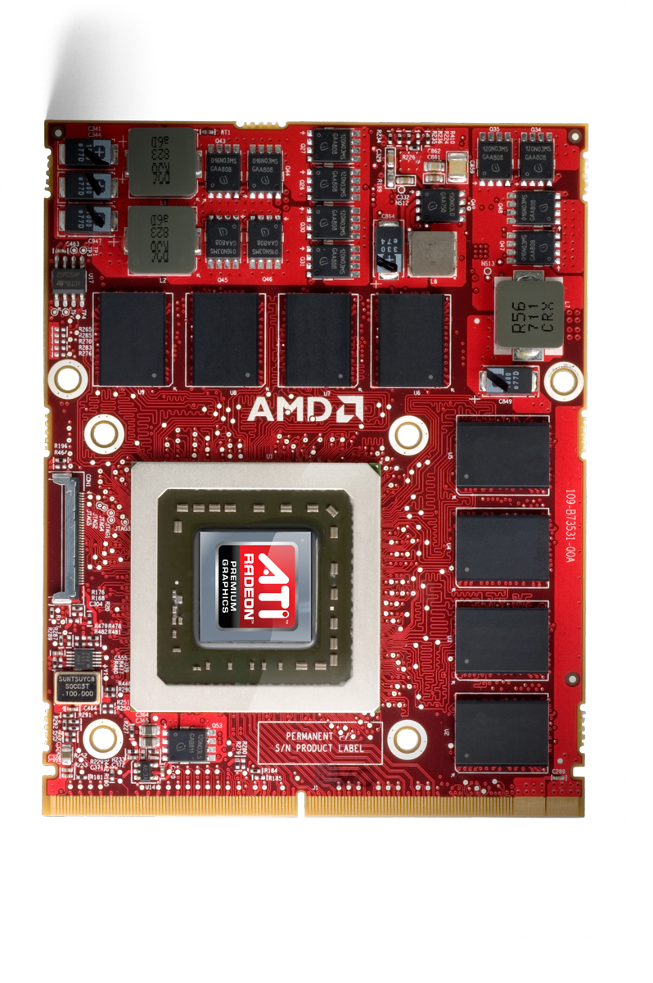
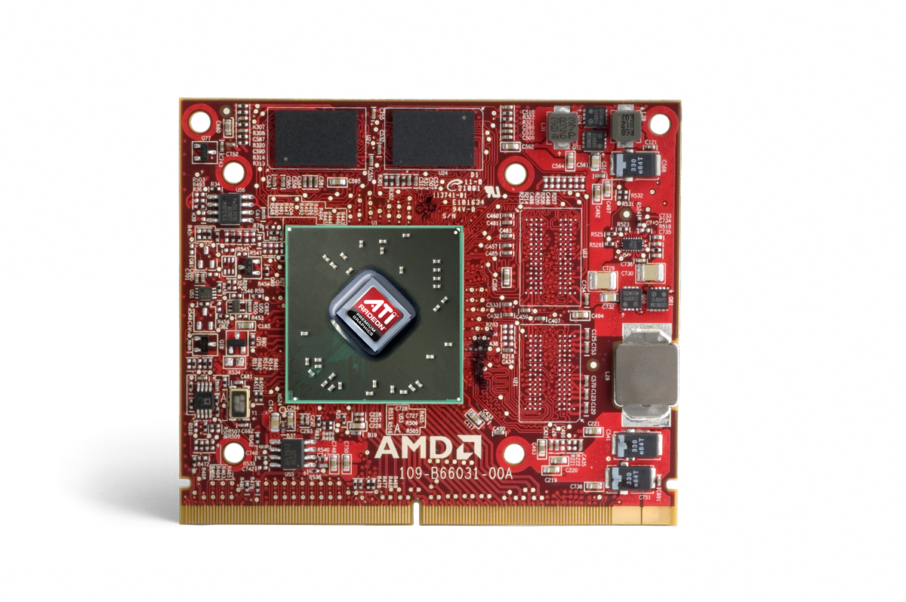


MXM Form Factor (Type A and Type B)
MXM Type A
MXM Type B

Slide 35

HP Mobile Workstation design Win 2013-14
AMD FirePro™ Exclusive Design Win
HP ZBook 14” mobile workstation
  AMD FirePro™ M4100
  Chip-down board type
  384 stream processors
  514 GFLOPS peak single precision floating point
  32 GFLOPS peak double precision floating point
  1GB GDDR5 memory
  128-bit memory interface
  64 GB/s memory bandwidth
  1.0 GHz memory clock (4.0 GB/s)
  No AMD Eyefinity support
World’s First Workstation Ultrabook™⁴
HP Announced Sept. 10, 2013
www.hp.com/go/ZBook14

Slide 36
AMD FirePro™ M4100 vs. M4000/M2000
 | AMD FirePro™ M4100 & HP 14” Z Book | AMD FirePro™ M4000 | AMD FirePro™ M2000
Display Outputs | 3 undocked (iGPU only) 5 docked (iGPU + dGPU) | 3 undocked 5 docked | 3 undocked 5 docked
Form Factor | Chip-down | MXM Type A | MXM Type A
Memory Size / Type | 1GB GDDR5 | 1GB GDDR5 | 1GB GDDR5
Memory Bandwidth/Interface | 64 GB/s 128-bit | 72 GB/Sec 128-bit | 25.6 GB/s 64-bit
Engine Clock Speed | 670 MHz | 600 MHz | 500 MHz
Max Resolution (per display, DisplayPort 1.2) | 4096x2160 | 4096x2160 | 4096x2160
Stereoscopic 3D Suport | Yes | Yes | Yes
AMD PowerTune and ZeroCore² | Yes | Yes | Yes
AMD Enduro and PowerGate⁴ | Yes | No | No
OpenGL Support | 4.3 | 4.2 | 4.2
OpenCL™ | 1.2 | 1.1 | 1.1
DirectX® Support | 11.1 | 11 | 11
Stream Processors | 384 | 512 | 480
Compute Power (single precision) | 514 GFLOPS | 614 GFLOPS | 480 GFLOPS
What’s New in M4100
  GCN Architecture
  Higher clock speeds
  DirectX® 11.1 support
  OpenGL 4.3 support
  OpenCL™ 1.2
  AMD Enduro technology (switchable graphics)
  AMD PowerGate technology
AMD Eyefinity not supported on 14” Z Book
  GPU can power up to two displays only when system is docked
  Maximum of 5 displays can be supported only when docked, achieved under normal Windows desktop operations

Slide 37
Amd fIREprO™ m4100
Value Propositions (Specific to HP Z Book)
AMD FirePro™ M4100 notebook graphics helped HP to redefine mobile computing, delivering the right mix of application performance and reliability, energy efficiency and battery life in the thin and light HP Z Book – the world’s first workstation Ultrabook™⁴
  1GB GDDR5 memory helps HP Z Book to keep pace with graphics-intensive tasks
  AMD Enduro™ technology helps to optimize HP Z Book power consumption by enabling users to ratchet up their system performance when they need it, and save battery power when they don’t
  AMD PowerGate technology helps the HP Z Book to intelligently adjust GPU power consumption to extend battery
  Support for DisplayPort 1.2 enables HP Z Book to achieve display resolutions well beyond standard HD, up to 4096x2160 per display when docked (limited to two displays at 60 Hz), allowing users to see more clearly and in more detail than ever before

Slide 38
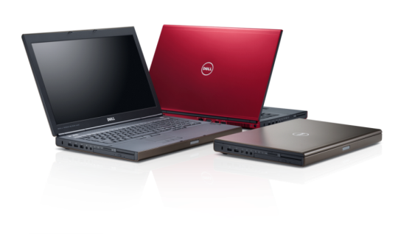
Dell Mobile Workstation 2013-14 design Wins
Can be Configured with AMD FirePro™ or Quadro
Dell Precision™ M6800/M6800 Covet Edition 17.3”
  AMD FirePro™ M6100
  Type A MXM
  768 stream processors
  1.651 TFLOPS peak single precision floating point
  103 GFLOPS peak double precision floating point
  2GB GDDR5 memory
  128-bit memory interface
  88 GB/s memory bandwidth
  1.375 GHz memory clock (5.5 GB/s)
Dell Precision™ M4800 15.6”
  AMD FirePro™ M5100
  Type B MXM
  640 stream processors
  992 GFLOPS peak single precision floating point
  103 GFLOPS peak double precision floating point
  2GB GDDR5 memory
  128-bit memory interface
  72 GB/s memory bandwidth
  1.125 GHz memory clock for GDDR5 (4.5 GB/s)
Dell Announced 9/9/13
http://www.dell.com/us/business/p/precision-m6800-workstation/pd
http://www.dell.com/ed/business/p/precision-m4800-workstation/pd

Slide 39
AMD Firepro™ M6100/M5100 vs. M6000/M4000
 | AMD FirePro™ M6100 & Dell M6800 | AMD FirePro™ M6000 | AMD FirePro™ M5100 & Dell M4800 | AMD FirePro™ M4000
Display Outputs¹ | 4 undocked 5 docked | 3 undocked 5 docked | 4 undocked 5 docked | 3 undocked 5 docked
Form Factor | MXM Type A | MXM Type B | MXM Type B | MXM Type A
Memory Size / Type | 2GB GDDR5 | 2GB GDDR5 | 2GB GDDR5 | 1GB GDDR5
Memory Bandwidth/Interface | 88 GB/s 128-bit | 72 GB/s 128-bit | 72 GB/s 128-bit | 72 GB/Sec 128-bit
Engine Clock Speed | 1075 MHz | 750 MHz | 1.125 GHz | 600 MHz
Max Resolution (per display, DisplayPort 1.2) | 4096x2160 | 4096x2160 | 4096x2160 | 4096x2160
Stereoscopic 3D Support | Yes | Yes | Yes | Yes
AMD PowerTune and ZeroCore Power² | Yes | Yes | Yes | Yes
AMD Enduro and PowerGate⁴ | Yes | No | Yes | No
OpenGL Support | 4.3 | 4.2 | 4.3 | 4.2
OpenCL™ | 1.2 | 1.1 | 1.2 | 1.1
DirectX® Support | 11.1 | 11 | 11.1 | 11
Stream Processors | 768 | 640 | 640 | 512
Compute Power (single precision) | 1.651 TFLOPS | 960 GFLOPS | 992 GFLOPS | 614 GFLOPS
What’s New in M6100 & M5100
  Higher clock speeds
  Greater compute performance
  DirectX® 11.1 support
  OpenGL 4.3 support
  OpenCL™ 1.2
  AMD Enduro technology support (optional add-in on Dell M6800 and M4800)
  Drive up to 8 displays with Display Port 1.2 MST hub (Enduro mode: 2x iGPU and 6x dGPU)¹

Slide 40
AMD FirePRo™ M6100
Value Propositions (Specific to Dell M6800/M6800 Covet)
AMD FirePro™ M5600 notebook graphics help Dell deliver the right mix of application performance and reliability, crisp graphics, energy efficiency and battery life worthy of the world’s most powerful 17” mobile workstation (according to Dell, http://goo.gl/RTg0B7)
  2GB GDDR5 memory helps Dell M6800 to keep pace with demanding applications, renders and other graphics-intensive tasks
  AMD Enduro™ technology helps to optimize Dell M6800 power consumption by enabling users to ratchet up their system performance when they need it, and save battery power when they don’t
  AMD PowerGate technology helps the Dell M4800 to intelligently adjust GPU power consumption to extend battery life
  AMD Eyefinity multi-display technology enables Dell M6800 to drive up to four displays when undocked and up to five when docked, independently or as one seamless desktop for more flexible user workflows⁵
  M6100 supports DisplayPort 1.2, enabling notebook workstations to achieve display resolutions well beyond standard HD, up to 4096x2160 per display, allowing users to see more clearly and in more detail than ever before¹

Slide 41
AMD FirePro™ M5100
Value Propositions (Specific to Dell M4800)
AMD FirePro™ M5100 notebook graphics help Dell deliver the right mix of application performance and reliability, crisp graphics, energy efficiency and battery life worthy of the world’s most powerful 15” mobile workstation (according to Dell, http://goo.gl/RTg0B7)
  2GB GDDR5 memory helps Dell Precision M4800 to keep pace with demanding applications, renders and other graphics-intensive tasks
  AMD Enduro™ technology helps to optimize Dell M4800 power consumption by enabling users to ratchet up their system performance when they need it, and save battery power when they don’t
  AMD PowerGate technology helps the Dell M4800 to intelligently adjust GPU power consumption to extend battery life
  AMD Eyefinity multi-display technology enables Dell M4800 to drive up to four displays when undocked and up to five when docked, independently or as one large seamless desktop for more flexible user workflows⁵
  Support for DisplayPort 1.2 enables Dell M4800 to achieve display resolutions well beyond standard HD, up to 4096x2160 per display, allowing users to see more clearly and in more detail than ever before⁶

Slide 42

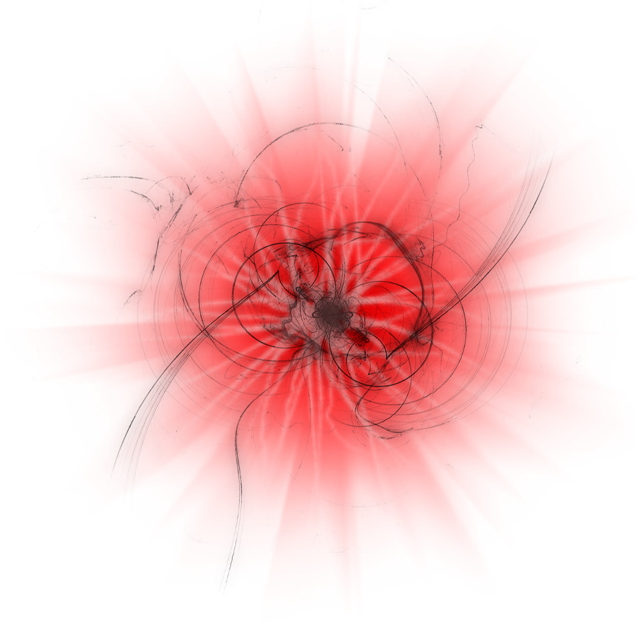


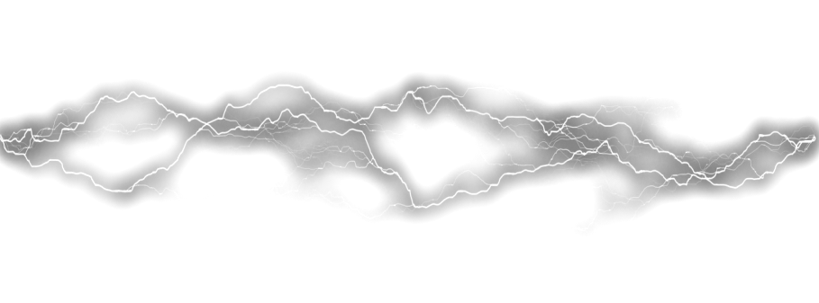


Balancing
Power
with
Performance
AMD Enduro™ Power technologies adapts to GPU requirements automatically⁴
Extending battery life

Slide 43
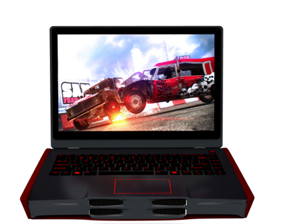

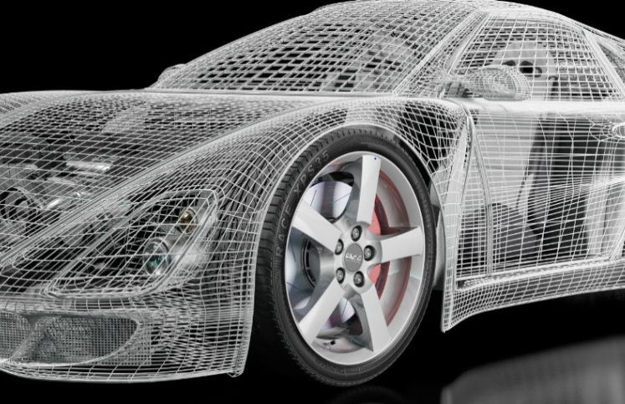



AMD Enduro™ Technology
Advanced Power, Performance & Optimal User Experience
Great performance & great battery life
With AMD Enduro™ Technology⁷
Flexible Performance & Power Efficiency
Enhanced battery life with instantaneous switching:
Automatically & seamlessly turns AMD FirePro™ discrete Mobile GPU on and off depending on system or application requirements
Smooth, automatic transition
GPU consumes 0 watts when powered down with AMD Enduro™ technology
CPU
GPU

Slide 44
Client Discrete

Slide 45
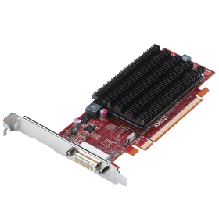
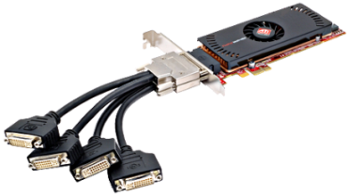
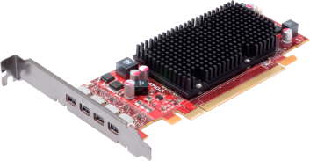
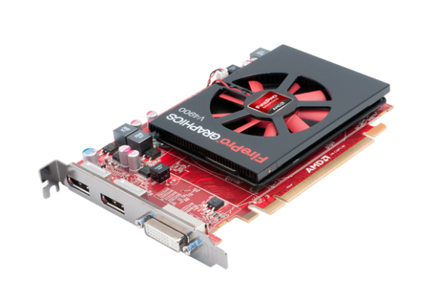
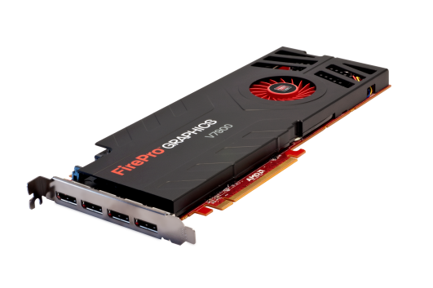



AMD FIREPROTM Workstation GRAPHICS
ATI FirePro™ 2450
512 MB
2D + MV
ATI FirePro™ 2460
512 MB
2D + MV
AMD FirePro™ 2270
1GB/512 MB
2D + MV
AMD FirePro™ V3900
1 GB
Entry 3D
AMD FirePro™ V4900
1 GB
Mid-Entry 3D
AMD FirePro™ V5900
2 GB
Mid-Range 3D
AMD FirePro™ V7900
2 GB
High-End 3D

Slide 46








AMD FIREPRO™ Graphics cards with GCN Architecture
AMD FirePro™ W600
2 GB
Mid-Range + MV
AMD FirePro™ W5000
2 GB
Mid-Range
AMD FirePro™ W7000
4 GB
High-End
AMD FirePro™ W8000
4 GB
High-End
AMD FirePro™ W9000
6 GB
Ultra High-End
AMD FirePro™ R5000
2 GB and PCoIP
Mid-Range
AMD FirePro™ S7000
4 GB
AMD FirePro™ S9000
6 GB
AMD FirePro™ S10000
6 GB
Dual-GPU

Slide 47


AMD FirePro™ 2270: 2D Productivity
Delivering a stable business environment for professionals
Features That Matter
512 MB and 1GB DDR3 Options
Passively Cooled
15W Max Power
Triple-Set Solution (DP/DVI/VGA)
Low Profile, Half Length

Slide 48

AMD FirePro™ 2460: Quad Display Play
Robust solution for financial and enterprise use cases
Features That Matter
AMD Eyefinity Multi-Display Technology
512 MB DDR3
Passively Cooled
Sub 20W Max Power
Four Mini-DP Connectors
Low Profile, Half Length

Slide 49
AMD FirePro™ W600: Displays Everywhere
The most powerful and cost effective solution for multi-monitor display walls
Features That Matter
Overlap support for up to six projectors
Bezel compensation
Maximum resolution of 4096x2304 per display
Multi-streaming audio support
High quality graphics performance
PCIe® Gen 3

Slide 50


AMD Firepro™ V3900: powerful entry level pro graphics
Features That Matter
AMD Eyefinity Multi-Display Technology
1GB DDR3
Actively Cooled
<75W Max Power
1 dual-link DVI, 1 DisplayPort
Low Profile, Half Length
“The AMD FirePro V3900 is a good card at an excellent price point. It's a solid step up from the V3800 and it more than holds its own in professional applications against a more expensive consumer solution.”
– Joel Hruska, Hot Hardware

Slide 51


AMD FIREPRO™ V4900: Entry Performance king
Certification, support, and performance for entry CAD and Media & Entertainment users
AMD FirePro™ V4900 | AMD vs. Competitor (K600)
768 GFLOPs of compute power vs. 336 GFLOPs | 2.25x
64 GB/s memory bandwidth vs. 29 GB/s | 2.2x
3 display outputs vs. 2 | 50% More
K600 specs can be viewed at http://www.nvidia.com/object/quadro-desktop-gpus-specs.html

Slide 52


AMD FIREPRO™ V4900: Price/Performance Leader
System Config: HP Z420, Intel Xeon E5-1660 @ 3.30GHz, 16GB RAM, Windows® 7 64-bit SP1. AMD driver version 9.003.3, Nvidia version 307.32.

Slide 53


AMD FIREPRO™ W5000: Mid-range dynamo
Easily handles complex models with outstanding price/performance
AMD FirePro™ W5000 | AMD vs. Competitor (K2000)
1.86 TFLOPS of compute power vs. 732.67 GFLOPS | 2.5x
102.4 GB/s memory bandwidth vs. 64 GB/s | 60% More
PCIe® Gen3 vs. Gen2 | 2x
K2000 specs can be viewed at http://www.nvidia.com/object/quadro-desktop-gpus-specs.html

Slide 54


AMD FIREPRO™ W5000: vs. Quadro K2000 in Maya
Artificial Benchmark
Real Application Models Benchmark
Normalized to K2000 = 1
16%
Faster!
48%
Faster!
85%
Faster!
System Config: HP Z420, Intel Xeon E5-1660 @ 3.30GHz,
16GB RAM, Windows® 7 64-bit SP1. AMD driver v9.003.3, NV v311.35.

Slide 55
AMD FIREPRO™ W5000: vs. Quadro K2000 in Creo 2.0
Artificial Benchmark
Real Application Models Benchmark
Normalized to K2000 = 1
43%
Faster!
55%
Faster!
77%
Faster!
System Config: HP Z420, Intel Xeon E5-1660 @ 3.30GHz,
16GB RAM, Windows® 7 64-bit SP1. AMD driver v9.003.3, NV v311.35.

Slide 56
AMD FIREPRO™ W5000: vs. Quadro K2000 in SolidWorks
Artificial Benchmark
Real Application Models Benchmark
Normalized to K2000 = 1
25%
Faster!
37%
Faster!
70%
Faster!
System Config: HP Z420, Intel Xeon E5-1660 @ 3.30GHz,
16GB RAM, Windows® 7 64-bit SP1. AMD driver v9.003.3, NV v311.35.

Slide 57
AMD FIREPRO™ W5000: vs. Quadro K2000 in Siemens NX
Artificial Benchmark
Real Application Models Benchmark
Normalized to K2000 = 1
55%
Faster!
64%
Faster!
62%
Faster!
System Config: HP Z420, Intel Xeon E5-1660 @ 3.30GHz,
16GB RAM, Windows® 7 64-bit SP1. AMD driver v9.003.3, NV v311.35.

Slide 58


AMD FIREPRO™ W7000: CAD/CAE & M&E Powerhouse
Incredible performance, superb visual quality and outstanding multi-display design experiences
AMD FirePro™ W7000 | AMD vs. Competitor (K4000)
2.43 TFLOPs of compute power vs. 1.25 TFLOPs | 2x
4GB memory vs. 3GB | 33% More
PCIe® Gen3 32GB/s vs. Gen2 16GB/s | 2x
K4000 specs can be viewed at http://www.nvidia.com/object/quadro-desktop-gpus-specs.html

Slide 59
AMD FIREPRO™ W7000: Industry leading performance
Normalized to K2000 = 1
System Config: HP Z420, Intel Xeon E5-1660 @ 3.30GHz,
16GB RAM, Windows® 7 64-bit SP1. AMD driver v2.8, NV v311.35.

Slide 60


AMD FIREPRO™ W8000: For Heavy Rendering & Compute Workloads
The best solution for users who need one card to meet their rendering and compute requirements
AMD FirePro™ W8000 | AMD vs. Competitor (K5000)
3.23 TFLOPs of compute power vs. 2.17 TFLOPs | 50% More
28.8 gigapixels/s fill rate vs. 22.6 gigapixels/s | 25% More
PCIe® 3.0 32GB/s vs. 2.0 16GB/s | 2x
$1,599 vs. $1,675.75 | 5% Less
K5000 specs can be viewed at http://www.nvidia.com/object/quadro-desktop-gpus-specs.html. K5000 pricing from www.sabrepc.com as of 5.28.13.

Slide 61
AMD FIREPRO™ W8000: Uncompromising performance
The High-End Category Leader for Multi-tasking and Application Performance
Performance / Price
(Graphics + Compute Composite)
2.8X
Better!
54%
Faster!
19%
Faster!
4X
Faster!
Averaged SPECapc Maya 2012, UGS NX6, Creo2, 3dsmax 2011, and Solidworks 2013 Graphics Composite scores + BaseMark CL / MSRP
System Config: HP Z420, Intel Xeon E5-1660 @ 3.30GHz, 16GB RAM, Windows® 7 64-bit SP1. AMD driver v9.003.3, NV v307.32.

Slide 62





AMD FirePro™ 3D Workstation Graphics HP Tower Design Wins
HP Z820 Workstation
AMD FirePro™ W7000, V3900
HP Z620 Workstation
AMD FirePro™ W7000, V3900
HP Z420 Workstation
AMD FirePro™ W7000, V3900
HP Z220 CMT
AMD FirePro™ V3900
HP Z220 SFF
AMD FirePro™ V3900

Slide 63




AMD FirePro™ 3D Dell Tower Design Wins 2013-14
Dell Precision T7610
AMD FirePro™ W7000,
W5000, V4900, V3900, 2270
Dell Precision T5610
AMD FirePro™ W7000,
W5000, V4900, V3900, 2270
Dell Precision T3610
AMD FirePro™W7000,
W5000, V4900, V3900, 2270
Dell Precision T1700 MT
AMD FirePro™ W5000, V4900,
V3900, 2270

Slide 64


AMD FirePRo™ 3D Dell Tower & Rack Design Win 2013-14
Dell Precision T1700 SFF
AMD FirePro™ 2270
Dell Precision R7610
AMD FirePro™ W5000, 2270

Slide 65



AMD FirePro™ 3D Lenovo Design Wins 2013-14
Lenovo ThinkStation C30
AMD FirePro™ W7000, W5000, V4900,
V3900, 2460, 2270
Lenovo ThinkStation S30
AMD FirePro™ W7000, W5000, V4900,
V3900, 2460, 2270
Lenovo ThinkStation D30
AMD FirePro™ W7000, W5000, V4900, V3900, 2460, 2270

Slide 66


AMD FirePro™ 3D Lenovo Design Wins 2013-14 Continued
Lenovo ThinkStation E32 T SFF
AMD FirePro™ 2270, 2460
Lenovo ThinkStation E32 T
AMD FirePro™ 2270, 2460

Slide 67
Cloud & Compute

Slide 68


AMD FirePro™ Compute Power, TFLOPS
5.91 SP
1.48 DP
28nm
(S10000)
2.72
40nm
1.20
55nm
0.36
90nm
0.44
80nm
TFLOPS
Delivering MORE PERFORMANCE
* All compute power values rounded to the nearest hundredth of a TFLOP.

Slide 69











AMD FirePro™ PCIe® GEN 3 LEADERSHIP
32
GB/s
16
GB/s
8
GB/s
Bandwidth (GB/s)
AHEAD of the Curve
69

Slide 70

AMD FIREPRO™ S7000 server graphics: Powerful Single-slot
AMD FirePro™ S7000 | AMD vs. Competitor (K20)
Price performance leadership | 59% less $
1.92 TFLOPS SPFP performance/$ vs. K20 at 1.14 | 68% more
Higher performance/watt | 16 GFLOPS
K20 specs can be viewed at http://www.nvidia.com/object/tesla-servers.htm.
Nvidia K20 pricing from www.superbiiz.com on 3/4/13 at $3,069.99,and S9000 MSRP is $1,249.
S7000 is 150W max power, K20 is 225W.
l
Notes:
From approved Computex Press deck, June 2013

Slide 71

AMD FIREPRO™ S9000 server graphics: Price/performance leadership
AMD FirePro™ S9000 | AMD vs. Competitor (K20)
6GB GDDR5 vs. 5GB | 1GB more
264 GB/s memory bandwidth vs. 208 | 21% more
1.29 TFLOPS SPFP performance/$ vs. K20 at 1.14 | 13% more
K20 specs can be viewed at http://www.nvidia.com/object/tesla-servers.htm.
Nvidia K20 pricing from www.superbiiz.com on 3/4/13 at $3,069.99,amd S9000 MSRP is $2,499.
l

Slide 72
AMD FIREPRO™ S10000 Server Graphics: Most Powerful Server GPU
Delivers unprecedented compute performance
AMD FirePro™ S10000 | AMD vs. Competitor (K40)
5.91 TFLOPS SPFP vs. 4.29 | 37% more
480 GB/s memory bandwidth vs. 288 | 66% more
1.48 TFLOPS DPFP vs. 1.43 | ˃3% more
K40 specs can be viewed at http://www.nvidia.com/object/tesla-servers.html
Notes:
From approved Computex Press deck, June 2013

Slide 73



AMD FirePro™ Dell Server Design Wins for VDI 2013-2014
Dell PowerEdge R720
AMD FirePro™ S9000, S7000, V7800P
Dell PowerEdge T620
AMD FirePro™ W7000, V7800P
Dell PowerEdge VRTX
AMD FirePro™ W7000

Slide 74


Citrix® Certified for The Cloud
Enabling robust Centralized Computing Experiences
Validated for Citrix® XenServer™ 6.1
Systems and GPUs are thoroughly vetted and tested for compatibility, reliability and performance
Dell PowerEdge™ T620
AMD FirePro™ W7000
Dell PowerEdge™ R720
AMD FirePro™ S7000 & S9000
http://hcl.vmd.citrix.com/GPUPass-throughDeviceList.aspx

Slide 75

GPU Virtualization with Vmware®
Shared GPU Supported on AMD Firepro® S-Series Server Cards for VDI
AMD FirePro™ S-Series cards combine with VMWare vSphere 5.5 virtualization platform to enable multiple virtual machines to access and share one GPU
VMware and AMD introduced Shared GPU functionality at vmworld 2013 on 8/29/13
Support up to four virtual desktops running 3D graphics applications from one GPU
With Shared GPU IT can more effectively manage and support a large number of traditional workers as well as smaller groups of specialized users
http://goo.gl/ijrsMO
Notes:
No announcement to point to. Only this session track, shortened lik included on the slide. https://vmworld2012.activeevents.com/connect/sessionDetail.ww?SESSION_ID=5030&tclass=popup

Slide 76

Add SANAM SLIDE
Power of AMD FIrePRo™ for GPU Compute: SANAM Supercomputer
University of Frankfurt
Frankfurt Institute for Advanced Studies
Antiproton and ion research
420 FirePro™ S10000 server cards
#2 Green500™ List, Nov 2012
Sustains up to 420 TFLOPS
180 kW total, 2.3 GLOPS/W
“To achieve the capacity we wanted, we would need to rely on the power of GPUs and the obvious supplier was AMD.”
Dr. Volker Lindenstruth, Goethe Univ.
http://www.youtube.com/watch?v=f67PA-TrhLQ
Notes:
“A generic supercomputer delivering this performance without GPUs would run up an electricity bill of about 750,000 Euros per year, whereas the annual power cost for SANAM is expected to be about 250,000 Euros.” Dr. Lindenstruth

Slide 77


Power of AMD FIrePRo™ for Display Walls: Stony Brook Univ.
The Reality Deck
1.5 billion pixels
Visualize large amounts of data
72 AMD FirePro™ graphics cards
16 ATI FirePro™ S400 sync cards
416 HD displays (2560x1440)
“AMD FirePro™ workstation graphics are central to this immersive experience.”
– Dr. Arie Kaufman, Project Director
www.youtube.com/watch?v=E9KNLnzaHOI
Notes:
Only AMD FirePro™ cards with can drive more than four displays from one GPU, up to six from one card and no MST hubs required
DisplayPort 1.2 support, 4Kx2K resolution enabled per display out put on both W600 and W9000, allowing up to six 4Kx2K displays to be powered from one card
Nvidia limited to four display outputs, even with MST hubs

Slide 78





Enabling Gamers to Play Favorite Titles on virtually any device, anywhere
Gamescom 2013, Germany
“AMD and CiiNOW are making gaming in the cloud a disruptive and visually compelling experience. Together, we enable instant, amazing gaming experiences on a wide variety of clients for game enthusiasts.“
Ron Haberman, CEO, CiiNOW, Inc.
http://goo.gl/zcuSTH

Slide 79
Footnotes
¹Software: Adobe Premiere Pro pre-release build 294 / Windows 7 64-bit, Effects: ProcAmp, sharpen, color Balance (RGB), RGB color Corrector, lumetri (multiple Deep Colour effects) System: Intel Xeon E5530 @ 2.40 GHZ, 12GB memory, 160GB Velociraptor, Drives: AMD 12102 / NVIDIA 311.35, Content: 4K TIFF 24-bit sequence
²Exxact Quantum TXR410-144R, Tyan FT72B7015, 32GB memory, Windows® 7 64-bit, and AMD driver version 9.003.3.3 / NVidia driver version 310.90.
³AMD PowerGate, PowerTune and AMD ZeroCore Power are technologies offered by certain AMD FirePro™ products, which are designed to intelligently manage GPU power consumption in response to certain GPU load conditions. Not all products feature all technologies – check with your component or system manufacturer for specific model capabilities.
⁴According to HP, not all HP Zbook configurations qualify as a mobile workstation Ultrabook™.
⁵AMD Eyefinity technology supports up to six DisplayPort™ monitors on an enabled graphics card. Supported display quantity, type and resolution vary by model and board design; confirm specifications with manufacturer before purchase. To enable more than two displays, or multiple displays from a single output, additional hardware such as DisplayPort-ready monitors or DisplayPort 1.2 MST-enabled hubs may be required. A maximum of two active adapters is recommended for consumer systems. See www.amd.com/eyefinityfaq for full details.
⁶Requires 4K display and content. Supported resolution varies by GPU model and board design; confirm specifications with manufacturer before purchase.
⁷AMD Enduro™ technology requires either an AMD “A” series or “E” series APU or an Intel processor, plus an AMD Radeon™ HD 7000M series or an AMD FirePro™ M5100/M4100/M3100 discrete graphics configuration and is available on Windows® 7 Professional, Windows® 7 Ultimate, Windows® 7 Home Premium, and/or Windows® 7 Home Basic OS. Linux OS supports manual switching which requires restart of X-Server to switch between graphics solutions. Not all AMD Radeon™ HD 7000M series or AMD FirePro™ M5100/M4100/M3100 GPU features and capabilities may be supported on all AMD Enduro™ technology-enabled components or systems — always check with your component or system manufacturer for specific mode capabilities and supported technologies.

Slide 80
Disclaimer & Attribution
The information presented in this document is for informational purposes only and may contain technical inaccuracies, omissions and typographical errors.
The information contained herein is subject to change and may be rendered inaccurate for many reasons, including but not limited to product and roadmap changes, component and motherboard version changes, new model and/or product releases, product differences between differing manufacturers, software changes, BIOS flashes, firmware upgrades, or the like. AMD assumes no obligation to update or otherwise correct or revise this information. However, AMD reserves the right to revise this information and to make changes from time to time to the content hereof without obligation of AMD to notify any person of such revisions or changes.
AMD MAKES NO REPRESENTATIONS OR WARRANTIES WITH RESPECT TO THE CONTENTS HEREOF AND ASSUMES NO RESPONSIBILITY FOR ANY INACCURACIES, ERRORS OR OMISSIONS THAT MAY APPEAR IN THIS INFORMATION.
AMD SPECIFICALLY DISCLAIMS ANY IMPLIED WARRANTIES OF MERCHANTABILITY OR FITNESS FOR ANY PARTICULAR PURPOSE. IN NO EVENT WILL AMD BE LIABLE TO ANY PERSON FOR ANY DIRECT, INDIRECT, SPECIAL OR OTHER CONSEQUENTIAL DAMAGES ARISING FROM THE USE OF ANY INFORMATION CONTAINED HEREIN, EVEN IF AMD IS EXPRESSLY ADVISED OF THE POSSIBILITY OF SUCH DAMAGES.
ATTRIBUTION
© 2013 Advanced Micro Devices, Inc. All rights reserved. AMD, the AMD Arrow logo and combinations thereof are trademarks of Advanced Micro Devices, Inc. in the United States and/or other jurisdictions. SPEC is a registered trademark of the Standard Performance Evaluation Corporation (SPEC). Other names are for informational purposes only and may be trademarks of their respective owners.

