Slide 1
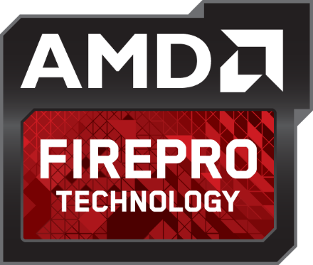
GPU Acceleration of Creo Parametric 2.0 with AMD FirePro Graphics
Jon Clark
Sr. Application Engineer June 2013

Slide 2
AGENDA
 | AMD FirePro Performance Comparisons (vs. the competition)
 | AMD & PTC Relationship
 | OIT – Order Independent Transparency
 | Demonstration
 | Performance by GPU Acceleration: Vertex Buffer Objects (VBO)
 | Workflow Productivity with AMD Eyefinity Multi-Display Technology
 | AMD FirePro Professional Graphics Portfolio

Slide 3
AMD FIREPROTM PERFORMANCE COMPARISONS
Vs. the competition

Slide 4
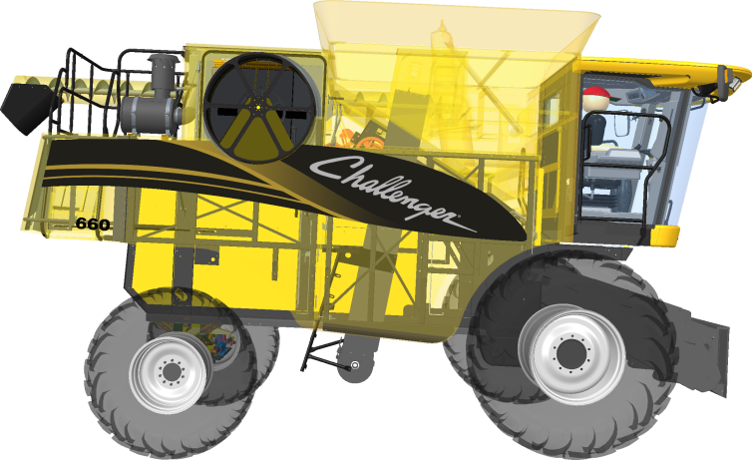
Performance Comparisons
TRANSPARENCY MODE – Challenger 660 Combine
18X¹
6X²
XTOP Size: 2GB
Challenger 660 Combine
Intel Xeon E5-1660 @ 3.3Ghz 6-Core, 8GB
Windows 7 x64, 1920x1200
Creo Parametric 2.0 M040
Drivers: AMD FirePro 9.003.3.3, NVidia Quadro 311.50 FPS measured with Fraps 3.4.99

Slide 5
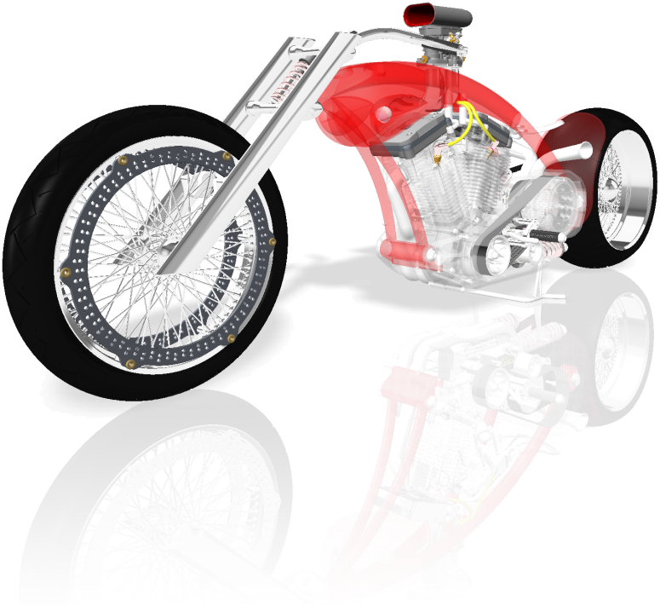
Performance Comparisons
TRANSPARENCY MODE – PTC Motorcycle
23X³
5X⁴
XTOP Size: 650MB
PTC Motorcycle
Intel Xeon E5-1660 @ 3.3Ghz 6-Core, 8GB
Windows 7 x64, 1920x1200
Creo Parametric 2.0 M040
Drivers: AMD FirePro 9.003.3.3, NVidia Quadro 311.50 FPS measured with Fraps 3.4.99

Slide 6
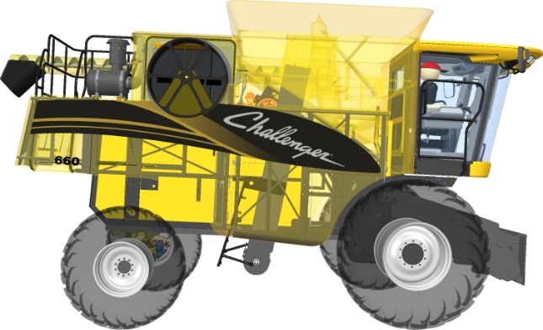
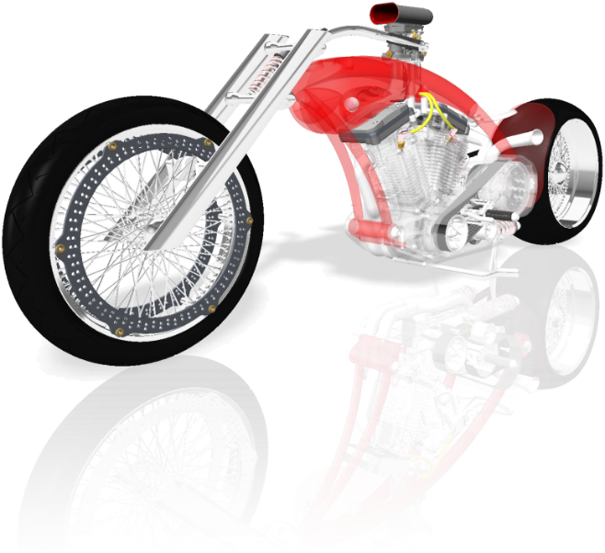
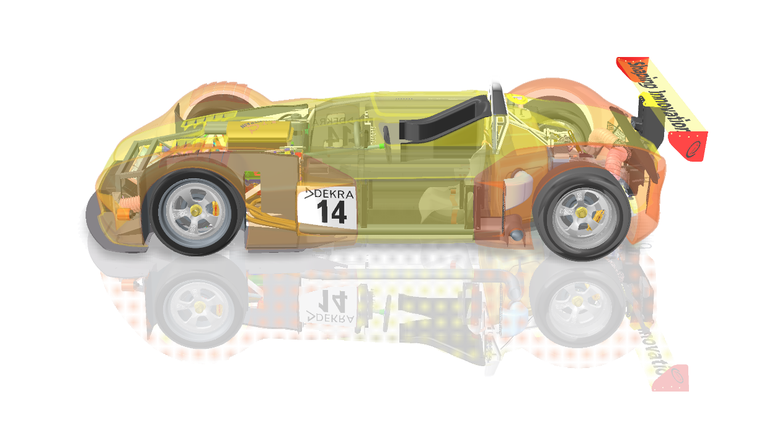
Performance Comparisons
SHADED MODE
1.6X⁵
Challenger 660 Combine, PTC Worldcar, PTC Motorcycle
Intel Xeon E5-1660 @ 3.3Ghz 6-Core, 8GB
Windows 7 x64, 1920x1200
Creo Parametric 2.0 M040
Drivers: AMD FirePro 9.003.3.3, NVidia Quadro 311.50 FPS measured with Fraps 3.4.99

Slide 7
AMD & PTC Relationship

Slide 8
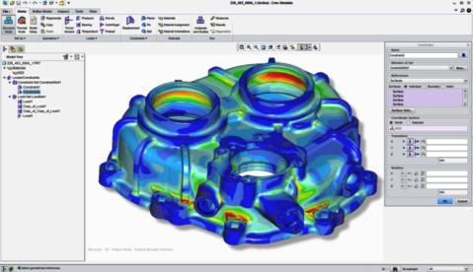
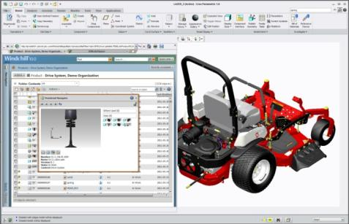
AMD & PTC Relationship
AMD + PTC = Deep technical collaboration
Graphics feature implementation (VBO)
New graphics performance in CP2 vs. CEP/WF5
Reliability for designers and engineers
Strategic commitment
Creo® certification for AMD FireProTM †
 | “Creating innovative products requires innovative graphics design technologies. PTC works closely with AMD to provide Creo® users with the reliability, performance and workflow innovations they need. AMD FirePro™ professional graphics cards are a great choice for Creo users who value a superb workstation-class design experience at a compelling price.” – Mike Campbell, Divisional VP of MCAD Product Management, PTC
† Creo® certification is of a complete system configuration which includes AMD FirePro™ Professional Graphics hardware.

Slide 9
AMD & PTC Relationship
AMD IS A PTC CUSTOMER!
Upgraded from WF5 to Creo 2.0 last year
PTC uses AMD FireProTM in their development process.
 | “As long-time PTC users, the AMD FirePro™ development team have come to count on the power and flexibility that Creo Elements/Pro brings to bear on product design and visualization. This reflects not only on the commitment to the AMD-PTC relationship but also a deep understanding of both the practical and technical end user requirements shared across the PTC end-user community.” – Khalid Sheltami, GPU Product Engineer, AMD

Slide 10
AMD FireProTM & Creo Parametric 2.0 Accelerating Your Workflow

Slide 11
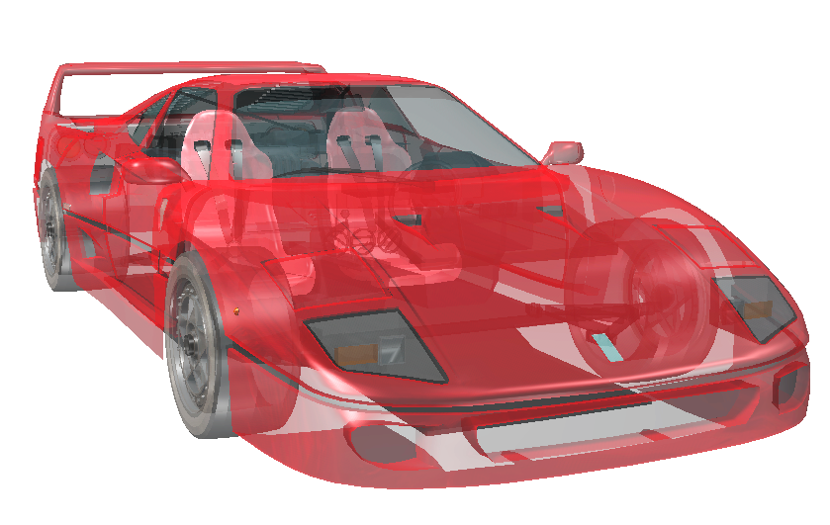
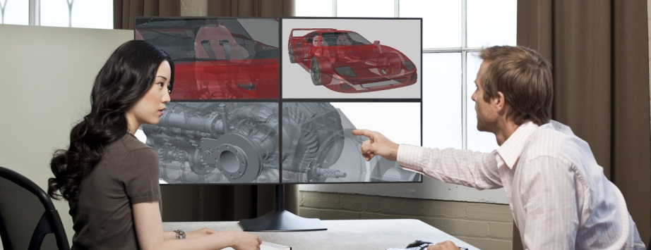
AMD & PTC Relationship
Leading Innovation for 3D CAD Markets
AMD FireProTM collaboration with PTC
Developed new advanced GPU-acceleration
Available only for PTC® Creo® Parametric 2.0 users
“OIT” - GPU-accelerated Transparency mode
“VBO” - “Always-on”, GPU-acceleration

Slide 12
OIT – Order Independent Transparency
Order Independent Transparency or “OIT” is a technique that more accurately renders overlapping semi-transparent objects without having to sort them before being rendered.

Slide 13
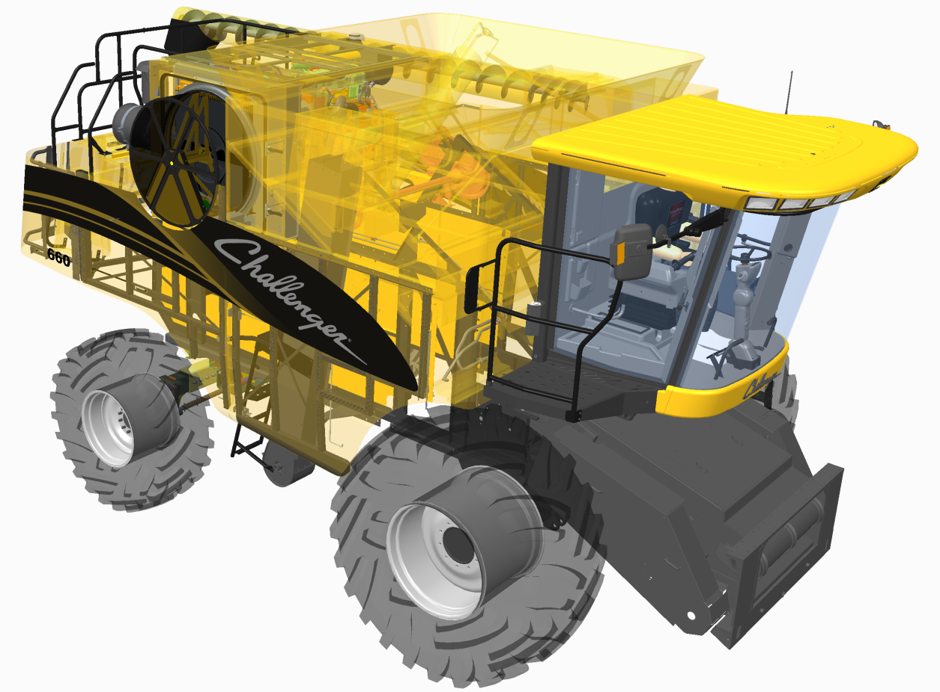
OIT – Order Independent Transparency
GPU-Accelerated Transparency
New for PTC® Creo® Parametric 2.0
Developed for Creo® Parametric 2.0
Up to 23X³ faster performance
Pixel-accurate transparency rendering
Greatly reduced visual artifacts
Exclusive feature to AMD FireProTM cards

Slide 14
OIT – Order Independent Transparency
OIT Functions | End User Experience | Workflow Benefit in Creo® Parametric® 2.0
Transparency Performance | 23X³ faster | Increase productivity Better early design insight Opportunities for new and innovative workflows
Accurate Depth Sorting | Virtually no transparent artifacts compared to Blended mode transparency | Accurate representation of digital model More efficient design inspection

Slide 15
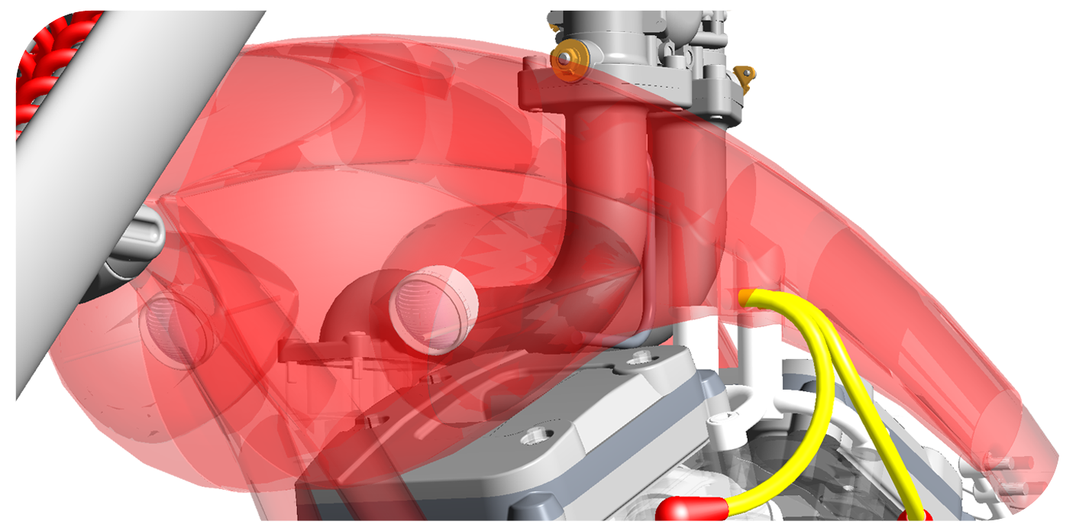
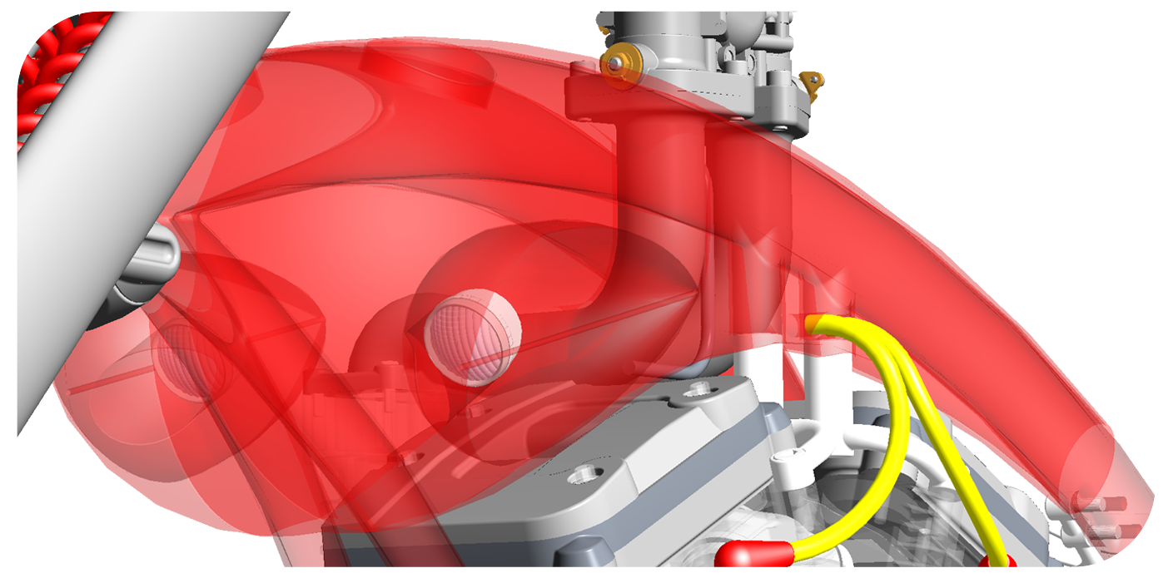
OIT – Order independent Transparency
GPU-accelerated OIT mode enabled!
Standard Blended Transparency Mode
View your model accurately and without visible artifacts!
Visible artifacts and imprecise rendering

Slide 16
Demonstrations

Slide 17
Side-by-side performance comparison
TRANSPARENCY – Challenger 660 Combine
NVidia Quadro K4000
AMD FIREPRO W7000
BLENDED
OIT

Slide 18
Performance by GPU Acceleration Vertex Buffer Objects (VBO)

Slide 19
VBO –vertex buffer object
Vertex Buffer Object
OpenGL™ programming feature
Contains graphics information
Vector, vertex, and color
Resides in video memory
Can be reused
VBOs offer substantial performance gains primarily because the data resides in video memory rather than the system memory, and so it can be rendered directly by the GPU.
GPU

Slide 20
VBO –Vertex Buffer Object
Accelerate Your Creo Parametric 2.0 Workflow with VBO Graphics Performance
VBO Function | End User Experience | Workflow Benefit in Creo® Parametric® 2.0
Advanced OpenGL implementation that leverages GPU acceleration and graphics memory to accelerate graphics performance in Creo® Parametric 2.0 | Dramatically increased frame rates Tested 4X+ faster in shaded mode† | More responsive model interaction Increase your productivity Enjoy a better design experience!
† Based on shaded mode graphics performance benchmark of PTC’s Challenger 660 Combine in Creo Parametric 2.0 (47.3 FPS, with VBO) vs. Pro/ENGINEER Wildfire 5.0 (9.0 FPS, without VBO), measured by AMD’s internal benchmark tool "AMD FRAPS_BENCH". Configuration: Dell T3500, Intel Xeon W3690 3.47Ghz 6-Core, 12GB, AMD FirePro V7900, Windows 7 x64, 1920x1200, AMD Catalyst Pro version 8.911.3.3.

Slide 21
Workflow Productivity AMD Eyefinity Multi-Display Technology

Slide 22
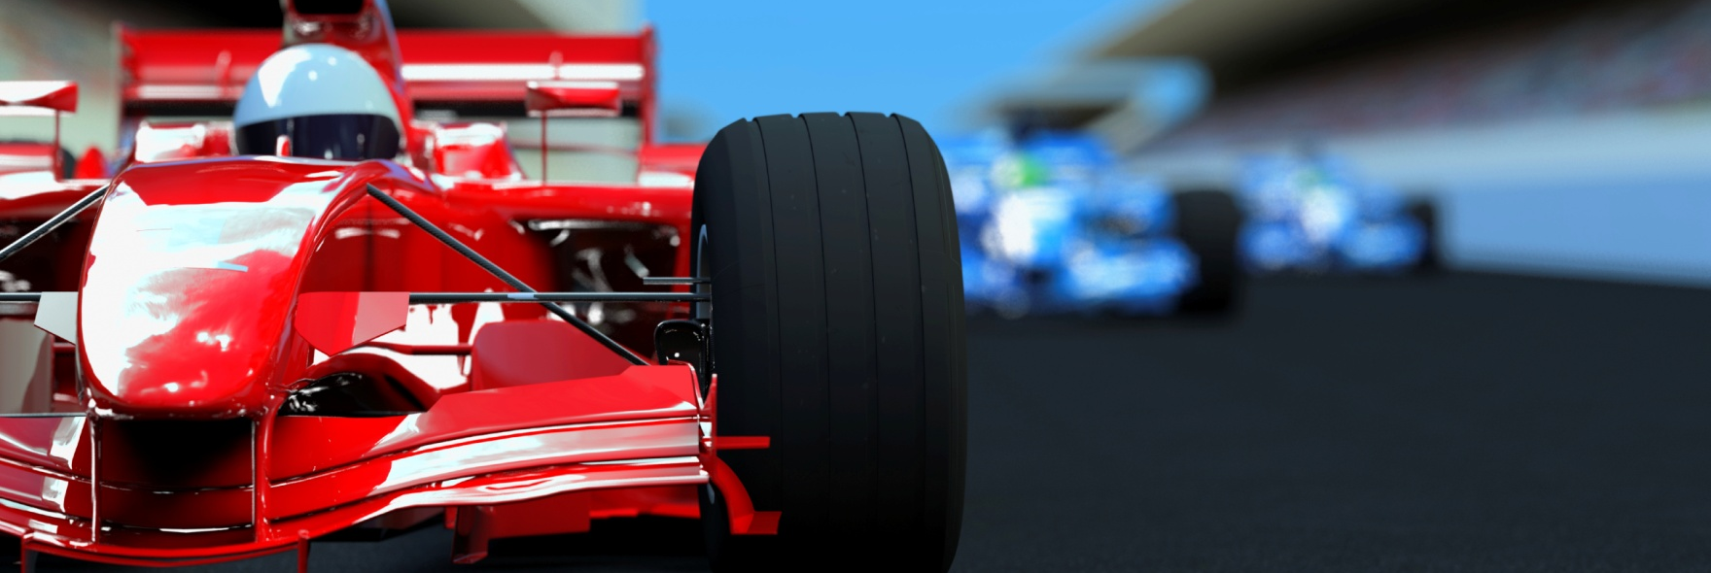
AMD FireProTM Professional Graphics Technologies
Optimized Performance for Professionals

Slide 23
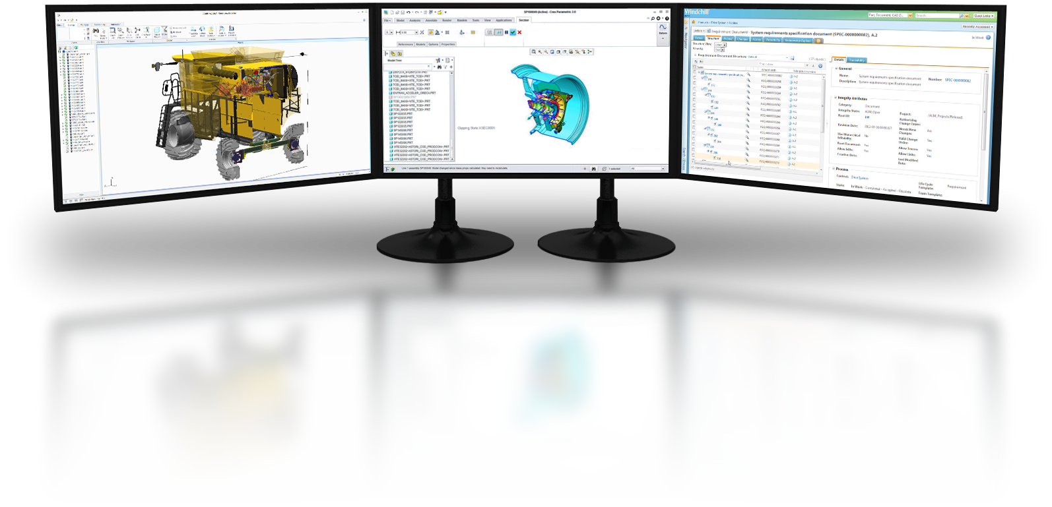
AMD Eyefinity Multiple-Display Technology
See More. Do More.
Stay updated with real-time information
Interact with more applications simultaneously
Work continuously and efficiently
Up to SIX displays⁶ on a single card
Flexible display configurations via CCC
Low total cost of ownership

Slide 24
AMD FireProTM Workstation Graphics Portfolio

Slide 25
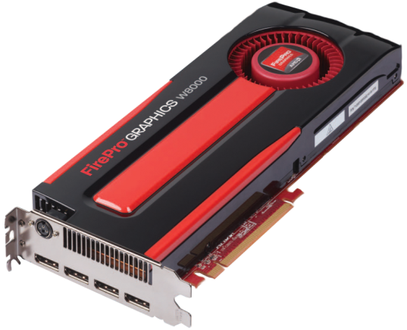
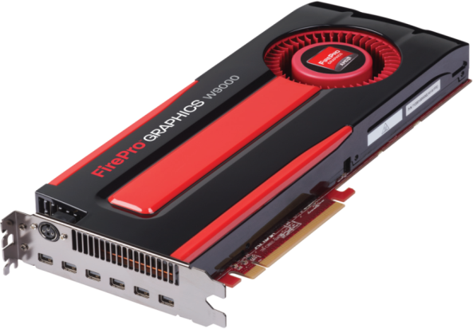
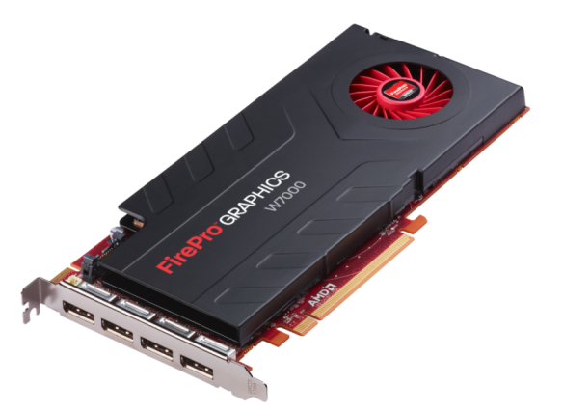
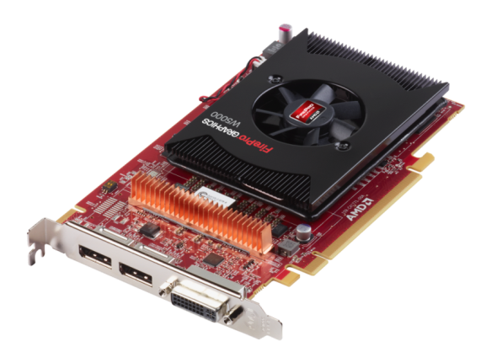
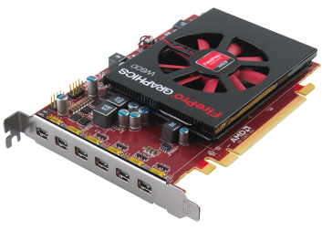
AMD FireProTM Professional Workstation Graphics
Brand New 28nm Architecture: GCN
AMD FireProTM W600
2 GB
Mid-Range + MV
AMD FireProTM W5000
2 GB
Mid-Range
AMD FireProTM W7000
4 GB
High-End
AMD FireProTM W8000
4 GB
High-End
AMD FireProTM W9000
6 GB
Ultra High-End

Slide 26
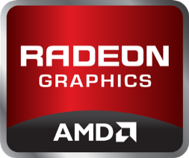
Graphics
Core Next
Notes:
GCN at its core is the basis of a GPU that performs well at both graphical and computing tasks.

Slide 27
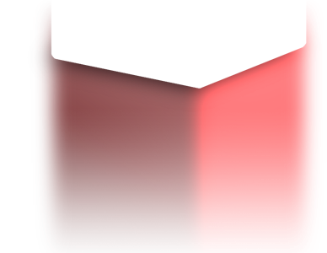
First in Industry standards
32
GB/s
16
GB/s
Bandwidth (GB/s)
8
GB/s
FIRST to PCI-E Gen3
AMD FirePro | GPU acceleration of PTC Creo 2.0 with AMD FirePro graphics | Tuesday June 11, 2013 | PTC live global 2013
27
Notes:
We’re also first to PCI-E 3.0 with our latest generation of graphics products, which provides double the bandwidth compared to PCI-E 2.0.

Slide 28
AMD FireProTM Professional Workstation Graphics
 | AMD FireProTM W5000 | AMD FireProTM W7000 | AMD FireProTM W8000 | AMD FireProTM W9000
Class | Mid-Range | High-End (Hi) | High-End (lo) | Ultra High-End
Predecessor | V5900 | V7900 | V8800 | V9800
Memory | 256-bit 2GB GDDR5 | 256-bit 4GB GDDR5 | 256-bit 4GB GDDR5 ECC | 384-bit 6GB GDDR5 ECC
Display Connectors | 2X DP 1X DL-DVI 3D Stereo | 4X DP 3D Stereo Framelock/Genlock | 4X DP 3D Stereo Framelock/Genlock | 6X Mini-DP 3D Stereo Framelock/Genlock
Max Power Consumption | 75W | 150W | 189W | 274W
Form Factor | Single-Slot | Single-Slot | Double-Slot | Double-Slot

Slide 29
footnotes
¹ 18 times faster transparency graphics performance running PTC’s Challenger 660 Combine assembly in Creo Parametric 2.0 M040 (50.4 FPS, OIT mode) vs. Creo Elements Pro 5.0 M170 (2.7 FPS, blended mode), measured by AMD’s internal benchmark tool "AMD FRAPS_BENCH". Configuration: Dell T3600, Intel Xeon E5-1660 3.3Ghz 6-Core, 8GB, AMD FirePro W9000, Windows 7 x64, 1920x1200, AMD Catalyst Pro version 9.003.3.3, FPS measured with Fraps 3.4.99. FP-28
² 6 times faster transparency graphics performance of AMD FirePro W7000 (OIT mode) vs. NVidia Quadro K4000 (blended mode) running PTC’s Challenger 660 Combine assembly in Creo Parametric 2.0 M040 (46.8 FPS) vs. Creo Elements Pro 5.0 M170 (7.5 FPS), measured by AMD’s internal benchmark tool "AMD FRAPS_BENCH". Configuration: Dell T3600, Intel Xeon E5-1660 3.3Ghz 6-Core, 8GB, Windows 7 x64, 1920x1200, AMD Catalyst Pro version 9.003.3.3, NVidia Quadro driver version 311.50, FPS measured with Fraps 3.4.99. FP-28
³ 23 times faster transparency graphics performance running PTC’s Motorcycle assembly in Creo Parametric 2.0 M040 (73.6 FPS, OIT mode) vs. Creo Elements Pro 5.0 M170 (3.2 FPS, blended mode), measured by AMD’s internal benchmark tool "AMD FRAPS_BENCH". Configuration: Dell T3600, Intel Xeon E5-1660 3.3Ghz 6-Core, 8GB, AMD FirePro W9000, Windows 7 x64, 1920x1200, AMD Catalyst Pro version 9.003.3.3, FPS measured with Fraps 3.4.99. FP-28
⁴ 5 times faster transparency graphics performance of AMD FirePro W7000 (OIT mode) vs. NVidia Quadro K4000 (blended mode) running PTC’s Motorcycle assembly in Creo Parametric 2.0 M040 (67.2 FPS) vs. Creo Elements Pro 5.0 M170 (12.7 FPS), measured by AMD’s internal benchmark tool "AMD FRAPS_BENCH". Configuration: Dell T3600, Intel Xeon E5-1660 3.3Ghz 6-Core, 8GB, Windows 7 x64, 1920x1200, AMD Catalyst Pro version 9.003.3.3, NVidia Quadro driver version 311.50, FPS measured with Fraps 3.4.99. FP-28
⁵ 1.6 times faster shaded graphics performance of AMD FirePro W7000 vs. NVidia Quadro K4000 running PTC’s Worldcar assembly in Creo Parametric 2.0 M040 (160.8 FPS) vs. Creo Elements Pro 5.0 M170 (100.8 FPS), measured by AMD’s internal benchmark tool "AMD FRAPS_BENCH". Configuration: Dell T3600, Intel Xeon E5-1660 3.3Ghz 6-Core, 8GB, Windows 7 x64, 1920x1200, AMD Catalyst Pro version 9.003.3.3, NVidia Quadro driver version 311.50, FPS measured with Fraps 3.4.99. FP-28
⁶ AMD Eyefinity technology works with applications that support non-standard aspect ratios, which is required for panning across multiple displays. To enable more than two displays, additional panels with native DisplayPort connectors, and/or DisplayPort compliant active adapters to convert your monitor’s native input to your cards DisplayPort or Mini-DisplayPort connector(s), are required. AMD Eyefinity technology can support up to 6 displays using a single enabled AMD FirePro™ graphics card with Windows Vista or Windows 7 operating systems – the number of displays may vary by board design and you should confirm exact specifications with the applicable manufacturer before purchase. SLS (“Single Large Surface”) functionality requires an identical display resolution on all configured displays. The AMD FirePro V3900 can support 5 HD displays using AMD Eyefinity and DisplayPort 1.2 multi-streaming technologies (4 x 1920x1080p DisplayPort displays + 1 x DVI) and requires DisplayPort 1.2 multi-streaming-enabled monitors and/or hubs. FP-14

Slide 30
Disclaimer & Attribution
The information presented in this document is for informational purposes only and may contain technical inaccuracies, omissions and typographical errors.
The information contained herein is subject to change and may be rendered inaccurate for many reasons, including but not limited to product and roadmap changes, component and motherboard version changes, new model and/or product releases, product differences between differing manufacturers, software changes, BIOS flashes, firmware upgrades, or the like. AMD assumes no obligation to update or otherwise correct or revise this information. However, AMD reserves the right to revise this information and to make changes from time to time to the content hereof without obligation of AMD to notify any person of such revisions or changes.
AMD MAKES NO REPRESENTATIONS OR WARRANTIES WITH RESPECT TO THE CONTENTS HEREOF AND ASSUMES NO RESPONSIBILITY FOR ANY INACCURACIES, ERRORS OR OMISSIONS THAT MAY APPEAR IN THIS INFORMATION.
AMD SPECIFICALLY DISCLAIMS ANY IMPLIED WARRANTIES OF MERCHANTABILITY OR FITNESS FOR ANY PARTICULAR PURPOSE. IN NO EVENT WILL AMD BE LIABLE TO ANY PERSON FOR ANY DIRECT, INDIRECT, SPECIAL OR OTHER CONSEQUENTIAL DAMAGES ARISING FROM THE USE OF ANY INFORMATION CONTAINED HEREIN, EVEN IF AMD IS EXPRESSLY ADVISED OF THE POSSIBILITY OF SUCH DAMAGES.
ATTRIBUTION
© 2013 Advanced Micro Devices, Inc. All rights reserved. AMD, the AMD Arrow logo and combinations thereof are trademarks of Advanced Micro Devices, Inc. in the United States and/or other jurisdictions. SPEC is a registered trademark of the Standard Performance Evaluation Corporation (SPEC). Other names are for informational purposes only and may be trademarks of their respective owners.

