Slide 1
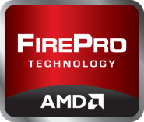
Maximizing PTC Creo 2.0 Performance

Slide 2
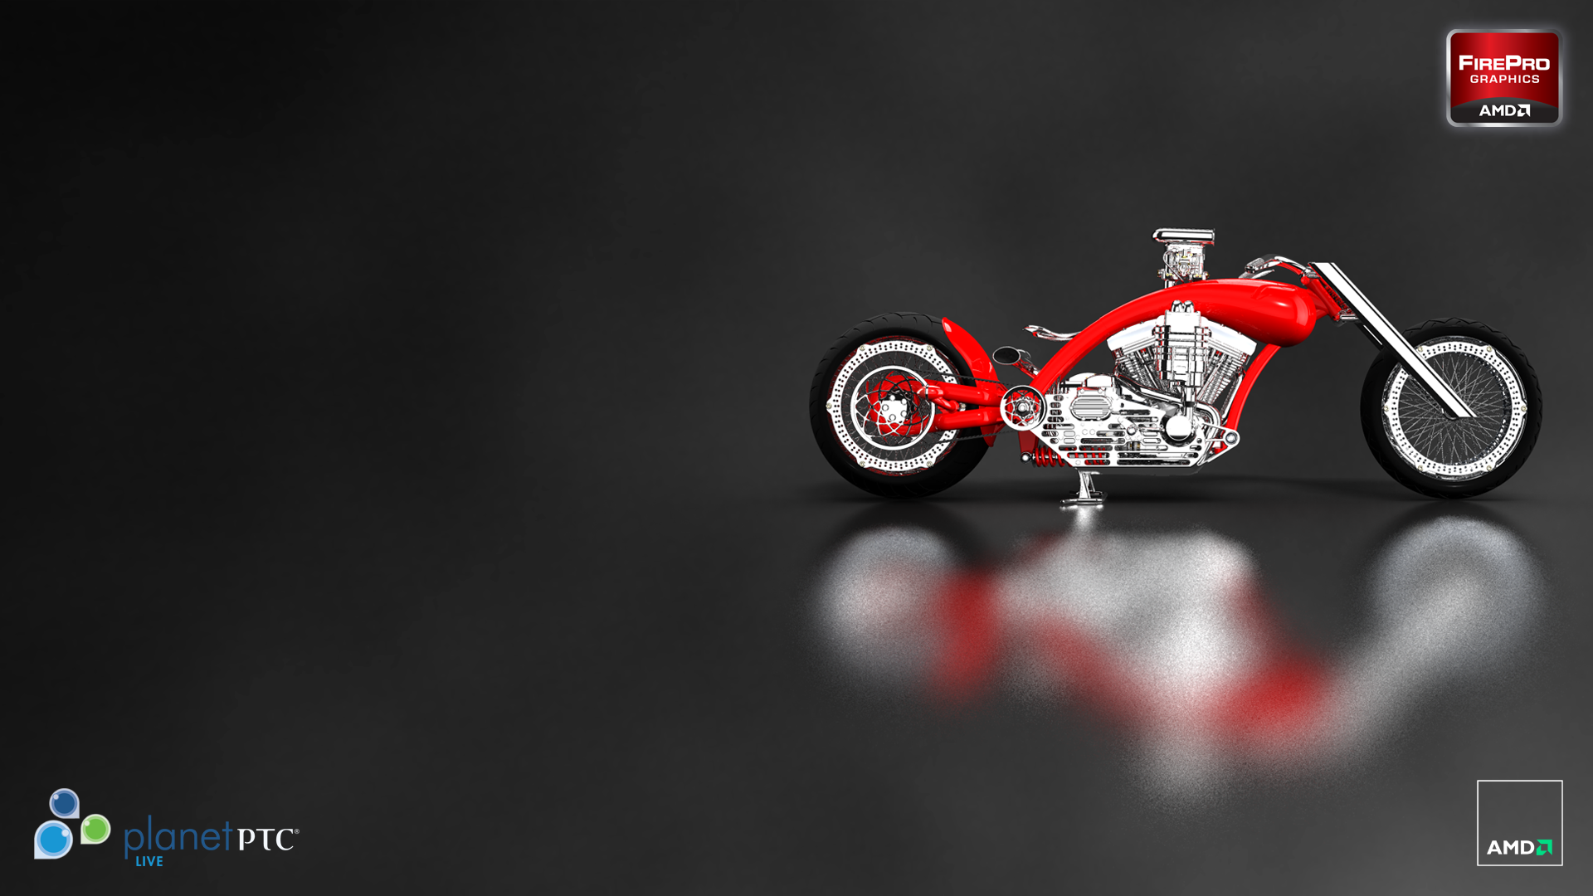
AMD & PTC Zusammenarbeit

Slide 3
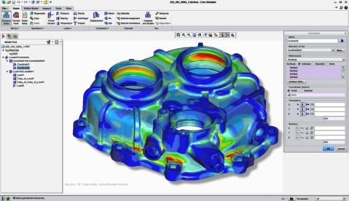
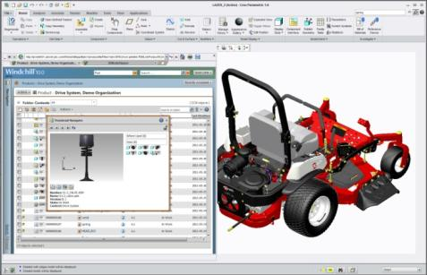
AMD & PTC Zusammenarbeit
AMD + PTC = intensive techn. Zusammenarbeit
Impementierung von neuen Grafikfeatures(VBO)
Neue Grafik Performance in CP2 vs. WF5
Höhere Zuverlässigkeit für Designer und Ingenieure
Strategische Zusammenarbeit
PTC Creo® Zertifizierung für AMD FirePro™ †
“Creating innovative products requires innovative graphics design technologies. PTC works closely with AMD to provide Creo® users with the reliability, performance and workflow innovations they need. AMD FirePro™ professional graphics cards are a great choice for Creo users who value a superb workstation-class design experience at a compelling price.”
– Mike Campbell, Divisional VP of MCAD Product Management, PTC
† Creo® certification is of a complete system configuration which includes AMD FirePro™ Professional Graphics hardware.

Slide 4
AMD & PTC Zusammenarbeit
AMD ist ein PTC Kunde!
Wir führen gerade ein Upgrade auf CP2 vonWF5 durch
PTC setzt AMD FirePro™ in eigener Entwicklung ein.
“As long-time PTC users, the AMD FirePro™ development team have come to count on the power and flexibility that Creo Elements/Pro brings to bear on product design and visualization.
This reflects not only on the commitment to the AMD-PTC relationship but also a deep understanding of both the practical and technical end user requirements shared across the PTC end-user community.”
– Khalid Sheltami, GPU Product Engineer, AMD

Slide 5
AMD FirePro™ & PTC Creo Beschleunigen Sie Ihren Workflow

Slide 6
OIT – Order Independent Transparency
Order Independent Transparency or “OIT” ist eine Technik, die sich überlappende Bereiche im Modell schnell und akurat berechnet und die halb-transparenten Bereiche sofort darstellt, ohne Wartezeiten.

Slide 7
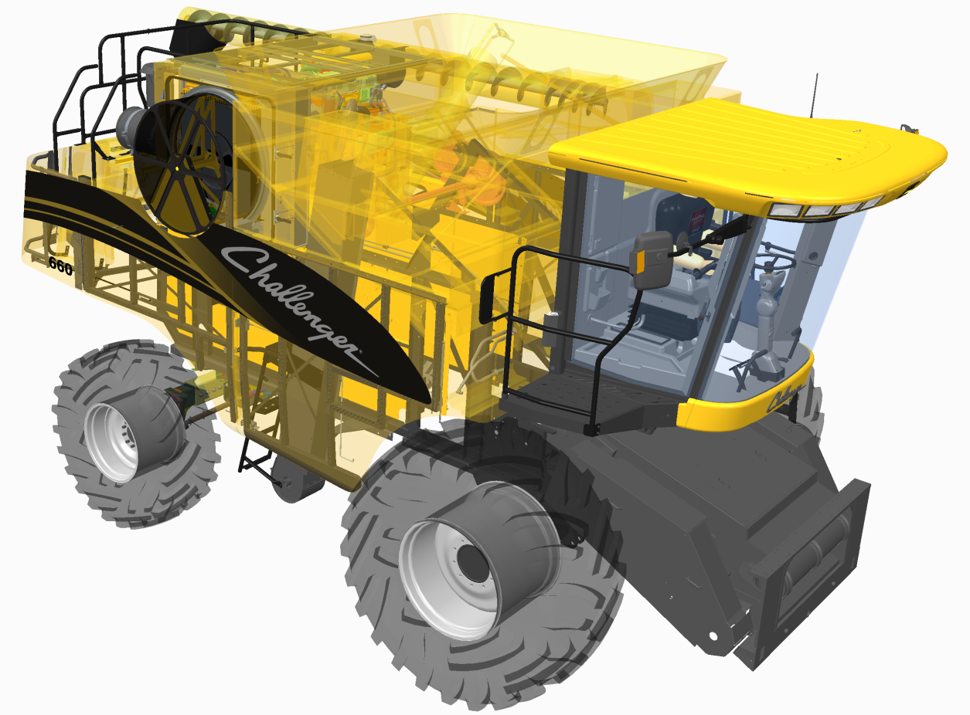
OIT – Order independent Transparency
GPU-Beschleunigter Transparenz Modus
NEU in PTC® Creo®
Entwickelt für PTC Creo®
Bis zu 900%† höhere Performance
Pixel-accurate transparency rendering
Die Artefaktbildung wird wirkungsvoll reduziert
Exclusives Feature nur mit AMD FirePro™ Karten möglich
† 900% faster transparency performance of PTC’s Motorcycle in Creo Parametric 2.0 “OIT” transparency mode (30.9 FPS) vs. Pro/ENGINEER Wildfire 5.0 "Blended" transparency mode (3.0 FPS), measured by AMD’s internal benchmark tool "AMD FRAPS_BENCH".
Configuration: Intel Xeon W3690 3.47Ghz 6-Core, 12GB, AMD FirePro V7900, Windows 7 x64, 1920x1200, AMD Catalyst Pro version 8.911.3.3.
.

Slide 8
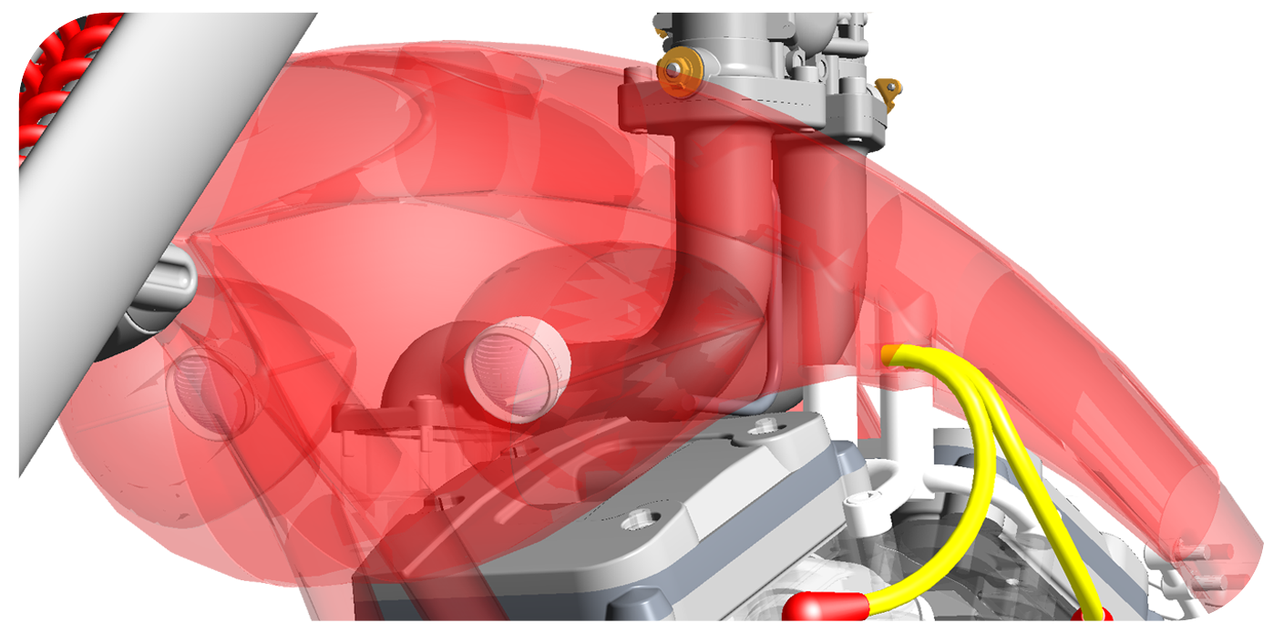
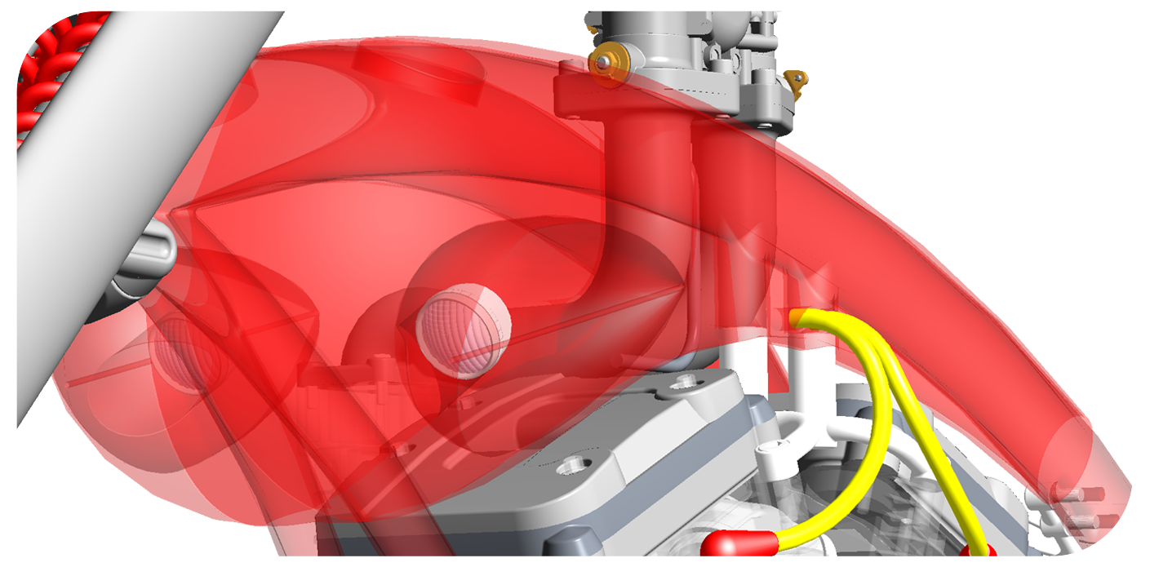
OIT – Order independent Transparency
GPU-accelerated OIT mode eingeschaltet
Standard Blended Transparency Mode
Visible artifacts and imprecise rendering

Slide 9
OIT Transparency Benchmarks

Slide 10
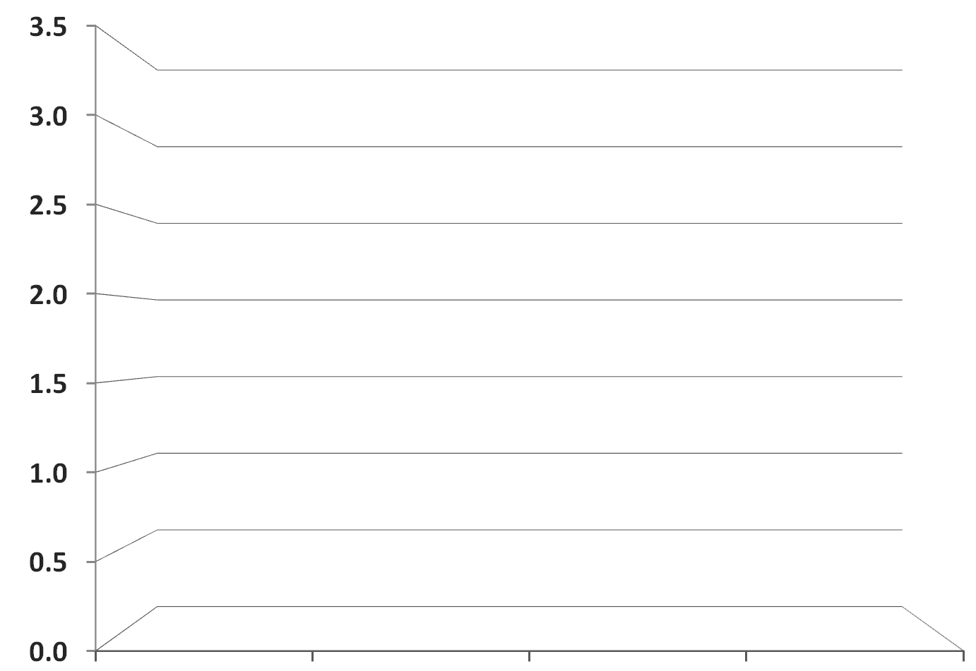
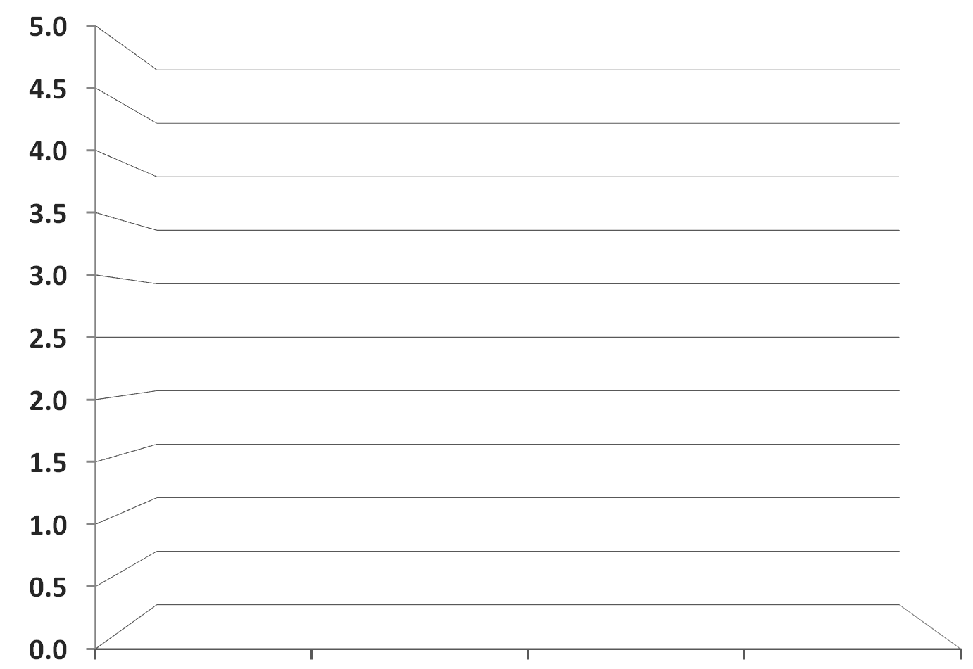
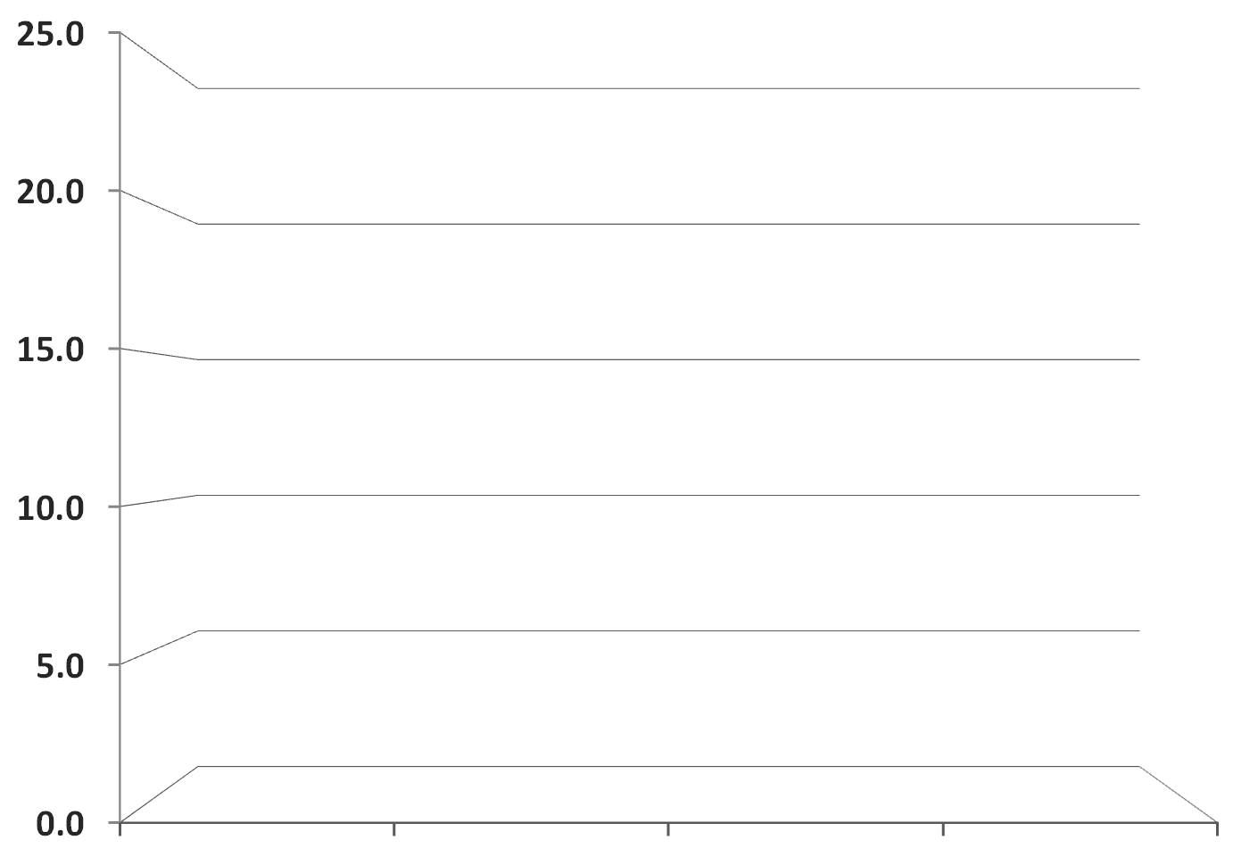
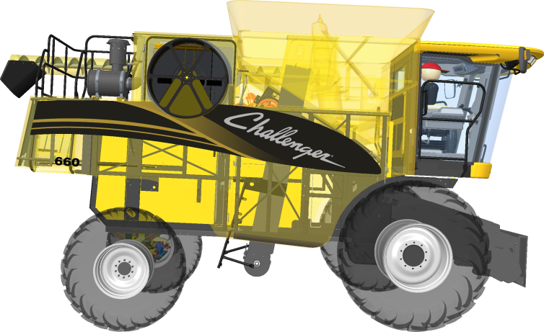
OIT Transparency Benchmarks
Pro/E Wildfire 5.0 - Blended
Challenger 660 Combine
Creo Parametric 2.0 - Blended
Creo Parametric 2.0 - OIT
25
+800%¹
15
12
FPS
10
XTOP Size: 2GB
Challenger 660 Combine
Intel Xeon W3690 3.47Ghz 6-Core, 12GB
Windows 7 x64, 1920x1200
Creo Parametric 2.0 F000, Pro/E Wildfire 5.0 M060
AMD Catalyst Pro version 8.911.3.3 Measured with Fraps 3.4.7
10 | AMD FirePro™ | Maximizing PTC Creo Parametric 2.0 Workstation Performance | PlanetPTC LIVE 2012

Slide 11
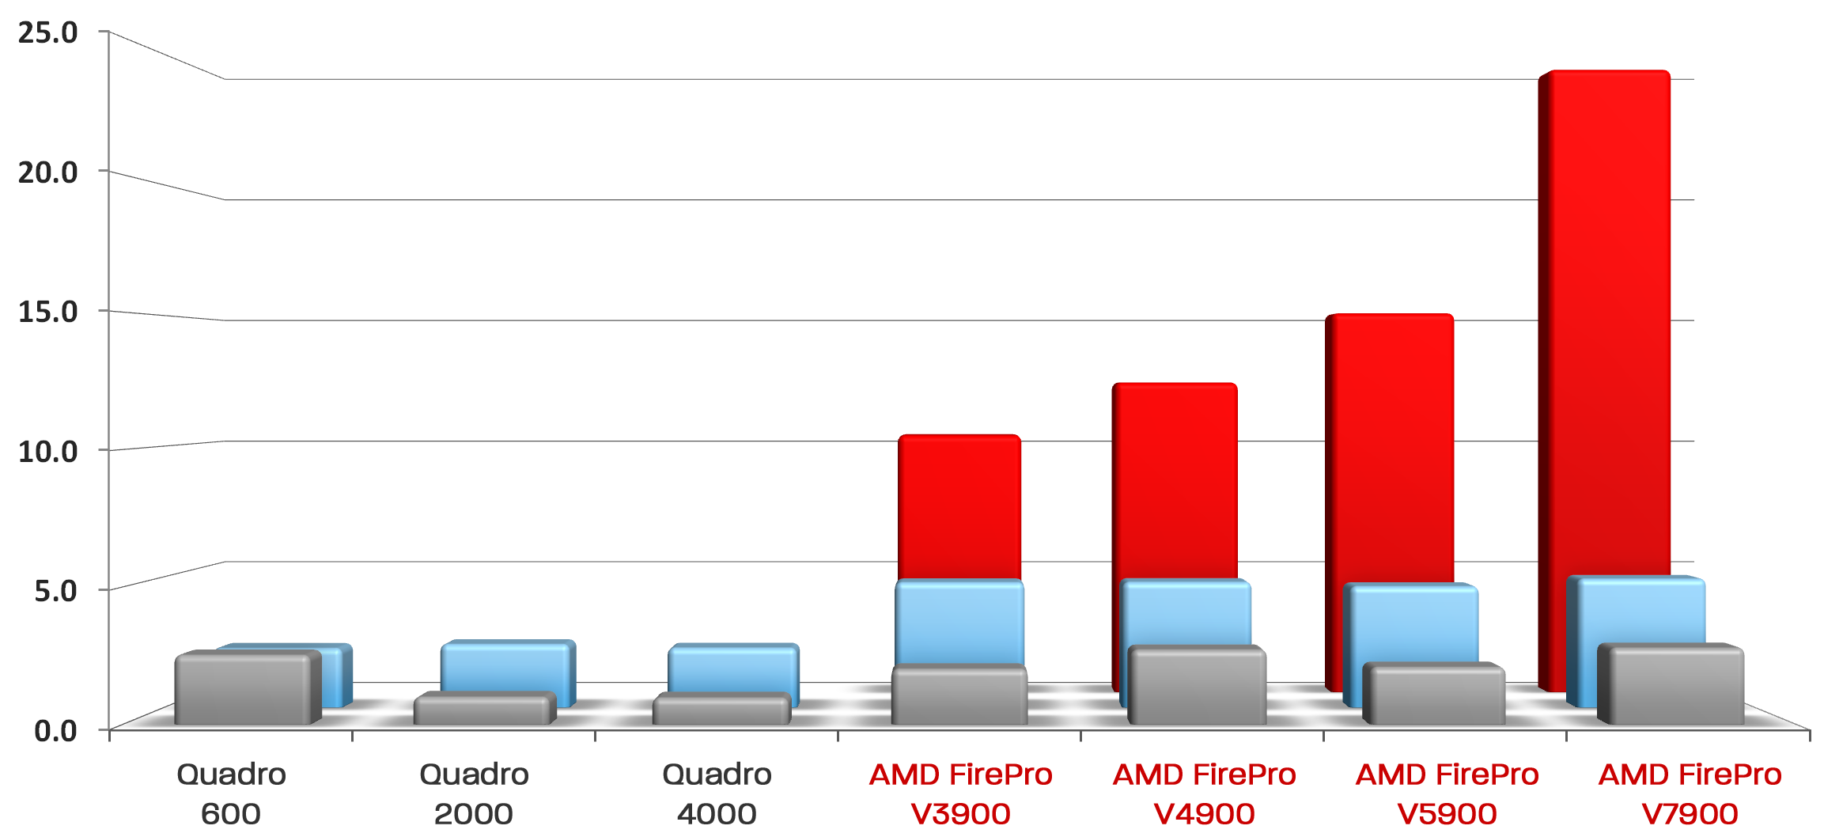
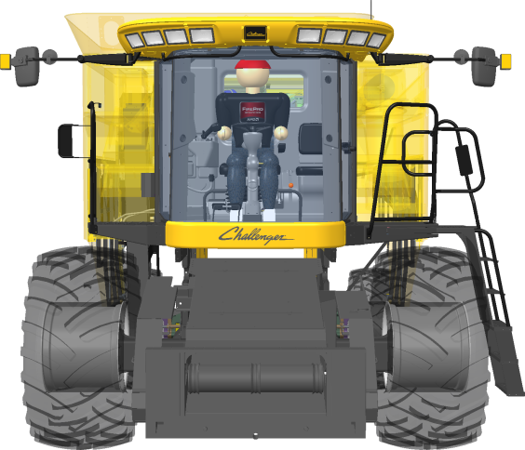
OIT Transparency Benchmarks
Challenger 660 Combine
Pro/E Wildfire 5.0 - Blended
+800%¹
Creo Parametric 2.0 - Blended
Creo Parametric 2.0 - OIT

Slide 12
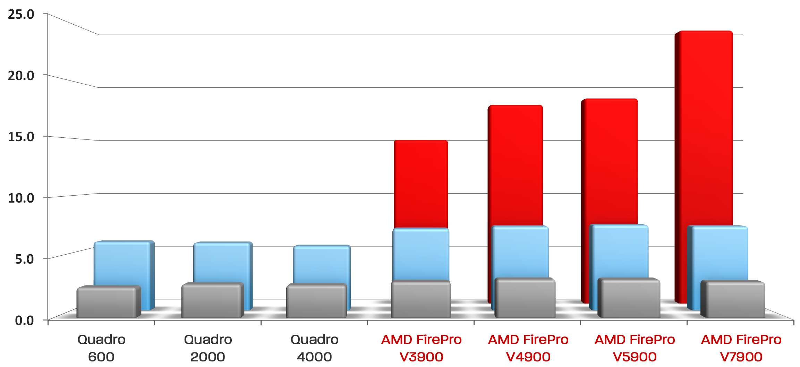
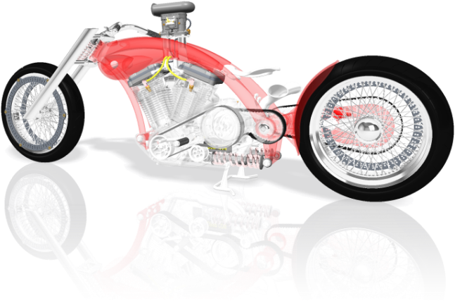
OIT Transparency Benchmarks
PTC Motorcycle
Pro/E Wildfire 5.0 - Blended
+900%²
Creo Parametric 2.0 - Blended
Creo Parametric 2.0 - OIT

Slide 13
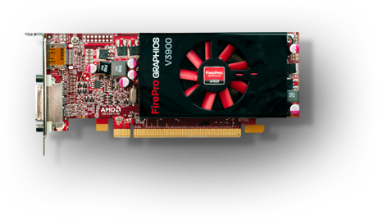
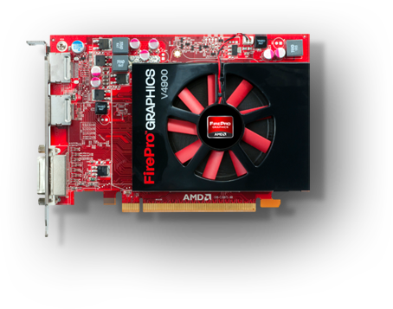
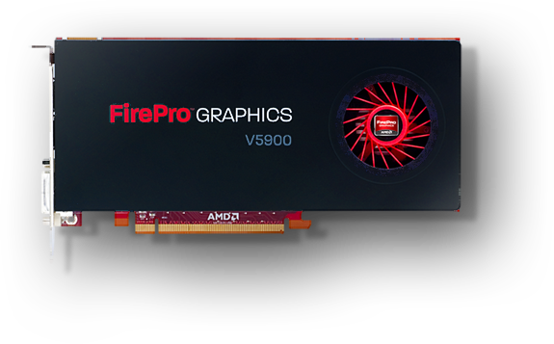
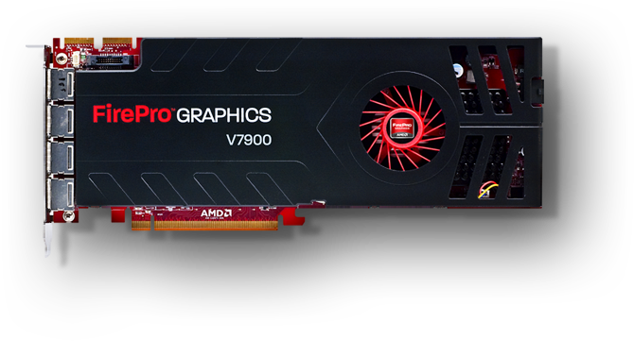
AMD FirePro™ Workstation Portfolio

Slide 14
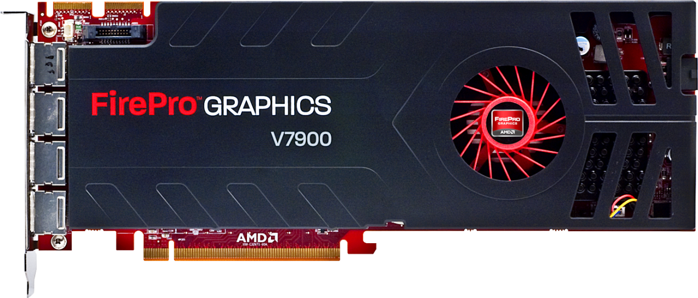
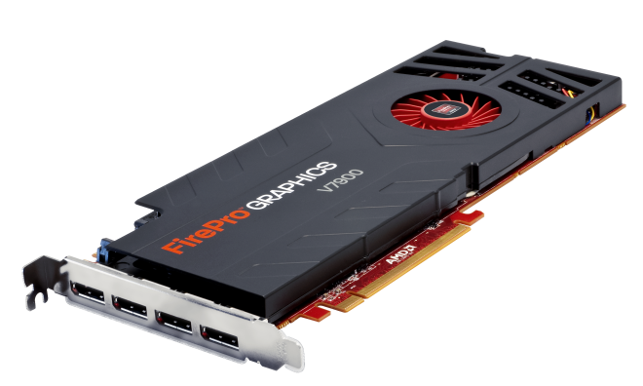
AMD FirePro™ Professional Workstation Grafik
NEU 2011-2012
FirePro V7900
HighEnd Grafik Performance
FirePro V7900
High End Performance
2GB GDDR5 – 160 GB/s
4X DP @ 2560 x 1600
150W
$999 MSRP
Sehr große Projekte
Sehr große “Parts”
komplexe Oberflächen-Geometry
Weitere HighEnd Features (Stereo, GenLock)
PCIe 2.1

Slide 15
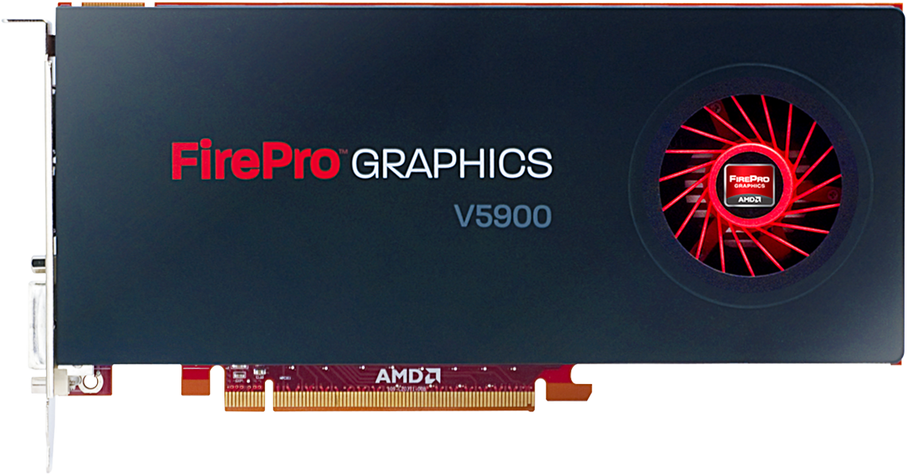
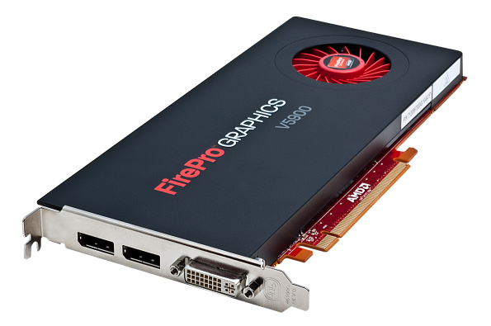
AMD FirePro™ Professional Workstation Grafik
NeU 2011-2012
FirePro V5900
Mid-Range mit High-End Features
FirePro V7900
Mid-Range Performance
2GB GDDR5 – 64 GB/s
2X DP, 1X DVI @ 2560 x 1600
75W
$599 MSRP
PCIe 2.1
Große Projekte
Mittlere Teilegröße

Slide 16
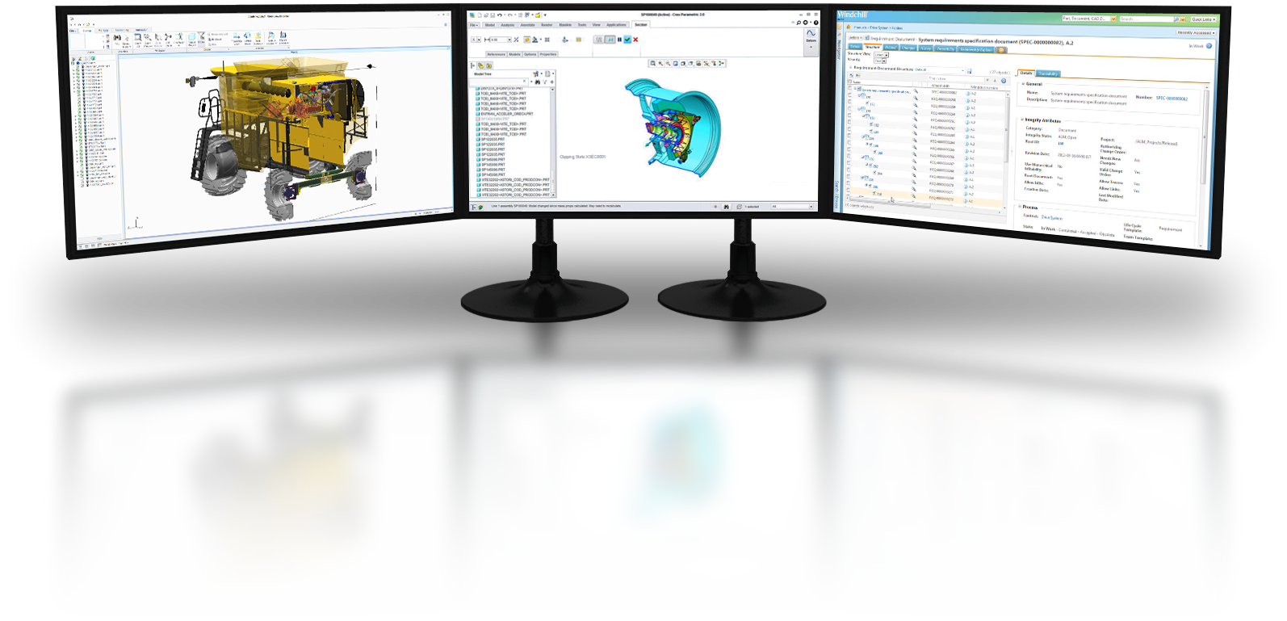
AMD Eyefinity: Mehrschirm - Technologie
“See More. Do More.”
Erhöhen Sie Ihre Produktivität
Volle 3D Performance auf allen Displays
Gleichzeitges Arbeiten in versch. Apps
Bessere Effizienz, schnelleres Arbeiten
Bis zu 6 Bildschirme³ an einer Karte
Flexible Konfigurationen im Treiber
Niedrige Beschaffung/Unterhaltung

Slide 17
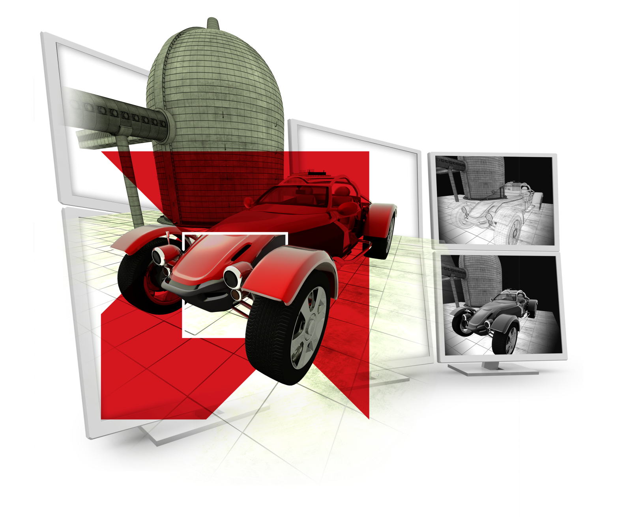
Danke für Ihre Aufmerksamkeit!

Slide 18
FOOTNOTES
¹ Based on a graphics performance benchmark of PTC’s Challenger 660 Combine assembly in Creo Parametric 2.0 (25.3 FPS) vs. Pro/ENGINEER Wildfire 5.0 (2.8 FPS), measured by AMD’s internal benchmark tool "AMD FRAPS_BENCH". Configuration: Dell T3500, Intel Xeon W3690 3.47Ghz 6-Core, 12GB, AMD FirePro V7900, Windows 7 x64, 1920x1200, AMD Catalyst Pro version 8.911.3.3. FP-28
² Based on a graphics performance benchmark of PTC’s Motorcycle assembly in Creo Parametric 2.0 “OIT” transparency mode (30.9 FPS) vs. Pro/ENGINEER Wildfire 5.0 "Blended" transparency mode (3.0 FPS), measured by AMD’s internal benchmark tool "AMD FRAPS_BENCH". Configuration: Dell T3500, Intel Xeon W3690 3.47Ghz 6-Core, 12GB, AMD FirePro V7900, Windows 7 x64, 1920x1200, AMD Catalyst Pro version 8.911.3.3. FP-21
³ AMD Eyefinity technology works with applications that support non-standard aspect ratios, which is required for panning across multiple displays. To enable more than two displays, additional panels with native DisplayPort connectors, and/or DisplayPort compliant active adapters to convert your monitor’s native input to your cards DisplayPort or Mini-DisplayPort connector(s), are required. AMD Eyefinity technology can support up to 6 displays using a single enabled AMD FirePro™ graphics card with Windows Vista or Windows 7 operating systems – the number of displays may vary by board design and you should confirm exact specifications with the applicable manufacturer before purchase. SLS (“Single Large Surface”) functionality requires an identical display resolution on all configured displays. The AMD FirePro V3900 can support 5 HD displays using AMD Eyefinity and DisplayPort 1.2 multi-streaming technologies (4 x 1920x1080p DisplayPort displays + 1 x DVI) and requires DisplayPort 1.2 multi-streaming-enabled monitors and/or hubs. FP-14

Slide 19
DISCLAIMER
The information presented in this document is for informational purposes only and may contain technical inaccuracies, omissions and typographical errors.
The information contained herein is subject to change and may be rendered inaccurate for many reasons, including but not limited to product and roadmap changes, component and motherboard version changes, new model and/or product releases, product differences between differing manufacturers, software changes, BIOS flashes, firmware upgrades, or the like. AMD assumes no obligation to update or otherwise correct or revise this information. However, AMD reserves the right to revise this information and to make changes from time to time to the content hereof without obligation of AMD to notify any person of such revisions or changes.
AMD MAKES NO REPRESENTATIONS OR WARRANTIES WITH RESPECT TO THE CONTENTS HEREOF AND ASSUMES NO RESPONSIBILITY FOR ANY INACCURACIES, ERRORS OR OMISSIONS THAT MAY APPEAR IN THIS INFORMATION.
AMD SPECIFICALLY DISCLAIMS ANY IMPLIED WARRANTIES OF MERCHANTABILITY OR FITNESS FOR ANY PARTICULAR PURPOSE. IN NO EVENT WILL AMD BE LIABLE TO ANY PERSON FOR ANY DIRECT, INDIRECT, SPECIAL OR OTHER CONSEQUENTIAL DAMAGES ARISING FROM THE USE OF ANY INFORMATION CONTAINED HEREIN, EVEN IF AMD IS EXPRESSLY ADVISED OF THE POSSIBILITY OF SUCH DAMAGES.
TRADEMARK ATTRIBUTION
© Copyright 2012 Advanced Micro Devices, Inc. All rights reserved. AMD, the AMD Arrow logo, FirePro, Catalyst, and combinations thereof are trademarks of Advanced Micro Devices, Inc. Microsoft and Windows are registered trademarks of Microsoft Corporation in the United States and other jurisdictions. PTC and Creo are registered trademarks of Parametric Technology Corporation or its subsidiaries in the United States and other countries. Other names are for informational purposes only and may be trademarks of their respective owners. Benchmarking datasets and related images provided courtesy of PTC and AMD. 3D models used for additional graphics design elements provided courtesy of TurboSquid and its vendors.

