Slide 1
AMD FIREPRO™ / CREO 2.0 Sales Deck
April 2012

Slide 2
AMD + PTC A strong and Enduring relationship

Slide 3
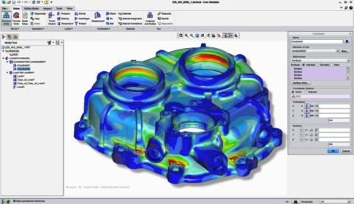
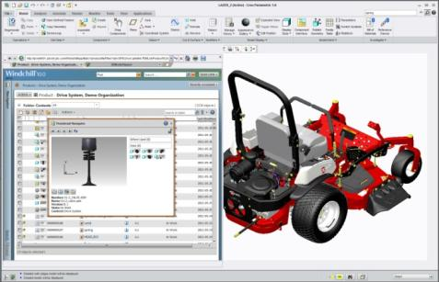
AMD & PTC Relationship
AMD + PTC = Deep technical collaboration for optimized graphics performance, graphics feature implementation, and reliability for designers and engineers
Strategic commitment to the relationship
Creo® certification for AMD FirePro™
“Creating innovative products requires innovative graphics design technologies. PTC works closely with AMD to provide Creo® users with the reliability, performance and workflow innovations they need. AMD FirePro™ professional graphics cards are a great choice for Creo users who value a superb workstation-class design experience at a compelling price.”
– Mike Campbell, Divisional VP of MCAD Product Management, PTC

Slide 4
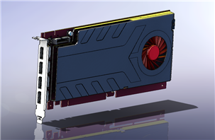
AMD & PTC Relationship
PTC and AMD enjoy a very strong relationship. Both use each other’s products in their development process.
AMD IS A PTC CUSTOMER! Creo® Elements /Pro (previously named Pro/ENGINEER®) is used by AMD design team for the development of AMD FirePro™ graphics cards.
“As long-time PTC users, the AMD FirePro™ development team have come to count on the power and flexibility that Creo Elements/Pro applications bring to bear on product design and visualization.
This reflects not only on the commitment to the AMD-PTC relationship but also a deep understanding of both the practical and technical end user requirements shared across the PTC end-user community.”
- Khalid Sheltami, GPU Product Engineer, AMD

Slide 5
AMD FirePpro & Creo Parametric 2.0 The fruits of our labor

Slide 6
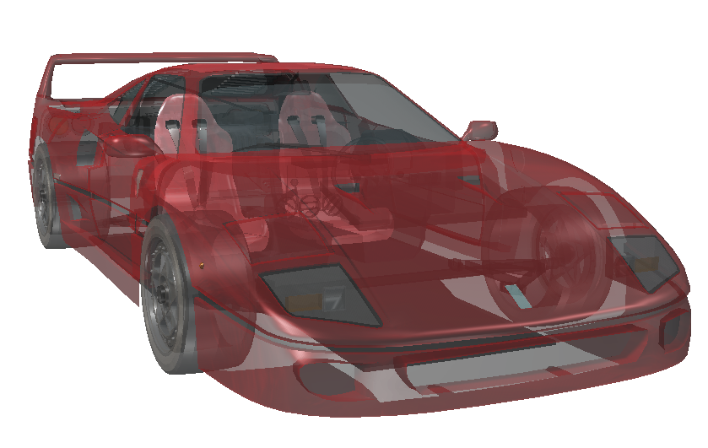
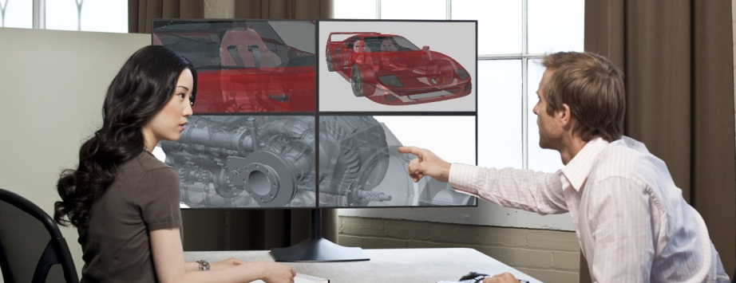
AMD + PTC – leading Innovation for 3D CAD marketspace
AMD FirePro™ team collaborated with PTC on new, advanced GPU-acceleration for PTC® Creo® Parametric 2.0 users
“OIT” - GPU-accelerated Transparency mode
“VBO” - “Always-on”, GPU-accelerated 3D viewport performance enhancements

Slide 7
GPU-accelerated Transparency mode in Creo® Parametric 2.0 via “OIT”

Slide 8
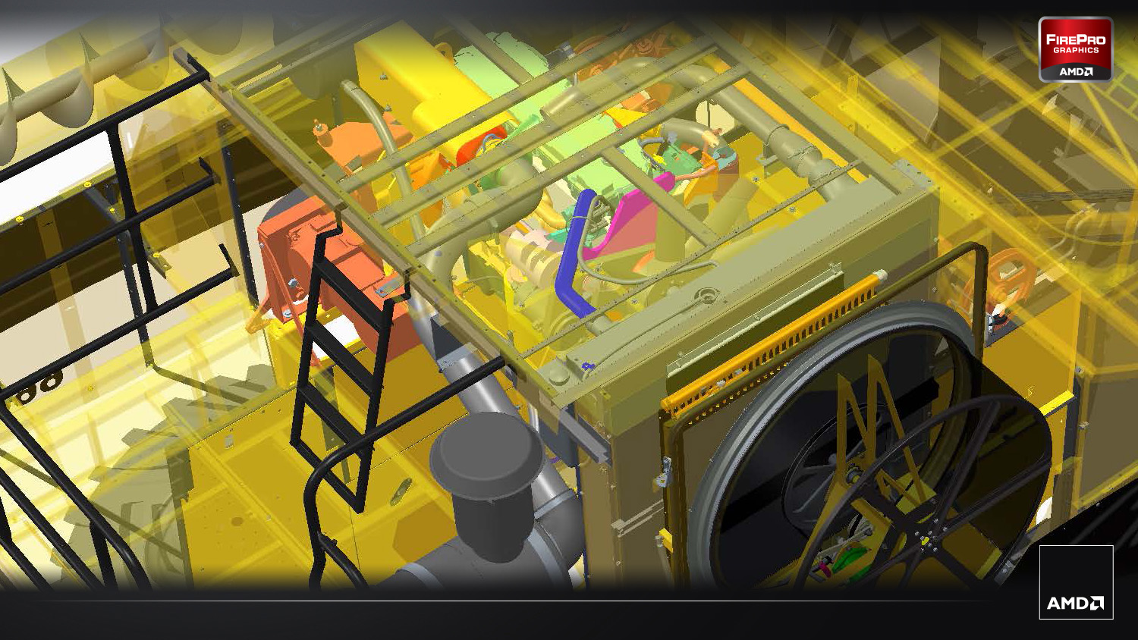
OIT – Order independent Transparency
Order-independent transparency or “OIT” in computer graphics programming terminology denotes any technique that can correctly render overlapping semi-transparent objects without having to sort them before they are being rendered.

Slide 9
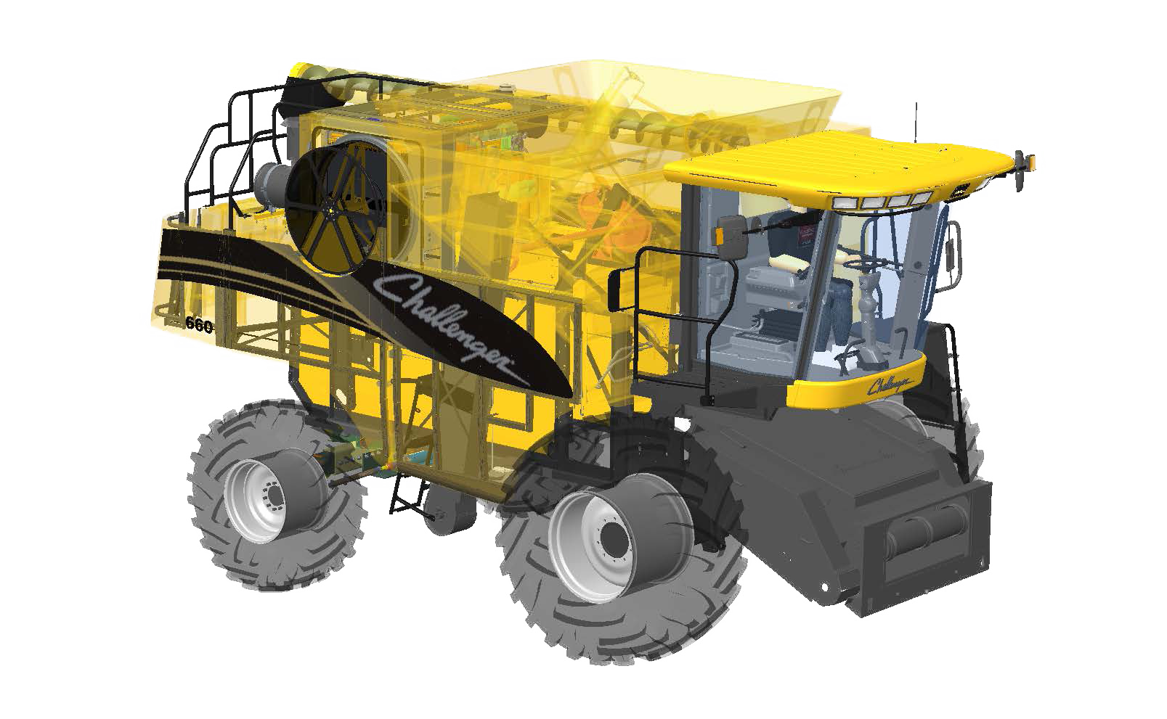
OIT – Order independent Transparency
GPU-accelerated transparency rendering in PTC® Creo® Parametric 2.0 via “OIT”-
Developed for Creo® Parametric 2.0 by AMD FirePro™ team in close collaboration with PTC
Up to 900%+ faster 3D performance with Creo® Parametric 2.0*
Pixel-accurate transparency rendering – (greatly reduced visual artifacting)
Exclusive feature - OIT mode only accessible when using AMD FirePro™ cards
Based on comparison of Creo 2.0 “OIT” mode (25.3 FPS) vs. "blended" transparency mode in Wildfire 5 (2.8 FPS) running internal benchmark, "AMD_FP_Creo_Fraps_Bench," using AMD’s motorcycle dataset and "shaded" mode. Configuration: Dell T3500, Intel Xeon W3690 3.47Ghz 6-Core, 12GB, AMD FirePro V7900, Windows 7 x64, 1920x1200, Driver: AMD Catalyst Pro 8.911.3.3
.

Slide 10
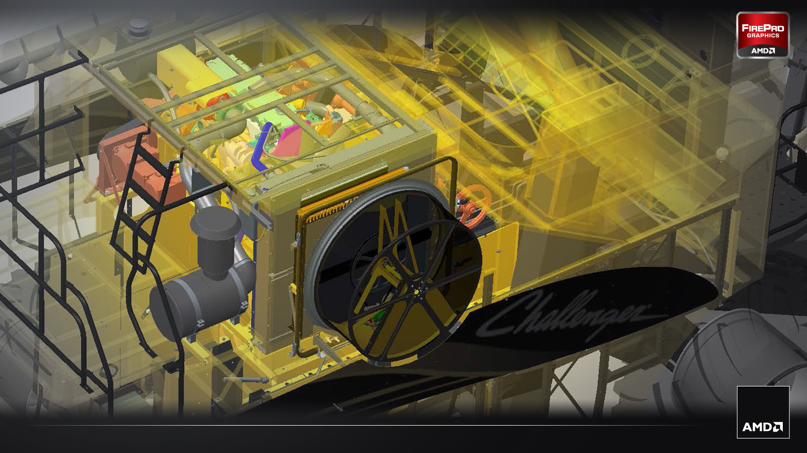
OIT – Order independent Transparency FEATURE
OIT Functions | End User Experience | Workflow Benefit for Creo® Parametric® 2.0 users
Faster transparency rendering | Up to over 900%+ faster 3D performance* | Helps Increase designer productivity Helps improve designer intuition and overall decision-making effectiveness Opens the door for innovative, novel 3D CAD workflows
“Pixel-accurate” depth sorting | Greatly reduced visual artifacting and more nuanced screen rendering | Helps improve designer intuition and overall decision-making effectiveness Proximity and collision analysis is simplified and made more efficient
Based on comparison of Creo 2.0 “OIT” mode (30.9 FPS) vs. "blended" transparency mode in Wildfire 5 (3.0 FPS) running internal benchmark, "AMD_FP_Creo_Fraps_Bench," using AMD’s motorcycle dataset and "shaded" mode. Configuration: Dell T3500, Intel Xeon W3690 3.47Ghz 6-Core, 12GB, AMD FirePro V7900, Windows 7 x64, 1920x1200, Driver: AMD Catalyst Pro 8.911.3.3

Slide 11
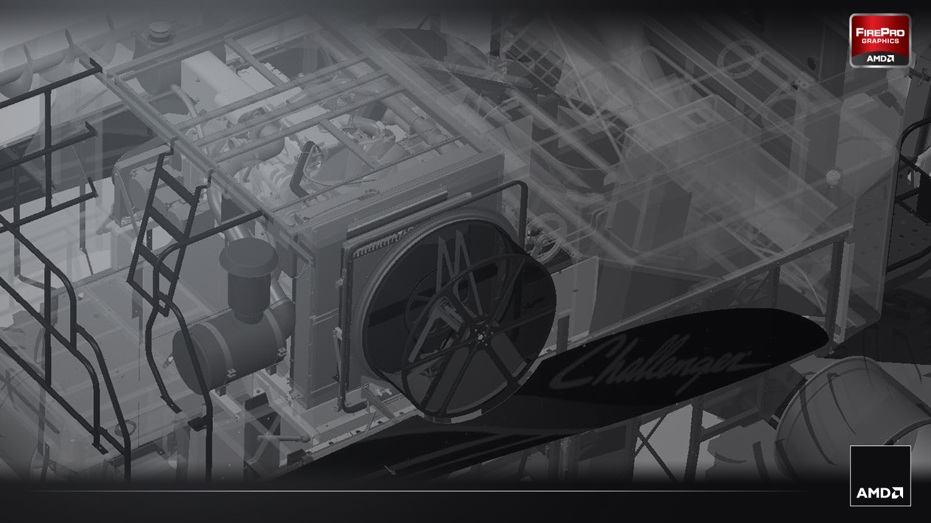
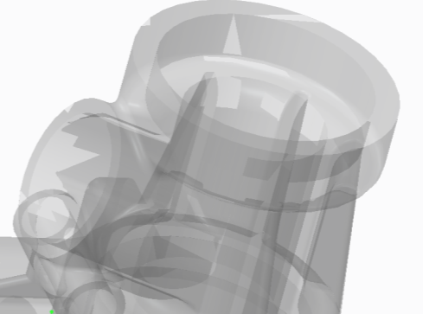
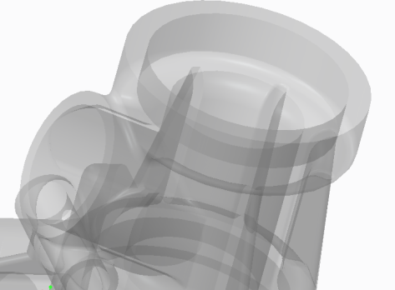
OIT – Order independent Transparency
Less Visual Artifacts !
Standard Blended transparency mode:
GPU-accelerated OIT mode enabled!
Visible artifacts and imprecise rendering
Pixel Accurate rendering without visible artifacts!

Slide 12
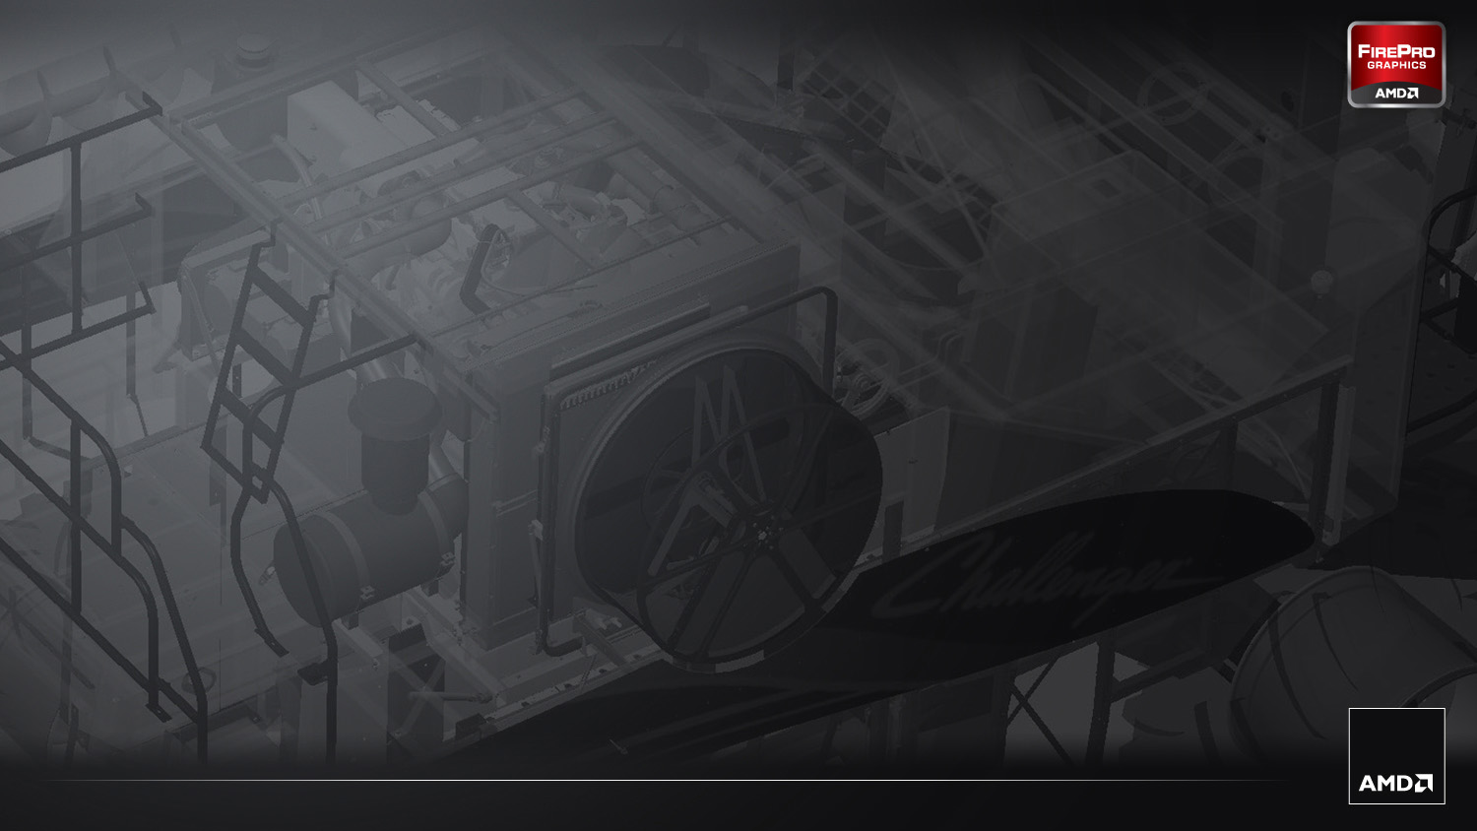
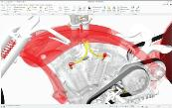
OIT – Benchmarks
Over 900% faster
Transparency Performance (medium sized dataset, shaded mode) measured in frames per second - higher scores = better user interactivity
FPS
Based on comparison of Creo 2.0 “OIT” mode (30.9 FPS) vs. "blended" transparency mode in Wildfire 5 (3.0 FPS) running internal benchmark, "AMD_FP_Creo_Fraps_Bench," using AMD’s motorcycle dataset and "shaded" mode. Configuration: Dell T3500, Intel Xeon W3690 3.47Ghz 6-Core, 12GB, AMD FirePro V7900, Windows 7 x64, 1920x1200, Driver: AMD Catalyst Pro 8.911.3.3

Slide 13
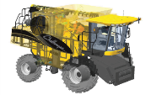
OIT – Benchmarks
Transparency Performance (large dataset, shaded mode) measured in frames per second - higher scores = better user interactivity
Over 800% faster
FPS
Based on comparison of Creo 2.0 “OIT” mode (25.3 FPS) vs. "blended" transparency mode in Wildfire 5 (2.8 FPS) running internal benchmark, "AMD_FP_Creo_Fraps_Bench," using PTC combine dataset and "shaded" mode. Configuration: Dell T3500, Intel Xeon W3690 3.47Ghz 6-Core, 12GB, AMD FirePro V7900, Windows 7 x64, 1920x1200, Driver: AMD Catalyst Pro 8.911.3.3

Slide 14
Full-time GPU-accelerated 3D viewport performance enhancements via “VBO”

Slide 15
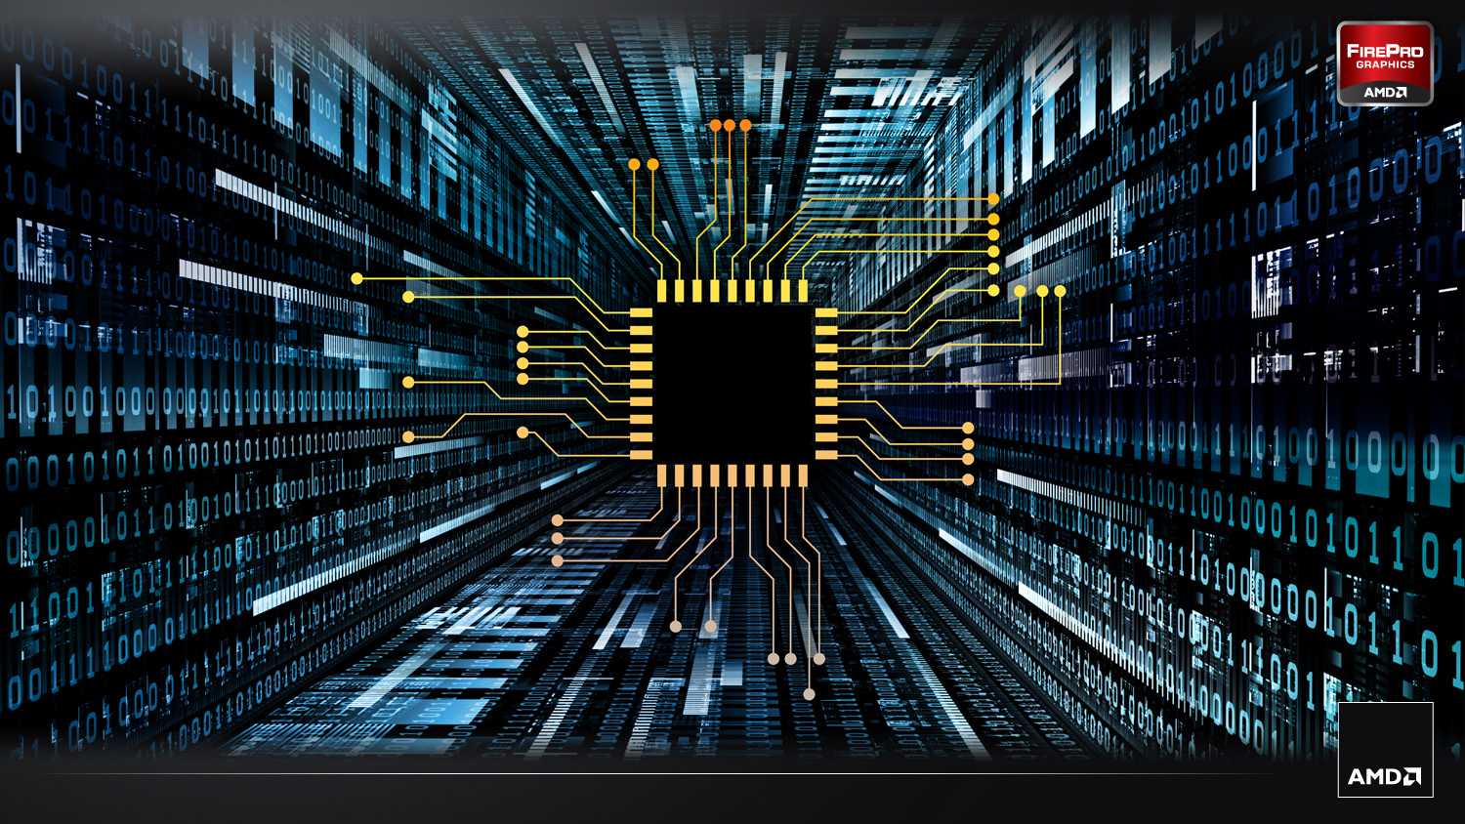
VBO –vertex buffer object
VBOs offer substantial performance gains in the viewport primarily because the data resides in the video device GPU memory rather than the system memory and so it can be rendered directly by the GPU.
Vertex Buffer Object or “VBO” is an OpenGL™ programming feature that provides methods for uploading data (vertex, normal vector, color, etc.) to the video device (GPU) for non-immediate-mode rendering.
GPU

Slide 16
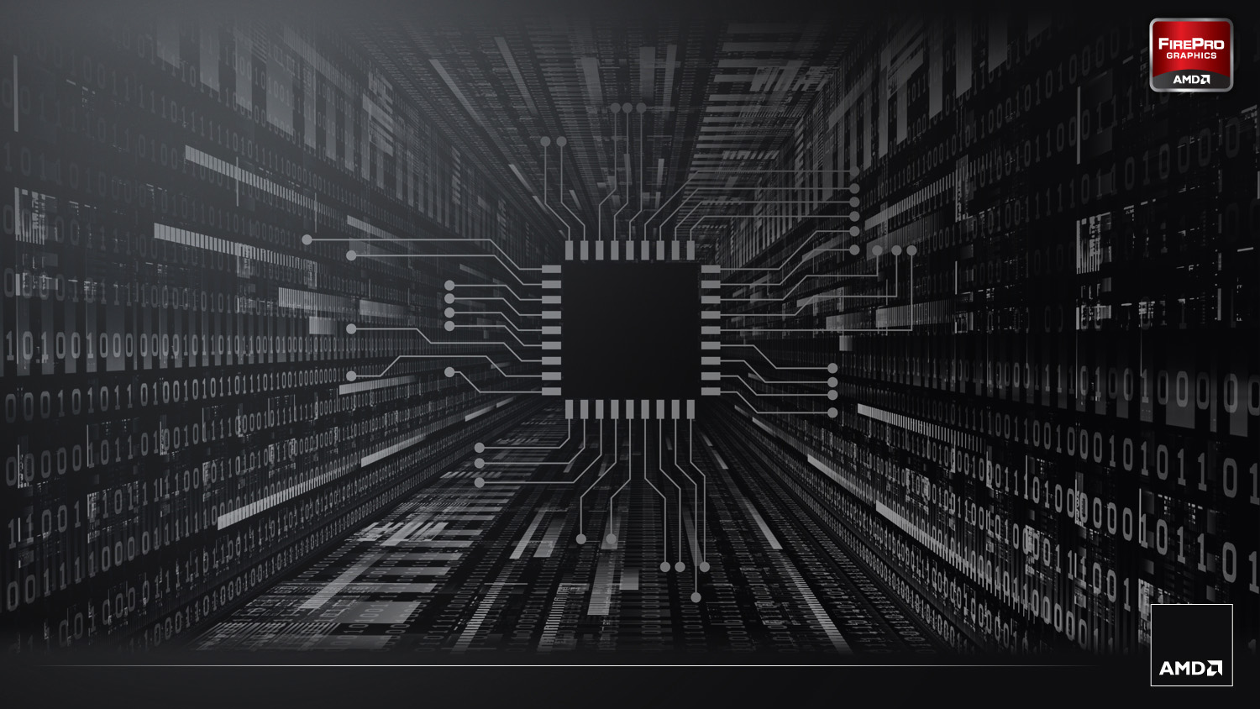
VBO –vertex buffer object FEATURE
“VBO” – GPU-accelerated 3D viewport performance enhancements in Creo
VBO Function | End User Experience | Workflow Benefit for Creo® Parametric® 2.0 users
Advanced OpenGL implementation that leverages GPU acceleration and graphics memory to accelerate 3D viewport performance in Creo® Parametric 2.0 | Dramatically increased (up to 4X+ faster) 3D frame rates* for all display modes | Smooth 3D viewport interactivity increases end-user productivity for a better design experience
Based on comparison of Creo 2.0 (with VBO) (47.3 FPS) vs. Wildfire 5 (without VBO) (9.0 FPS) running internal benchmark, "AMD_FP_Creo_Fraps_Bench," using PTC’s combine dataset and "shaded" mode. Configuration : Dell T3500, Intel Xeon W3690 3.47Ghz 6-Core, 12GB, AMD FirePro V7900, Windows 7 x64, 1920x1200, Drivers: AMD Catalyst Pro 8.911.3.3

Slide 17
VBO –vertex buffer object
GPU-accelerated 3D rendering optimizations in Creo® Parametric 2.0 via “VBO”
“Always-on” GPU-accelerated 3D viewport performance enhancement
Up to over 4X+ faster 3D performance and interactivity vs. Wildfire 5* for all display modes
Developed by AMD and PTC as a joint project
Overcomes CPU-based performance limitations of previous-generation (Pro E / Wildfire 5) 3D viewport
Available to all PTC® Creo® Parametric 2.0 users
Picture to come
Based on comparison of Creo 2.0 (with VBO) (47.3 FPS) vs. Wildfire 5 (without VBO) (9.0 FPS) running internal benchmark, "AMD_FP_Creo_Fraps_Bench," using PTC’s combine dataset and "shaded" mode. Configuration : Dell T3500, Intel Xeon W3690 3.47Ghz 6-Core, 12GB, AMD FirePro V7900, Windows 7 x64, 1920x1200, Drivers: AMD Catalyst Pro 8.911.3.3

Slide 18
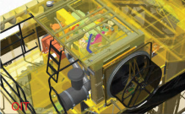
VBO –Benchmarks
Creo® Parametric® 2.0 (VBO) vs. Pro/ENGINEER Wildfire 5.0 (no VBO) (large dataset, shaded mode) measured in frames per second - higher scores = better user interactivity
Over 400% faster
FPS
Based on comparison of Creo 2.0 (with VBO) (47.3 FPS) vs. Wildfire 5 (without VBO) (9.0 FPS) running internal benchmark, "AMD_FP_Creo_Fraps_Bench," using PTC’s combine dataset and "shaded" mode. Configuration : Dell T3500, Intel Xeon W3690 3.47Ghz 6-Core, 12GB, AMD FirePro V7900, Windows 7 x64, 1920x1200, Drivers: AMD Catalyst Pro 8.911.3.3

Slide 19
AMD-PTC 2012 marketing plan

Slide 20
Elements of a Co-marketing Plan
AMD PR/Events around PTC Creo 2.0 Parametric launch
PR - AMD Creo 2.0 OIT press release – at launch time
PlanetPTC Live – AMD sponsorship
Customer reference and Success stories
Working with PTC VARs in the US: NxRev and Tristar
Online Marketing and Collaterals (generate awareness)
Partner reference sheet to PTC sales, white paper, datasheet (APS)
creo.ptc.com blog + videos, AMD and PTC certification websites
Presentation Material
AMD PTC relationship, messaging, and product review
Benchmark data
SpecAPC, AMD automated benchmarks, OCUS, SPECviewperf12
Notes:
PR/Events
PR - AMD Creo 2.0 OIT press release - Timeframe is after launch and GA (end of March) - Need quote from Mike Campbell
Planet PTC Live – AMD sponsorship (participation with HP or Dell?)
Online Marketing and Collaterals (generate awareness)
Partner ref. sheet targeting PTC channel – being developed
Existing AMD Datasheet (APS) – to be revised – need to change quote
Creo.ptc.com blog with following videos examples:
AMD PTC partnership. In progress
OIT in Creo 2 with large assemblies – explain the benefit and the 5 time performance gain over Nvidia (or CPU based transparency)
Importance of graphics (Pro vs. consumer type) with implementation of new technology like VBO
Scalability + move to Creo 2.0 and upgrade HW
wildfire against Creo 2 on a mid range graphics
wildfire against Creo 2 on a high-end graphics
AMD vs. Nvidia
White paper/report/technical brief on performance and benchmarking (technical sales)
Showing performance differentiator
OIT performance gain
Scalability across FirePro cards
Proe5 and Creo2
Customer success story and case study (FirePro and upgrade to Creo 2) – increased performance
AMD and PTC certification websites
Presentation Material
AMD PTC joint presentation (in progress)
Sales presentation
Benchmark data
SpecAPC, AMD automated benchmarks, OCUS, etc

Slide 21
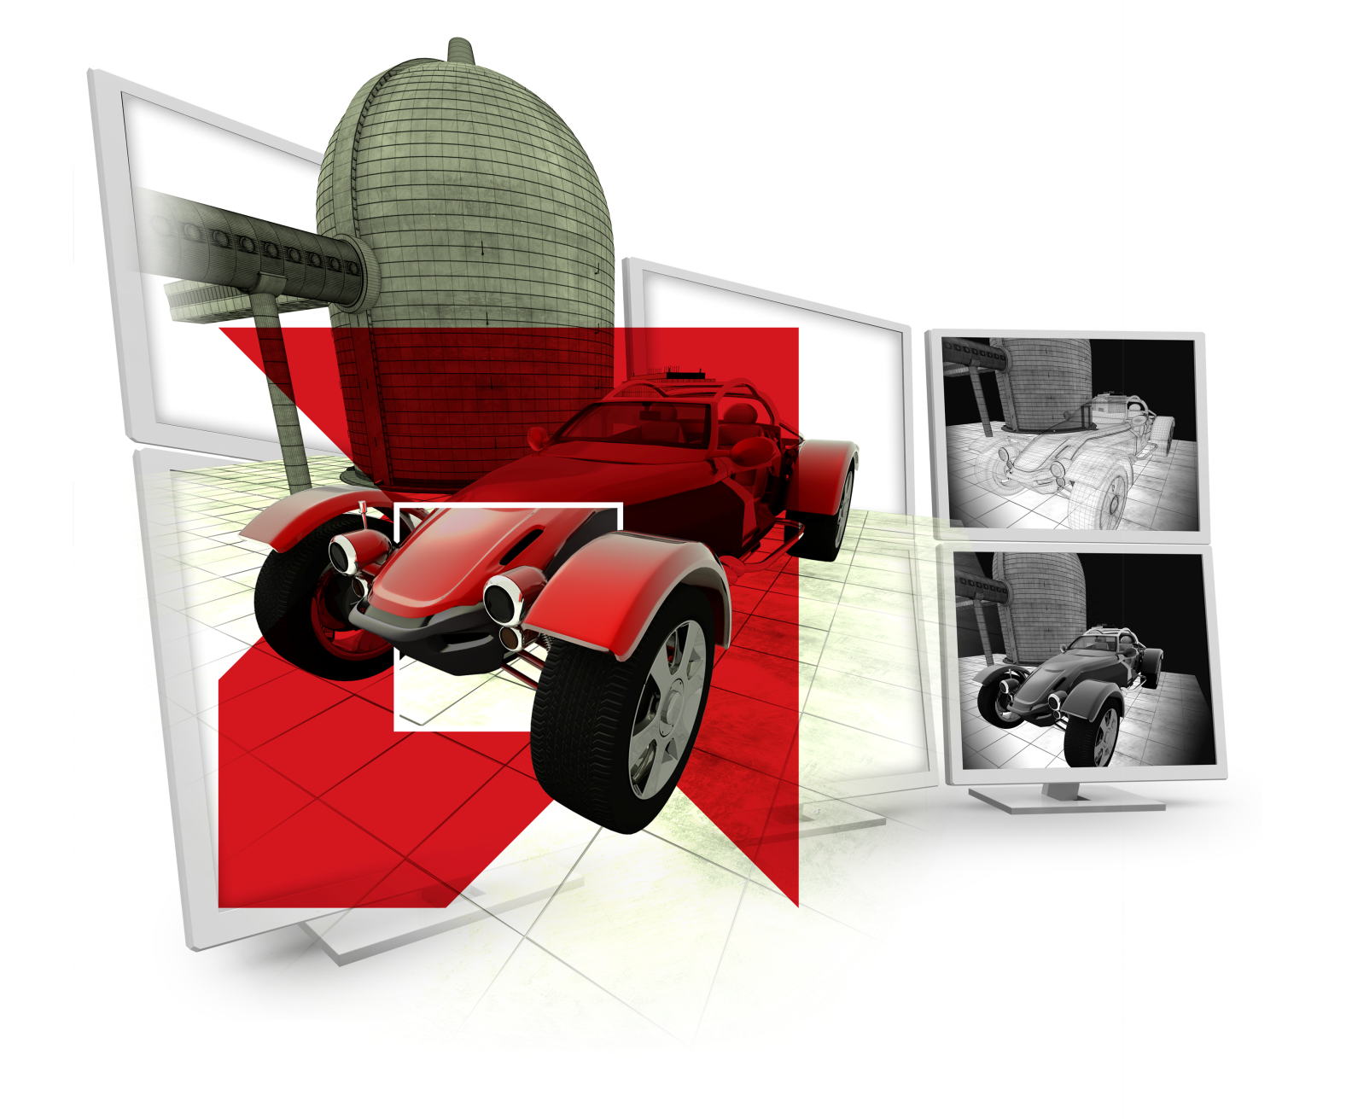
Thank you

Slide 22
DISCLAIMER
The information presented in this document is for informational purposes only and may contain technical inaccuracies, omissions and typographical errors.
The information contained herein is subject to change and may be rendered inaccurate for many reasons, including but not limited to product and roadmap changes, component and motherboard version changes, new model and/or product releases, product differences between differing manufacturers, software changes, BIOS flashes, firmware upgrades, or the like. AMD assumes no obligation to update or otherwise correct or revise this information. However, AMD reserves the right to revise this information and to make changes from time to time to the content hereof without obligation of AMD to notify any person of such revisions or changes.
AMD Eyefinity technology works with applications that support non-standard aspect ratios, which is required for panning across multiple displays. To enable more than two displays, additional panels with native DisplayPort connectors, and/or DisplayPort compliant active adapters to convert your monitor’s native input to your cards DisplayPort or Mini-DisplayPort connector(s), are required. AMD Eyefinity technology can support up to 6 displays using a single enabled AMD FirePro™ graphics card with Windows Vista or Windows 7 operating systems – the number of displays may vary by board design and you should confirm exact specifications with the applicable manufacturer before purchase. SLS (“Single Large Surface”) functionality requires an identical display resolution on all configured displays.
AMD MAKES NO REPRESENTATIONS OR WARRANTIES WITH RESPECT TO THE CONTENTS HEREOF AND ASSUMES NO RESPONSIBILITY FOR ANY INACCURACIES, ERRORS OR OMISSIONS THAT MAY APPEAR IN THIS INFORMATION.
AMD SPECIFICALLY DISCLAIMS ANY IMPLIED WARRANTIES OF MERCHANTABILITY OR FITNESS FOR ANY PARTICULAR PURPOSE. IN NO EVENT WILL AMD BE LIABLE TO ANY PERSON FOR ANY DIRECT, INDIRECT, SPECIAL OR OTHER CONSEQUENTIAL DAMAGES ARISING FROM THE USE OF ANY INFORMATION CONTAINED HEREIN, EVEN IF AMD IS EXPRESSLY ADVISED OF THE POSSIBILITY OF SUCH DAMAGES.
Trademark Attribution
© Copyright 2012 Advanced Micro Devices, Inc. All rights reserved. AMD, the AMD Arrow logo, FirePro, Catalyst, and combinations thereof are trademarks of Advanced Micro Devices, Inc. Microsoft and Windows are registered trademarks of Microsoft Corporation in the United States and other jurisdictions. PTC and Creo are registered trademarks of Parametric Technology Corporation or its subsidiaries in the United States and other countries. Other names are for informational purposes only and may be trademarks of their respective owners. Benchmarking datasets and related images provided courtesy of PTC and AMD. 3D models used for additional graphics design elements provided courtesy of TurboSquid and its vendors.

