Slide 1
Large format lcd displays
Product Overview

Slide 2
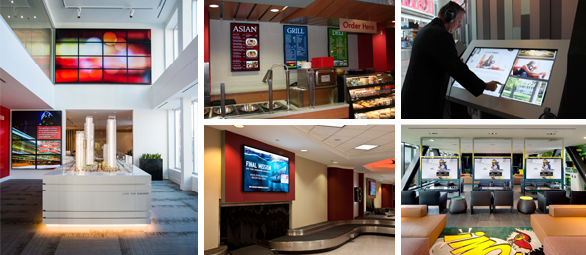
Planar Large Format LCD Displays
Planar’s large format LCD displays are designed for demanding applications with high durability and performance requirements. From communicating information to enhancing ambiance, Planar’s large format LCD display lines are the ideal complement to any retail store, lobby, control room or other professional application.

Slide 3
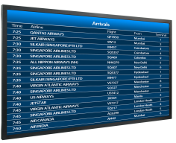
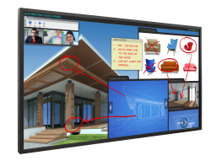




Comprehensive Line
Planar EP-Series
(FHD)
(UHD)
Planar UltraRes Series (UHD)
Planar PS-Series (FHD)
Planar Simplicity Series (FHD)
Planar UltraLux Series (FHD)
32”
42”
46”
55”
58”
65”
70”
80”
82”
84”
98”

Slide 4
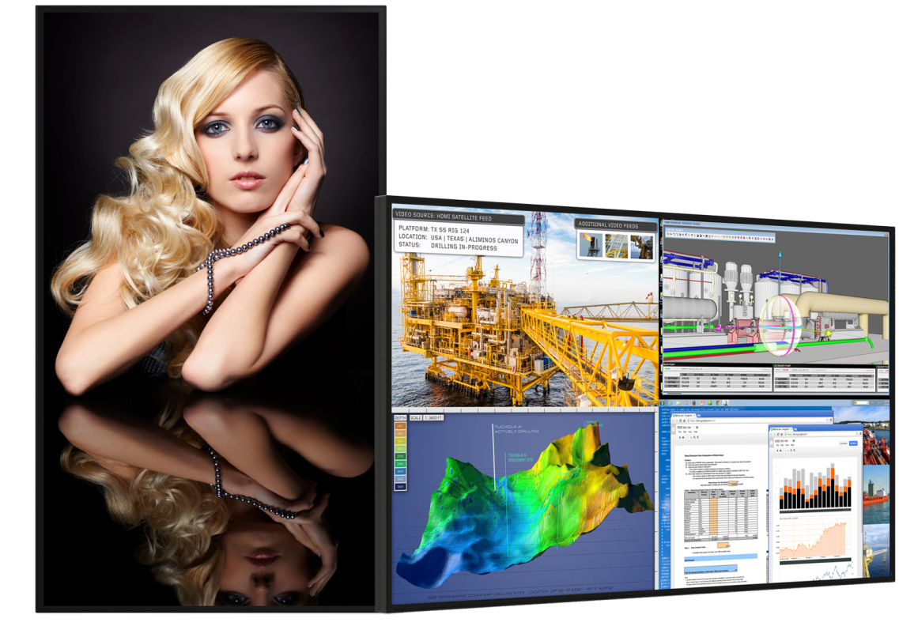
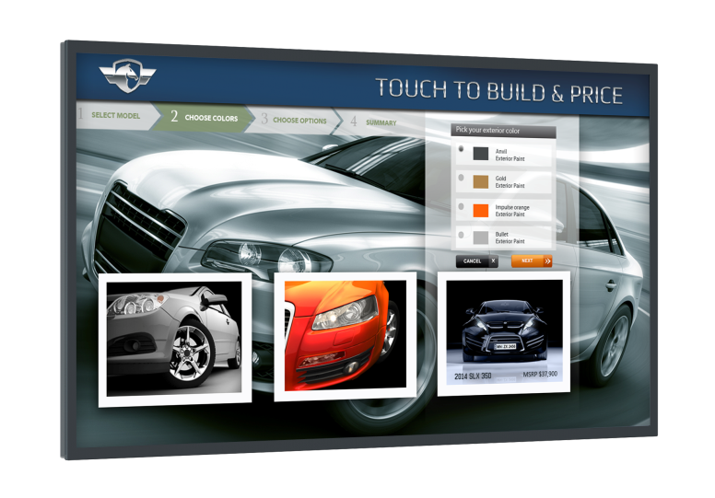
Planar UltraRes Series
Stunning 4K Clarity in Immersive 84" and 98" Sizes
Available in 84" and 98"
3840 x 2160 resolution
Extensive connectivity options
4K @ 60Hz support, including single cable HDMI 2.0
Advanced design for function and style
Fanless, whisper-quiet
350-500 nits of brightness
MediaPlex software for quadrant viewing, upscaling and downscaling
Touch and 3D options available

Slide 5
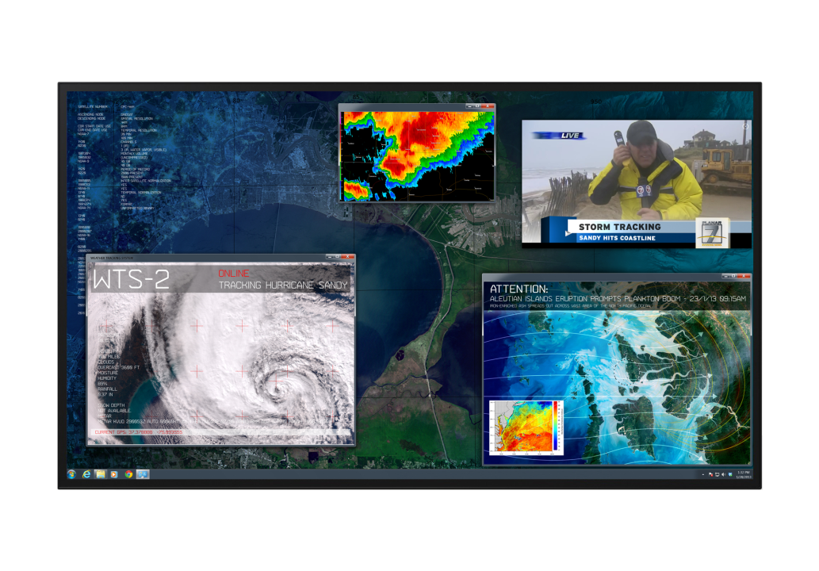

Planar UltraRes Series Differentiators
Extensive connectivity – 4 HDMI, 4 DP
MediaPlex quadrant viewing with upscaling and downscaling
Fanless, whisper-quiet
4K @ 60Hz with single HDMI cable
Ultra -slim profile
Redundant power
Logo-free bezel
Field replaceable components
Easy-to-access inputs using kickstand mode
3D support
Touch options supporting up to 32 touch points
3-Year Advance Exchange warranty

Slide 6

Planar UltraLux Series
State-of-the-Art Digital Signage Displays
Available in 70" and 80"
Modern industrial design
ERO™ edge-to-edge Corning Gorilla Glass option
Ultra-slim ADA-compliant profile
Portrait or landscape orientation
Supports up to 24x7 operation
Efficient power management enables fanless operation and power redundancy
Media player compartment with power
700 nits of brightness

Slide 7
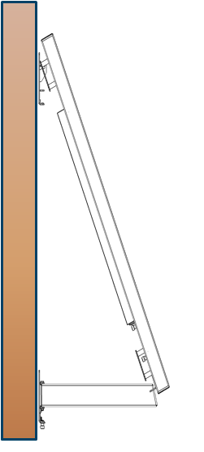
Planar Profile Mounting System
Ultra-Slim Mount with Service Access Mode
Planar Profile Mounting System is available for all Planar UltraRes Series and Planar UltraLux Series displays
Enables a mounting depth of <4 inches from the wall to meet ADA compliance
Locks in place
Pivots open, kick-stand holds
Easy access to cables and removable service components
Landscape and portrait options

Slide 8



Planar EP-Series Ultra HD Displays
High Performance UHD Display Solutions
Available in 58" and 65” models
3840 x 2160 resolution
Supports 4K at up to 30Hz
Reliable for up to 24x7 operation
Supports portrait and landscape orientation
OPS slot enables seamless digital signage integration
Built-in speakers
Narrow, logo-free metal bezel
Touch models available
Whisper-quiet, fanless design
350 nits (65”) and 450 nits (58”) of brightness

Slide 9

Planar EP-Series Full HD Displays
High Performance Full HD Display Solutions
Available in 46" and 55” models
Suitable for up to 24x7 operation
700 nits of brightness for higher ambient
light environments
Narrow, logo-free metal bezel
Eco-friendly, fanless design
Wide array of connectivity options
Supports portrait and landscape orientation
Built-in speakers
Optional SDI inputs available for broadcast customers
Optional loop out connectors for
video wall installations

Slide 10

Planar PS-Series
Commercial-Grade Digital Signage Displays
Available in 46", 55", 65“, 70“, and 82”
Full HD resolution
Supports up to 24x7 operation
450-500 nits of brightness
Built-in speakers
Comprehensive set of inputs and control
Logo-free metal bezels
Ultra-slim and energy efficient LED backlight
Select models available with USB playback
Touch models available

Slide 11
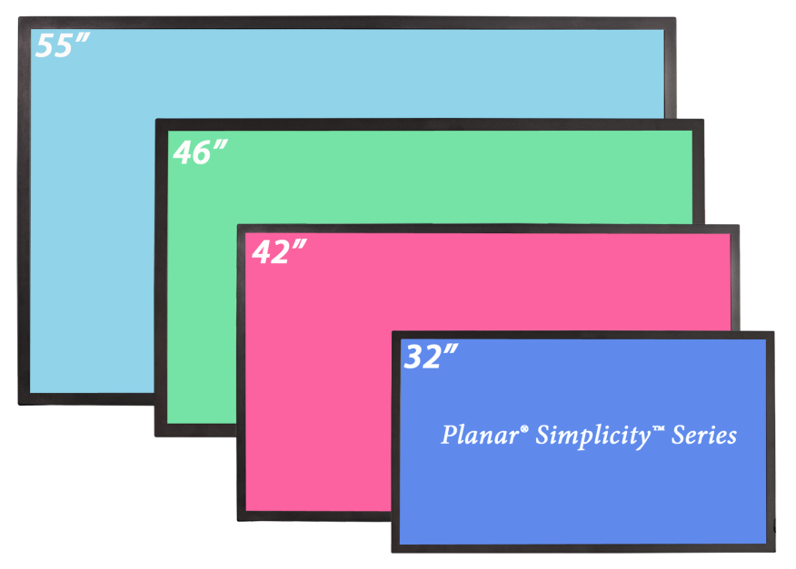
Planar Simplicity Series
Cost-Effective Digital Signage Displays
  Available in 32", 42“, 46" and 55" sizes
  Slim profile, less than 1.7” deep
  Elegant logo-free symmetrical bezel with
  ultra-slim profile
  USB media playback with scheduling
  Full array of connectivity and control
  Built-in speakers
  Industry-leading energy-efficiency

Slide 12

Planar Touch Displays
Planar is a leader in durable, vibrant touch display solutions providing a range of high-quality solutions across a spectrum of interactive technologies.
Planar's interactive displays represent best-in-class image performance while tailored to meet the unique needs of each application. Built for the most demanding environments and to customers' exacting standards, Planar touch displays offer unmatched performance and value across our broad product offering.

Slide 13

Planar UltraRes Touch
Multi-User, Multi-Touch 4K Display
84" and 98” sizes available
3840 x 2160 resolution
Multi-user with up to 32 simultaneous touch points
4K accuracy and full gesture support
Includes Planar’s exclusive ERO™ optical glass bonding technology
Ideal for Board Rooms: white board, annotation, collaboration
Ideal for Public displays: way-finding, directory, catalogue, interactive promotions

Slide 14

Planar UltraLux Touch
A Multi-Touch, Multi-User Experience
Available in 70" and 80" displays
Highly accurate and reliable IR Touch
Includes Planar’s exclusive ERO™ optical glass bonding technology featuring Corning Gorilla Glass
Supports up to 6 simultaneous touch points
Supports a wide range of operating systems
Ideal for corporate collaboration, interactive digital signage and way-finding

Slide 15



ERO with Corning Gorilla Glass Benefits
Combining Planar’s ERO™ technology with Corning® Gorilla® Glass
Available on Planar UltraLux with ERO, Planar UltraLux Touch, Planar UltraRes Touch 84”
Planar Display
ERO™ Bonding
Enhances durability
Provides superior optical performance and contrast
No air gap eliminates debris risk and reduces parallax for improved touch accuracy
4x more durable than conventional soda lime glass
Improved scratch resistance
Thinner glass reduces parallax which improves touch accuracy
Superior durability, optical performance, scratch resistance, and touch accuracy

Slide 16
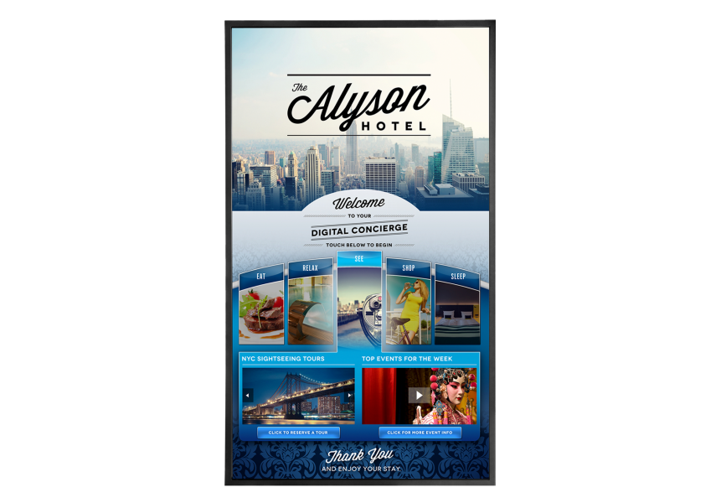
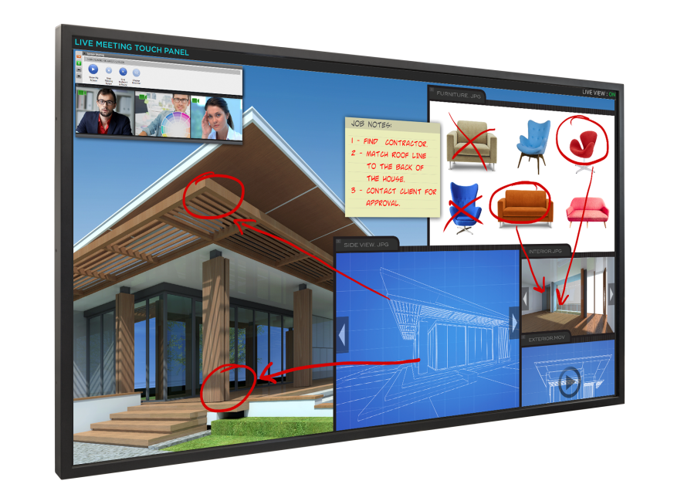
Planar EP-Series Ultra HD Integrated Touch
Interactivity Meets 4K Clarity for the Ultimate Display Experience
Available in 58" and 65"
Ultra HD native resolution (3840x2160)
Supports up to 6 touch points
IR touch technology
Supports wide range of operating systems
Ultra-slim profile with no bulky overlay
Landscape or portrait capable
Narrow, logo-free metal bezel
Features OPS slot for a PC-free touch screen

Slide 17
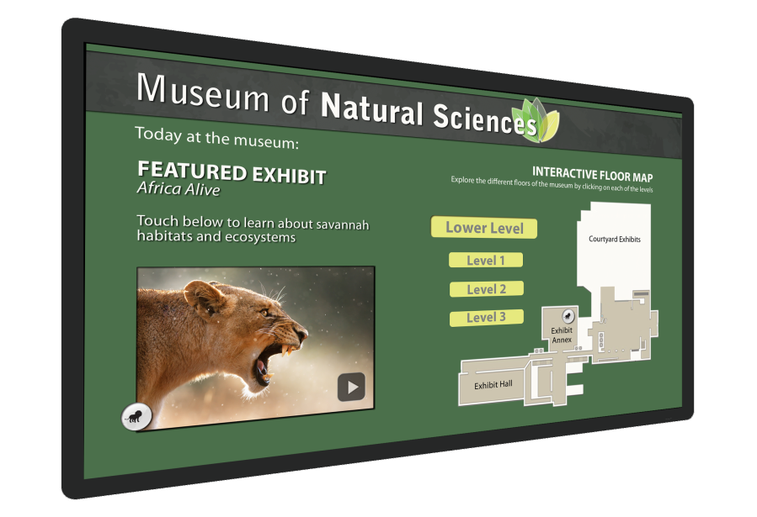
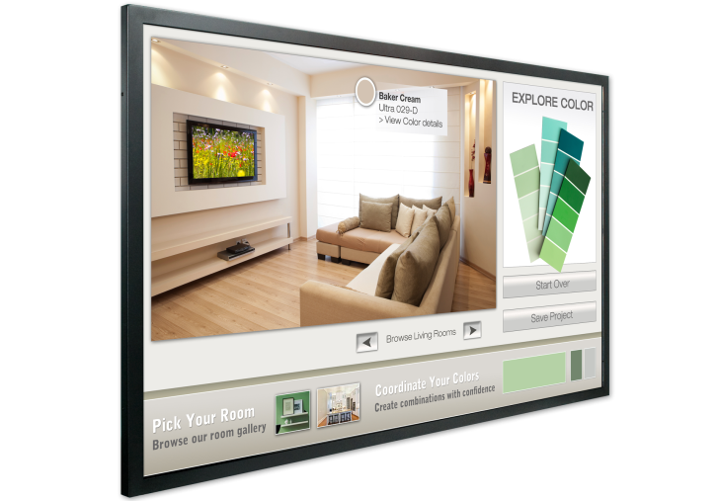
Planar PS-Series Touch Displays
Interactive Commercial LCD Displays
Available in 46", 55“, 70“, and 82” sizes
Supports up to 6 simultaneous touch points (46” and 55”) and 10 simultaneous touch points (70” and 82”)
IR touch technology
Ultra-slim profile with no bulky overlay
Landscape or portrait orientation (46”, 55”, 70”)
Energy-efficient LED backlight
Narrow, logo-free metal bezel

Slide 18


Free Your Frame!
All Planar Large Format Digital Signage Products Are Logo-Free
Logo-Free Benefits:
Eliminates awkward sideways logo in portrait orientation
Spotlight is on the content, not the bezel
No advertising other than yours
“The museum was adamant that no logos appear on any visible product unless that product was a sponsor of the museum.” – Kinetics Audio
Planar
Other Brands

Slide 19
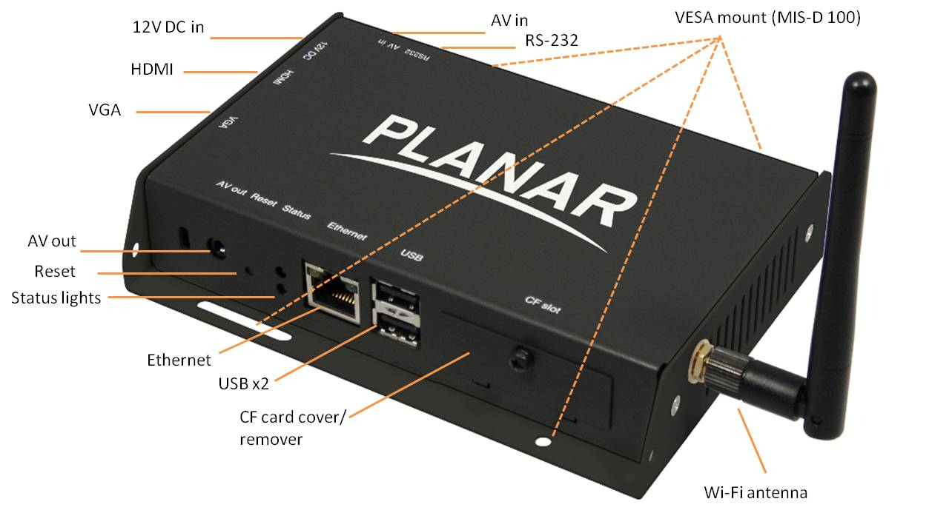
Planar ContentSmart Media Player
Full HD 1080p Media Payer
Full HD resolution media player
Solid state, no moving parts
Non-PC based - no maintenance, no downtime, no virus or Windows issues
Includes free ContentSmart Software
Easy-to-use ‘click and drag’ digital signage templates

Slide 20
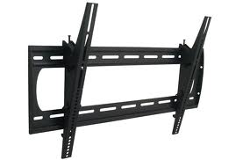
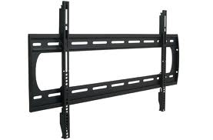
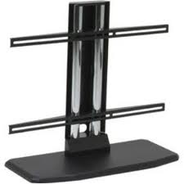
Planar Large Format Accessories
Tilting Wall Mounts
Fixed Wall Mounts
Planar provides a variety of accessories for our large format LCD displays. Whether your display requires a tabletop stand or a wall mount, Planar accessories are fully adjustable and easy to install. Planar's mounting solutions have high weight capacities, are built for commercial applications and are fully adjustable with tilt and rotational movement.
Table Stands

Slide 21

Planar Industry-Leading CustomerFirst Warranty
Planar Large Format LCD Display Warranty
Planar UltraRes Series, Planar UltraLux Series and Planar EP-Series are covered by Planar’s Standard Limited Warranty, featuring 3-year protection, advance replacement and access to 24x7 emergency phone support.
Planar PS-Series and Planar Simplicity Series are covered by Planar’s CustomerFirst™ 3-Year Warranty, including a 3-year, 2-day advance replacement.

Slide 22
Thank You!

