Slide 1
PLANAR ULTRARES SERIES PRODUCT OVERVIEW
March2017

Slide 2
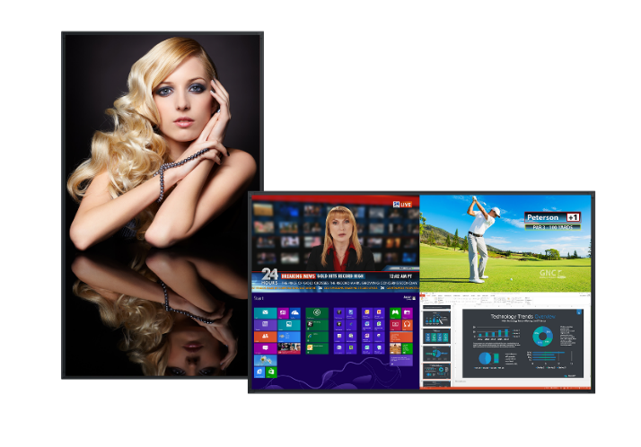
Planar® UltraRes™ Series
Stunning 4K Clarity in Immersive 75”, 86“, and 98" Sizes
75", 86", and 98" diagonal with native 3.840 x 2.160 resolution
Best-in-class image and color quality for native and upscaled content
Superior 4K video performance and compatibility
Planar® MediaPlex™ Plus processing for advanced multi-source viewing and image adjustment control
Ultra-slim Planar® Profile™ Mounting System simplifies installation and maintenance
Fanless operation with redundant power supply for added reliability
24x7 support in landscape or portrait orientation
Remote monitoring alerts via email when a designated event occurs
Fully integrated multi-touch models available

Slide 3






Planar UltraRes Series History of Innovation
Jun 2013
Multi-Touch UltraRes
Feb 2014
Largest Interactive, first UHD Display w/ Gorilla Glass
June 2014
98” UltraRes impresses at InfoComm 2014
Dec 2014
Industry’s first 98” 4K Touch ships
Oct 2015
Next generation models raise the bar
Aug 2016
Prestigious 4K Crestron Certification achieved
May 2016
Touch versions bundled with Planar® TouchMark™ annotation software
May 2014
First commercial UHD with single HDMI cable 4K @ 60Hz
Winter 2013
First to market- 84” UltraRes
Sept 2013
UltraRes MediaPlex first to offer multi-source viewing
Feb 2015
First of its kind mobile app goes live
Sept 2014
First to market 98” UltraRes ships

Slide 4
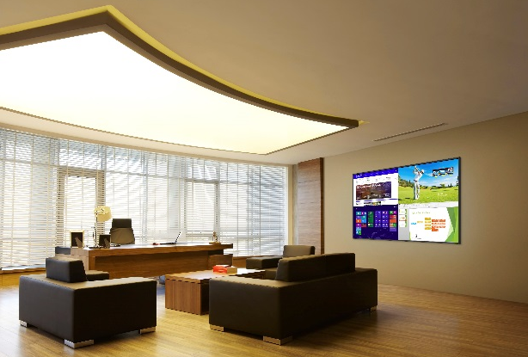
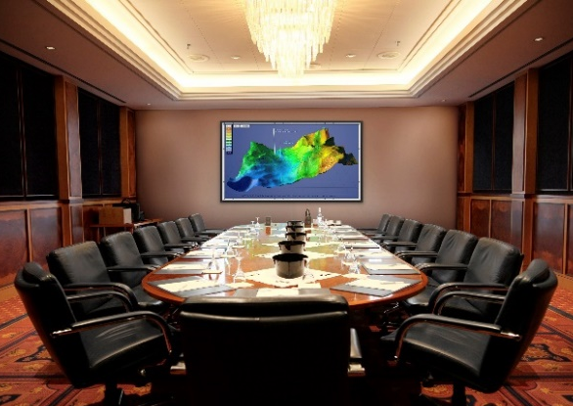

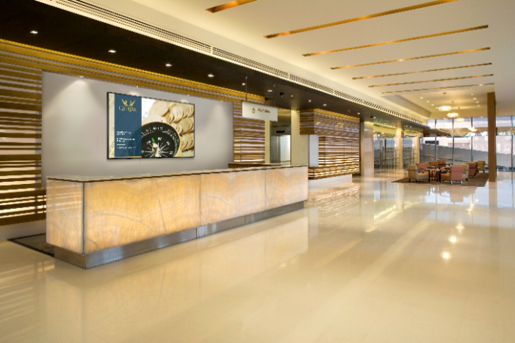
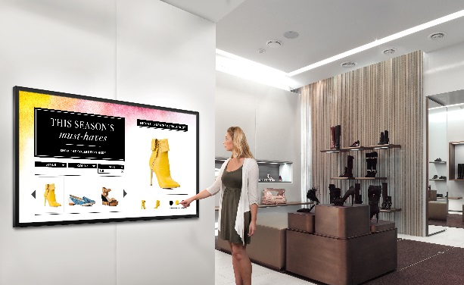
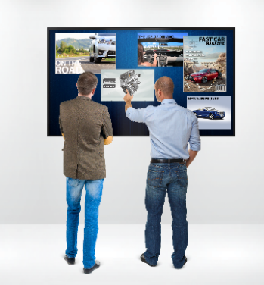
Planar UltraRes Series Common Applications
Executive Offices
Meeting Rooms
Digital Branding
Interactivity
Lobbies
Collaboration

Slide 5
Other Resolution-Rich Commercial Applications
Geospatial – satellite surveillance, mapping
Oil/gas – exploration, production management
Process control – power distribution management
CAD – aerospace, engineering, design, architecture
Visualization / Simulation
Medical imaging
Digital post-production proofing and monitoring (broadcast)
Scientific – university and commercial use
Control Room – side-by-side with windowing
Conference Room / Decision Room – business information and analysis

Slide 6
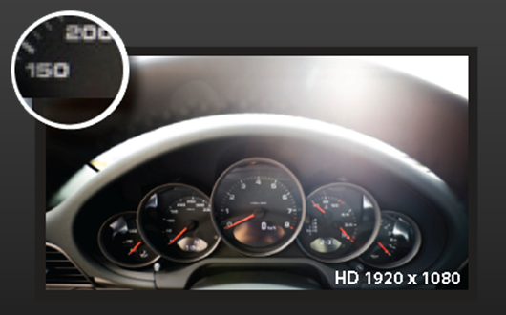
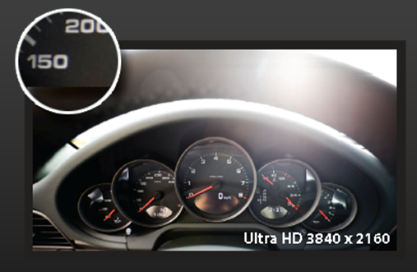
Outstanding Image Quality
Full HD Display
4K Display
4x the pixel density

Slide 7

Outstanding Image Quality
2x2 Full HD UNB Displays
Planar UltraRes Series
Similar size, same resolution, no bezels

Slide 8
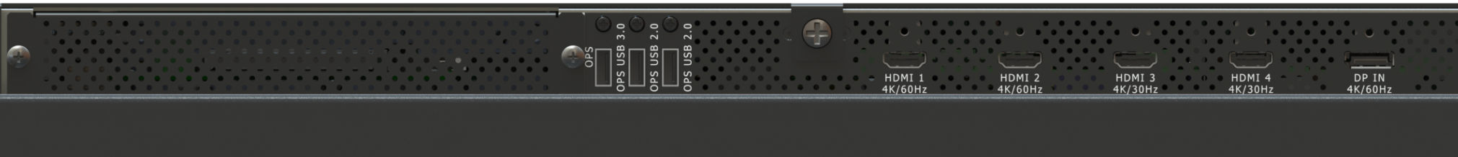
Planar UltraRes Series 4K Video Support
Designed for commercial applications
HDMI 2.0
HDCP 2.2 compliant
OPS slot
HDMI 1.4
DP 1.2
4K 60Hz
4K 60Hz
4K 30Hz
4K 60Hz

Slide 9
Native 4K 60Hz
HDMI 2.0 and DisplayPort 1.2
Enables smooth motion video and mouse tracking

Slide 10
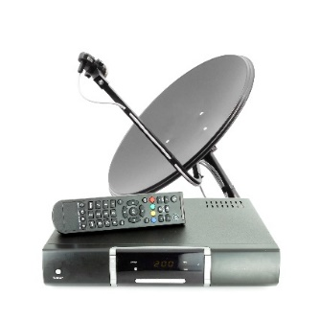
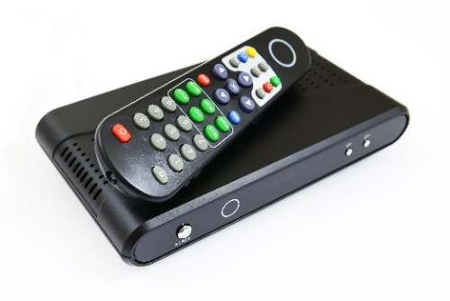
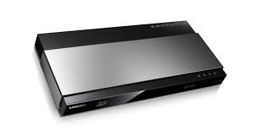
HDCP 2.2 Compliant
Compatible with current and future 4K sources

Slide 11
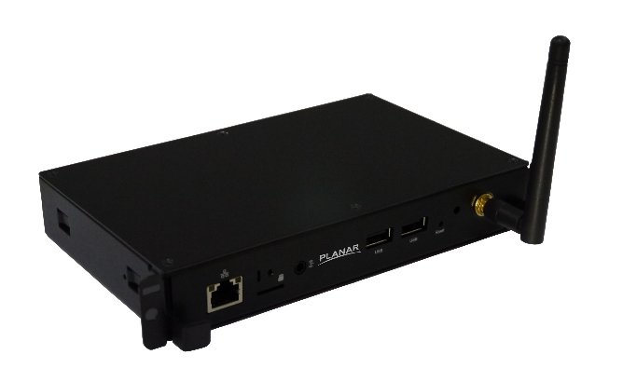
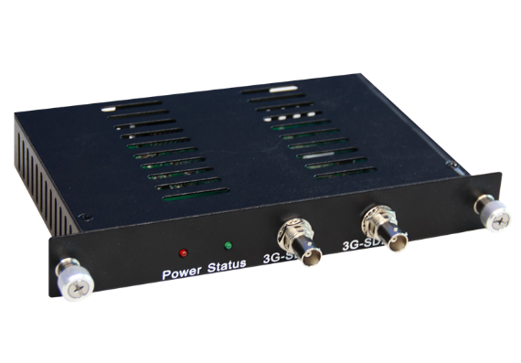
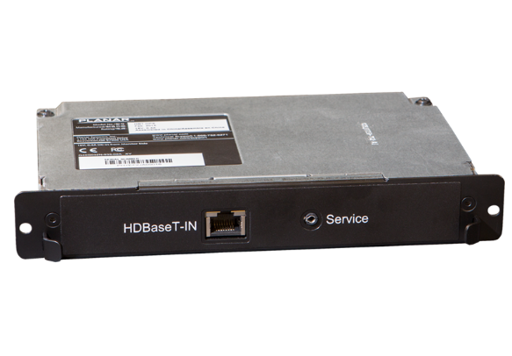
Intel Open Pluggable Specification (OPS) Expansion Slot
Embedded functionality and customized by the user
Planar ContentSmart 4K OPS media player
Planar 3G-SDI OPS
Planar HDBaseT Receiver OPS

Slide 12
Planar MediaPlex Plus Processing
Enhanced multi-source management
View multiple sources simultaneously in dual, triple, quad, or PiP layouts
Switch sources and layouts quickly
Make precise image adjustments by source
Save and recall preset configurations
Schedule events including on/off times, preset recalls, and more backlight adjustment
Select and switch audio sources

Slide 13
Planar MediaPlex Plus Processing
Enhanced multi-source management (continued)
Content rotation
Web control
Remote monitoring alerts
Advanced color management
Cloning
Pixel orbiter
Test patterns

Slide 14








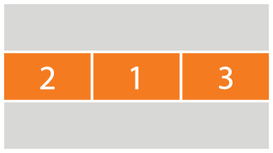


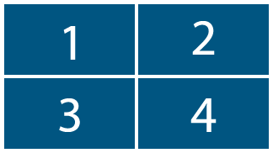

Multi-Source Layouts
Dual Views
PiP Views
Single View
Triple Views
Quad View
Note: 3 sizes of PiP window available for each layout

Slide 15
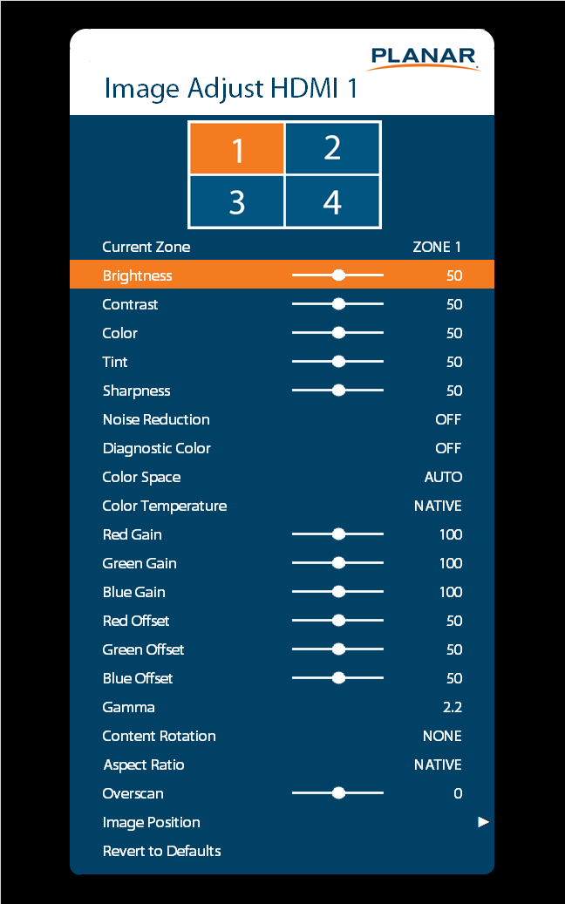
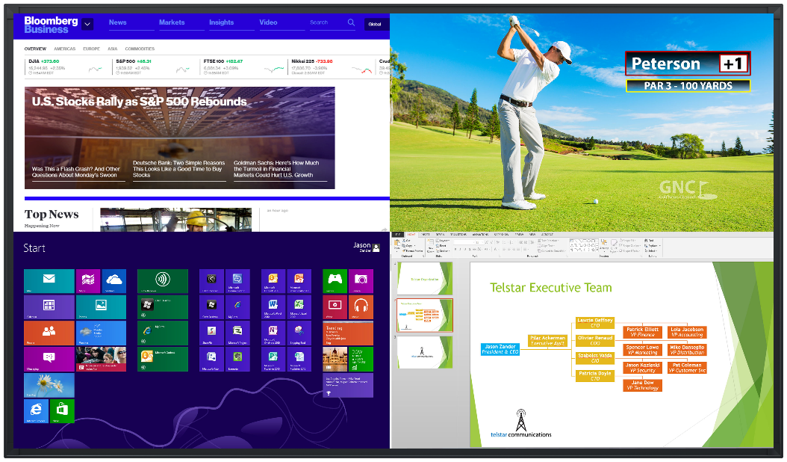
Image Adjustments by Source
Optimizes picture quality at the source level

Slide 16
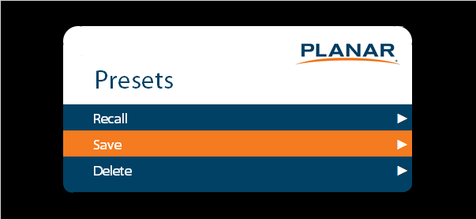
Custom Presets
Save and recall preset features incorporating:
Source
Layout
Image adjustment settings
Audio settings

Slide 17
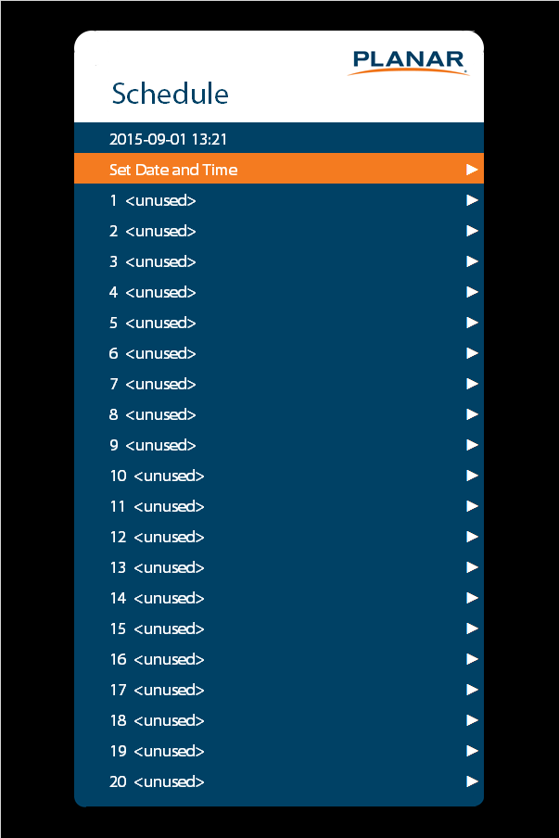
Advanced Scheduling
Schedule up to 20 events
On/Off
Presets
Backlight

Slide 18
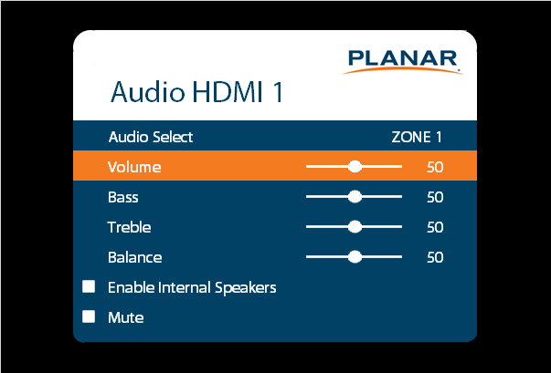
Multi-Source Audio
Audio source selected by zone

Slide 19

Content Rotation
Ability to rotate content orientation
None
90°
180°
270°
Note: This feature does not automatically detect the orientation of the content. Content would need to be rotated by command (remote, RS232, or LAN)

Slide 20
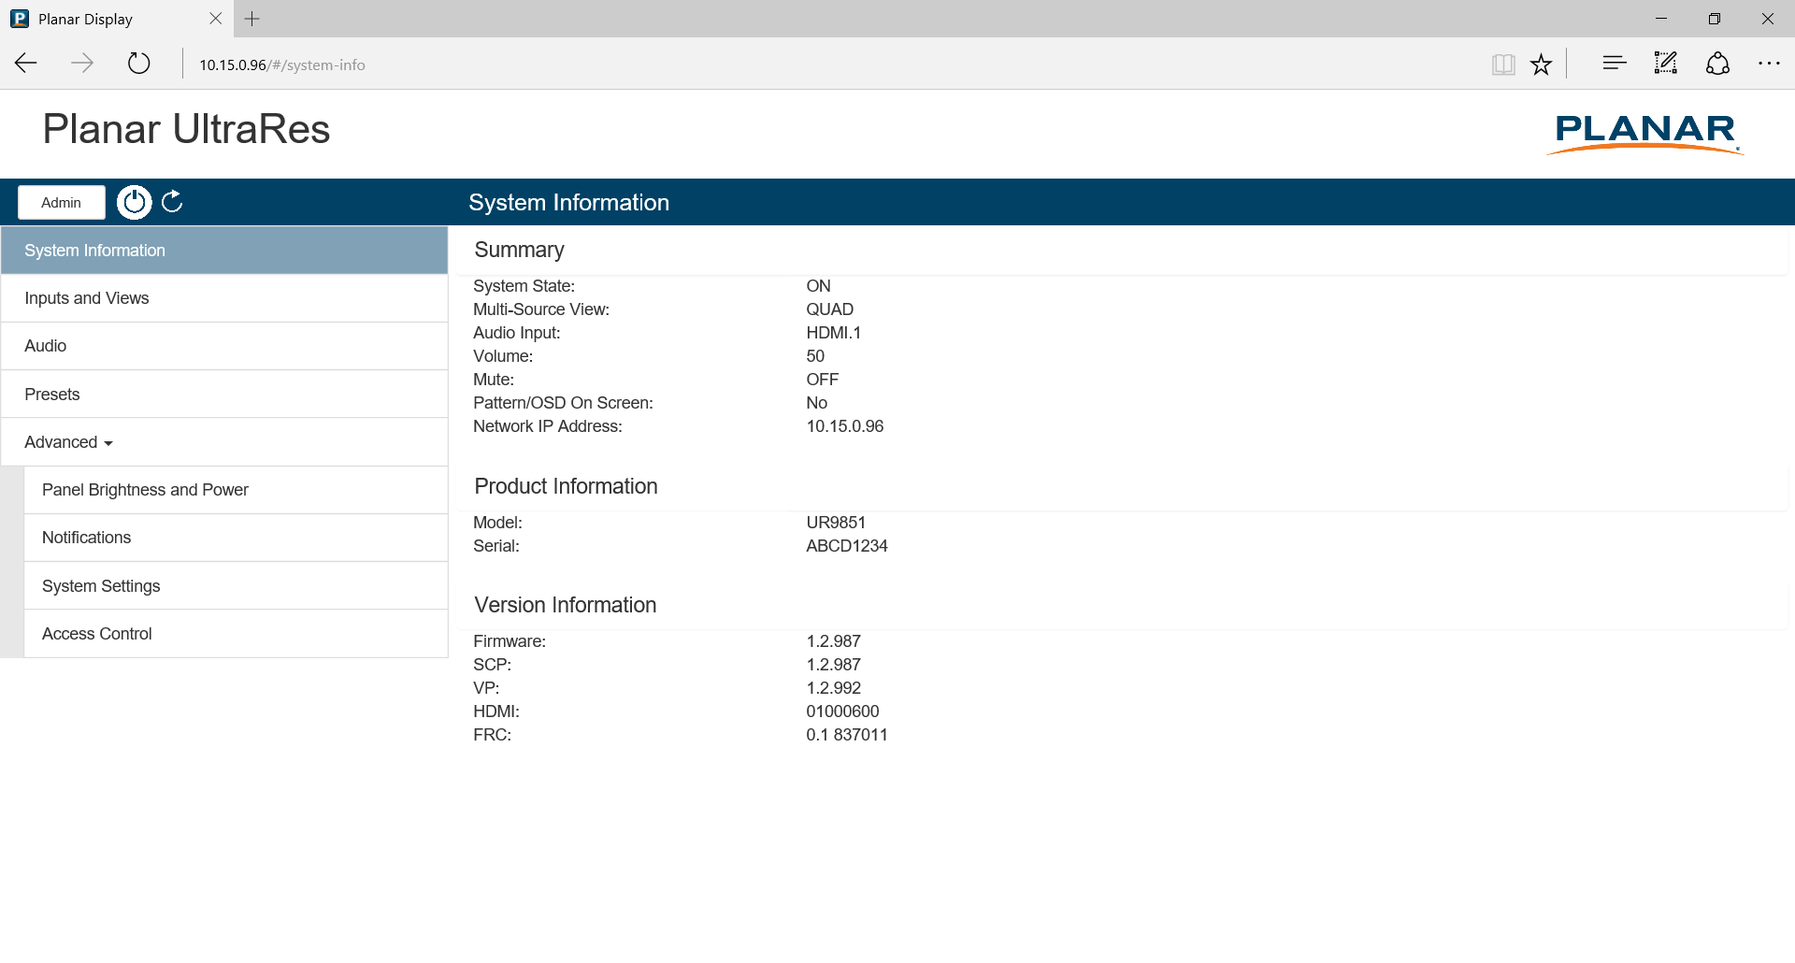
Web Control
Ability to view and control select features of the OSD with a Web browser
System information and status
Multi-source views
Presets
Panel brightness
Power
Audio

Slide 21
Remote Monitoring Alerts
Enables email notifications for designated events
Power On/Off: Occurs when standby mode is entered and when the display is powered on
System Error: Occurs when the display has detected an error within the
system
Source Detect: Occurs when the display detects and displays a new input
signal
Source Lost: Occurs when the current input signal is no longer detected.
Source Selected: Occurs when a different input source is selected for any of the zones

Slide 22
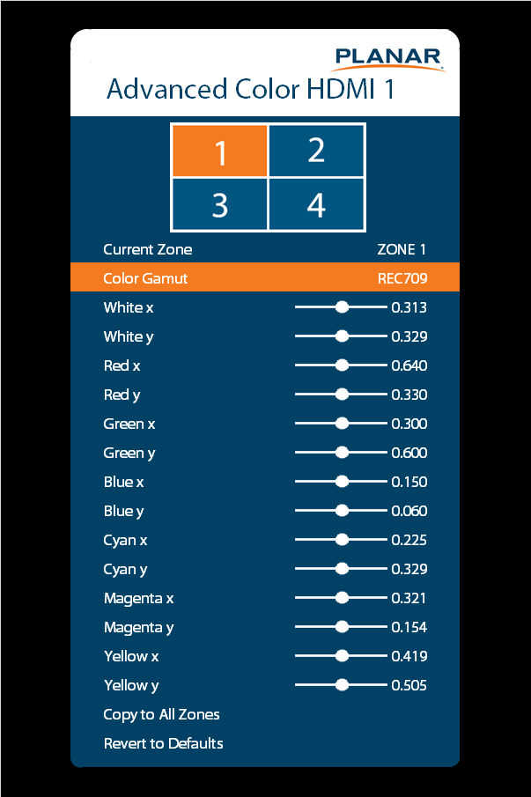
Advanced Color Management
Adjusts the color coordinates for any given zone
These controls can be used by advanced installers to achieve exact color point targets on the display

Slide 23
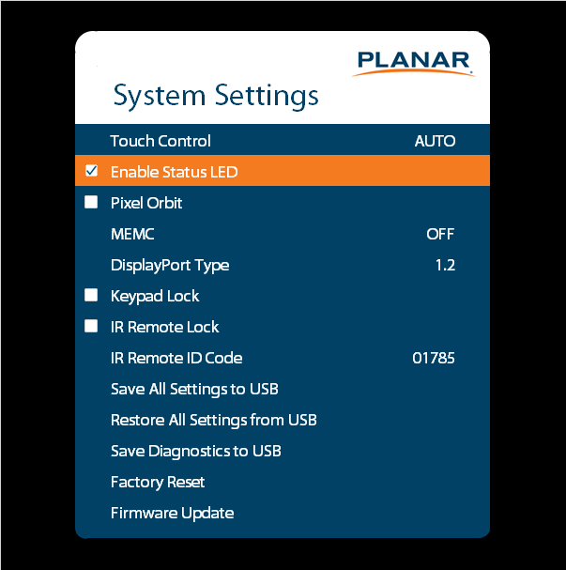
Cloning
Save and then copy settings to other displays

Slide 24
Pixel Orbiter
Creates slight frame motion to help avoid image retention

Slide 25
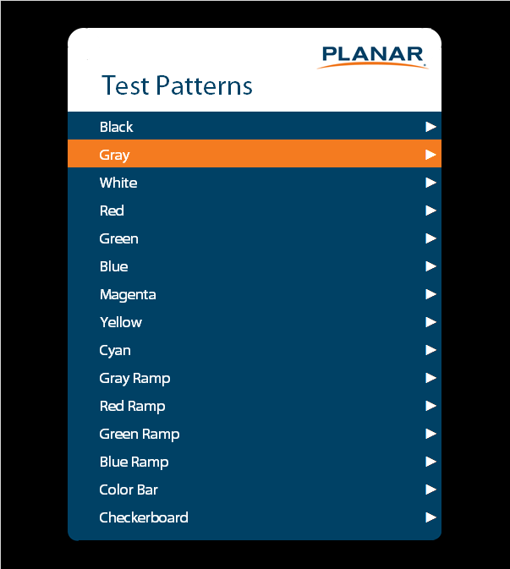
Test Patterns
Selects a test pattern to show on the display for diagnostic purposes

Slide 26
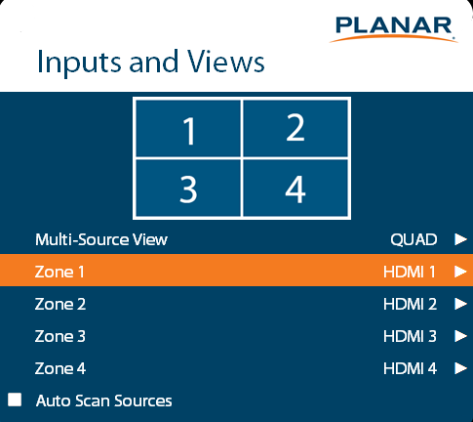
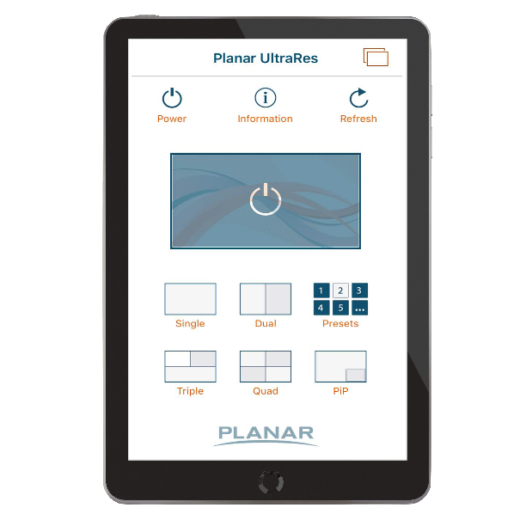
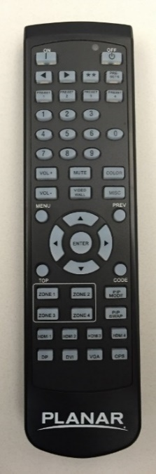
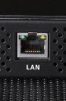
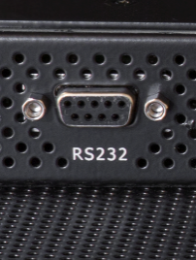
Planar UltraRes Series Control Options
On-Screen menu
Remote control with hot keys
UltraRes App for iOS and Android
RS-232
LAN
Rear keypad

Slide 27
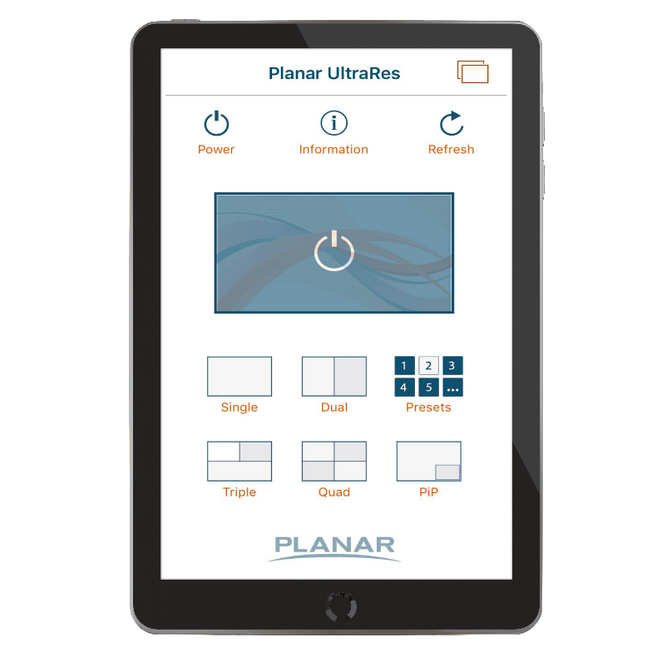


Planar® UltraRes™ App
Manage multi-source viewing on Planar UltraRes Series displays with a phone or tablet.
Select from up to 6 connected content sources
Switch between single, dual, triple, quad, or picture-in picture (PiP) layouts
Recall saved preset configurations
Create custom names for inputs
Hide unused inputs
Power on and off the display

Slide 28
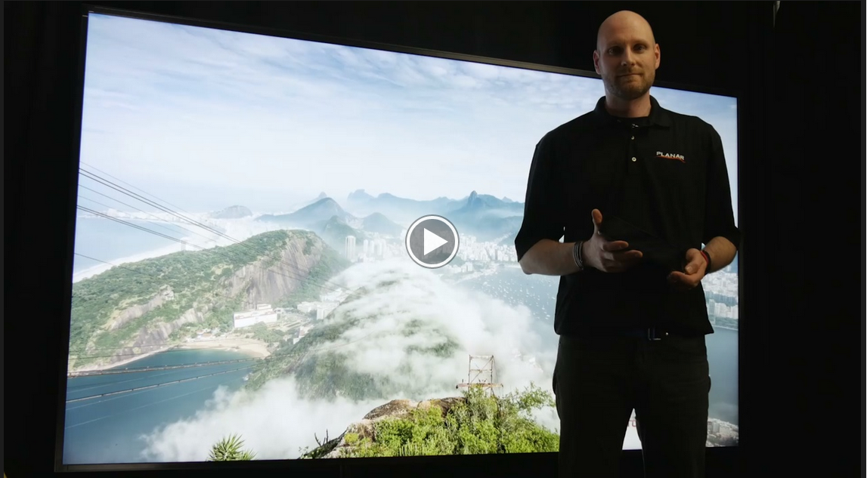
Planar MediaPlex Plus Processing Demo Video Series
Planar MediaPlex Plus overview
Saving and recalling presets
Scheduling set-up
Planar UltraRes App overview
Advanced features overview
www.planar.com/Ultrares

Slide 29
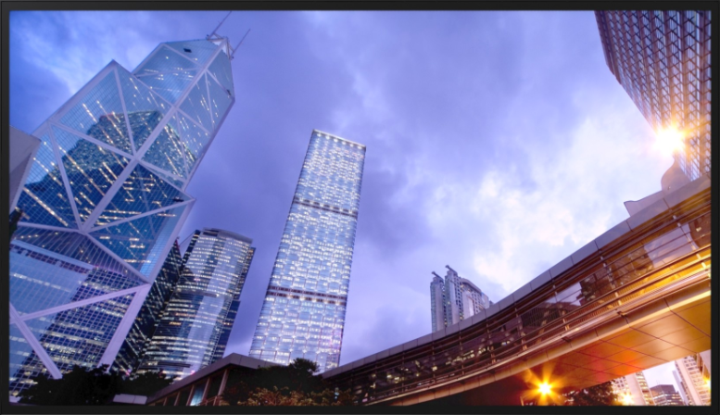
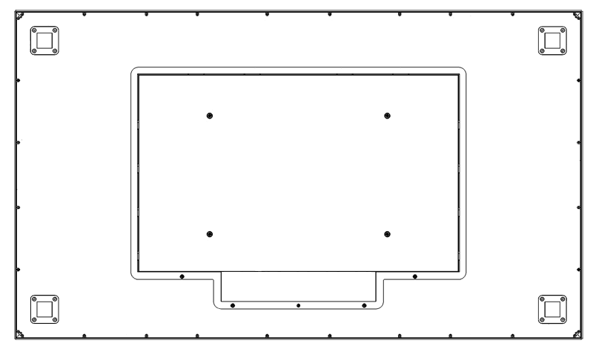
Industrial Design Matters
Slim bezel
Logo free
Place-able IR sensor
Aluminum bezel
VESA or Planar Profile™ mounting
Front service access. Lockable.
Field serviceable
Easy connectivity access
Redundant power
Fanless

Slide 30
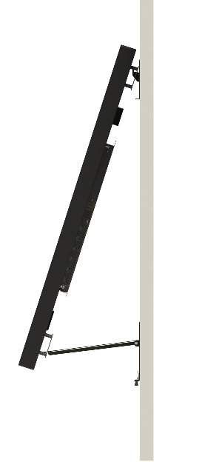

Planar Profile Mounting System
Industry’s slimmest wall mount
Kickstand Mode
Mounted
Ultra slim mounting profile
  3.6” non-touch
  4.1” touch
Kickstand mode enables easy access to inputs and removable service components
Locks in place
Landscape and portrait options

Slide 31
Planar UltraRes Series Models
9 Total Models
98”
86”
UR9851
UR9851-ERO
UR9851-ERO-T
75”
UR8651-MX
UR8651-MX-ERO
UR8651-MX-ERO-T
UR7551-MX
UR7551-MX-ERO
UR7551-MX-ERO-T
3 Models
3 Models
3 Models

Slide 32
Basic Specifications by Model
 | 75” | 86” | 98”
 | Planar UltraRes UR7551-MX | Planar UltraRes UR8651-MX | Planar UltraRes UR9851
Orientation | Landscape/Portrait
Recommended Usage | 24x7
Backlight | E-LED | E-LED | D-LED
Brightness | 500 cd/m²

Slide 33
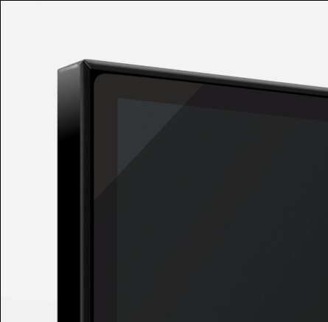
Extended Ruggedness and Optics (ERO)
Protective glass optically bonded to the front surface of the display with Planar® ERO™ (Extended Ruggedness and Optics™) technology
Planar ERO option is available on all Planar UltraRes Series models
Key benefits:
  Enhanced durability and ruggedness for added protection in high traffic environments
  Edge-to-edge glass front similar to the sleek look of smart phones and tablets
  Improved perceived contrast
  Resistant to condensation and dust

Slide 34

Planar UltraRes Touch
Interactive 4K professional display
75", 86", and 98" diagonal, 3840 x 2160 resolution
Multi-User – Up to 32 simultaneous touch points
Fully integrated, delivering an elegant design and more accurate multi-touch experience
Optimized for 4K accuracy
Utilizes exclusive Planar ERO optical glass bonding technology
Ideal for Board Room: white board, annotation, collaboration and Public Display: way-finding, directory, catalogue, interactive promotions

Slide 35


Collaborating with Planar TouchMark
Essential collaboration tools for on-screen annotation and whiteboarding
Collaborative software for basic annotation and whiteboarding in meeting rooms and classrooms
Easy to use - open any application, write, save, send
Optimized for resolutions up to 4K
Single licenses included with most Planar large format touch screens
Additional licenses available for purchase

Slide 36
Planar UltraRes Series Differentiators
4K @ 60Hz HDMI 2.0 and DisplayPort 1.2
Built-in Planar MediaPlex Plus processing delivers advanced multi-source viewing capabilities
Expansion slot meeting Intel’s OPS specification
Slimmest mounting profile
In-place service access mode (hinge and kickstand)
Fail-over power redundancy
Quiet operation – Fanless
Advanced scheduling
Planar ERO protective glass option on all models
Landscape/Portrait orientation support
Multiple panel sizes to meet specific needs
Multi-touch available for all versions
24x7 support
Warranty and support

Slide 37
THANK you

