Slide 1
LARGE FORMAT LCD DISPLAYS
Product Overview
March 2017

Slide 2
Planar Large Format LCD Displays
Planar large format LCD displays are designed for demanding applications with high durability and performance requirements. From communicating information to enhancing ambiance, Planar large format LCD display lines are the ideal complement to any retail store, lobby, control room, or other professional application.

Slide 3
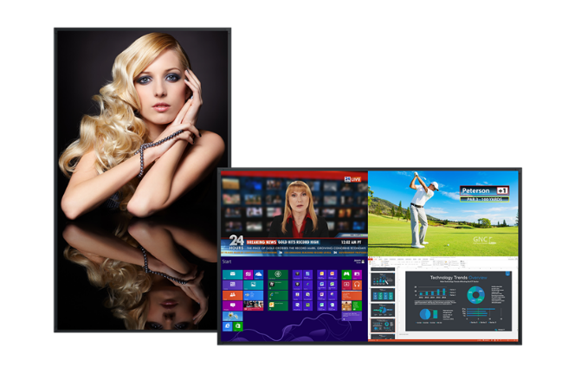
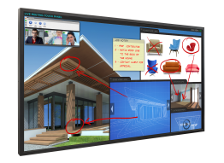
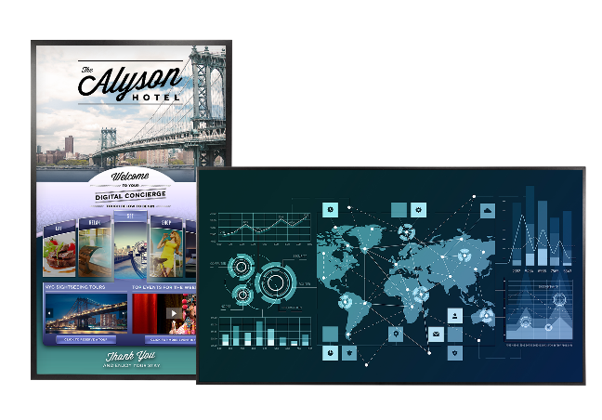
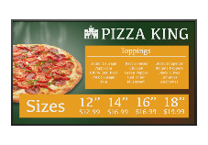
The Most Comprehensive Line of Large Format Displays
Planar® EP Series
(UHD)
Planar® UltraRes™ Series (UHD)
Planar® PS Series (FHD)
Planar® QE Series (UHD)
Planar® Simplicity™ Series (FHD)
46”
50”
75”
43”
48”
55”
58”
65”
86”
98”

Slide 4
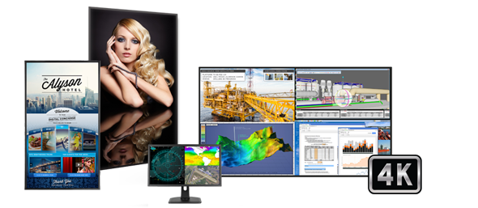
Planar Ultra HD LCD Displays
Planar offers a best-in-class portfolio of 4K display solutions that deliver unparalleled ultra HD image quality and performance for resolution-rich commercial applications.

Slide 5
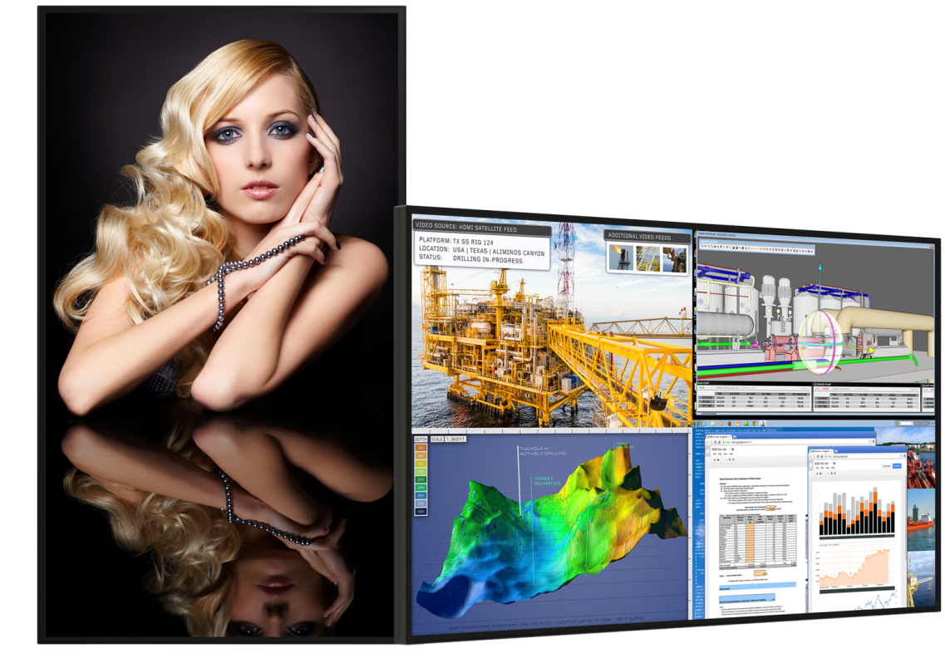
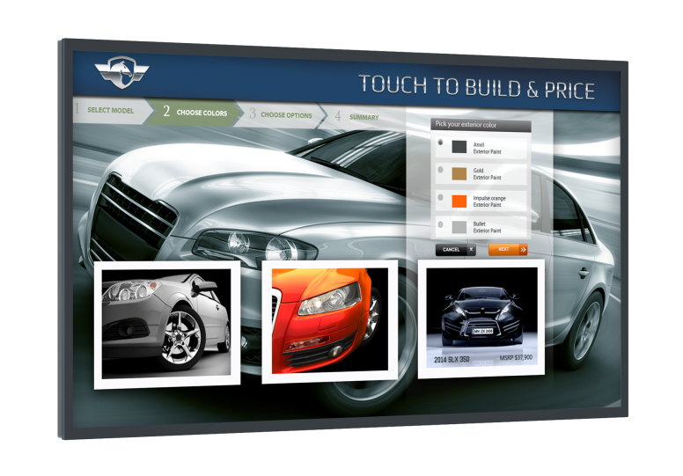
Planar UltraRes Series
Stunning 4K Clarity in Immersive 75”, 86“, and 98" Sizes
75", 86", and 98" diagonal with native 3.840 x 2.160 resolution
Best-in-class image and color quality for native and upscaled content
Superior 4K video performance and compatibility
Planar® MediaPlex™ Plus processing for advanced multi-source viewing and image adjustment control
Ultra-slim Planar® Profile™ Mounting System simplifies installation and maintenance
Fanless operation with redundant power supply for added reliability
24x7 support in landscape or portrait orientation
Remote monitoring alerts via email when a designated event occurs
Fully integrated multi-touch models available

Slide 6
Planar UltraRes Touch
Multi-User, Multi-Touch 4K Display
75”, 86“ and 98” sizes available
3.840 x 2.160 resolution
Multi-user with up to 32 simultaneous touch points
4K accuracy and full gesture support
Plug-and-play HID compliant
Fully integrated, delivering an elegant design and more accurate multi-touch experience
Includes Planar® ERO™ (Extended Ruggedness and Optics™) glass bonding technology
Ideal for board rooms: white board, annotation, collaboration
Ideal for public displays: way-finding, directory, catalogue, interactive promotions

Slide 7
Planar Profile Mounting System
Kickstand
Mode
Industry’s slimmest wall mount
Mounted
Available for all Planar UltraRes Series displays
Ultra slim mounting profile
3..4” non-touch
3.9” touch
Kickstand mode enables easy access to inputs and removable service components
Locks in place
Landscape and portrait options

Slide 8
ERO with Corning Gorilla Glass Benefits
Combining Planar ERO technology with Corning® Gorilla® Glass
Available on Planar UltraRes with ERO 75” and 86” and Planar UltraRes Touch 98”
Planar Display
ERO Bonding
Enhances durability
Provides superior optical performance and contrast
No air gap eliminates debris risk and reduces parallax for improved touch accuracy
4x more durable than conventional soda lime glass
Improved scratch resistance
Thinner glass reduces parallax, which improves touch accuracy
Superior durability, optical performance, scratch resistance, and touch accuracy

Slide 9
Planar UltraRes Series Differentiators
4K @ 60Hz HDMI 2.0 and Display Port 1.2
Built-in Planar MediaPlex Plus processing
Expansion slot meeting Intel’s OPS specification
Slimmest mounting profile and ADA compliant
In-place service access mode (hinge and kickstand)
Fail-over power redundancy
Quiet operation – fanless
Advanced scheduling
Remote monitoring alerts via email when a designated event occurs
Planar ERO glass bonding technology option on all models
24x7 support in landscape or portrait orientation
Multiple panel options to meet specific needs
Multi-touch available for all versions
Warranty and support

Slide 10
Planar QE Series Ushering in a new era of 4K digital signage
75”, 86” and 98” Ultra HD resolution LCD displays
End-to-end digital signage with embedded Planar® ContentSmart™ 4K player and software
Superior 4K video performance and compatibility
Single- and Quad-source viewing
Landscape and portrait flexibility
Designed for 24x7 operation
Fully integrated multi-touch models available

Slide 11
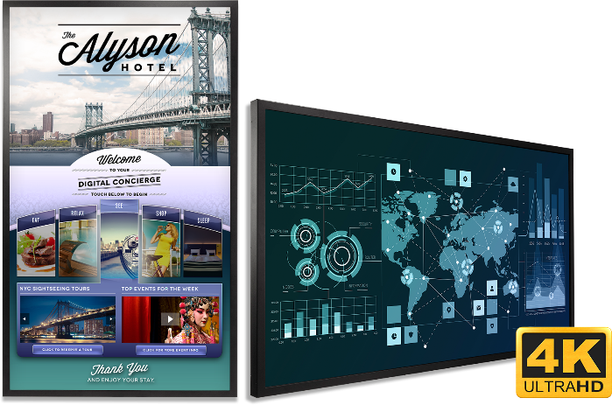
Planar QE Series Common Applications
Meeting rooms
Digital branding
Interactivity
Collaboration
Non-Touch
Touch

Slide 12
Planar QE Series Differentiators
4K @ 60Hz HDMI 2.0 and DisplayPort 1.2
Embedded Planar® ContentSmart™ 4K media player & software
Built-in processing delivers quad-source viewing capabilities
Quiet operation – Fanless
Advanced scheduling
Landscape/Portrait orientation support
Multiple panel sizes to meet specific needs
Multi-touch available for all versions
Planar ERO protective glass option on touch models
24x7 support
Warranty and support

Slide 13
Embedded Planar® ContentSmart™
Design, monitor and manage digital signage content directly from the display
Embedded 4K media player
8GB internal memory, Ethernet
Intuitive, easy to use, software
Repeat looping, weekly, monthly or special day playlist scheduling
Use virtually any media content type
Video, images, PowerPoint, HTML5, audio

Slide 14
Planar® ContentSmart™ Software – Easy as 1, 2, 3
create
schedule
deploy
enjoy!

Slide 15
Planar EP Series Displays
High Performance UHD Display Solutions
Available in 50”, 58“ and 65” models
3.840 x 2.160 resolution
Supports 4K at up to 60Hz (DP 1.2)
Reliable for up to 24x7 operation
Supports portrait and landscape orientation
OPS slot enables seamless digital signage integration
Multi-source viewing of 2, 3 or 4 simultaneous sources
Wide color gamut support (50” and 58” only)
Built-in speakers
Narrow, logo-free metal bezel
Touch models available
Whisper-quiet, fanless design
450-550 nits of brightness

Slide 16
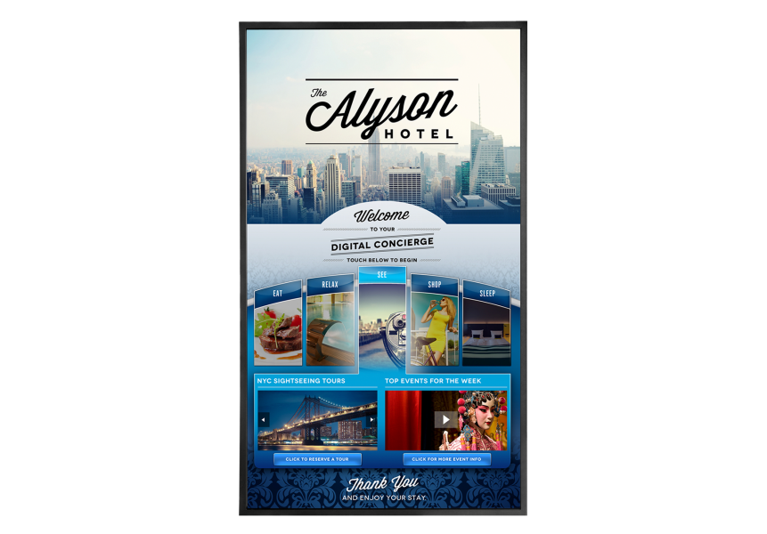
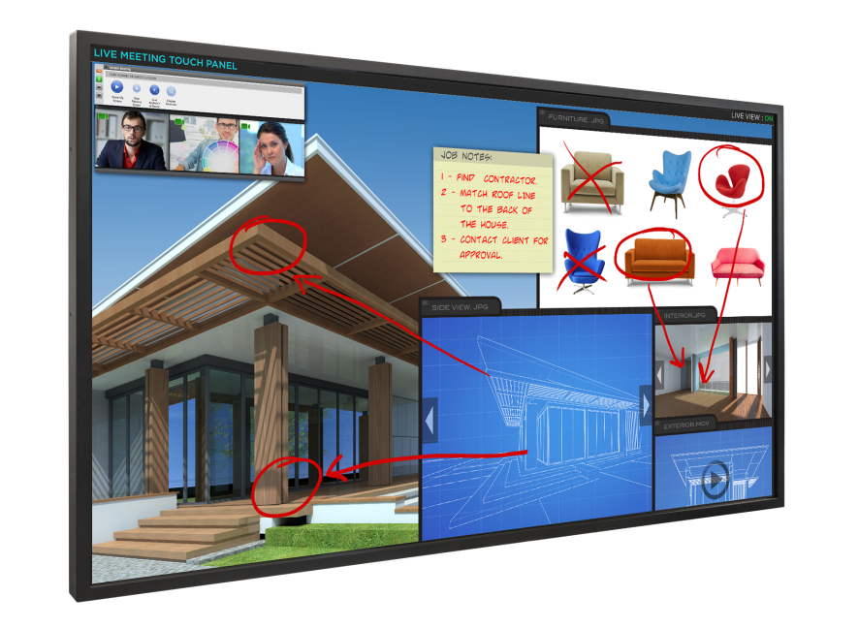
Planar EP Series Integrated Touch
Interactivity Meets 4K Clarity for the Ultimate Display Experience
Available in 50”, 58“ and 65"
Ultra HD native resolution (3.840x2.160)
Supports up to 6 touch points
IR touch technology
Supports wide range of operating systems
Ultra-slim profile with no bulky overlay
Anti-glare protective glass
Landscape or portrait capable
Narrow, logo-free metal bezel
Features OPS slot for a PC-free touch screen

Slide 17
Planar® ContentSmart™ 4K Media Players
Design, monitor and manage 4K digital signage content
Available in stand-alone and OPS models
Support for portrait or landscape display orientation
8GB memory, Ethernet and built-in WiFi
H.265 video codec for streaming 4K video
Includes ContentSmart™ Software – FREE
Easy-to-use, built-in digital signage templates
Use existing assets – pictures, videos, PPTs, audio
Repeat looping, weekly, monthly or special day scheduling of playlists
Applications:
Advertising | Brand Communications | Entertainment | Menu Boards | Employee Communications | Lobby Signage |

Slide 18
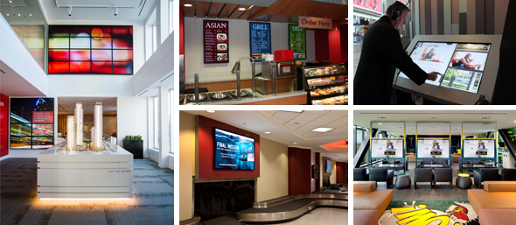
Planar Full HD LCD Displays
As a global leader in display technology, Planar innovates and redefines the standards for display design, performance, and reliability. With a range of full HD large format LCD displays for digital signage and commercial applications, Planar provides the most comprehensive and unique lines in the industry.

Slide 19
Planar PS Series
Commercial-Grade Digital Signage Displays
Available in 55", 65“ sizes
Full HD resolution
Supports up to 24x7 operation
500 nits of brightness
Landscape or portrait orientation
Built-in speakers
Comprehensive set of inputs and control
Logo-free metal bezels
Ultra-slim and energy efficient LED backlight
Touch models available

Slide 20
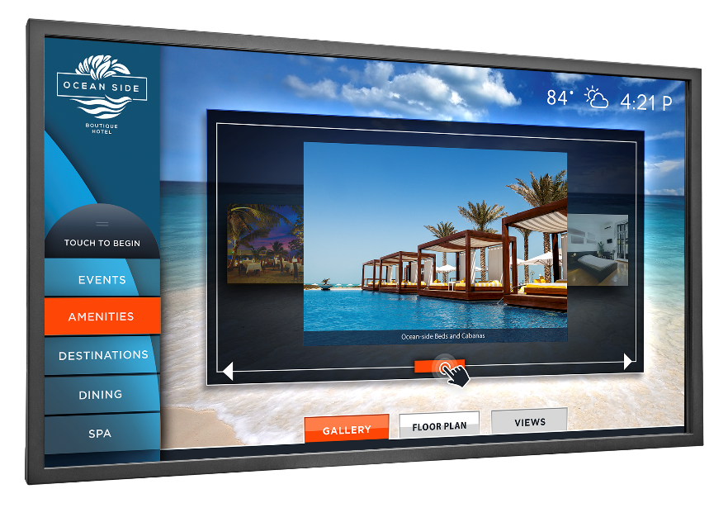
Planar PS Series Touch Displays
Interactive Commercial LCD Displays
Available in 46", 55" and 65” sizes
Supports up to 20 simultaneous touch points
IR touch technology
Ultra-slim profile with no bulky overlay
Landscape or portrait orientation
Energy-efficient LED backlight
Narrow, logo-free metal bezel

Slide 21
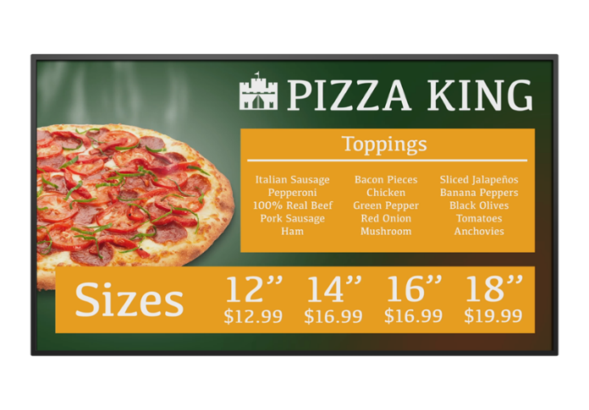
Planar Simplicity Series
Cost-Effective Digital Signage Displays
Available in 43“, 48”, 55“ and 65” sizes
Slim profile, ADA compliant
Narrow logo-free bezel
Landscape and portrait flexibility
USB media playback with scheduling
Full array of connectivity and control
Built-in speakers
Industry-leading energy efficiency

Slide 22
Planar TouchMark
Essential collaboration tools for on-screen annotation and whiteboarding
Collaborative software for basic annotation and whiteboarding in meeting rooms and classrooms
Easy to use - open any application, write, save, send
Optimized for resolutions up to 4K
Single licenses included with most Planar large format touch screens
Additional licenses available for purchase

Slide 23
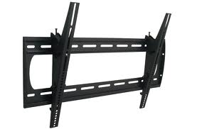
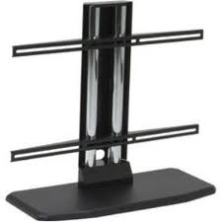
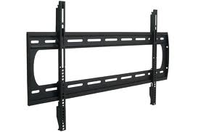
Planar Large Format Accessories
Tilting Wall Mounts
Planar provides a variety of accessories for our large format LCD displays. Whether your display requires a tabletop stand or a wall mount, Planar accessories are fully adjustable and easy to install. Planar mounting solutions have high weight capacities, are built for commercial applications, and are fully adjustable with tilt and rotational movement.
Table Stands
Fixed Wall Mounts

Slide 24
Planar Large Format LCD Display Warranty
Planar UltraRes Series and Planar EP Series are covered by Planar Standard Limited Warranty, featuring 3-year protection, advance replacement, and access to 24x7 emergency phone support.
Industry-Leading Planar® CustomerFirst™ Warranty
Planar PS Series and Planar Simplicity Series are covered by Planar CustomerFirst 3-Year Warranty, including a 3-year, 2-day advance replacement.

