Slide 1
Planar® DirectLight™ LED Video Wall System
Product Overview
October 2015

Slide 2
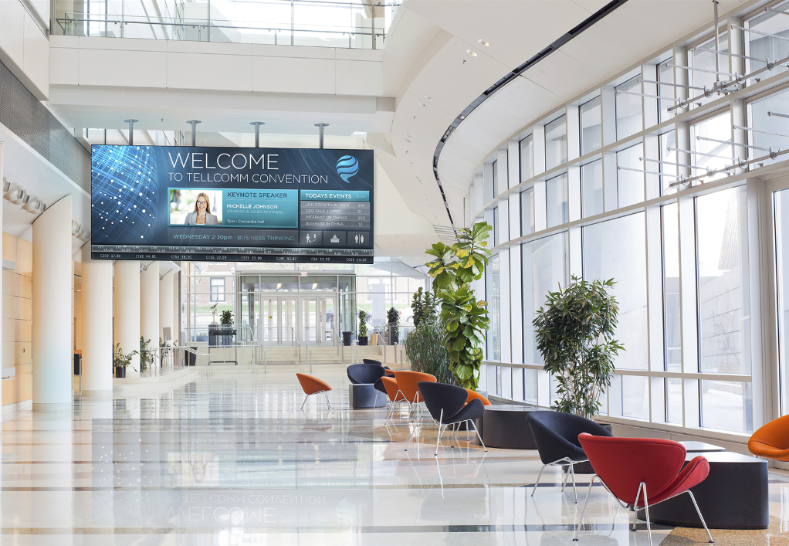

Planar® DirectLight™ LED Video Wall System
Family of Best-in-Class Direct View LED Video Walls for Digital Signage & Control Rooms
Superior Visual Performance
Mission-Critical Reliability
Optimized For Your Unique Indoor Environment
From a Partner you Trust:

Slide 3





An Award-Winning Solution
Planar DirectLight LED Video Wall’s Award & Recognition:
Notes:
Rave Publications 2015 Digital Signage Champs
Best New Indoor Display
http://www.ravepubs.com/the-2015-digital-signage-champs/
Commercial Integrator Best Electronics Systems Technologies of 2015
Criteria for the winning products included innovation, functionality, competitive advantages and benefits to the installer.
http://www.commercialintegrator.com/article/49_best_products_of_2015/news
AV Technology’s InfoComm 2015 Best of Show
AVT Judges: "Stunning, crisp, high contrast images are produced with ultra-fine pitch direct view LED video wall system and scales to nearly any size or shape. Off-board distributed architecture increases reliability and improves serviceability by removing heat, complexity, and potential points of failure.”
http://www.avnetwork.com/news/0006/av-technologys-infocomm-2015-best-of-show-awards-announced/95533
Sound & Video Contractor InfoComm 2015 Best of Show
S&VC Judges: “Ultra-fine pitch direct view LED video wall system scales to nearly any size or shape. The Planar DirectLight LED Video Wall Calculator, helps to assist in the sale by providing a simulated representation of the video wall along with important product specifications specific the video wall design.”
http://www.svconline.com/thewire/best-show-infocomm-2015/401834
Digital Signage Magazine Best of Show InfoComm 2015
“… recognize new and outstanding products… ”
http://www.avnetwork.com/digital-signage/0003/infocomm-digital-signage-best-of-show-award-winners-announced/95532

Slide 4
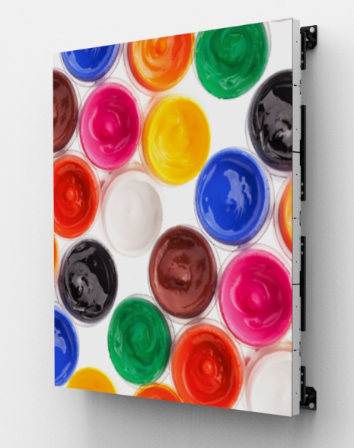
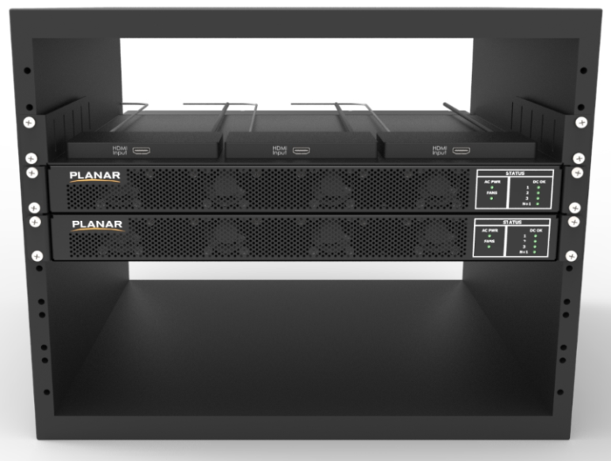
Planar DirectLight Video Wall Components
Power, Data and Control Cables
Planar® EasyAlign™ Mounting System
LED Display Modules
Power Supply Modules
Video Signal Extenders
2
5
1
4
3

Slide 5
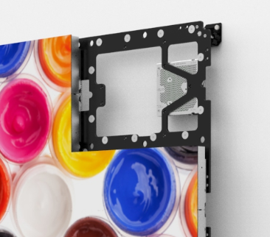
Precision Alignment & Image Optimization
Achieved with Revolutionary Mounting System and Software:
Planar® DirectLight™ Control Software for automated fine tune optimization
Planar EasyAlign Mounting System for ultra-fine 6-axis adjustments

Slide 6
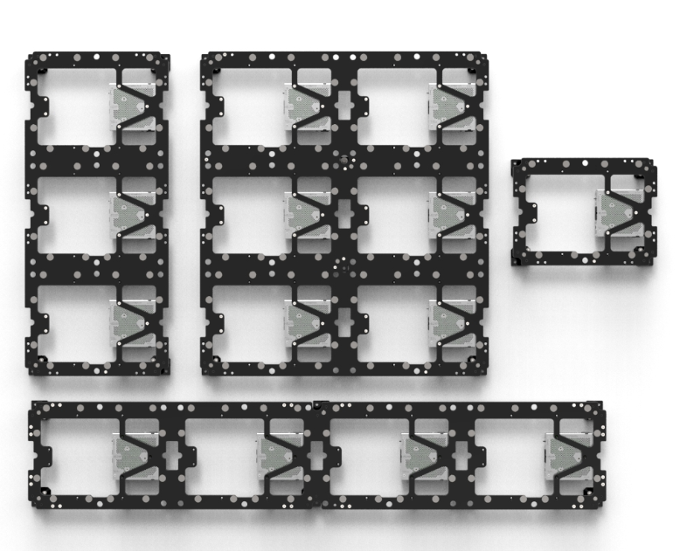
Planar EasyAlign Mounting System
Available in:
1x3
2x3
Configuration: | Dimensions:
2x3 (6 Display Modules) | 31.5x35.4” 800x900mm
4x1 (4 Display Modules) | 63.0x11.8” 1,600x300mm
1x3 (3 Display Modules) | 15.7x35.4” 400x900mm
1x1 (1 Display Module) | 15.7x11.8” 400x300mm
1x1
Planar® DirectLight™ LED Video Wall Calculator automatically configures optimal combination of mounts
4x1

Slide 7
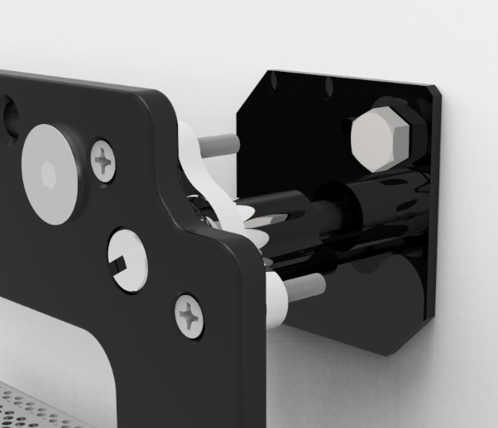
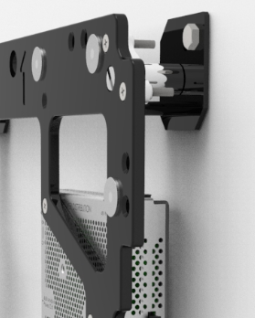
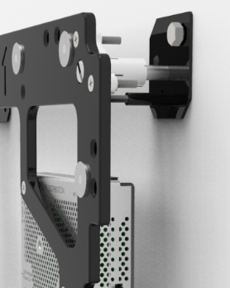
Z-Axis Adjustment on Planar EasyAlign Mounting System
Maximum Depth*:
4”/102mm
Minimum Depth*:
3.5”/89mm
z-Axis
Adjustment
Cam (4)
* Total mounted depth including Planar EasyAlign Mounting System & LED Display Module

Slide 8
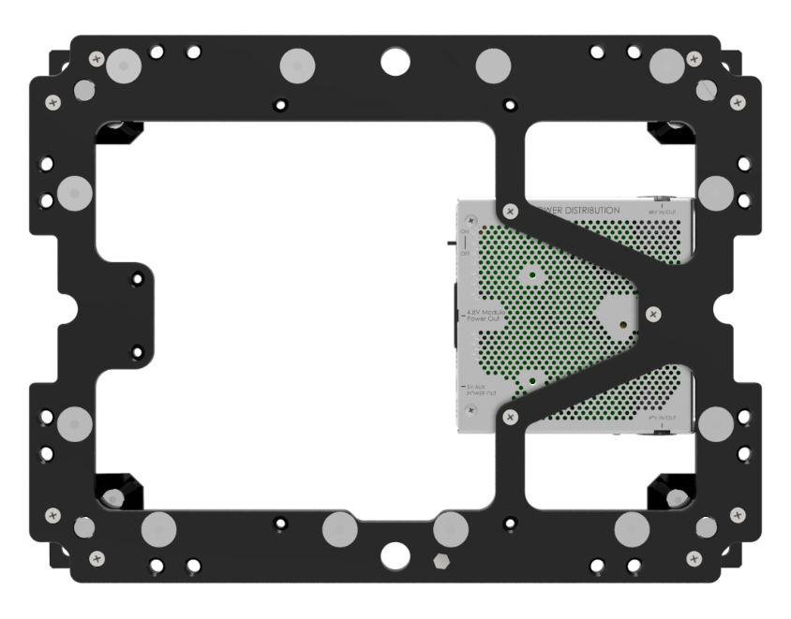
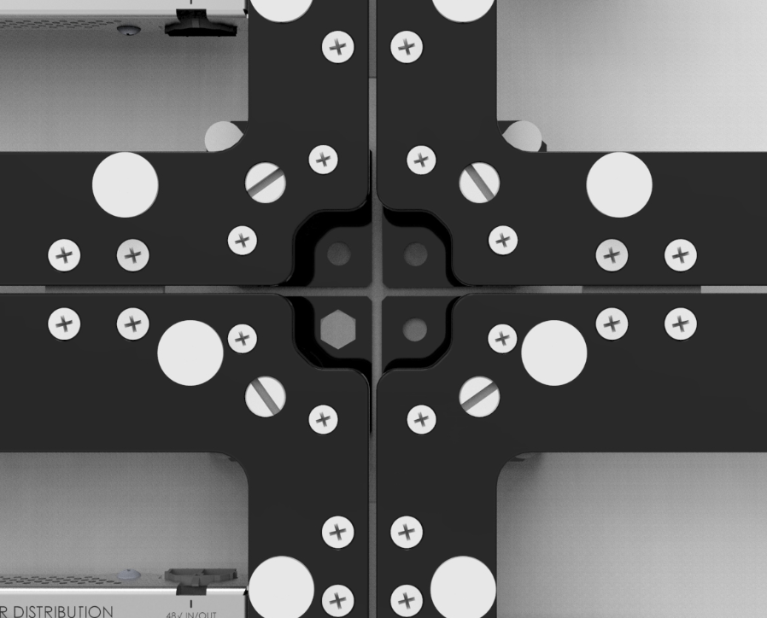
Precision x, y and z-Axis Alignment on Planar EasyAlign Mount
Magnet Pads Larger than LED Display Module Attach Points for x-and y-Axis Adjustment (12)
Link Mount Plates for x- and y-Axis Alignment Between Adjacent Planar EasyAlign Mounts
z-Axis Adjust Points In Each Corner (4)
z-Axis Locking Screws In Each Corner (4 pair)

Slide 9
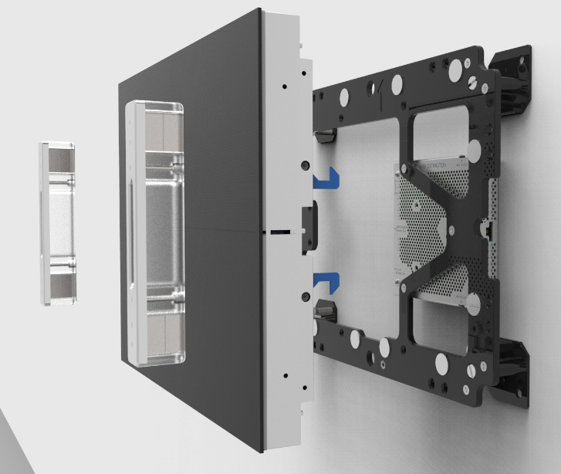
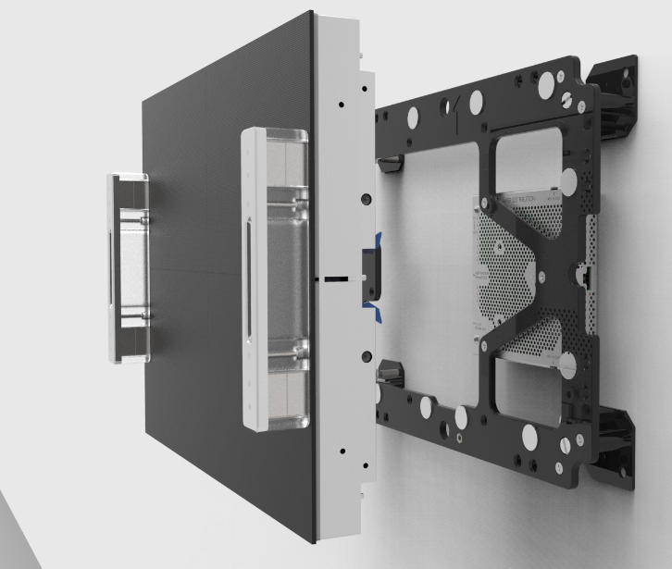
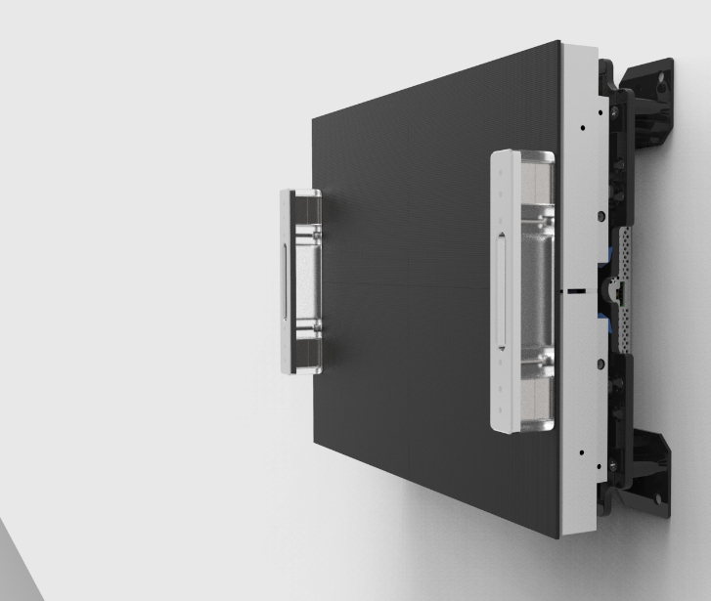
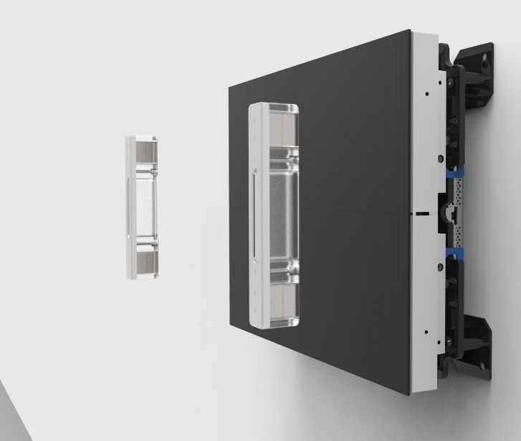
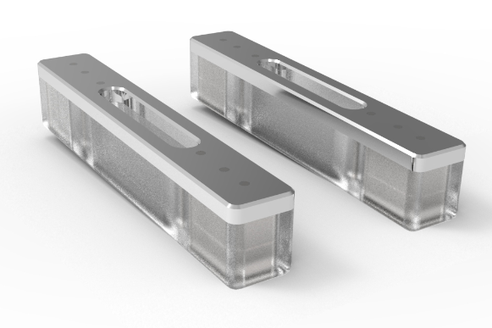
Attachment of LED Display Module to Planar EasyAlign Mount
Insertion Tool Retracts Locking Mechanism
Insertion
Tool (pair)
LED Display
Module
Locking
Mechanism (4)
LED Display
Module
Locks Onto
EasyAlign Mount
Locking Mechanism for Added Safety and Security

Slide 10
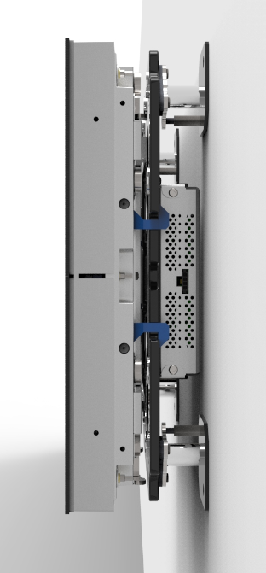
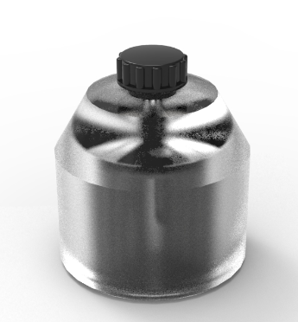
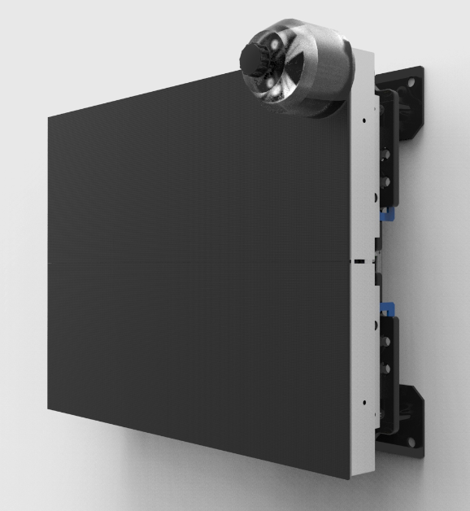
Ultra-Fine z-Axis Alignment on LED Display Modules
Z-Axis
Adjustment
Tool
z-Axis
Adjustment
Cam
±0.08” (2mm)
(8 per LDM)

Slide 11
Planar DirectLight Control Software
For Ultra-fine Image Optimization
Windows-based app for set-up and image control
Brightness control
RGB adjustment
Gamma gray scale adjustment
Color space and color temperature
adjustment
Output On/Off
Electronic seam correction – per pixel control

Slide 12

Unique Off-Board Power Architecture Delivers 24x7 Reliability
Centrally-locate with other electronics up to 200’/61M away from the LED video wall
Easy-to-access location minimizes disruption at the LED video wall
Rack mounted power supply allows for efficient cooling and improved maintenance access
Redundant power supply, video source and cabling options available to ensure uninterrupted operation
Fiber Optic and HDBaseT video extenders available

Slide 13
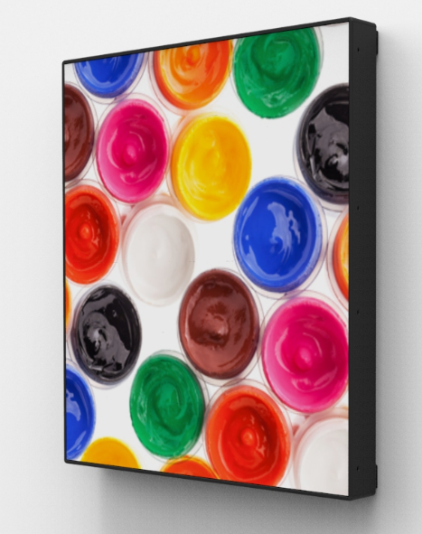
Remote Power Architecture Improves Reliability & Experience
Commercial-grade quality
Removes heat and complexity from behind the LED video wall
Delivers whisper quiet, fan-less operation

Slide 14
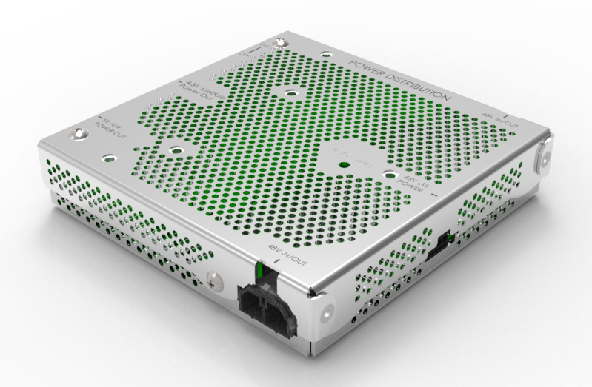
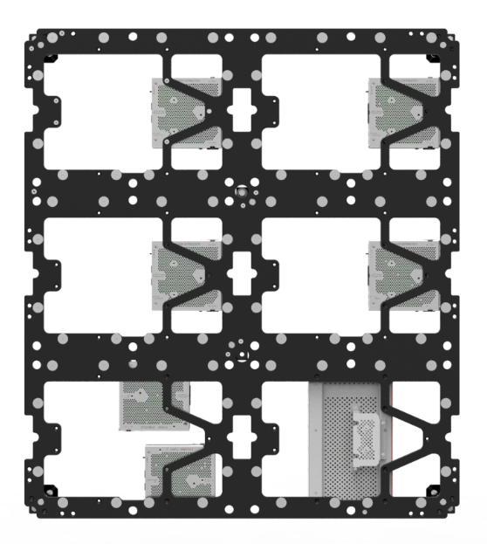
Simplified Installation with Planar EasyAlign Mounting System
Integrated power distribution for fewer long distance cable runs and faster installation
No AC power outlets required behind the LED video wall, reducing installation complexity
Power Distribution Unit (PDU)

Slide 15
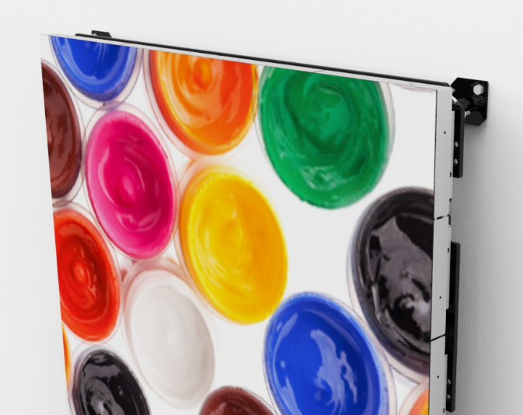
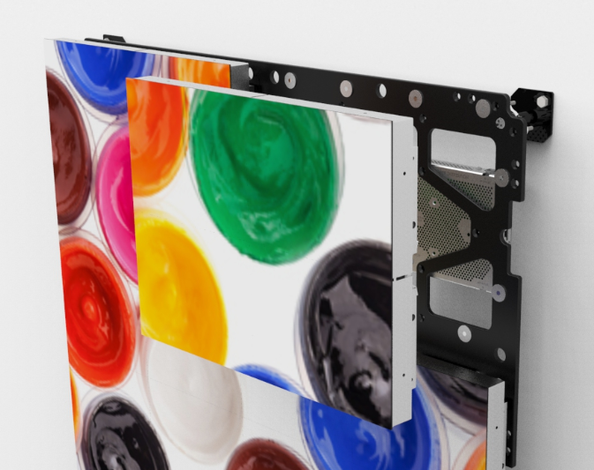
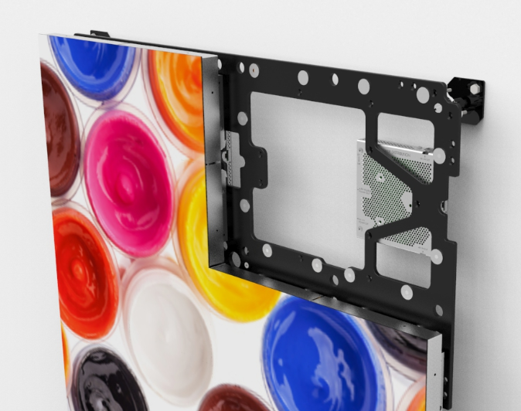
Front Serviceability Minimizes Downtown
Eliminates the need for rear access, freeing valuable space
Lockable for added safety and security
Single person installation and removal of LED Display Modules
Install and remove without adjusting others on the LED video wall

Slide 16
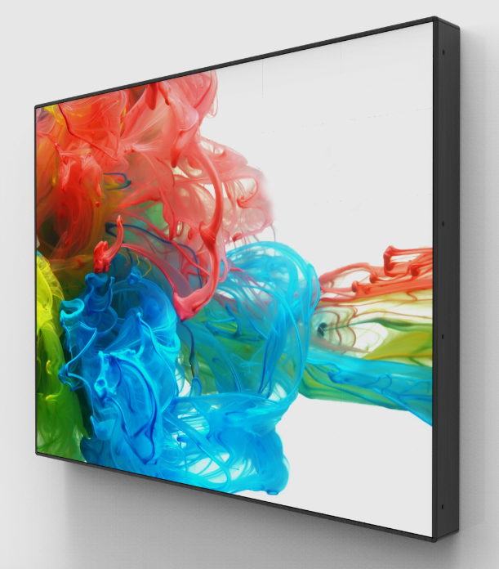
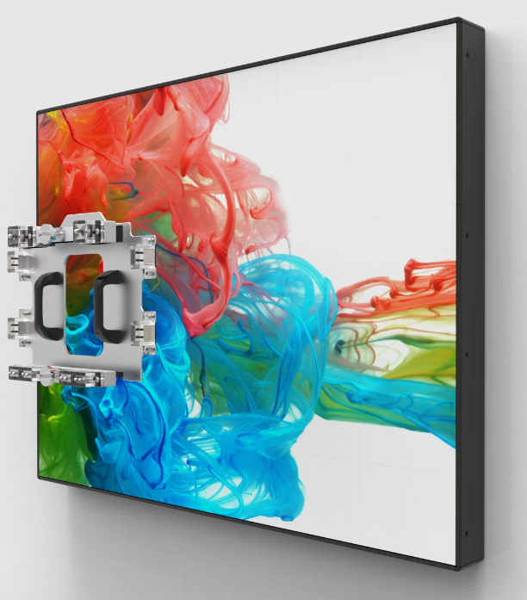
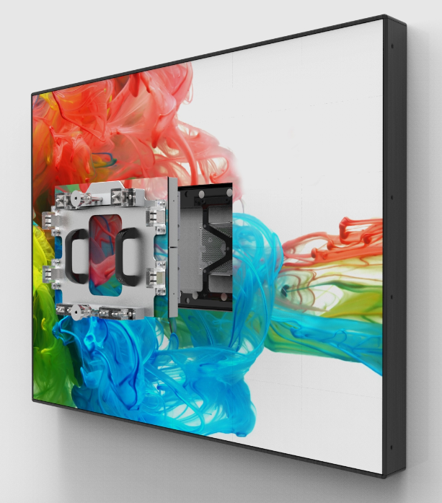
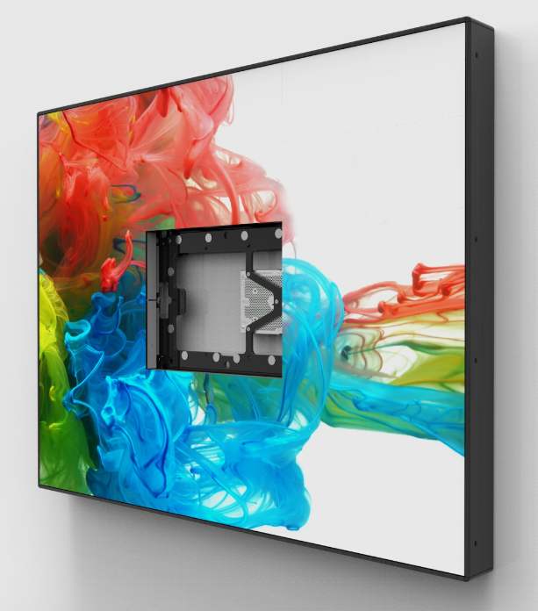
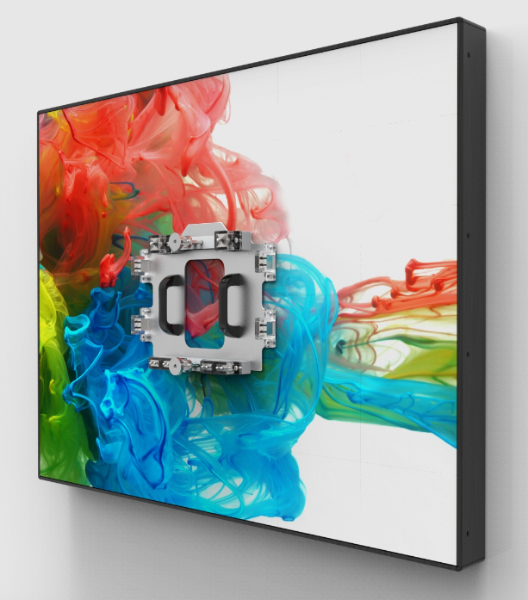
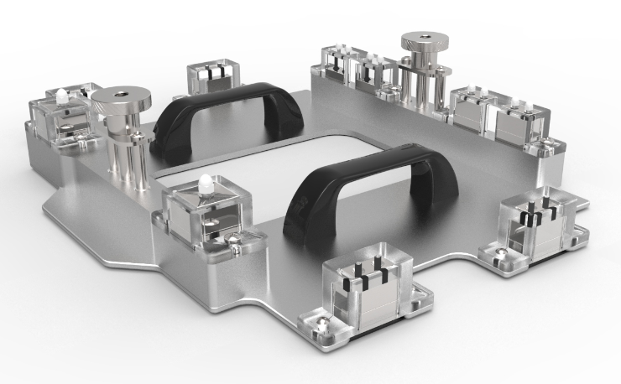
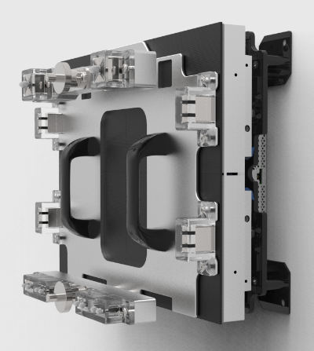
Simplified Service
Removal of LED Display Module
Removal Tool
Remove Any
LED Display
Module Without
Moving Or
Damaging Those
Surrounding It!
Removal Tool on LED Display Module

Slide 17
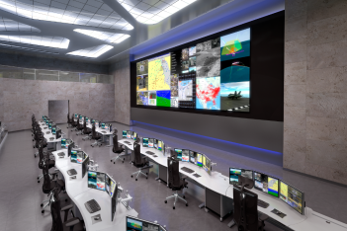
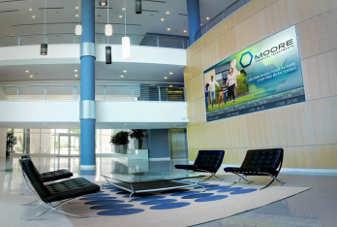
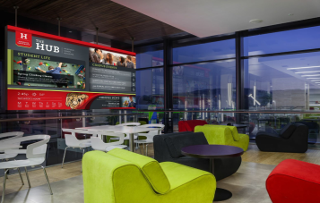
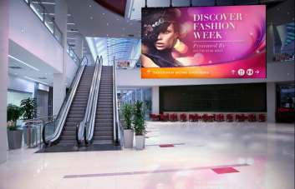
Extensible to Wide Variety of Environments
Optimized for 16:9 aspect ratio, 1080p & 4K formats
Wide variety of configurations possible
Maintains color calibration even at low brightness
Excellent off-axis viewing with no color shift
Broad compatibility with leading image processing and content management systems
Thinnest direct view LED video wall available
Eliminates the need for rear access, freeing valuable space
No AC power outlets required behind the LED video wall
Delivers whisper quiet, fan-less operation
Control Room
Corporate
University
Public Spaces

Slide 18
Super Slim Profile
Ideal for Space-Constrained Environments:
Less than 4”/102mm total mounted depth
Americans with Disabilities Act-compliant (ADA )
Eliminates need for recessed video wall, saving time consuming building modifications

Slide 19
Optimized for 16:9 Aspect Ratio
11.8’/3.6M
289.1”/7.3M
8.9’/2.7M
216.8”/5.5M
5.9’/1.8M
144.5”/3.7M
3.0’/0.9M
72.3”/1.8M
5.3’ 1.6M
10.5’ 3.2M
15.8’ 4.8M
21.0’ 6.4M
DL1.6 | 960x540 | 1,920x1,080 | 2,880x1,620 | 3,840x2,160
DL1.9 | 832x468 | 1,664x936 | 2,496x1,404 | 3,328x1,872
DL2.5 | 640x360 | 1,280x720 | 1,920x1,080 | 2,560x1,440
DL3.1 | 512x288 | 1,024x576 | 1,536x864 | 2,048x1,152

Slide 20
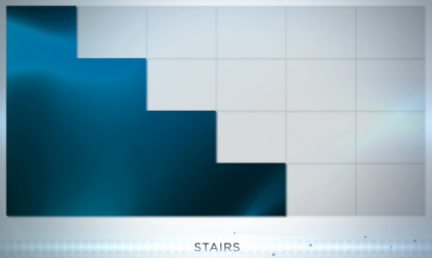
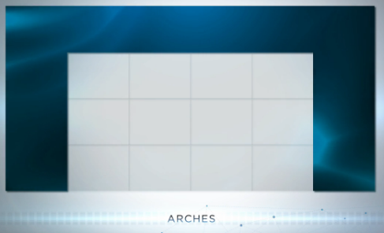
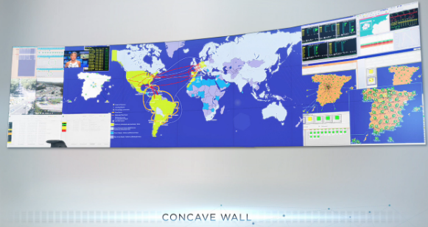
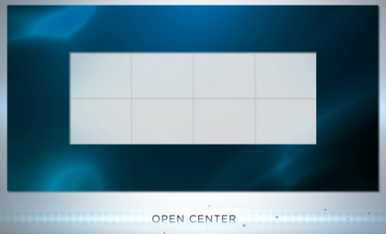
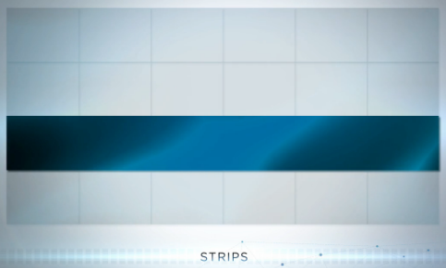
Wide Variety of Configurations Possible
Via Planar EasyAlign Mounting System
Concave, floor standing and hanging enabled via 3rd party mounting structures

Slide 21
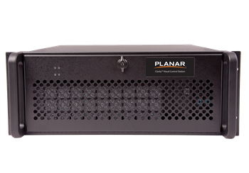
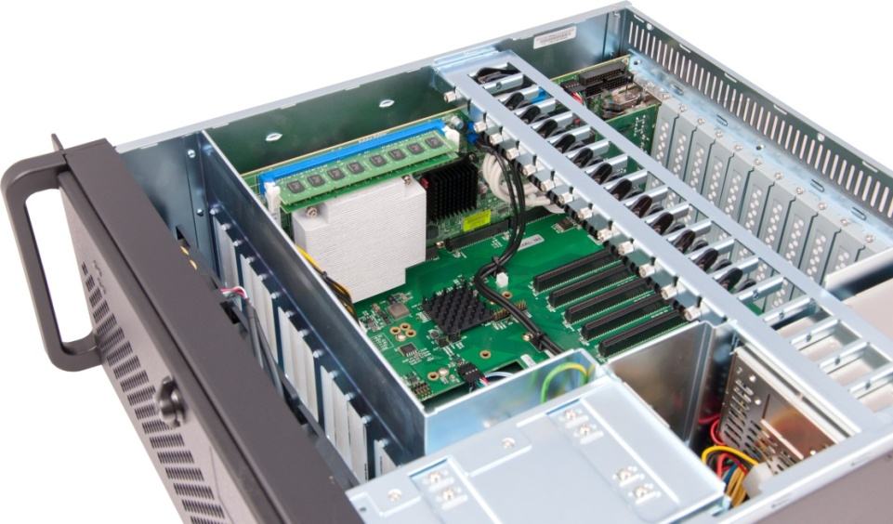
Image Processing & Content Management
Broad compatibility with leading image processing and content management systems such as Clarity® Visual Control Station (VCS)
Clarity VCS Video Wall Processor
  Flexible and easy-to-use video wall controller
  All-in-one hardware and software solution
  Drives video walls of up to 40 high resolution displays
  Locally or remotely controlled

Slide 22
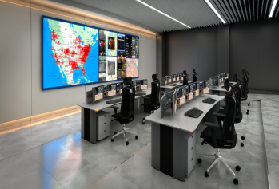



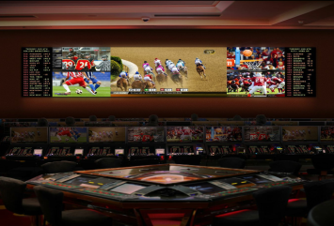

Planar DirectLight Target Applications
Fixed Installations, Indoor Installations:
Public Areas
Retail
Corporate Lobbies & Common Areas
Atrium & Architectural
Museums
Universities
Control Rooms
Broadcast On-Air
Presentation & Decision Rooms
Auditoriums
Clarity™ Matrix G2 Overview

Slide 23

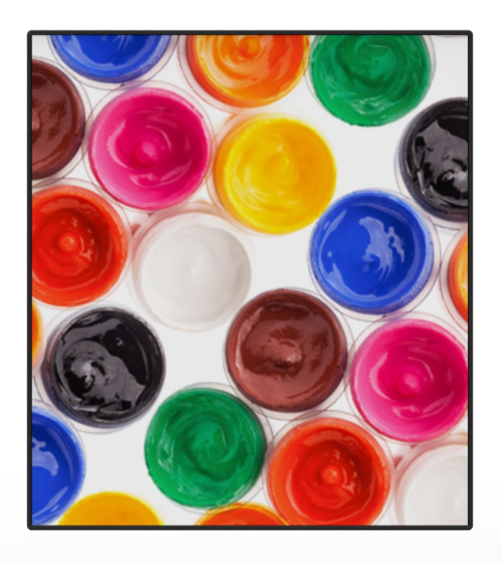
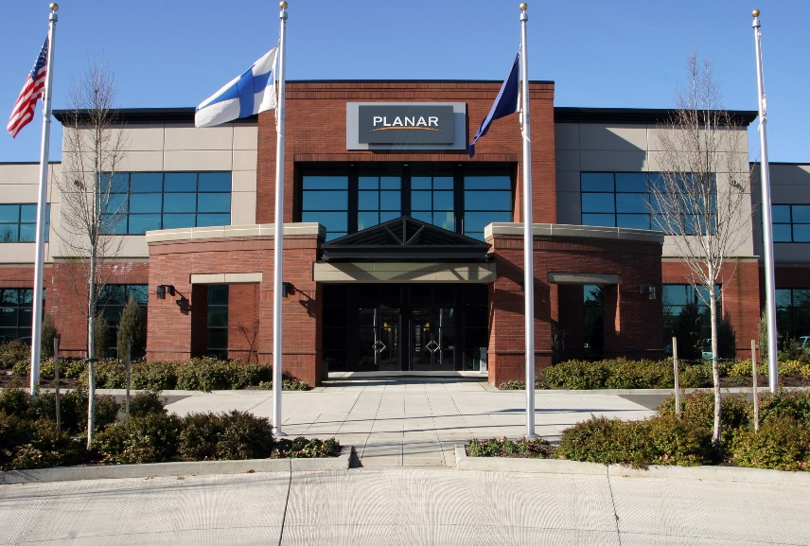
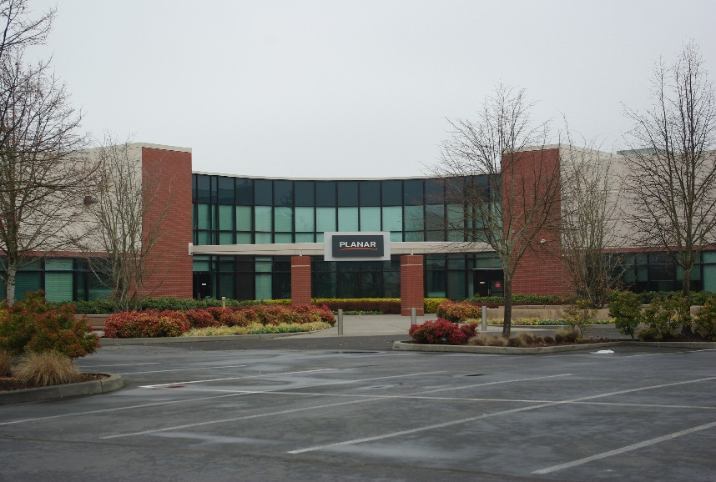
Made In The USA
Designed, Assembled and Shipped from Beaverton, Oregon; USA
Planar Headquarters
Planar Manufacturing

Slide 24
Planar® DirectLight™ LED Video Wall System
Family of Best-in-Class Direct View LED Video Walls for Digital Signage & Control Rooms
Superior Visual Performance
Mission-Critical Reliability
Optimized For Your Unique Indoor Environment
From a Partner you Trust:

Slide 25
Thank you!

