Slide 1
DirectLight™ LED Video Wall System
Best-in-Class Solution for Digital Signage & Control Rooms
DirectLight™ Product Overview

Slide 2
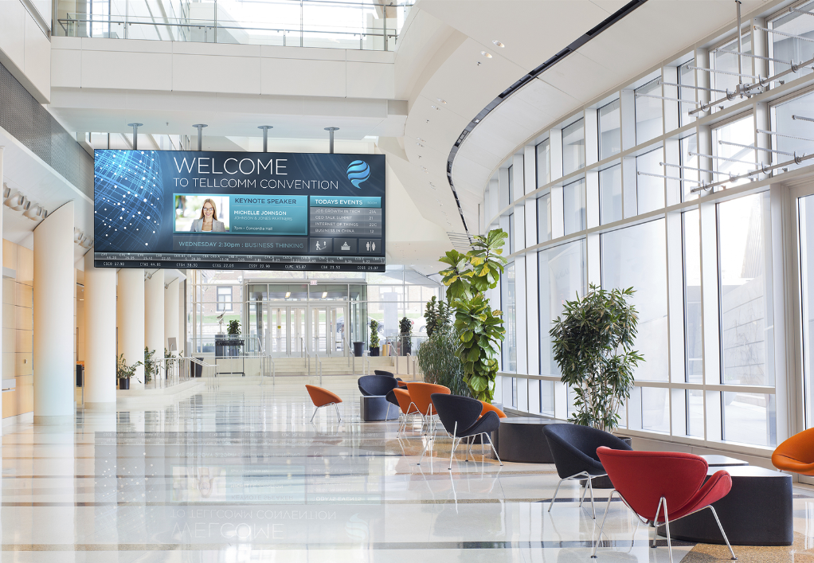
DirectLight™ LED Video Wall System
Family of Best-in-Class DV LED Video Walls for Digital Signage & Control Rooms
Superior Visual Performance
Mission-Critical Reliability
Optimized For Your Unique Indoor Environment
From a partner you trust:

Slide 3
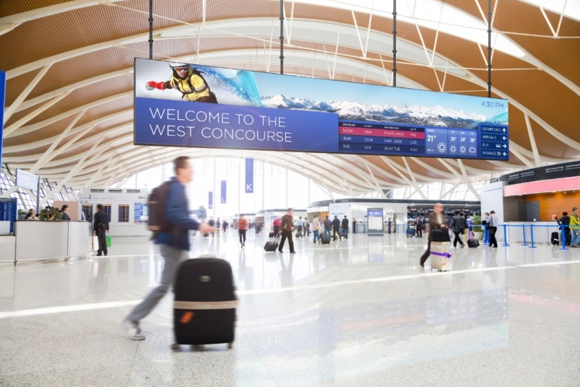
Truly Seamless, Ultra-Fine Pitch with Unmatched Image Quality
Black resin LEDs and MicroGrid Shader™ for deeper blacks, higher contrast and lower reflectance
Maintains color calibration even at low brightness
Excellent off-axis viewing with no color shift
Available in 1.6, 1.9, 2.5 and 3.1mm pitches in a single architecture
Seamless bezel-free: No more seams dividing your content

Slide 4
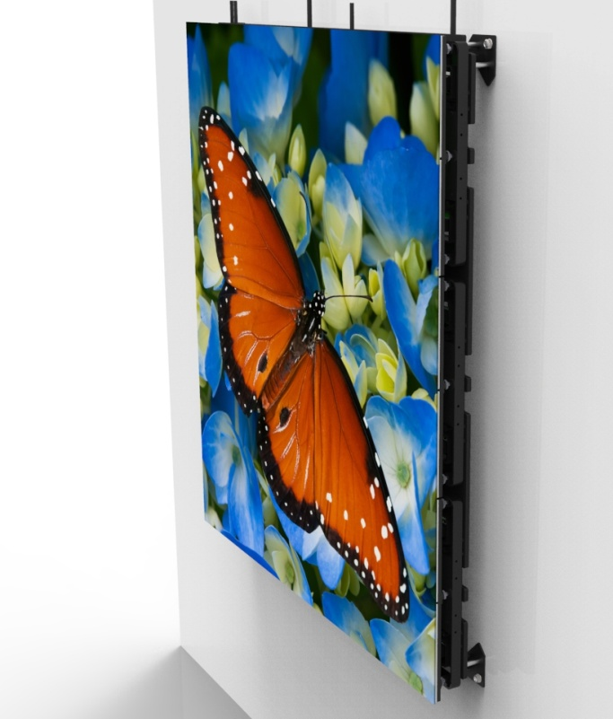
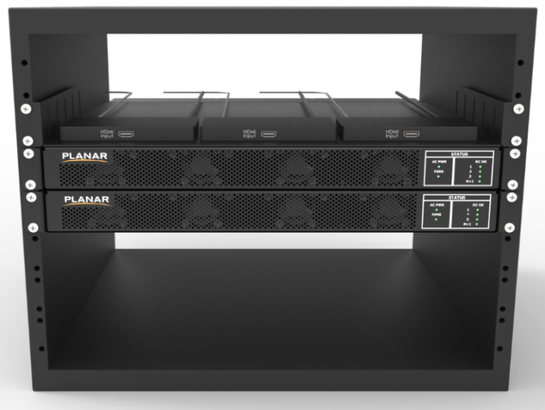
DirectLight™ LED Video Wall System Components
Power, Data and Control Cables
EasyAlign™ Mounting System
LED Display Modules
Power Supply Modules
Video Signal Extenders
3
2
5
1
4

Slide 5
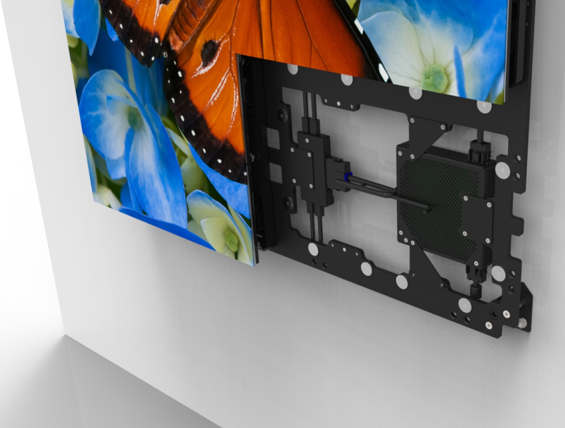
Precision Alignment & Image Optimization with Revolutionary Mounting System + Software
EasyAlign™ Mounting system for ultra-fine 6-axis adjustments
DirectLight™ Control Software for automated fine tune calibration

Slide 6
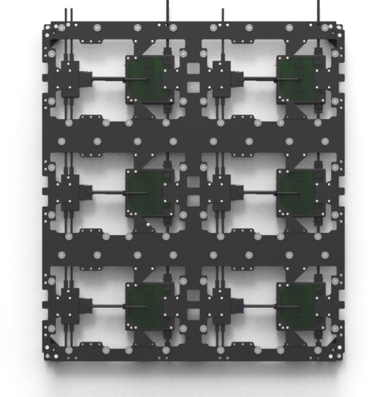
EasyAlign™ Mounting System
Available in:
DirectLight™ LED Calculator
automatically configures optimal
combination of mounts
Configuration | Dimensions
2x3 (6 Display Modules) | 31.5x35.4” 800x900mm
4x1 (4 Display Modules) | 63.0x11.8” 1,600x300mm
1x3 (3 Display Modules) | 15.7x35.4” 400x900mm
1x1 (1 Display Module) | 15.7x11.8” 400x300mm
Shown: 2x3

Slide 7
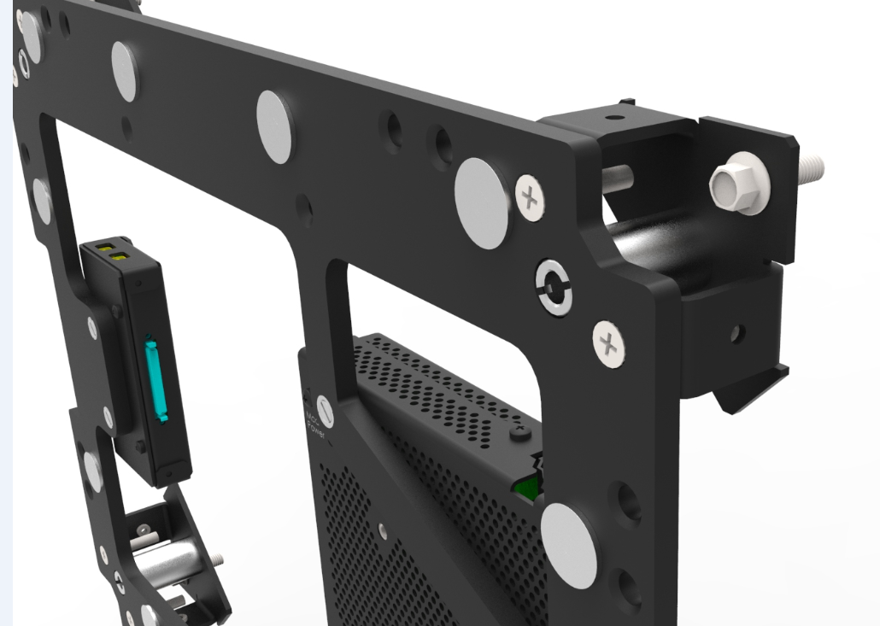
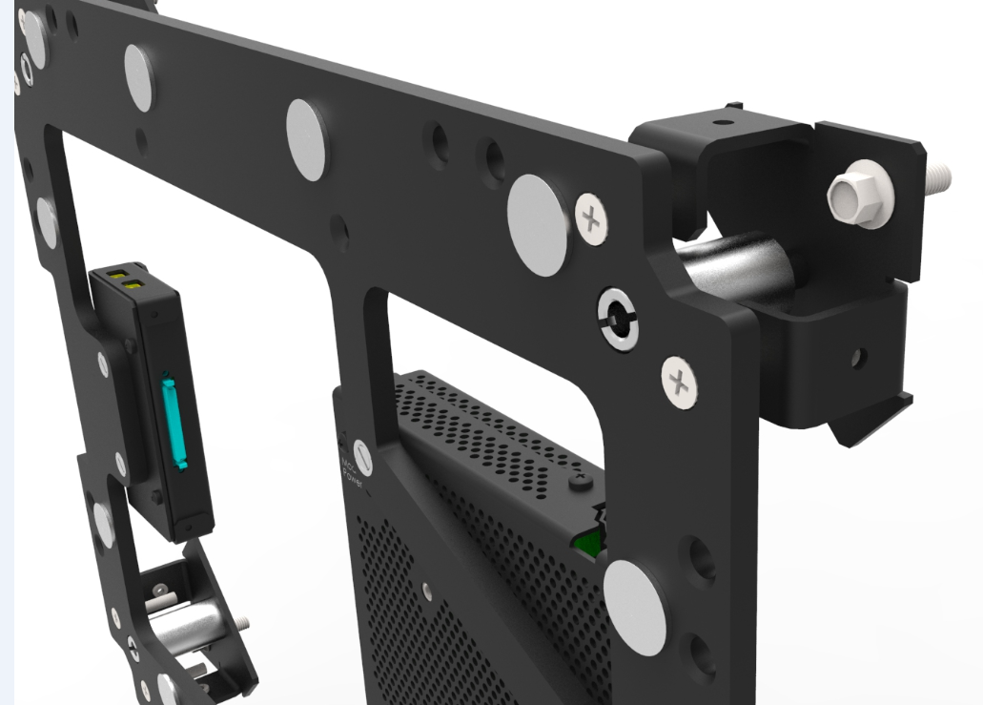
Z-axis Adjustment on EasyAlign™ Mounting System
Maximum Depth:
4”/102mm
Minimum Depth:
3.5”/89mm

Slide 8
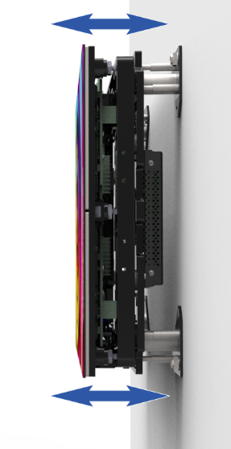
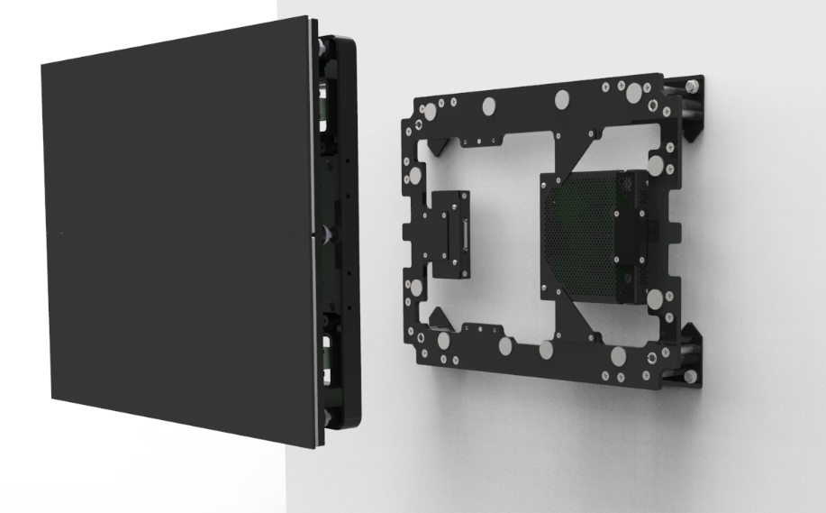
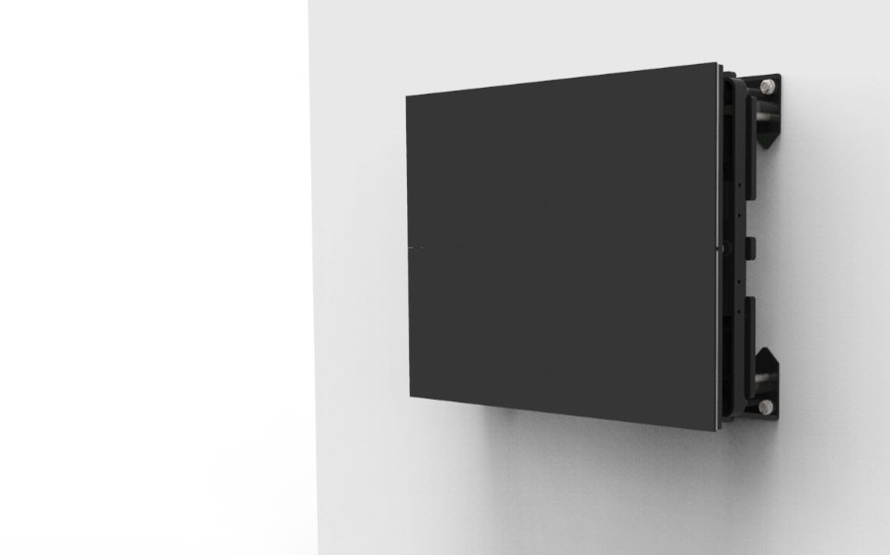
Attachment of LED Display Module
to EasyAlign™ Mounting System

Slide 9
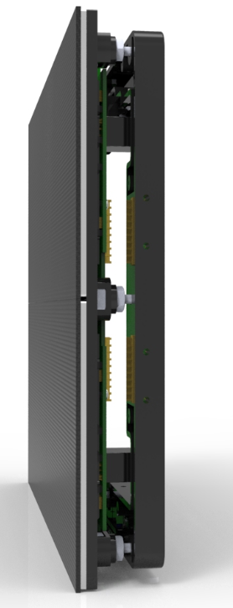
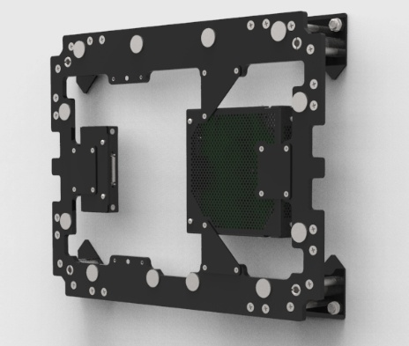
Precision Alignment
8 Z-axis adjust points on each LED Display Module with
magnetized adjustment tool.
Magnet pads for LED Display Module attachment
Z-axis adjust points in each corner

Slide 10
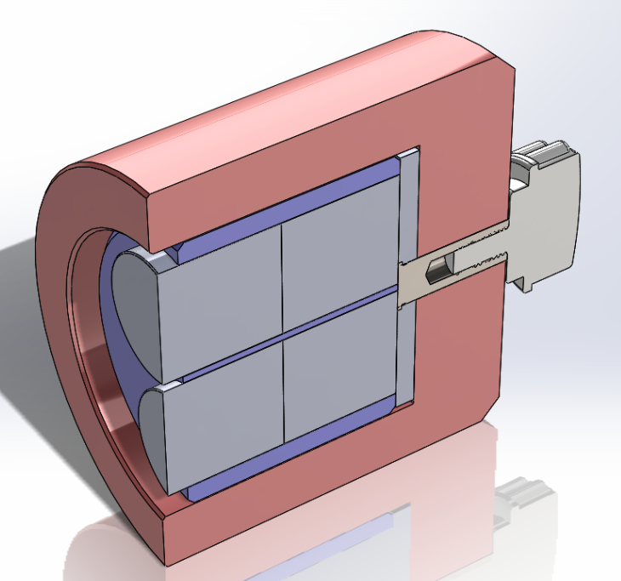
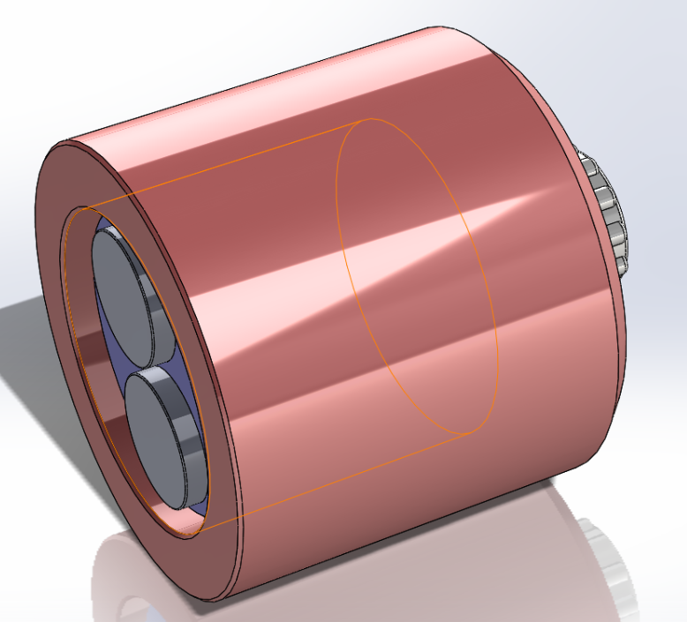
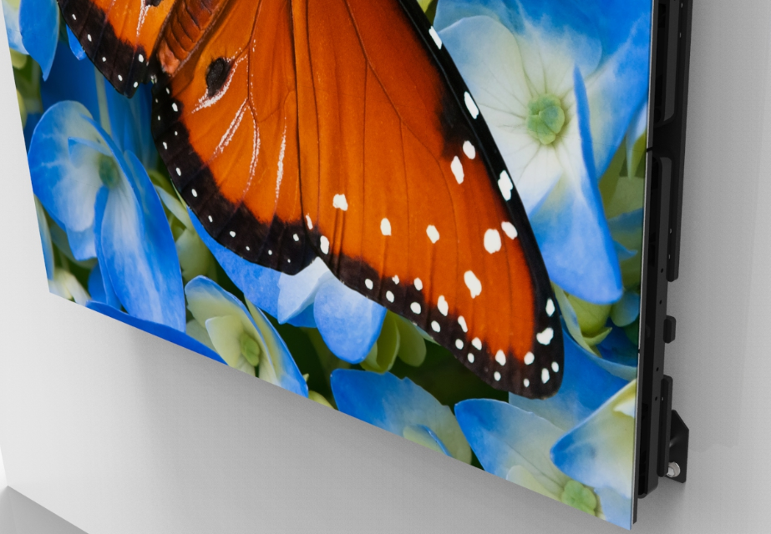
Z-axis Adjustment on LED Display Module

Slide 11
DirectLight™ Control Software
For Ultra-fine Image Optimization
Windows based app for setup and image control
Brightness control
RGB adjustment
Gamma gray scale adjustment
Color space and color temperature adjustment
Output On/Off
Electronic seam correction – per pixel control

Slide 12
Unique Off-Board Power Architecture Delivers 24x7 Reliability
Centrally locate with other electronics up to 200’/61M away from the LED video wall
Easy to access location minimizes disruption at the LED video wall
Rack mounted power supply allows for efficient cooling and improved maintenance access
Redundant power supply, video source and cabling options available to ensure uninterrupted operation
Fiber optic and HDBaseT video extenders available

Slide 13
Remote Power Architecture Improves Reliability & Improves Experience
Commercial grade quality
Removes heat and complexity from behind the LED video wall
Delivers whisper quiet, fan-less operation

Slide 14
Simplified Installation with Revolutionary Mounting System
Integrated power and video distribution for fewer long distance cable runs and faster installation
No AC power outlets required behind the LED video wall, reducing installation complexity

Slide 15
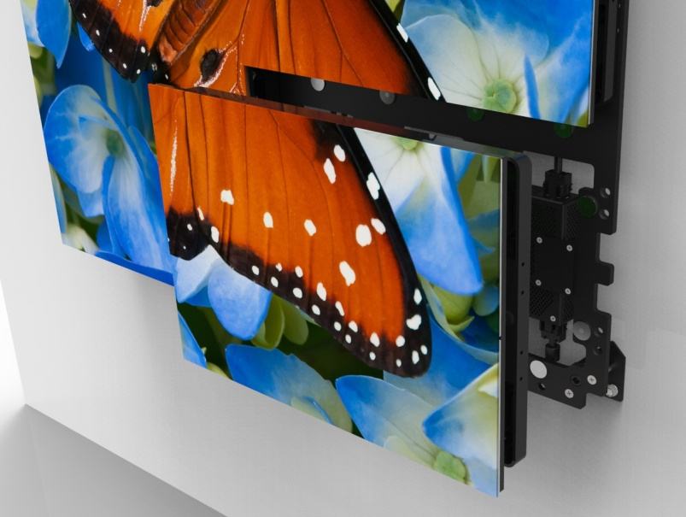
Front Serviceability Minimizes Downtown
Single person installation and removal of LED Display Modules
Install and remove without adjusting others on the LED video wall
Eliminates the need for rear access , freeing valuable space
Lockable for added safety and security

Slide 16
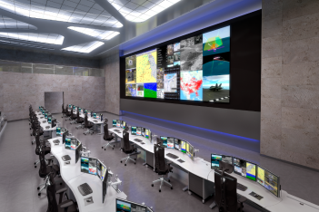
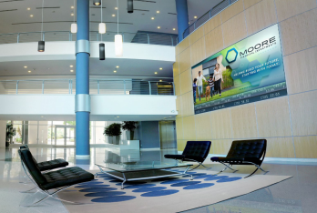
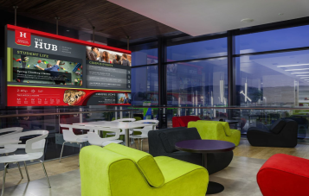
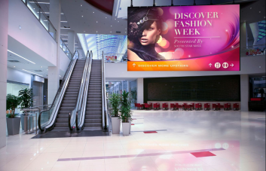
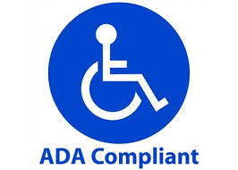
Extensible to Wide Variety of Environments
Optimized for 16:9 aspect ration, 1080p & 4K formats
Wide Variety of configurations possible
Maintains color calibration even at low brightness
Excellent off-axis viewing with no color shift
Broad compatibility with leading image processing and content management systems
Thinnest direct view LED video wall available
Eliminates the need for rear access , freeing valuable space
No AC power outlets required behind the LED video wall
Delivers whisper quiet, fan-less operation
Control Room
Corporate
University
Public Spaces

Slide 17
Super Slim Profile Ideal For Space Constrained Environments
Less than 4”/102mm mounted depth
Americans with Disabilities Act (ADA ) compliant
Eliminates need for recessed wall, saving time consuming building modifications

Slide 18
Optimized for 16:9 Aspect Ratio
11.8’/3.6M
289.1”/7.3M
8.9’/2.7M
216.8”/5.5M
5.9’/1.8M
144.5”/3.7M
3.0’/0.9M
72.3”/1.8M
5.3’ 1.6M
10.5’ 3.2M
15.8’ 4.8M
21.0’ 6.4M
DL1.6 | 960x540 | 1,920x1,080 | 2,880x1,620 | 3,840x2,160
DL1.9 | 832x468 | 1,664x936 | 2,496x1,404 | 3,328x1,872
DL2.5 | 640x360 | 1,280x720 | 1,920x1,080 | 2,560x1,440
DL3.1 | 512x288 | 1,024x576 | 1,536x864 | 2,048x1,152

Slide 19
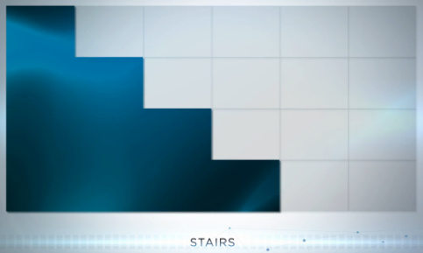
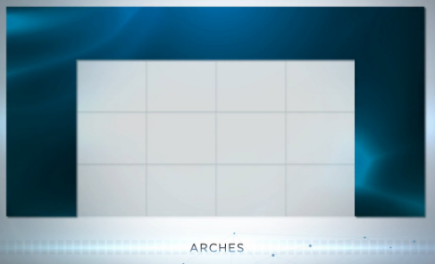
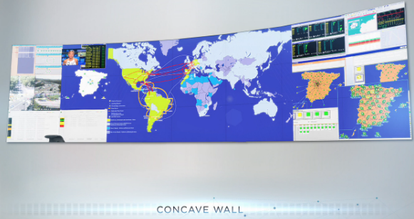
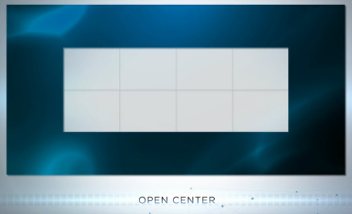
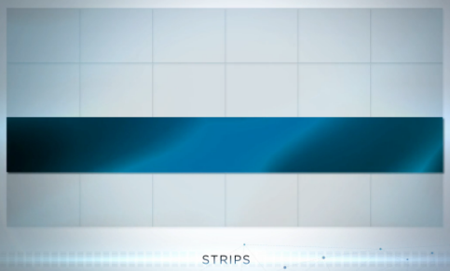
Wide Variety of Configurations Possible
Via EasyAlign™ Mounting System
Concave, curved, floor standing and hanging enabled via 3rd party mounting structures

Slide 20
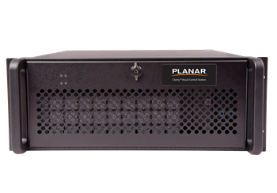
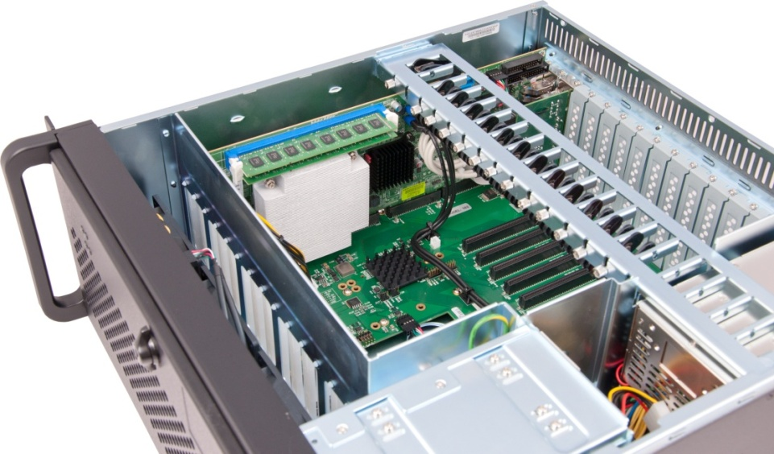
Image Processing & Content Management
Broad compatibility with leading image processing and content management systems such as Clarity™ Visual Control Station (VSC)
Clarity Visual Control Station (VCS)
Flexible and easy-to-use video wall controller
All-in-one hardware and software solution
Drives video walls of up to 40 high resolution displays
Locally or remotely controlled

Slide 21
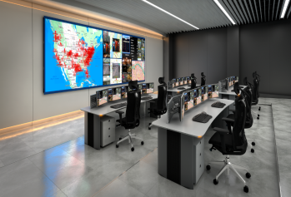
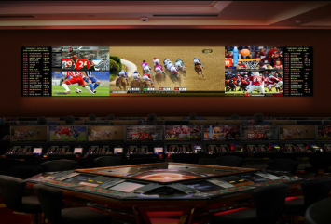
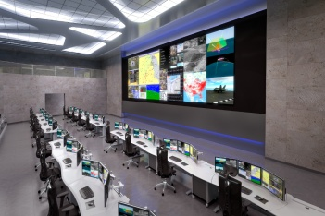
Targeted Applications
Fixed Installation, Indoor
Public Areas
Retail
Corporate Lobby & Common Areas
Atrium & Architectural
Museum
University
Control Room
Broadcast On-Air
Presentation & Decision Room
Auditorium
Clarity™ Matrix G2 Overview

Slide 22
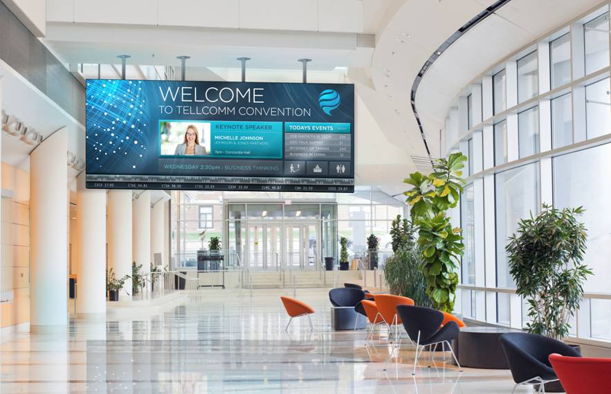
DirectLight™ LED Video Wall System
Family of Best-in-Class DV LED Video Walls for Digital Signage & Control Rooms
Superior Visual Performance
Mission-Critical Reliability
Optimized For Your Unique Indoor Environment
From a partner you trust:

Slide 23
Thank you!

