Slide 1
Planar® DirectLight™ LED Video Wall System
Processing Overview
August 2015

Slide 2
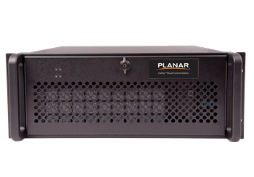
Planar® DirectLight™ LED Video Wall System Content Planning
Video Processing Considerations
Content & Processing Options:
Design the content to fit the video wall’s resolution
Design the video wall to fit the content’s resolution
Use an external processor to process the content to fit the video wall

Slide 3
Planar DirectLight Content Planning
Video Processing Considerations
Standard Resolution:
If the Planar DirectLight video wall requires more than one LED Video Interface (LVI) at standard resolution, then each LVI must have its own content source. You may use either:
An external video processor with one output to each LVI
An PC with multiple graphics cards with one output to each LVI
Multiple synchronized media players with one output to each LVI
Non-Standard Resolution:
If the Planar DirectLight video wall requires more than one LED Video Interface (LVI) at non-standard resolution, then each LVI must have its own content source. You need:
An external video processor with the ability to exactly match vertical refresh and pixel clock for all resolutions

Slide 4
Example: Video Wall Equals One LVI
DL1.6: 8 x 6 LED Display Modules
1920 = 10.5’ (3.2m)
1080 = 5.9’ (1.8m)

Slide 5
Example: Video Wall Equals One LVI
DL1.6: 8 x 6 LED Display Modules
1920 = 10.5’ (3.2m)
= 48 Modules
1080 = 5.9’ (1.8m)

Slide 6
Example: Video Wall Equals One LVI
DL1.6: 8 x 6 LED Display Modules
1920 = 10.5’ (3.2m)
1080 = 5.9’ (1.8m)
= 1 LVI

Slide 7
Example: Video Wall Equals One LVI
DL1.6: 8 x 6 LED Display Modules
Processing Options
Media Player
PC
Synchronized Media Players
PC with multiple output video card
Video Processor
Video Processor that exactly matches vertical refresh and pixel clock for all resolutions
1920 = 10.5’ (3.2m)
1080 = 5.9’ (1.8m)
LVI A
1920 x 1080

Slide 8
Example: Video Wall Equals Two LVIs
DL1.6: 16 x 6 LED Display Modules
3840 = 21’ (6.4m)
1080 = 5.9’ (1.8m)

Slide 9
Example: Video Wall Equals Two LVIs
DL1.6: 16 x 6 LED Display Modules
3840 = 21’ (6.4m)
1080 = 5.9’ (1.8m)
= 96 Modules

Slide 10
Example: Video Wall Equals Two LVIs
DL1.6: 16 x 6 LED Display Modules
3840 = 21’ (6.4m)
1080 = 5.9’ (1.8m)
= 2 LVIs

Slide 11
Example: Video Wall Equals Two LVIs
DL1.6: 16 x 6 LED Display Modules
Processing Options
Media Player
PC
Synchronized Media Players
PC with multiple output video card
Video Processor
Video Processor that exactly matches vertical refresh and pixel clock for all resolutions
3840 = 21’ (6.4m)
1080 = 5.9’ (1.8m)
LVI A
1020 x 1080
LVI B
1920 x 1080

Slide 12
Example: Display Built to Match Video Wall (Non Standard Resolution)
DL1.6: 16 x 8 LED Display Modules
3840 = 21’ (6.4m)
1,440 = 7.9’ (2.4m)

Slide 13
Example: Display Built to Match Video Wall (Non Standard Resolution)
DL1.6: 16 x 8 LED Display Modules
3840 = 21’ (6.4m)
1,440 = 7.9’ (2.4m)
= 128 Modules

Slide 14
Example: Display Built to Match Video Wall (Non Standard Resolution)
DL1.6: 16 x 8 LED Display Modules
3840 = 21’ (6.4m)
1,440 = 7.9’ (2.4m)
= 4 LVIs

Slide 15
Example: Display Built to Match Video Wall (Non Standard Resolution)
DL1.6: 16 x 8 LED Display Modules
3840 = 21’ (6.4m)
LVI C
1920 x 720
LVI D
1920 x 720
1,440 = 7.9’ (2.4m)
= 4x (1920 x 720)
LVI A
1920 x 720
LVI B
1920 x 720

Slide 16
Example: Display Built to Match Video Wall (Non Standard Resolution)
DL1.6: 16 x 8 LED Display Modules
Processing Options
Media Player
PC
Synchronized Media Players
PC with multiple output video card
Video Processor
Video Processor that exactly matches vertical refresh and pixel clock for both resolutions
3840 = 21’ (6.4m)
LVI C
1920 x 720
LVI D
1920 x 720
1,440 = 7.9’ (2.4m)
LVI A
1920 x 720
LVI B
1920 x 720

Slide 17
Example: Display Built to Match Vide Wall (Various Non Standard Resolutions)
DL1.6: 13 x 9 LED Display Modules
3120 = 17’ (5.2m)
1,620 = 8.8’ (2.7m)

Slide 18
Example: Display Built to Match Video Wall (Various Non Standard Resolutions)
DL1.6: 13 x 9 LED Display Modules
3120 = 17’ (5.2m)
1,620 = 8.8’ (2.7m)
= 117 Modules

Slide 19
Example: Display Built to Video Match Wall (Various Non Standard Resolutions)
DL1.6: 13 x 9 LED Display Modules
3120 = 17’ (5.2m)
LVI C
1680 x 720
LVI D
1440 x 720
1,620 = 8.8’ (2.7m)
LVI A (1680 x 900)
LVI B (1400 x 900)
LVI C (1680 x 720)
LVI D (1440 x 720)
= 4 LVIs of various resolutions
LVI A
1680 x 900
LVI B
1440 x 900

Slide 20
Example: Display Built to Match Video Wall (Various Non Standard Resolutions)
DL1.6: 13 x 9 LED Display Modules
Processing Options
Media Player
PC
Synchronized Media Player
PC with multiple output video card
Video Processor
Video Processor that exactly matches vertical refresh and pixel clock for all resolutions
3120 = 17’ (5.2m)
LVI C
1680 x 720
LVI D
1440 x 720
1,620 = 8.8’ (2.7m)
LVI A
1680 x 900
LVI B
1440 x 900

Slide 21
Example: Video Wall Smaller than One LVI
DL1.6: 4 x 6 LED Display Modules
960 = 5.3’ (1.6 m)
1080 = 5.9’ (1.8m)

Slide 22
Example: Video Wall Smaller than One LVI
DL1.6: 4 x 6 LED Display Modules
960 = 5.3’ (1.6 m)
1080 = 5.9’ (1.8m)
= 24 Modules

Slide 23
Example: Video Wall Smaller than One LVI
DL1.6: 4 x 6 LED Display Modules
960 = 5.3’ (1.6 m)
1080 = 5.9’ (1.8m)
= 1 LVI

Slide 24
Example: Video Wall Smaller than One LVI
DL1.6: 4 x 6 LED Display Modules
Processing Options
Media Player
PC
Synchronized Media Player
PC with multiple output video card
Video Processor
Video Processor that exactly matches vertical refresh and pixel clock for all resolutions
960 = 5.3’ (1.6 m)
1080 = 5.9’ (1.8m)
LVI
960 x 1080

Slide 25
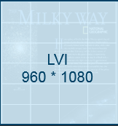
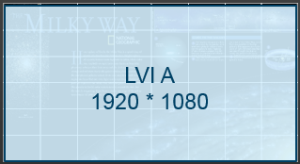
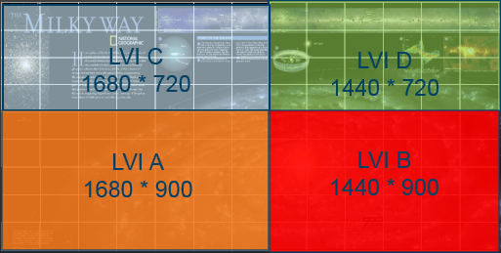
Planar DirectLight Processing Selection Table
 |  | Media Player | PC | Synchronized Media Player | PC with multiple output video card | Video Processor | Video Processor that matches vertical refresh and pixel clock for all resolutions
LED video wall smaller than one LVI |  |  |  |  |  | ☻ | ☻
LED video wall equals one LVI |  | ☻ | ☻ | ☻ | ☻ | ☻ | ☻
LED video wall equals multiple LVIs with standard resolution |  |  |  | ☻ | ☻ | ☻ | ☻
LED video wall to match wall space, one or more non-standard resolutions |  |  |  |  |  |  | ☻

Slide 26
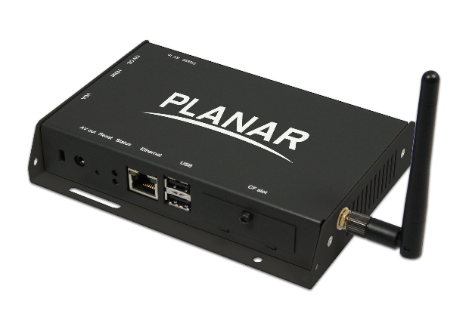
Media Players
Best used for:
Signage applications
Standard resolution
LED video wall driven by single LVI
Content consist of one set of images or videos displayed across the entire video wall
Definition:
Purpose-designed appliance for the display of video and pictures
Play, catalog and store art, photos and/or videos in resident hard drives or solid state storage
On some models content can be managed over the network
Low power consumption
Rack-mountable, wall-mountable, table top and OPS configurations
Available in HD and 4K resolutions

Slide 27
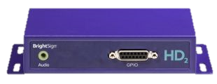
Synchronized Media Players
Best used for:
Signage Applications
Standard resolution
LED video wall driven by multiple standard resolution LVIs
Content consist of one set of images or video displayed across the entire video wall
Content consist of multiple images or video synchronized across different LVIs
Definition:
Purpose-designed appliance for the display of video and pictures
Play, catalog and store local art, photos and videos in resident hard drives or solid state storage
On some models content can be managed over the network
Low power consumption processors
Rack-mountable, wall-mountable, table top and OPS configurations
Available in HD and 4K resolutions
Players frame synchronized, allowing them to work together, creating a shared experience

Slide 28
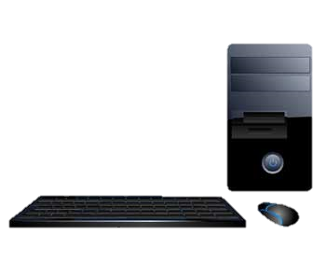
Personal Computers (PC)
Best used for:
Running applications
Standard resolution
LED video wall driven by single standard resolution LVIs
Content consist of one or various applications displayed across the entire wall
Definition:
Off-the-shelf computer with Windows, Mac or Linux operating systems
Run applications from hard drive, network or internet
With appropriate software, administrator can remote into PC for administrative purposes
Recommended due ability to run custom and off-the-shelf applications
Rack-mountable, wall-mountable, table top and OPS configurations
Available in various resolutions

Slide 29
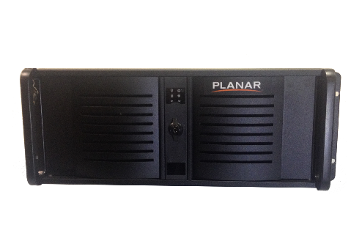
Personal Computers (PC) with Advance Video Card
Best used for:
Running applications
Standard resolution
LED video wall driven by multiple standard resolution LVIs
Content consist of one or various applications displayed across the entire video wall
Definition:
Off-the-shelf computer with Windows, Mac or Linux operating systems
Run applications from hard drive, network or internet
With appropriate software, administrator can remote into PC for administrative purposes
Recommended due ability to run custom and off-the-shelf applications
Rack-mountable, wall-mountable, table top and OPS configurations
Available in various resolutions
Advanced graphics video card(s) allow connection to multiple LVIs (HDI)

Slide 30
Video Processors
Best used for:
Routing multiple sources into one or more video walls
LED video wall driven by one or multiple non standard resolution LVIs
Content consist of one or various sources or applications displayed across the entire video wall
Definition:
Designed to enhance functionality of video walls
Designed to capture, display and manage multiple sources on a video wall
Supports wide range of visual inputs including analog, digital and high definition audio and computer sources
Easy-to-use graphical user interface allows easy selection and placement of sources
Run applications from hard drive, network or internet
With appropriate software, administrator can remote into PC for administrative purposes
Rack-mountable
Professional graphics video card(s) allow connection to multiple LVIs (HDI inputs) outputs

Slide 31
Video Processors (Exactly Match Vertical Refresh and Pixel Clock for all Resolutions)
Best used for:
Routing multiple sources into one or more video walls
LED video wall driven by one or multiple non standard resolution LVIs
Content consist of one or various sources or applications displayed across the entire video wall
Definition:
Designed to enhance functionality of video walls
Designed to capture, display and manage multiple sources on a video wall
Supports wide range of visual inputs including analog, digital and high definition audio and computer sources
Easy-to-use graphical user interface allows easy selection and placement of sources
Run applications from hard drive, network or internet
With appropriate software, administrator can remote into PC for administrative purposes
Rack-mountable
Professional graphics video card(s) allow connection to multiple LVIs (HDI inputs) outputs
Enhanced internal timing and set-up software to avoid video defects due to mixed resolutions

Slide 32
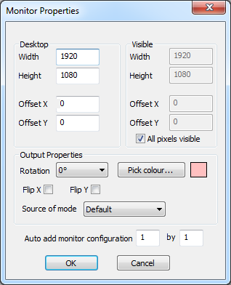
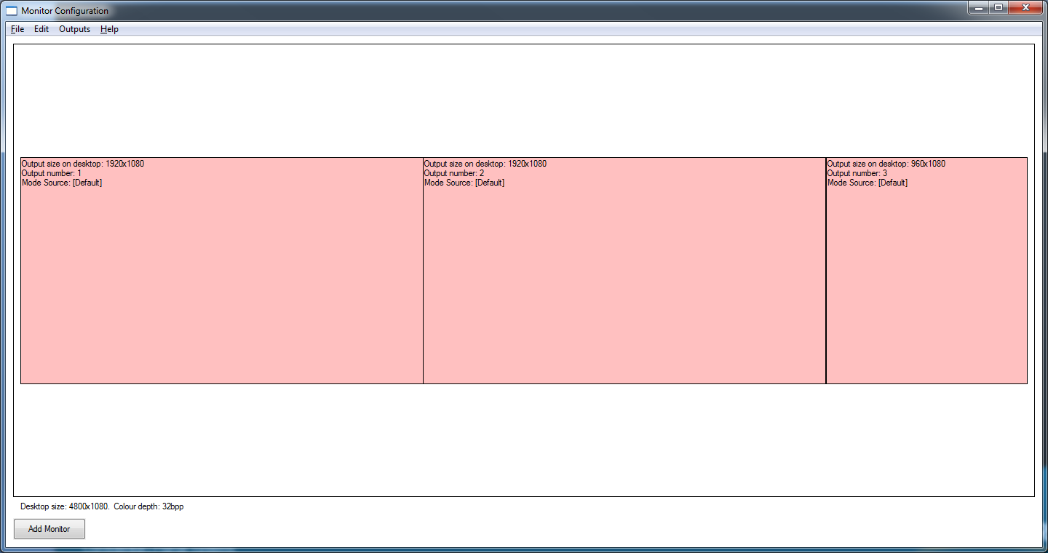
Clarity® Visual Control Station™ (VCS™)
Clarity VCS Optimizations Uniquely Matches Planar DirectLight Scalability
Add a resolution simply by entering the width, height and offset
When mixing 2 different resolutions, it automatically recalculates to the correct timing that exactly match vertical refresh and pixel clock for both resolutions
Avoids video imperfections (tearing) due to refresh frequency mismatch

Slide 33
Planar DirectLight background

Slide 34
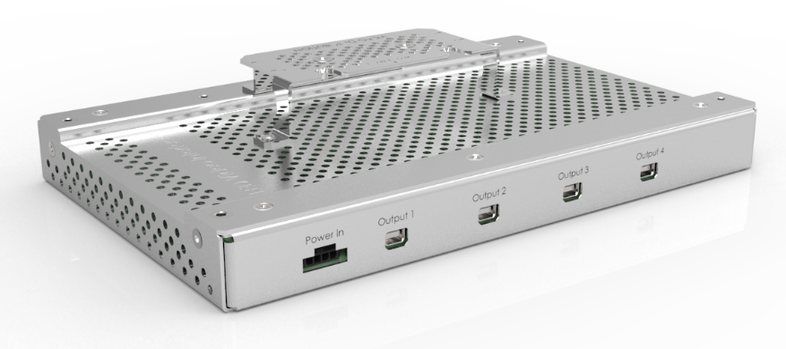
Planar DirectLight Video Connectivity
Planar DirectLight LED Video Interface:
Connects HDMI input to LED Display Modules
1920 x 1080 maximum resolution
Manages brightness and picture adjustments
Supports a RS-232 and LAN control
Resides behind the video wall
LED Display Modules are supported by a single LED Video Interface
 | Maximum Width: | Maximum Height: | Maximum Total:
DL1.6 | 8 | 6 | 48
DL1.9 | 9 | 6 | 54
DL2.5 | 12 | 9 | 108
DL3.1 | 15 | 11 | 165

Slide 35
Planar DirectLight Content Planning (Standard vs. Non-Standard Resolutions)
Standard Resolutions:
Configuration supported by off-the-shelf video card drivers.
For example:
1920 x 1080
1600 x 900
1280 x 720
800 x 600
Non-Standard Resolutions:
Configuration not supported by off-the-shelf video card drivers.
8.9’/2.7M
DL1.6: 144.5”/3.7M
1920*540
+1920*1080
= 1920*1620
5.9’/1.8M
DL1.6: 144.5”/3.7M
1920*1080
10.5’
3.2M
10.5’
3.2M

Slide 36
Examples: Non-Standard 16:9 Resolutions (In Red)
11.8’/3.6M
289.1”/7.3M
8.9’/2.7M
216.8”/5.5M
5.9’/1.8M
144.5”/3.7M
3.0’/0.9M
72.3”/1.8M
5.3’ 1.6M
10.5’ 3.2M
15.8’ 4.8M
21.0’ 6.4M
DL1.6 | 960x540 | 1,920x1,080 | 2,880x1,620 | 3,840x2,160
DL1.9 | 832x468 | 1,664x936 | 2,496x1,404 | 3,328x1,872
DL2.5 | 640x360 | 1,280x720 | 1,920x1,080 | 2,560x1,440
DL3.1 | 512x288 | 1,024x576 | 1,536x864 | 2,048x1,152

