Slide 1
Clarity Matrix with G2 Architecture
The best-in-class LCD video wall system just got better
Clarity Matrix G2 Product Overview

Slide 2
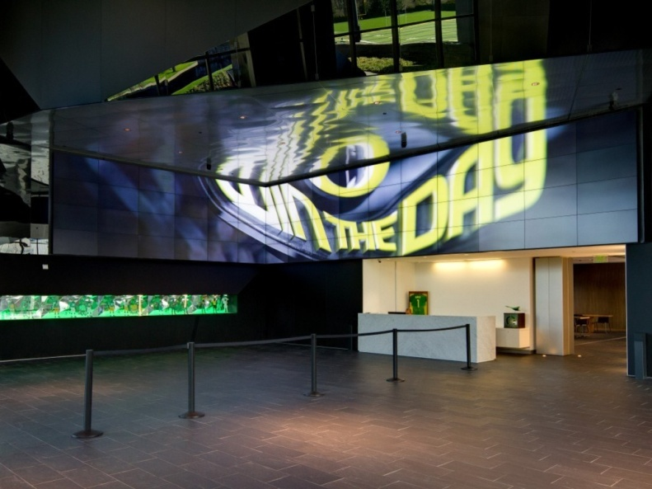
LCD Technology
Ultra-Narrow Bezel LCD Video Walls
High-Impact Video Walls
Shallow Depth
Great Brightness
Great Viewing Angles
Good Color and Brightness Matching
Long Life- Minimal Maintenance
Notes:
It wasn’t until 2 years ago that LCD technology had really became a viable technology used in video wall applications. Up until that point rear projection cubes were predominantly used in video walls. The gaps between screens for LCD were too large totally be effective. With a gap of only 7.3 mm or ¼” this category of LCD really Open up the opportunity for High Impact Video walls. This technology features great brightness, great viewing angles, Good brightness and Color, and provide a long life with minimal Maintenance required.
WW Market estimates for this category of product is 200k panels. The rear projection cube market had previously houvered around 40k cubes. So you can see in just 2 years it is 5 times the market and continues to grow.

Slide 3
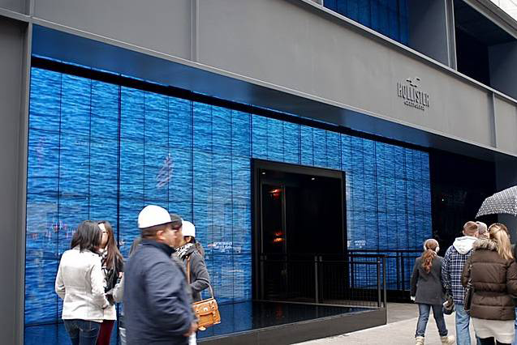
Video Wall Applications
Digital Signage
Build a Brand Experience
Informative
Attract Customers
Engage Customer Interactions
Notes:
The video wall applications that we sell Matrix into can be categorized into two different market segments.
One is Digital Signage where video wall customers are looking to create a branding experience whether that is in a retail space like the Holister store in NYC or a corporate lobby building the brand of the company with its employees or visitors

Slide 4
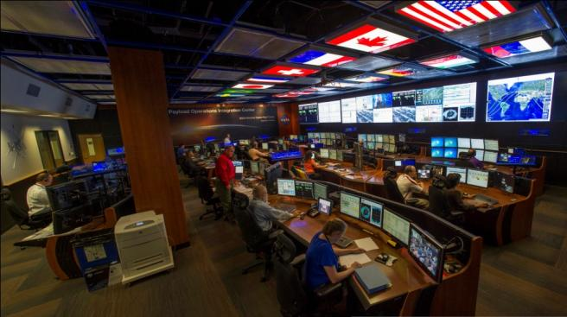
Video Wall Applications
Visualization Rooms
Data Visualization
Collaboration
Mission-Critical Decision Making
Notes:
The Second market segment for the Matrix LCD is Visualization Rooms. You have heard the term Control room before but the applications that this category of product is going into is more than just control rooms that video wall customers are looking to visualize Data, collaborate amongst people in the room or looking at other video walls and making mission critical descision

Slide 5
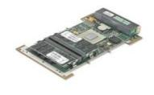
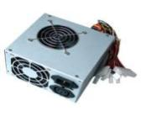
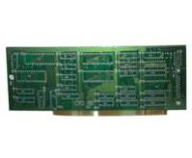
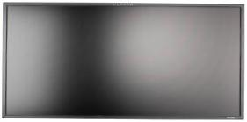
Typical LCD Display Architecture
Fans
Weight & Depth
- Mounting, alignment, structural and service issues
+
Single Board PC + Software
+
Heat
- TIR and Failures
Power supply
+
Points of failure
- High probability that something breaks
I/O Controller Board
+
MTTR
- Finding and replacing the bad part
LCD with Backlight

Slide 6
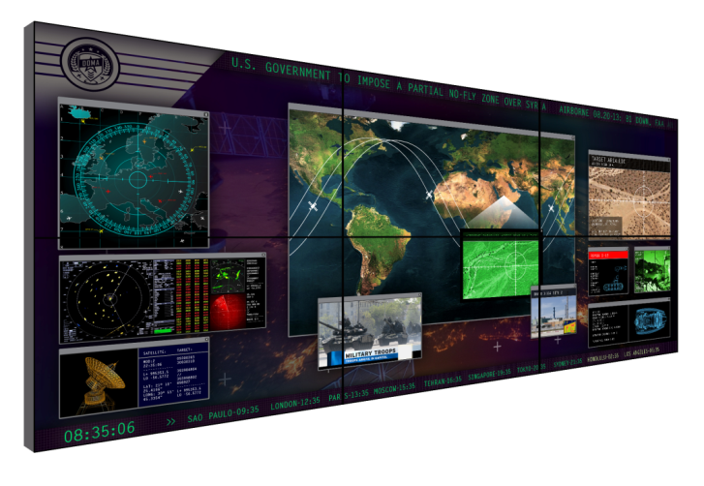
Clarity™ Matrix with G2 Architecture
Clarity Matrix is a unique approach to ultra-narrow bezel LCD video walls, creating a best-in-class video wall solution for Digital Signage and Control Rooms Applications
New G2 architecture delivers
Superior visual performance
Mission-critical design
Simplified design, installation and service
Confidential | Planar Systems
Clarity™ Matrix G2 Overview

Slide 7
LCD Video Wall Innovations

Slide 8
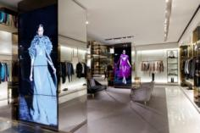
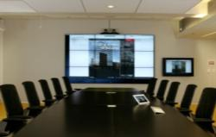
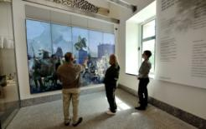
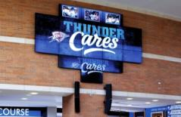
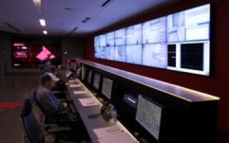
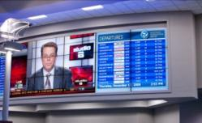
Clarity Matrix G2
Target Audiences & Applications
Primary Audiences
Retail
Corporate
Higher Education
Military
Common Applications
Digital signage
Command & control
Corporate communications
Entertainment
Clarity™ Matrix G2 Overview

Slide 9
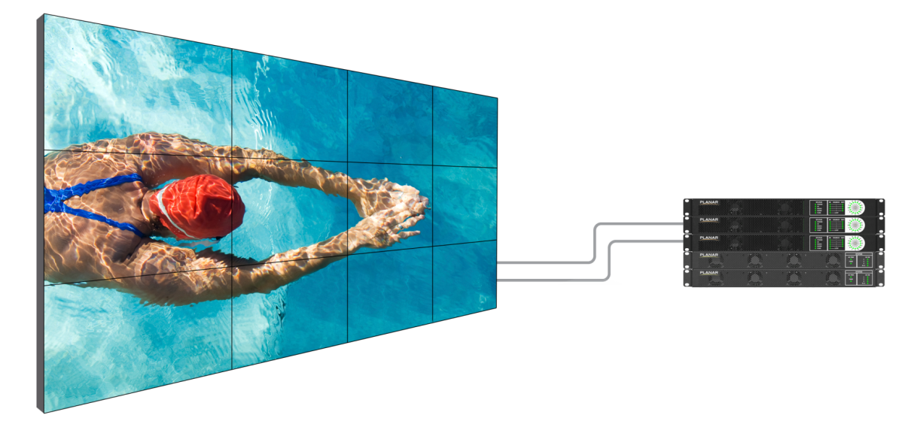
Matrix G2 LCD Video Wall System Components
1. Matrix LCD Modules
Slim, light weight design
Includes EasyAxis™ mounting and alignment system
1
2. Quad Controller Module
1U rack mountable module drives up to 4 panels
Carries video and control signals over one shielded Cat 6 per cable
Big Picture Plus Processing
2
3
4
3. Power Supply Module
1u rack mount module can Drive 4,6 or 8 panels
n+1 redundant supply option
4. Power & Data Cables
1 Power cable per 4-8 panels
1 x Cat6 Cable per panel
© 2014 Planar Systems, Inc.
Clarity™ Matrix G2 Overview

Slide 10
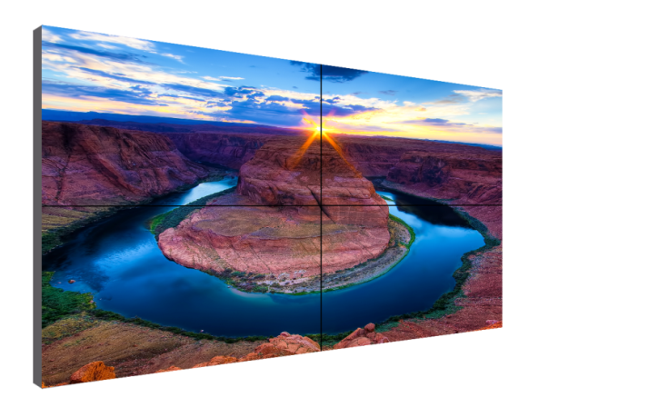
Clarity Matrix G2
1) Superior Visual Performance
Perfect panel-to-panel alignment
Thinnest profile LCD video wall in the industry
Brightness and color balance tools
High bandwidth input connectivity
Single source UltraHD (4K) input and scaling
10-bit color input and processing
Tiled bezel width as narrow as 3.7 mm
Clarity™ Matrix G2 Overview

Slide 11
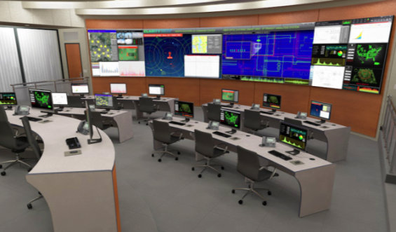
Clarity Matrix G2
2) Mission Critical Design
Redundant power supply option
Reduced heat load at the LCD, extending its life
Fewer points of failure at the video wall
High MTBF and low MTTR
Ambient light sensor reduces the entire video wall brightness during dark times of the day, lowering operating costs
Prevention of image retention
SNMP and network health and status monitoring
Clarity™ Matrix G2 Overview

Slide 12
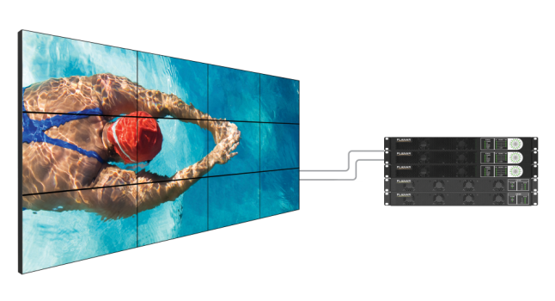
Clarity Matrix G2
3) Simplified Design, Installation and Service
Included with Clarity Matrix LCDs:
EasyAxis™ Mounting system – Six axes of adjustment for perfect panel alignment
Off-board Quad Controllers – Remotely co-locate processors, power, content sources
Off-board power supply modules – No AC power outlets required behind the displays
Big Picture Plus processing – Scale any source across the entire video wall
Reduced cable count to the wall – Power cables are daisy-chained, single Cat 6 per panel
Built-in video extenders – Eliminates compatibility issues and costs of third-party extenders
Single IR receiver – Control displays individually or globally with a single remote
Reduced rack footprint – PS Modules are now just one rack unit high and can power 4, 6, or 8 panels
VESA mounting option – LCDs include VESA hole pattern
Clarity™ Matrix G2 Overview

Slide 13
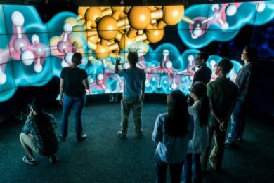
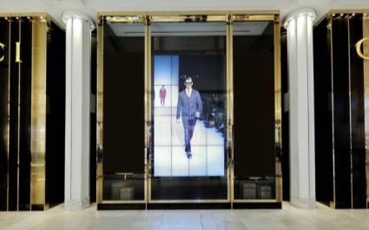
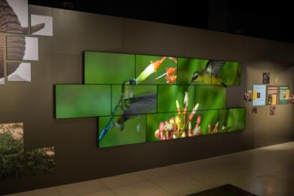
Clarity Matrix G2
Case Studies http://casestudies.planar.com
University of Illinois
CAVE2™ Electronic Visualization Laboratory
Chicago, IL
Gucci
Retail Stores
Multiple locations worldwide
National Geographic Museum
Wildlife Exhibit
Washington, DC
Clarity™ Matrix G2 Overview

Slide 14
Clarity Matrix G2
Why Clarity Matrix & Planar?
Planar has over 30 years of experience in display technologies, 15 years experience manufacturing video walls, and hundreds of technical innovations in the display industry across many markets
Clarity Matrix has been proven in the global market for five years and has an outstanding reputation for high performance and low maintenance in mission-critical control room and retail environments
Planar has a large global footprint of manufacturing, sales, service and support along with hundreds of resellers that are already very knowledgeable on the Clarity Matrix system
Clarity™ Matrix G2 Overview

Slide 15
Clarity Matrix G2 Competitive Positioning

Slide 16
Ultra-Narrow Bezel LCD Comparison
Feature | Benefit
Off Board Electronics and Power Supply | Removes Heat, Weight, Noise, and Points of failure from the Wall Quicker to service, No disruption or cost associated with servicing at the wall
Redundant Power Supply | No downtime if power supply failure occurs
Fan-less LCD Design | Less noise Less points of failure
Less than ≤ 3.6“/ 93mm Depth | Maintain LCD's Slim profile ADA Compliant
Protective Glass Option | Provides panel protection for video walls placed in public spaces Provides a touch surface that is modular
4k resolution video wall scaling | Input sources of 3840x2160 can be daisy chained and scaled across the video wall
Positioning Sensors | Eases installation and configuration by auto ID and video wall scaling
Color Balance Calibration Tool | Eases Color and brightness matching on the displays
DisplayPort Input | Input sources of 3840x2160 resolution can be input and display native resolution across 2x2 array.
Built-in Video Wall Scaling | No additional scalers or processing needed to stretch an image over the entire video wall
46” and 55” Ultra-narrow and super narrow bezel LCD | Narrow bezel LCD Technology for near seamless video walls
Model Meets Specification
Partially Supported
Not Available

Slide 17
Clarity Matrix G2
Most Successful Lock-out Specs
Video wall must not require AC power behind the displays
LCD displays must not have fans
Mounting system must provide 6 axes of adjustment for panel alignment
Mounted depth must be ADA-compliant (<4” protrusion)
LCD displays must have redundant power supplies
LCD displays must have optically bonded protective glass
Video wall must support signal transmission of 330 ft. (100 m) without any extenders
Clarity™ Matrix G2 Overview

Slide 18
Clarity Matrix G2
Continued Differentiation
Off-board electronics architecture
Fan-less design
Thinnest mounted depth: 3.6”
Extended Ruggedness & Optics (ERO) option
Single 4K input with scaling
Clarity™ Matrix G2 Overview

Slide 19
Clarity Matrix G2
Responding to Competitive Specs
Image retention orbiter
SNMP
10-bit color processing
Ambient light sensor
Clarity™ Matrix G2 Overview

Slide 20
Clarity Matrix installations

Slide 21
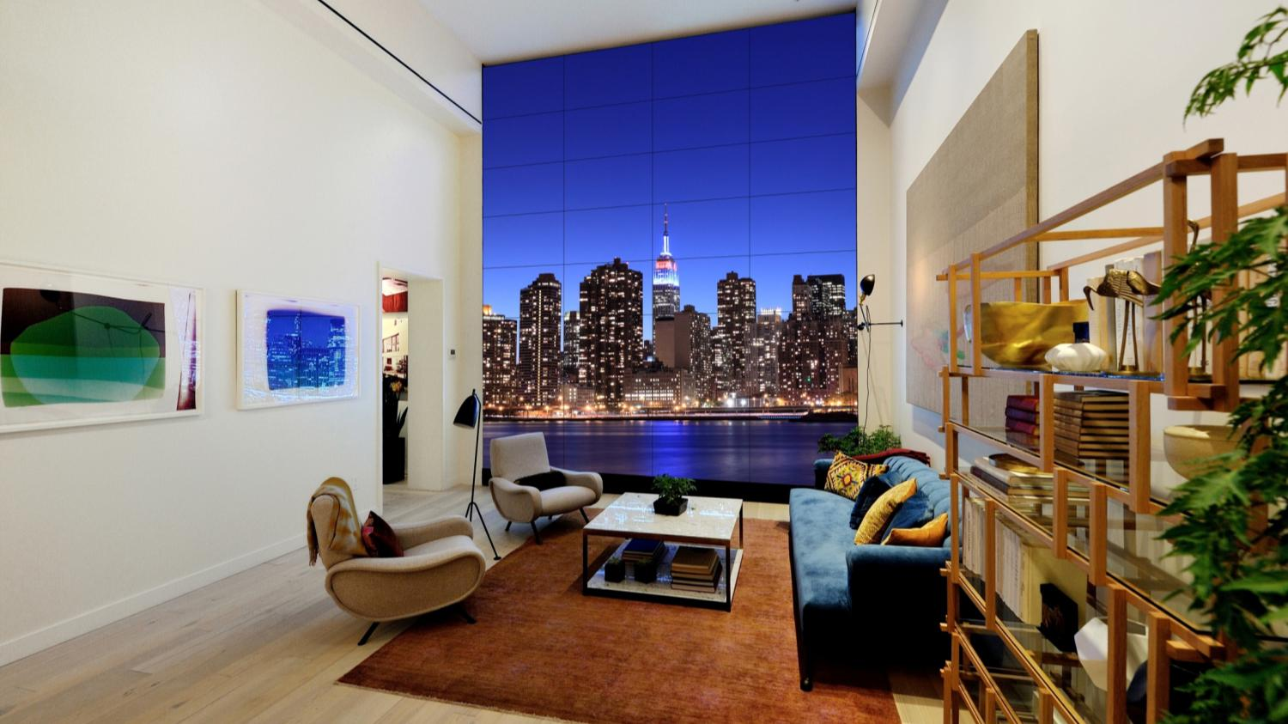
Corporate
Toll Brothers City Living—Brooklyn, NY
View Case Study

Slide 22
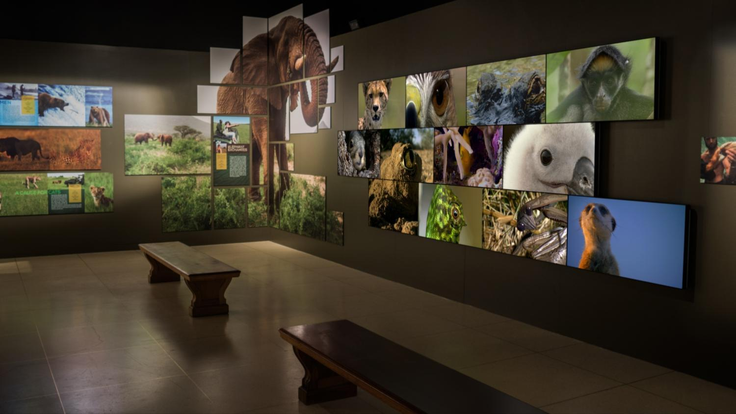
Museum
National Geographic Museum—Washington D.C.
View Case Study

Slide 23
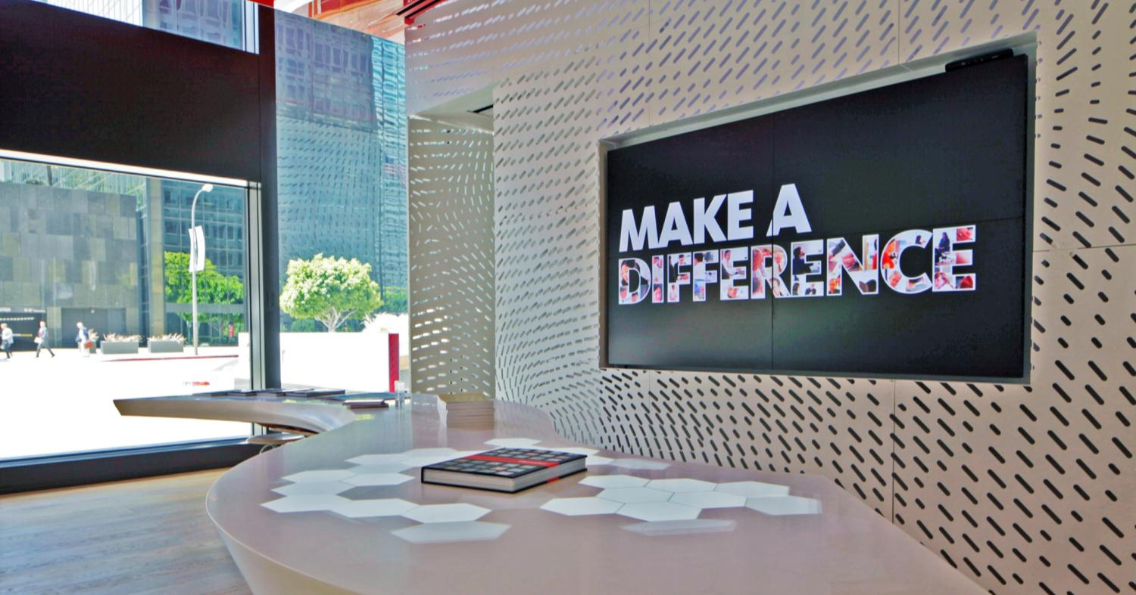
Corporate
Gensler—Los Angeles, CA
View Case Study

Slide 24
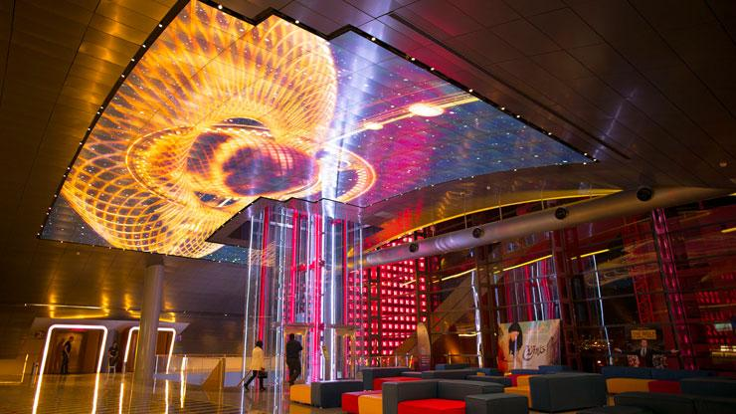
Architecture/Public Venue
CinemaCity—Beirut, Lebanon

Slide 25
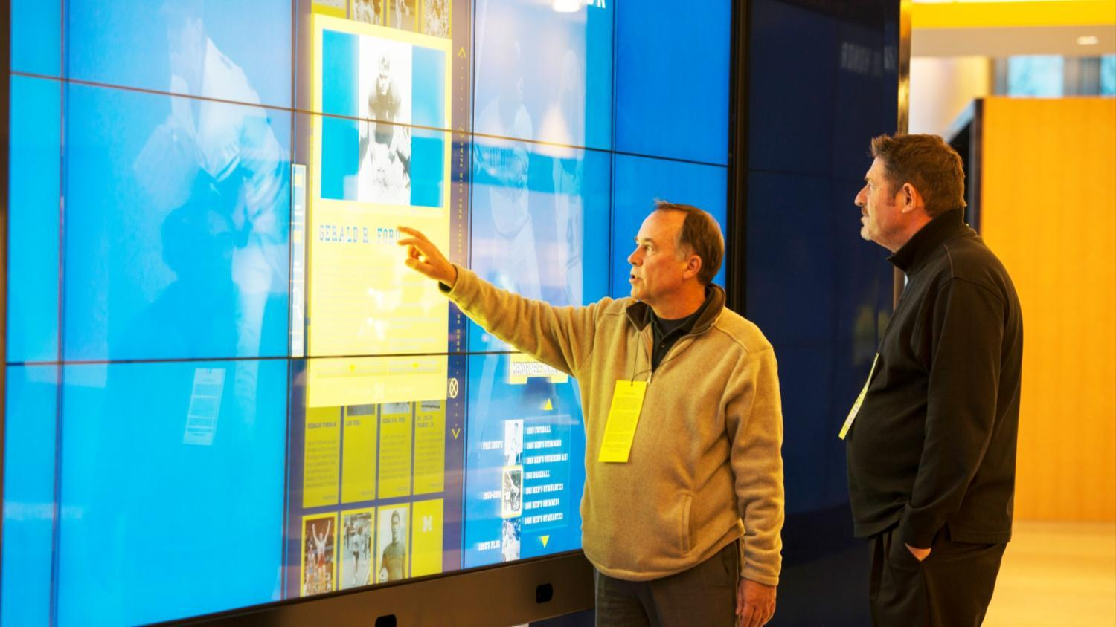
Sports Venue/Higher Education
University of Michigan Crisler Center
View Case Study

Slide 26
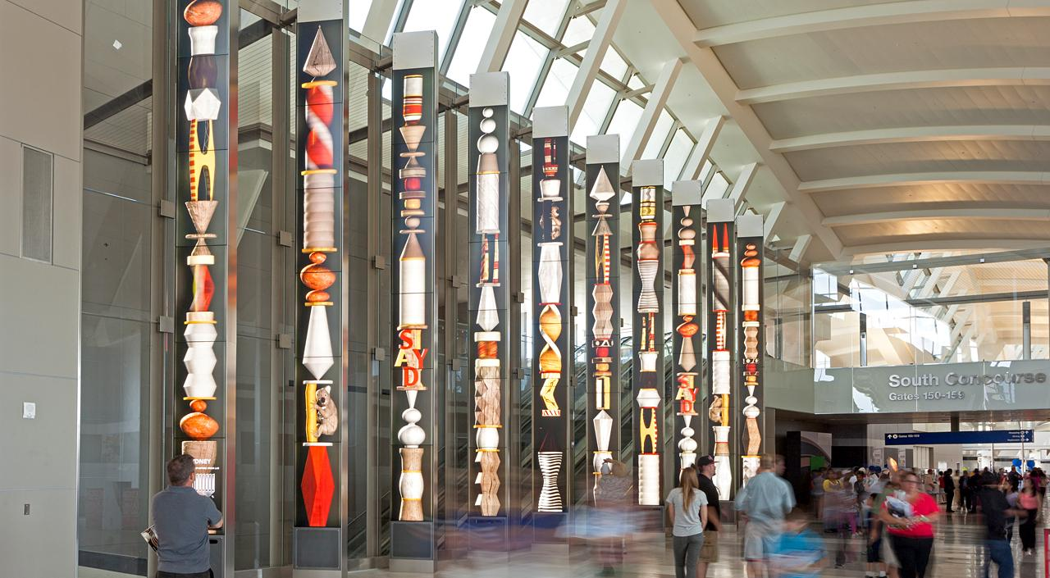
Transportation
LAX Airport—Los Angeles, CA

Slide 27
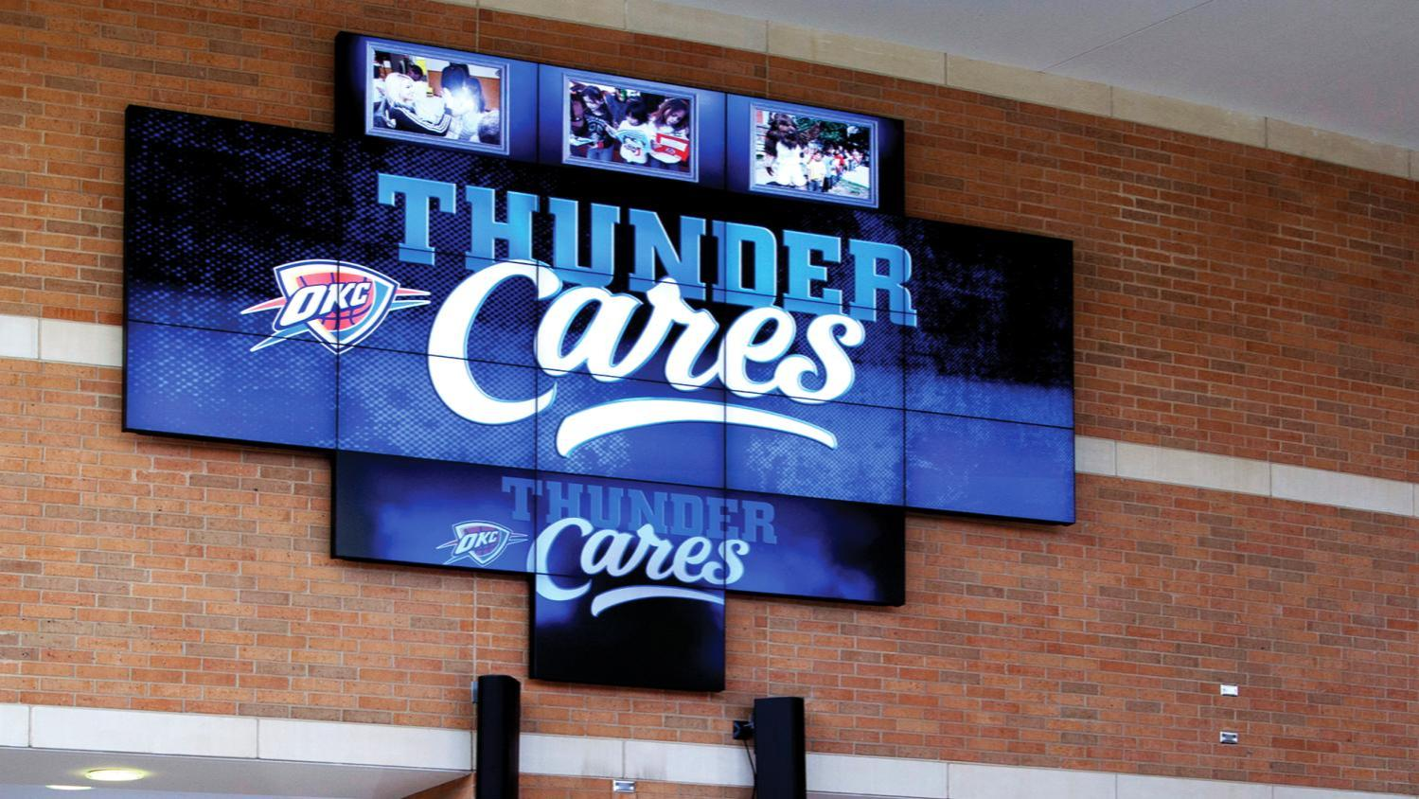
Sports Venue
Chesapeake Energy Arena
Home of the NBA’s Oklahoma City Thunder
View Case Study

Slide 28
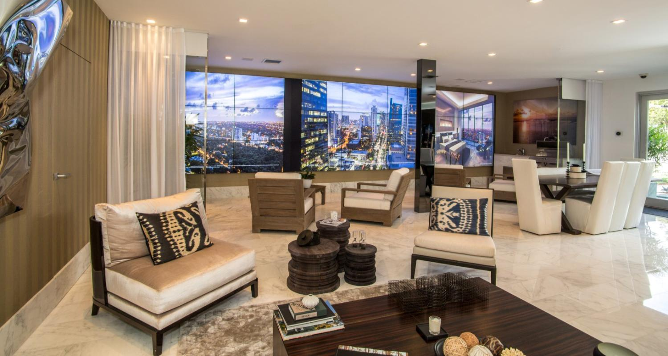
Corporate
Property Management Group—Miami, FL
View Case Study

Slide 29
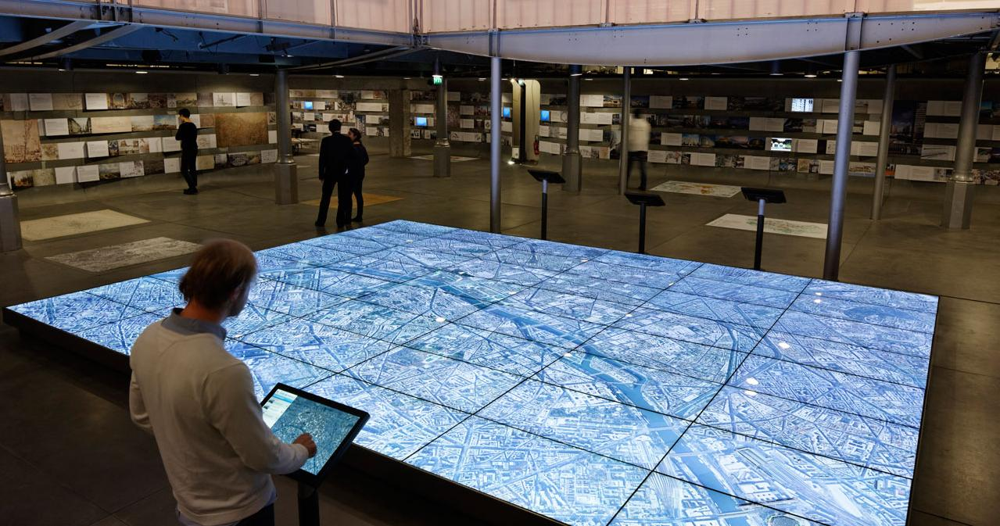
Museum
Pavillon De L’ Arsenal—Paris, France
29
Confidential | Planar Systems

Slide 30
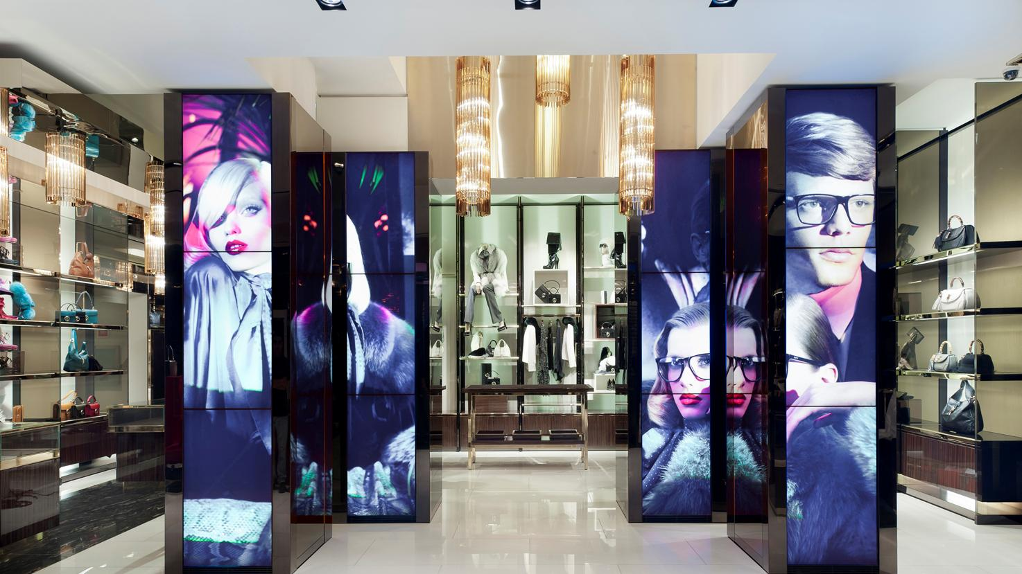
Retail
Gucci Flagship Store—Milan, Italy
View Case Study

Slide 31
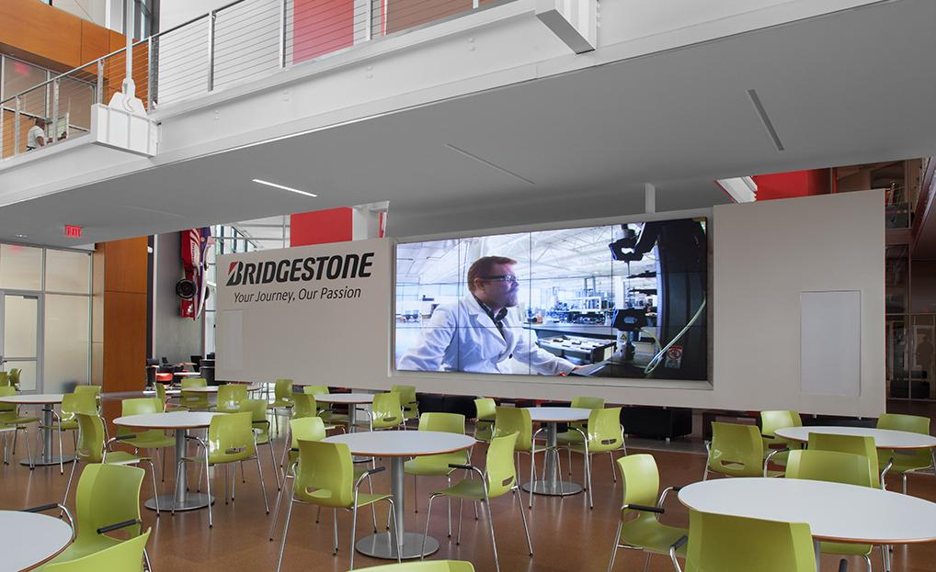
Corporate
Bridgestone Tires

Slide 32
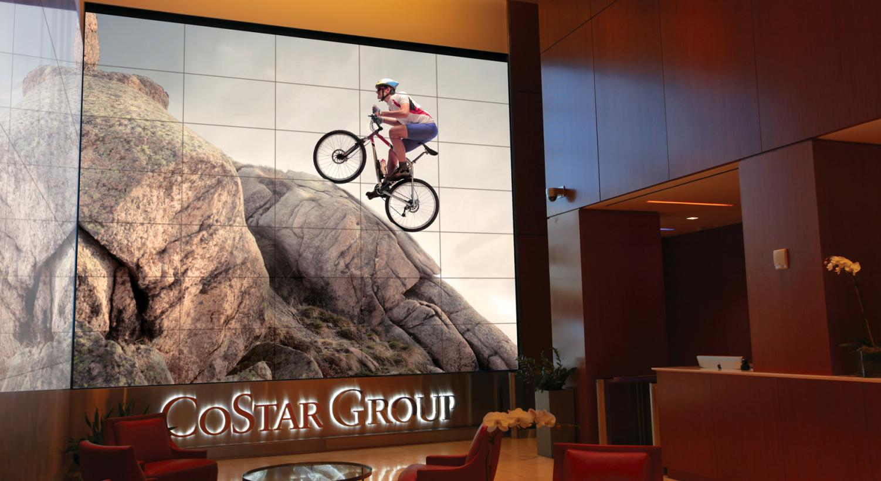
Corporate Lobby
CoStar Group—Washington D.C., USA

Slide 33
Museum
John Deere Pavilion—Moline, IL
33
Confidential | Planar Systems

Slide 34
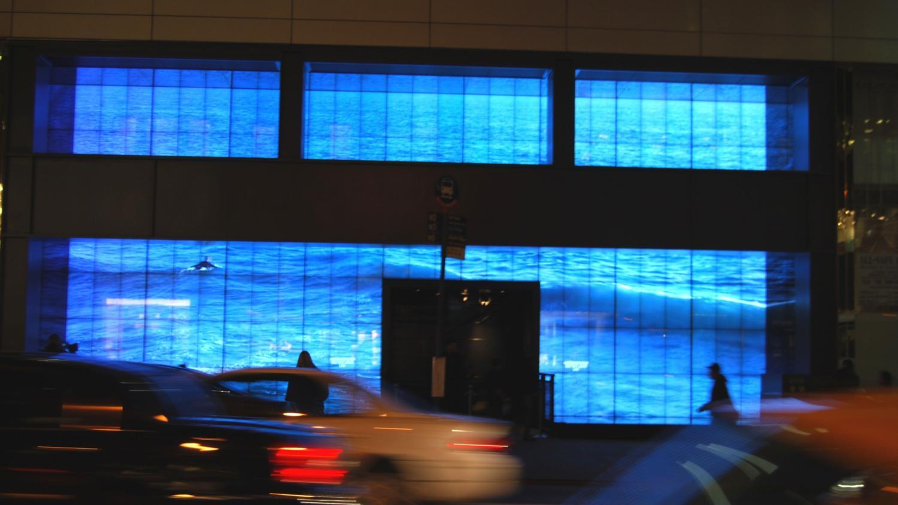
Touch screen Monitors Pacific Eye Clinic, Beaverton, OR
Retail Hollister Co—New York, NY
34
Confidential | Planar Systems

Slide 35
Museum The National WWII Museum—New Orleans, LA
View Case Study

Slide 36
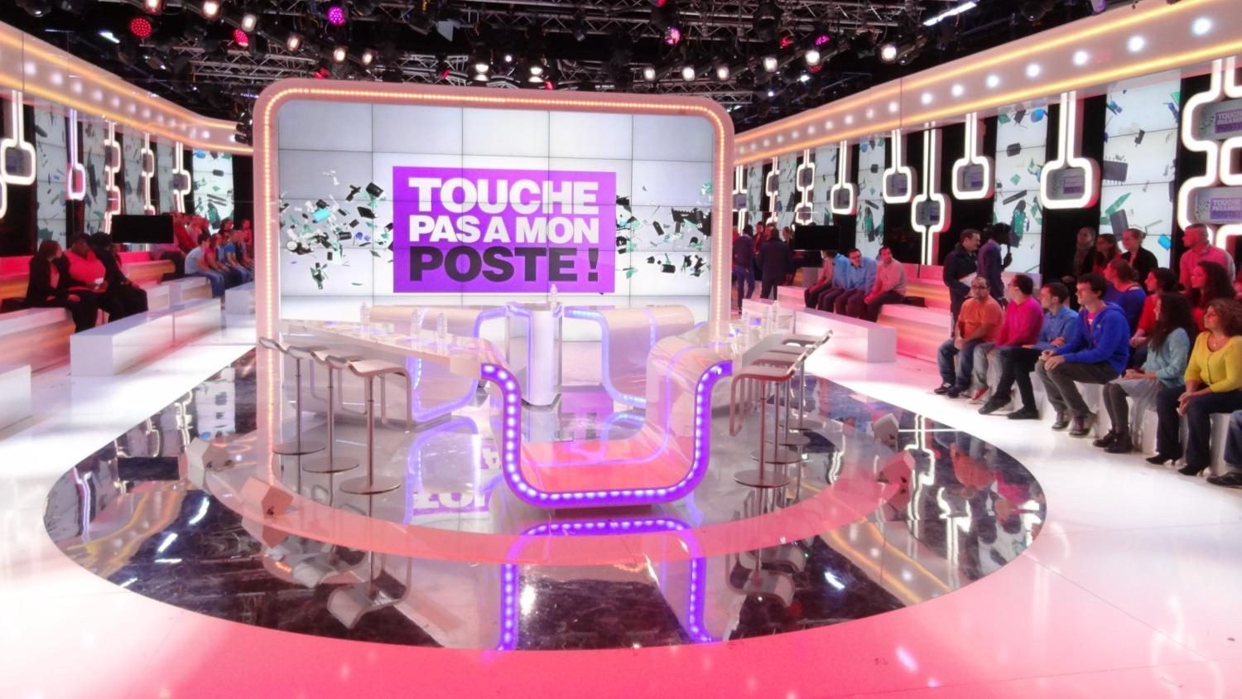
Broadcast Canal+Group—Issy-les-Moulineaux France
View Case Study

Slide 37
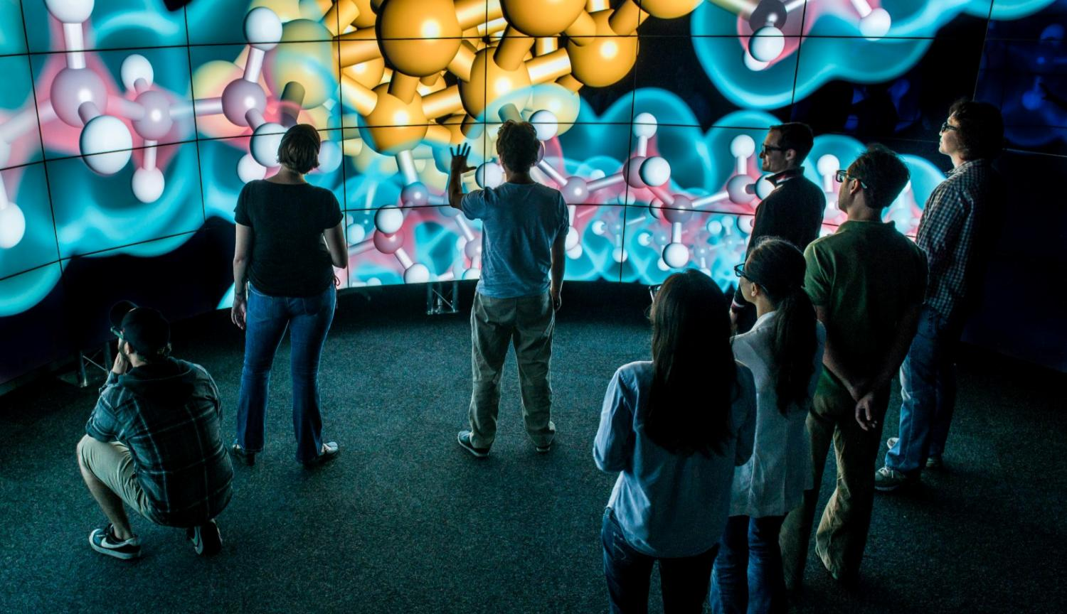
Higher Education/Simulation
University of Illinois Chicago Electronic Visualization Lab (EVL)
View Case Study

Slide 38
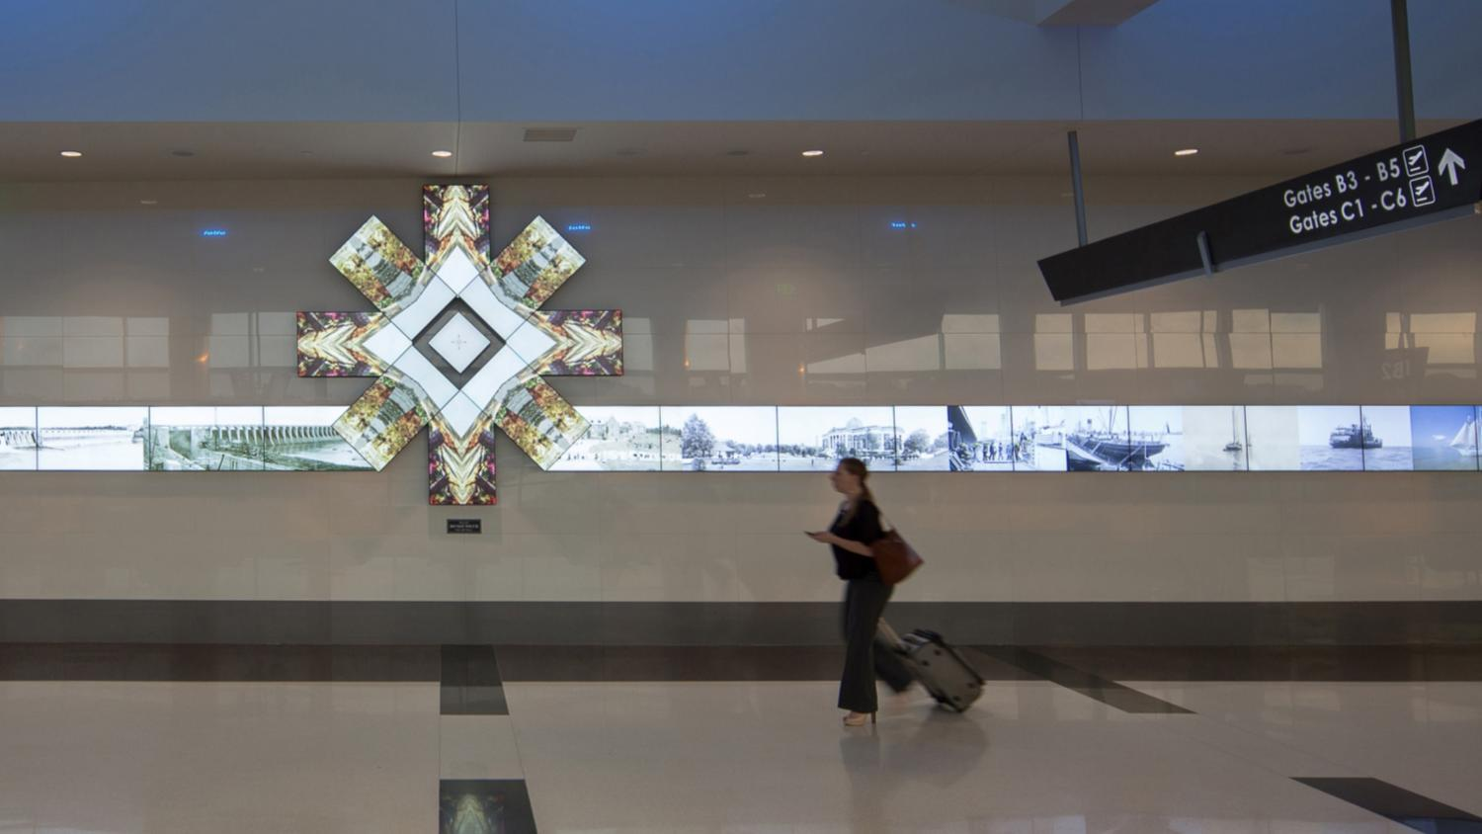
Transportation Birmingham Airport—Birmingham, Alabama
View Case Study

Slide 39
Clarity Matrix G2 Product Details

Slide 40
Clarity Matrix G2
Product Naming
Product Family: Clarity™ Matrix LCD Video Wall with G2 Architecture
Product Models: LX, MX, 3D
Product Options:
Brightness | Diagonal | Resolution | Tiled Bezel Width |  | Orientation | ERO | Distance (standard 60m)
LX – 500 Nit MX – 800 Nit | 46” 55” | HD – 1080p | S – 5.5 mm U – 3.7 mm |  | L – Landscape P – Portrait V – VESA | ERO | 100 m
Clarity™ Matrix G2 Overview

Slide 41
Clarity Matrix G2
Product Models
LX S Models | LX 3D Models | MX46 S Models | LX46HDU Models | MX46 U Models | MX55 S Models | LX55HDU Models | MX55 U Models
LX46HDS-L LX46HDS-P LX46HDS-V LX46HDS-L-ERO LX46HDS-P-ERO LX46HDS-V-ERO LX55HDS-L LX55HDS-P LX55HDS-V LX55HDS-L-ERO LX55HDS-P-ERO LX55HDS-V-ERO | LX46S-3D-L LX46S-3D-L-100 LX46S-3D-L, Top LX46S-3D-L-100, Top LX46S-3D-L, Bot LX46S-3D-L-100, Bot | MX46HDS-L MX46HDS-P MX46HDS-V MX46HDS-L-100 MX46HDS-P-100 MX46HDS-V-100 MX46HDS-L-ERO MX46HDS-P-ERO MX46HDS-V-ERO MX46HDS-L-ERO-100 MX46HDS-P-ERO-100 MX46HDS-V-ERO-100 | LX46HDU-L LX46HDU-P LX46HDU-V LX46HDU-L-100 LX46HDU-L-ERO LX46HDU-P-ERO LX46HDU-V-ERO LX46HDU-L-ERO-100 | MX46HDU-L MX46HDU-P MX46HDU-V MX46HDU-L-100 MX46HDU-P-100 MX46HDU-V-100 MX46HDU-L-ERO MX46HDU-P-ERO MX46HDU-V-ERO MX46HDU-L-ERO-100 MX46HDU-P-ERO-100 MX46HDU-V-ERO-100 | MX55HDS-L MX55HDS-P MX55HDS-V MX55HDS-L-100 MX55HDS-P-100 MX55HDS-V-100 MX55HDS-L-ERO MX55HDS-P-ERO MX55HDS-V-ERO MX55HDS-L-ERO-100 MX55HDS-P-ERO-100 MX55HDS-V-ERO-100 | LX55HDU-L LX55HDU-P LX55HDU-V LX55HDU-L-100 LX55HDU-L-ERO LX55HDU-P-ERO LX55HDU-V-ERO LX55HDU-L-ERO-100 | MX55HDU-L MX55HDU-P MX55HDU-V MX55HDU-L-100 MX55HDU-P-100 MX55HDU-V-100 MX55HDU-L-ERO MX55HDU-P-ERO MX55HDU-V-ERO MX55HDU-L-ERO-100 MX55HDU-P-ERO-100 MX55HDU-V-ERO-100
Clarity™ Matrix G2 Overview

Slide 42
Planar LCD Video Wall Line-up
Matrix HX
PS5580
Video Wall Monitor
400 nits
Big Picture 10x10
Tiling mount
Matrix
MXHD-U
Matrix MXHD-S
High Brightness
60” 1,900 nits
AP / LED™
Matrix Architecture
EasyAxis™ Mount
Matrix
LXHD-U
Next Generation
High Performance
46” & 55” 800 nits
G2 Architecture
EasyAxis™ Mount
ADA Compliant
3.7 mm tiled bezel width
Extended distance up to 500 Ft.
Matrix LXHD-S
High Performance
46” & 55” 800 nits
G2 Architecture
EasyAxis™ Mount
ADA Compliant
5.5 tiled bezel width
Extended distance up to 500 Ft.
Matrix 3D
Next Generation
Standard Performance
46” & 55” 500 nits
G2 Architecture
EasyAxis™ Mount
ADA Compliant
3.7 mm tiled bezel width
Extended distance up to 500 Ft.
Standard Performance
46” & 55” 500 nits
G2 Architecture
EasyAxis™ Mount
5.5 tiled bezel width
3D Video Wall
46” WXGA
450 nits
G2 Architecture
Confidential | Planar Systems
Clarity™ Matrix G2 Overview
Notes:
MX55HDU
-3.9mm
-ADA Compliant
HX60 Maintains the Matrix 1 architecture
800 Nits for MX
LX Modules are changing
- 500 Nits for LX
Increased Depth (4.6”)
20% lower power consumption
Matrix 3D 46”
PS5580

Slide 43
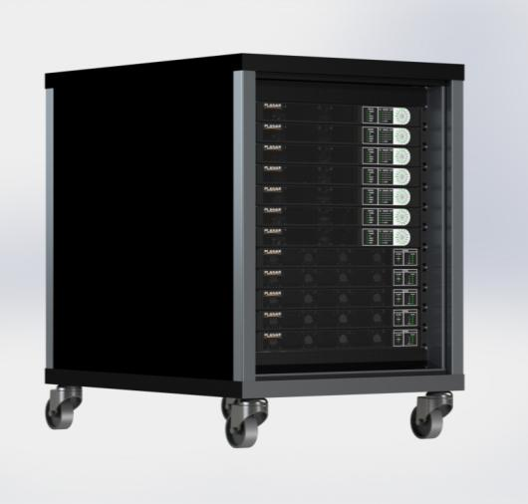
Clarity Matrix G2
Off-Board Electronics Architecture
Benefits of Off-Board Electronics
Removes heat, weight, depth, noise, and points of failure from the video wall
Rack can be co-located with sources and processing for convenient cabling, security and climate control
Maintenance is easy to access and does not interfere with video wall
Redundant power supply option maintains operation in the case of a power supply failure
© 2014 Planar Systems, Inc.
Clarity™ Matrix G2 Overview

Slide 44
Clarity Matrix G2
Standard cable lengths: 200 ft./ 60 m
Longer distance option: 500 ft./ 150 m
Built-in IR remote extension
Quad Controller Module
1 RU
Integrated WallNet Option | DisplayPort 1.1 input | HDMI input x 4 | One Cat6 cable per Matrix panel | DisplayPort 1.1 loop out
Clarity™ Matrix G2 Overview

Slide 45
Clarity Matrix G2
Image Processing
Supports a Wide Range of Processing Options
Clarity Matrix Big Picture Plus processing
Clarity Visual Control Station (VCS)
Indisys™ image processing support
Support for all leading image processors and digital signage solutions via HDMI, DVI, DisplayPort inputs
© 2014 Planar Systems, Inc.
Clarity™ Matrix G2 Channel Webinar 3-20-14

Slide 46
Clarity Matrix G2
Power Supply Module
Supported cable lengths of 500 ft./ 150 m
Redundant power supply option
1 RU
IEC C20 AC input | Power connector for Quad Controllers | Daisy-chain up to 8 panels with one cable | Health status monitoring
Clarity™ Matrix G2 Overview

Slide 47
Clarity Matrix G2
Supported Cable Lengths
Clarity Matrix G2 Quad Controller Module
Standard length 200 ft / 61 m
Extended length
500 ft / 150m
Third party extenders
Cat 6 Cable Lengths
Bulk cables and connectors support field-terminated lengths
25 ft/7.6 m
100 ft/30.4m
50 ft/15.2 m
75 ft/22.8 m
200 ft/60m
Clarity Matrix G2 Power Supply Module
Standard configuration support – 500 ft / 152 m
Power Cable Lengths
Bulk cables and connectors support field-terminated lengths
25 ft/7.6 m
50 ft/15.2 m
100 ft/30.4m
75 ft/22.8 m
200 ft/60m
Clarity™ Matrix G2 Overview

Slide 48
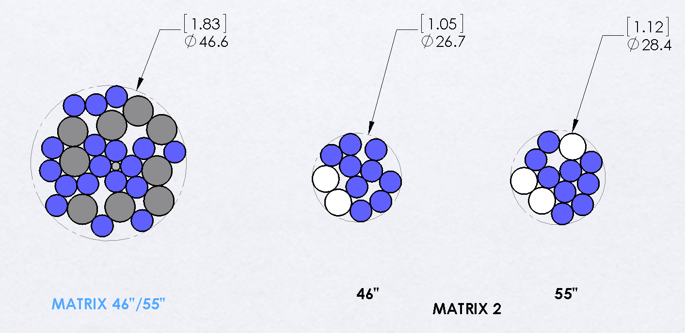
Clarity Matrix G2
Reduced Cables to the Wall
Clarity™ Matrix G2 Overview

Slide 49
Clarity Matrix G2
Firmware
10-Bit data path
Wallnet support (SNMP)
Ambient light sensor
Clarity™ Matrix G2 Overview

Slide 50
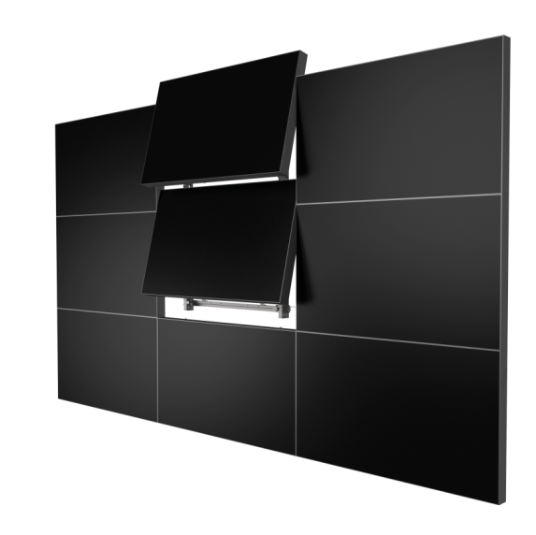
Clarity Matrix G2
Mounting System
EasyAxis™ Mounting System includes added robustness and improved cable access
Reduced space requirements above the panel for service position
Attachment points maintain position of previous EasyAxis mount
Now supports optional VESA mounting
Clarity™ Matrix G2 Overview

Slide 51
Clarity Matrix G2 options & accessories

Slide 52
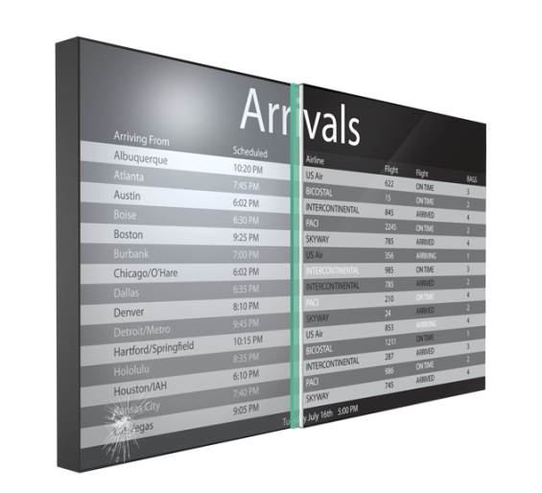
Clarity Matrix G2
Extended Ruggedness & Optics (ERO)
The ERO™ Advantage
Added protection and durability
Improved contrast, clarity and legibility
Keeps out dust and moisture
Reduced glare and parallax error
Modular touch surface
© 2014 Planar Systems, Inc.
Clarity™ Matrix G2 Overview

Slide 53
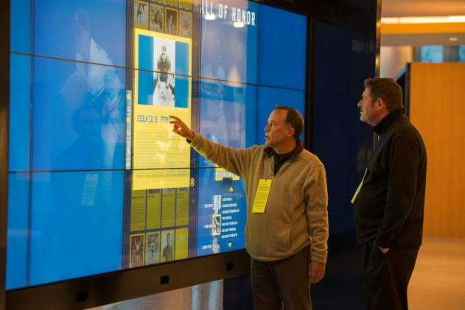
Clarity Matrix G2
MultiTouch
Interactive LCD Video Wall
Up to 32 simultaneous touch points
Allows multiple people to interact without affecting each other
Pinpoint touch accuracy
Capable of wall sizes up to 300” diagonal
Modular protective touch surface with ERO™
Available in 46” or 55” in 1920x1080 resolution
© 2014 Planar Systems, Inc.
Clarity™ Matrix G2 Overview

Slide 54
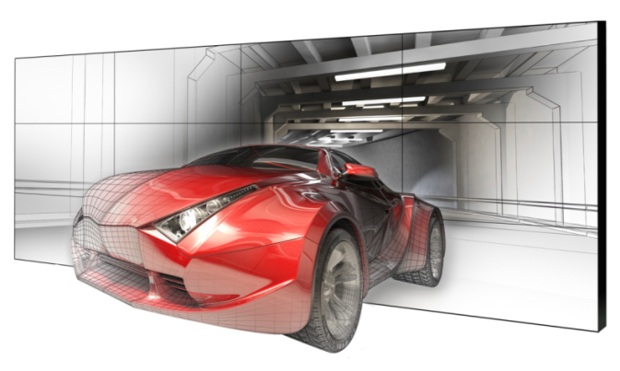
Clarity Matrix G2
3D LCD Video Wall
Large Format Professional 3D Visualization
Flicker-free, think profile stereoscopic display
3D optical system with passive glasses
Wide viewing angles for multiple users
Excellent brightness and contrast
Off-board electronics architecture
Spectacular 3D and 2D viewing experience
Available in 46” with 1366x768 resolution
© 2014 Planar Systems, Inc.
Clarity™ Matrix G2 Overview

Slide 55
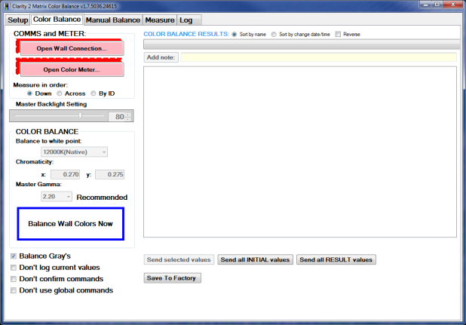
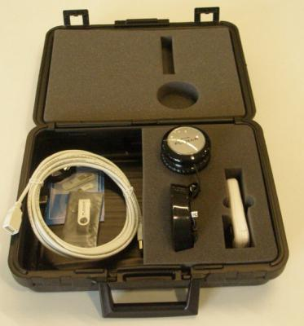
Clarity Matrix G2
Accessories
Cat6 Cables: 25, 50, 75, 100 ft.
DC Power Cable (Plenum Rated): 8, 25, 50, 75, 100 ft.
Bulk cables, connectors, tools
Redundant power supply option
Floor stands
Edge trim
Color Balance Tool
Stud adapter bracket
Integrated WallNet
Matrix MultiTouch
© 2014 Planar Systems, Inc.
Clarity™ Matrix G2 Overview

Slide 56
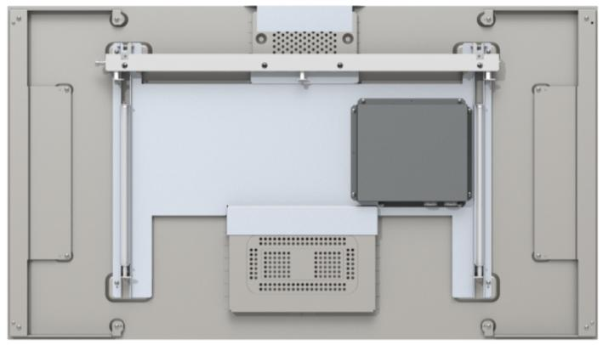
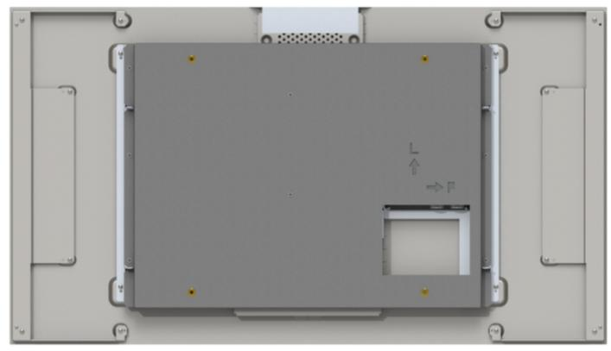
What’s New with Clarity Matrix G2
Mounting Options
400 x 400 mm
Updated EasyAxis Mounting System
Optional VESA mount hole pattern
© 2014 Planar Systems, Inc.
Clarity™ Matrix G2 Overview

Slide 57
Clarity Matrix G2 Sales Tools

Slide 58
Clarity Matrix G2
Sales Tools
Control Room product family brochure and datasheet
Digital Signage product family brochure and datasheet
Matrix 3D datasheet
Product presentation
Product renderings
CAD files with more configurations
Product and service videos
Matrix family web pages
Specifications sheets
Bid Specification document
Competitive bubble chart
Matrix Calculator
Case studies website
Clarity™ Matrix G2 Overview

Slide 59
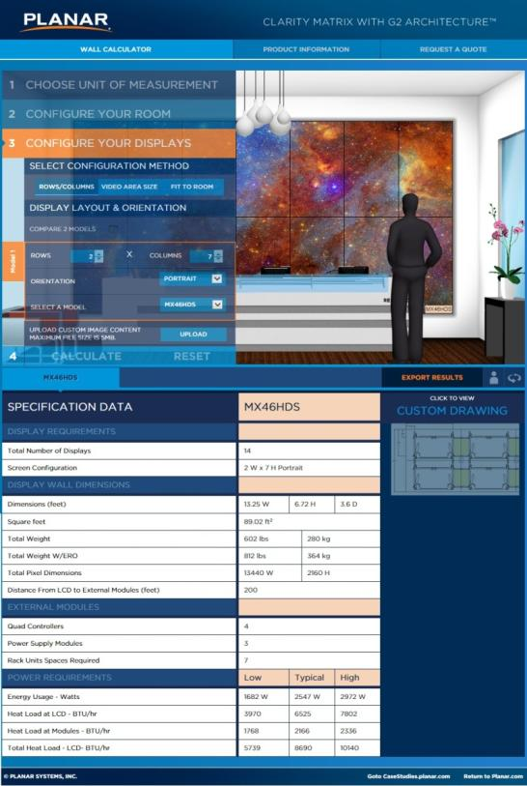
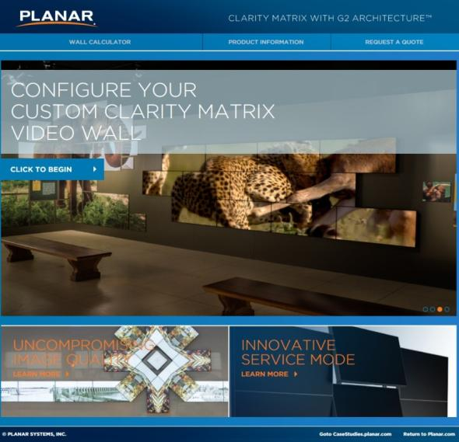
Clarity Matrix G2
New Matrix Calculator
Clarity™ Matrix G2 Overview

Slide 60
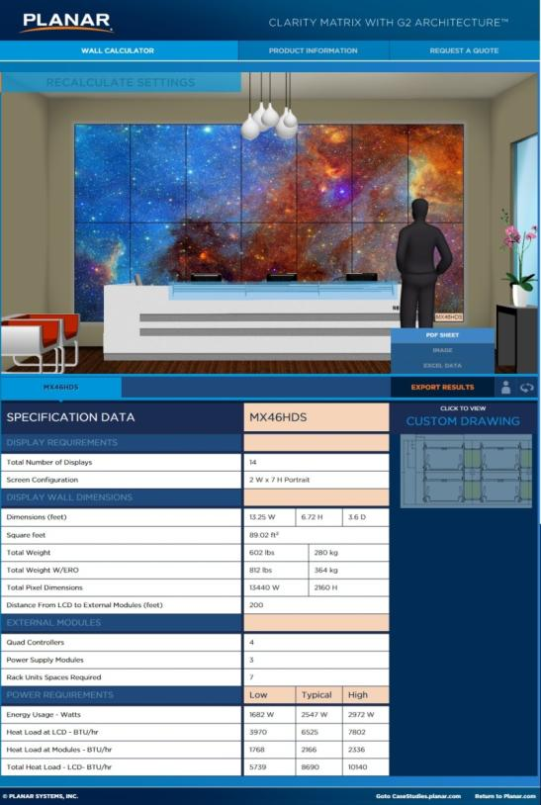
Clarity Matrix G2
New Matrix Calculator
Clarity™ Matrix G2 Overview

Slide 61
Clarity Matrix with G2 Architecture
The best-in-class LCD video wall system just got better
Clarity Matrix G2 Product Overview
Preliminary Presentation for Planar Use Only – December 2013

