Slide 1
CLARITY MATRIX LCD VIDEO WALL SYSTEM
February 2017

Slide 2
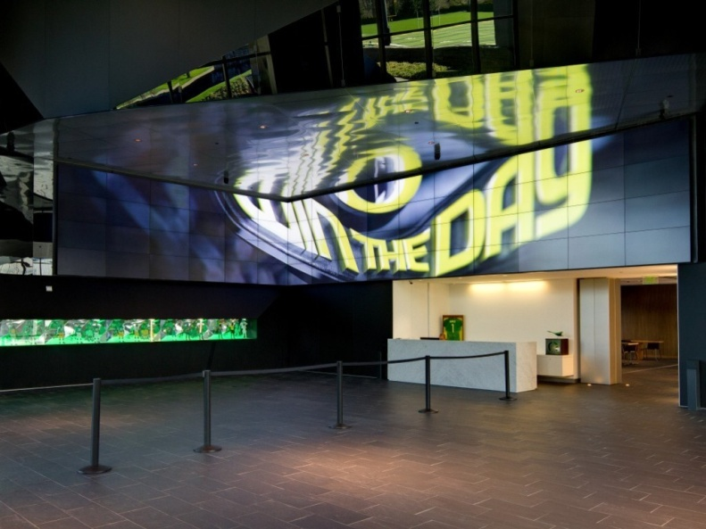
LCD Technology
Ultra-narrow bezel LCD video walls
High-impact video walls
Shallow depth
Great brightness
Great viewing angles
Good color and brightness matching
Long life- minimal maintenance

Slide 3
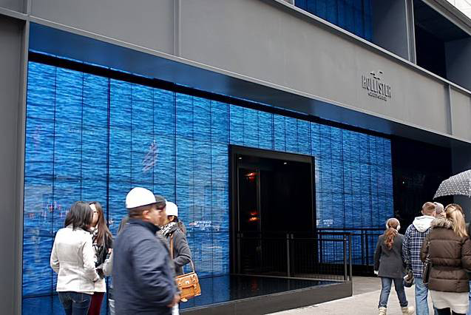
Video Wall Applications
Digital signage
Build a brand experience
Informative
Attract customers
Engage customer interactions

Slide 4
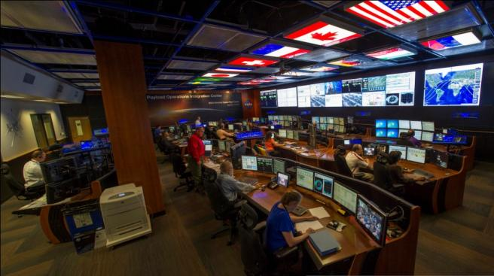
Video Wall Applications
Visualization rooms
Data visualization
Collaboration
Mission-critical decision making

Slide 5
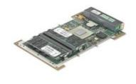
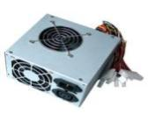
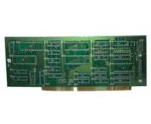
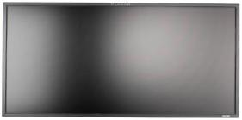
Typical LCD Display Architecture
Fans
Weight and Depth
Mounting, alignment, structural, and service issues
Heat
TIR and failures
Points of failure
High probability that something breaks
MTTR
Finding and replacing the bad part
+
Single Board PC + Software
+
Power supply
+
I/O Controller Board
+
LCD with Backlight

Slide 6
Clarity Matrix LCD Video Wall System
Clarity® Matrix® LCD Video Wall System is a unique approach to ultra-narrow bezel LCD video walls, creating a best-in-class video wall solution for digital signage and control room applications
Clarity Matrix delivers
Superior visual performance
Mission-critical design
Simplified design, installation, and service

Slide 8
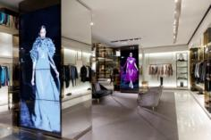
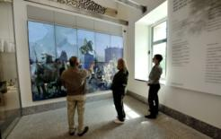
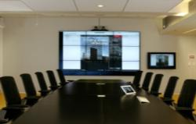
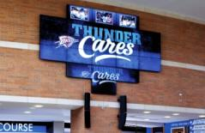
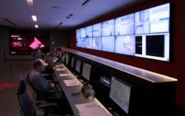
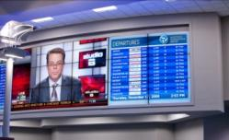
Clarity Matrix LCD Video Wall System
Target audiences and applications
Primary Audiences
Retail
Corporate
Higher education
Military
Common Applications
Digital signage
Command and control
Corporate communications
Entertainment

Slide 9
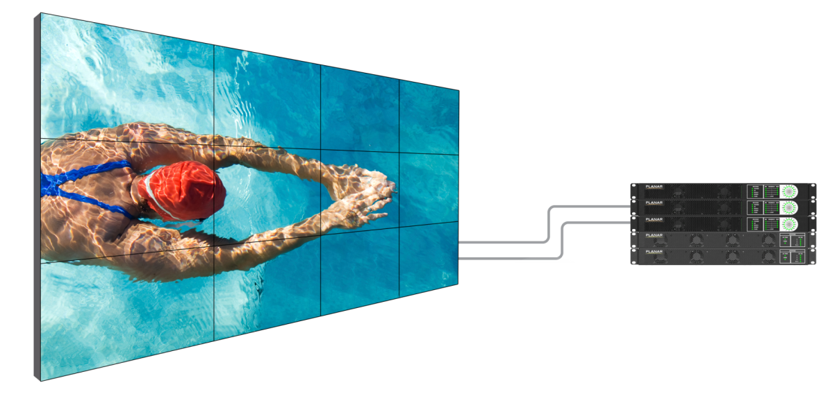
Clarity Matrix LCD Video Wall System Components
Clarity Matrix LCD Modules
Slim, light-weight design
Includes Planar® EasyAxis™ Mounting System for perfect panel-to-panel alignment
Quad Controller Module
1U rack mountable module drives up to 4 panels
Carries video and control signals over one shielded Cat 6 per cable
Planar® Big Picture Plus™ Video Wall Processor
1
2
3
4
Power Supply Module
1u rack mount module can Drive 4, 6, or 8 panels
n+1 redundant supply option
Power & Data Cables
1 Power cable per 4-8 panels
1 x Cat6 Cable per panel

Slide 10
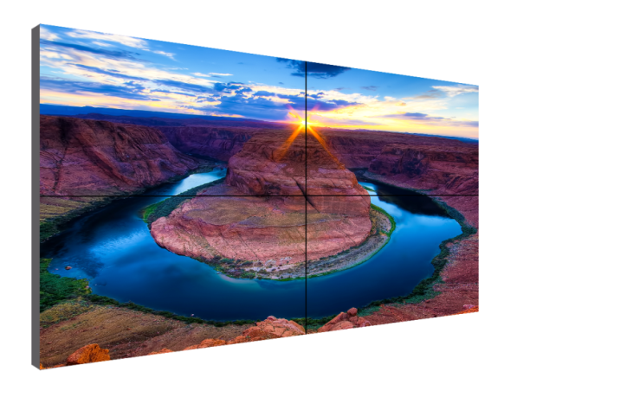
Clarity Matrix LCD Video Wall System
1. Superior visual performance
Perfect panel-to-panel alignment
Thinnest profile LCD video wall in the industry
Brightness and color balance tools
High bandwidth input connectivity
Single source Ultra HD (4K) input and scaling
10-bit color input and processing
Tiled bezel width as narrow as 1.7mm

Slide 11
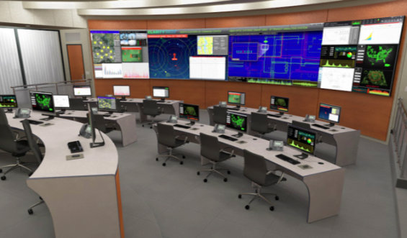
Clarity Matrix LCD Video Wall System
2. Mission critical design
Redundant power supply option
Clarity® Matrix® Fiber Video Extension option for classified information transmission
Reduced heat load at the LCD, extending its life
Fewer points of failure at the video wall
High MTBF and low MTTR
Ambient light sensor reduces the entire video wall brightness during dark times of the day, lowering operating costs
Prevention of image retention
SNMP and network health and status monitoring

Slide 12
Clarity Matrix LCD Video Wall System
3. Simplified design, installation, and service
Included with Clarity Matrix LCDs:
Planar EasyAxis Mounting system – Six axes of adjustment for perfect panel alignment
Off-board Quad Controllers – Remotely co-locate processors, power, content sources
Off-board power supply modules – No AC power outlets required behind the displays
Planar Big Picture Plus processing – Scale any source across the entire video wall
Reduced cable count to the wall – Power cables are daisy-chained, single Cat 6 per panel
Built-in video extenders – Eliminates compatibility issues and costs of third-party extenders
Single IR receiver – Control displays individually or globally with a single remote
Reduced rack footprint – PS Modules are now just one rack unit high and can power 4, 6 or 8 panels
VESA mounting option – LCDs include VESA hole pattern

Slide 13
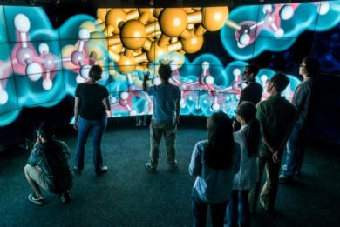
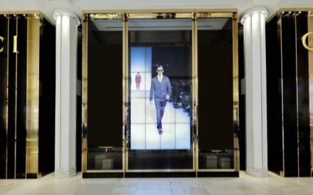
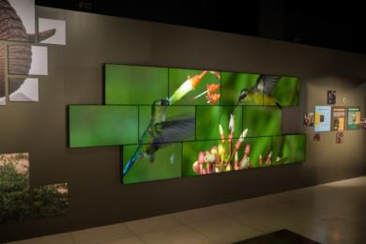
Clarity Matrix LCD Video Wall System
Case Studies – http://casestudies.planar.com
University of Illinois
CAVE2™ Electronic Visualization Laboratory
Chicago, IL
Gucci
Retail Stores
Multiple locations worldwide
National Geographic Museum
Wildlife Exhibit
Washington, DC

Slide 14
Clarity Matrix LCD Video Wall System
Why Clarity Matrix and Planar?
Planar has over 30 years of experience in display technologies, 15 years experience manufacturing video walls, and hundreds of technical innovations in the display industry across many markets
Clarity Matrix has been proven in the global market for five years and has an outstanding reputation for high performance and low maintenance in mission-critical control room and retail environments
Planar has a large global footprint of manufacturing, sales, service, and support along with hundreds of resellers that are already very knowledgeable on the Clarity Matrix system

Slide 15
Clarity Matrix LCD Video Wall System competitive positioning

Slide 16
Ultra-Narrow Bezel LCD Comparison
Model Meets Specification
Partially Supported
Not Available
Feature | Benefit
Off Board Electronics and Power Supply | Removes Heat, Weight, Noise, and Points of failure from the Wall Quicker to service, No disruption or cost associated with servicing at the wall
Redundant Power Supply | No downtime if power supply failure occurs
Fan-less LCD Design | Less noise Less points of failure
Less than ≤ 3.6“/ 93mm Depth | Maintain LCD's Slim profile ADA Compliant
Protective Glass Option | Provides panel protection for video walls placed in public spaces Provides a touch surface that is modular
4k resolution video wall scaling | Input sources of 3840x2160 can be daisy-chained and scaled across the video wall
Positioning Sensors | Eases installation and configuration by auto ID and video wall scaling
Color Balance Calibration Tool | Eases Color and brightness matching on the displays
DisplayPort Input | Input sources of 3840x2160 resolution can be input and display native resolution across 2x2 array.
Built-in Video Wall Scaling | No additional scalers or processing needed to stretch an image over the entire video wall
46” and 55” Extreme and Ultra-narrow bezel LCD | Narrow bezel LCD Technology for near seamless video walls

Slide 17
Clarity Matrix LCD Video Wall System
Most successful lock-out specs
Video wall must not require AC power behind the displays
Video wall must support transmission of classified information without the use of third party extenders
LCD displays must not have fans
Mounting system must provide 6 axes of adjustment for panel alignment
Mounted depth must be ADA-compliant (< 4” protrusion)
LCD displays must have redundant power supplies
LCD displays must have optically bonded protective glass
Video wall must support signal transmission of 500 ft. (150 m) without any extenders

Slide 18
Clarity Matrix LCD Video Wall System
Continued differentiation
Off-board electronics architecture
Fan-less design
Thinnest mounted depth: 3.6”
Planar® ERO™ (Extended Ruggedness and Optics™) technology option
Single 4K input with scaling

Slide 19
Clarity Matrix LCD Video Wall System
Responding to competitive specs
Image retention orbiter
SNMP
10-bit color processing
Ambient light sensor

Slide 20
Clarity matrix installations

Slide 21
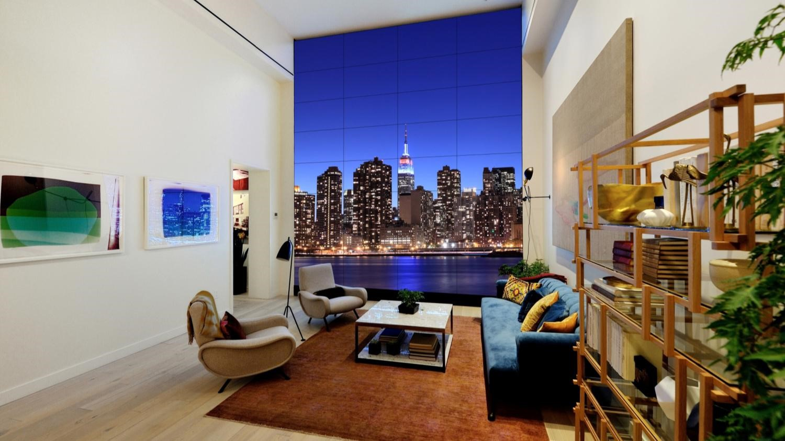
Corporate
Toll Brothers City Living — Brooklyn, NY
View Case Study

Slide 22
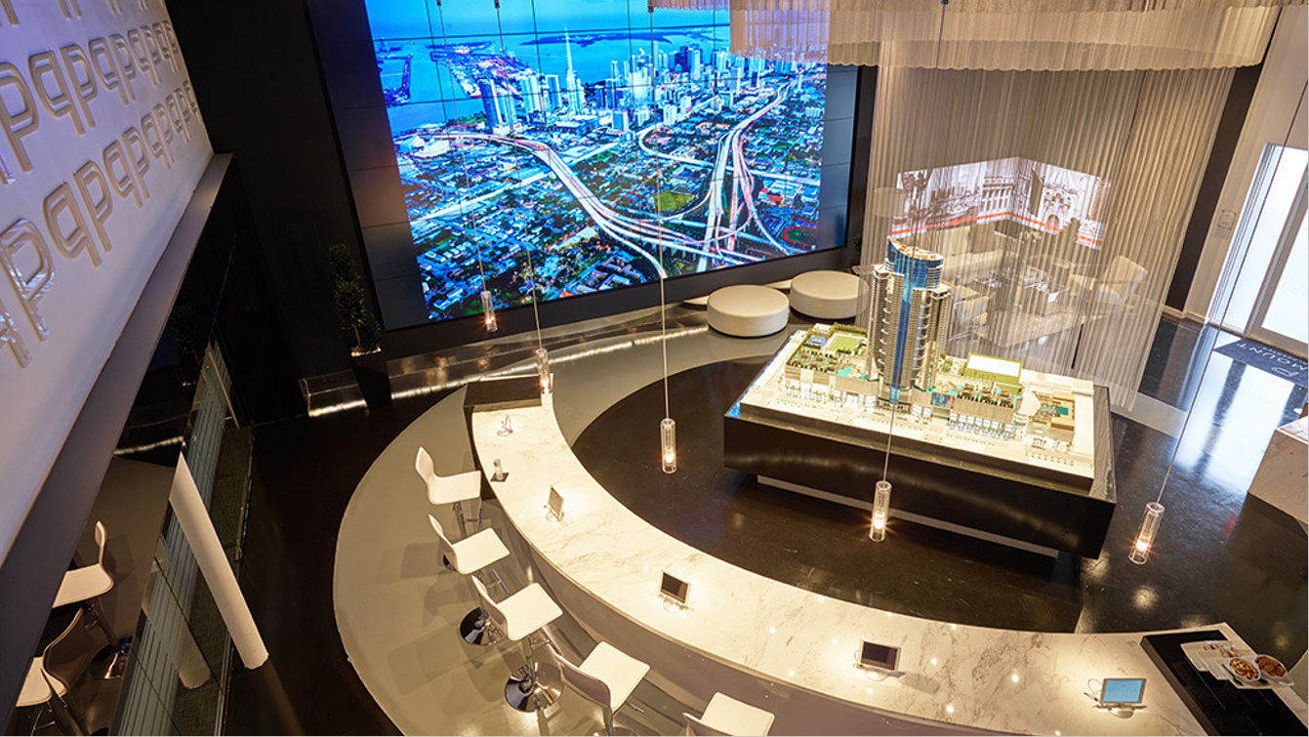
Corporate
Paramount Miami Worldcenter — Miami, FL
View Case Study

Slide 23
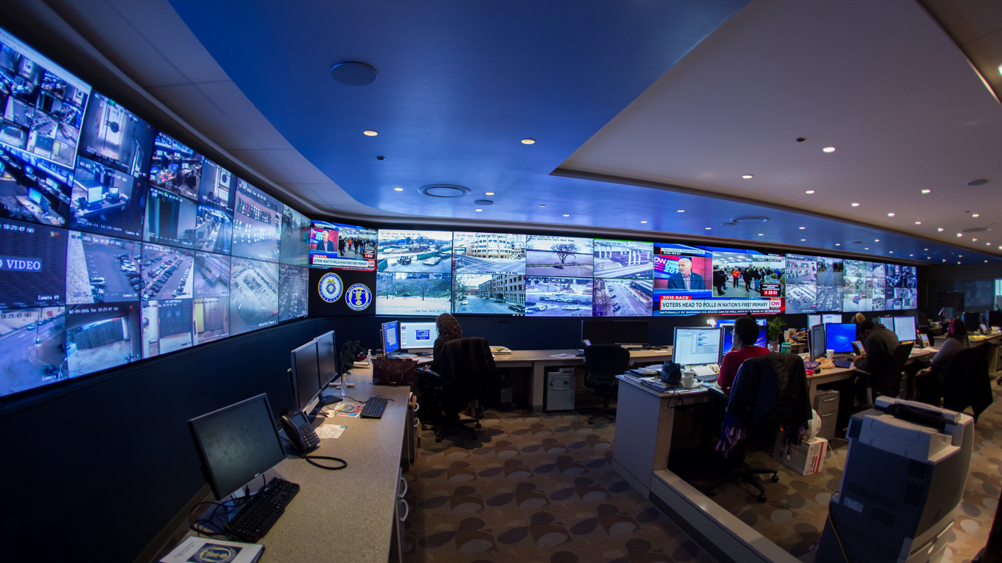
Control Room
Memphis Police — Memphis, TN

Slide 24
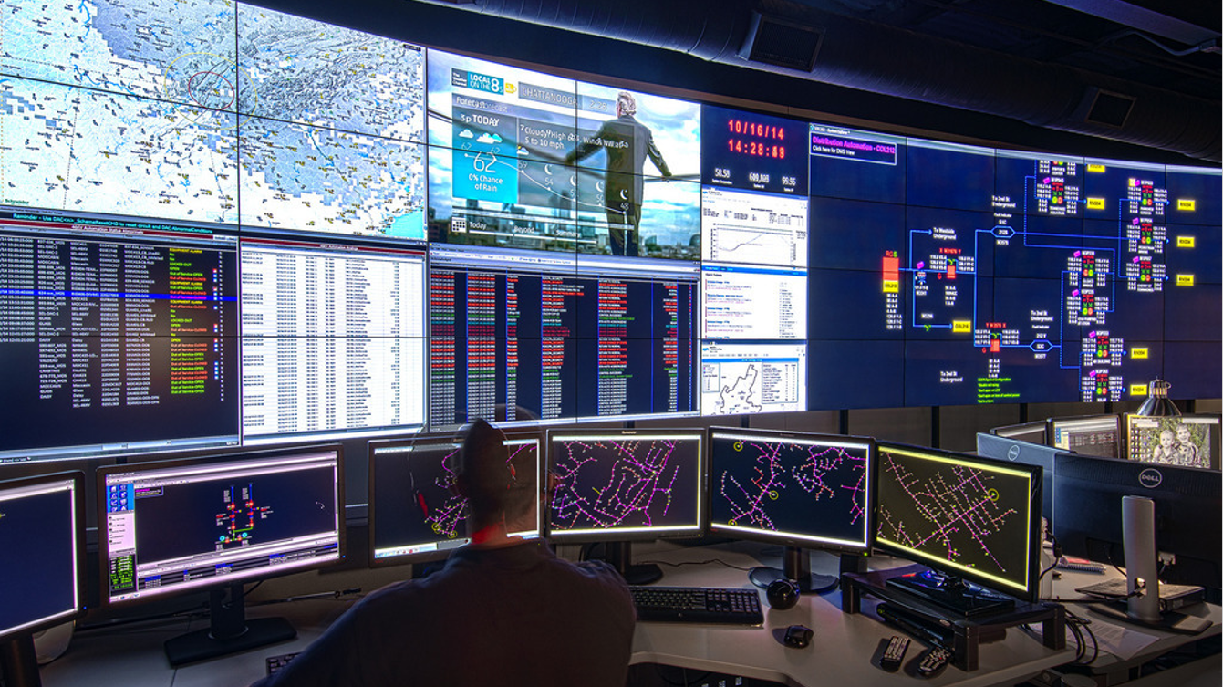
Control Room
Electronic Power Board — Chattanooga, TN
View Case Study

Slide 25
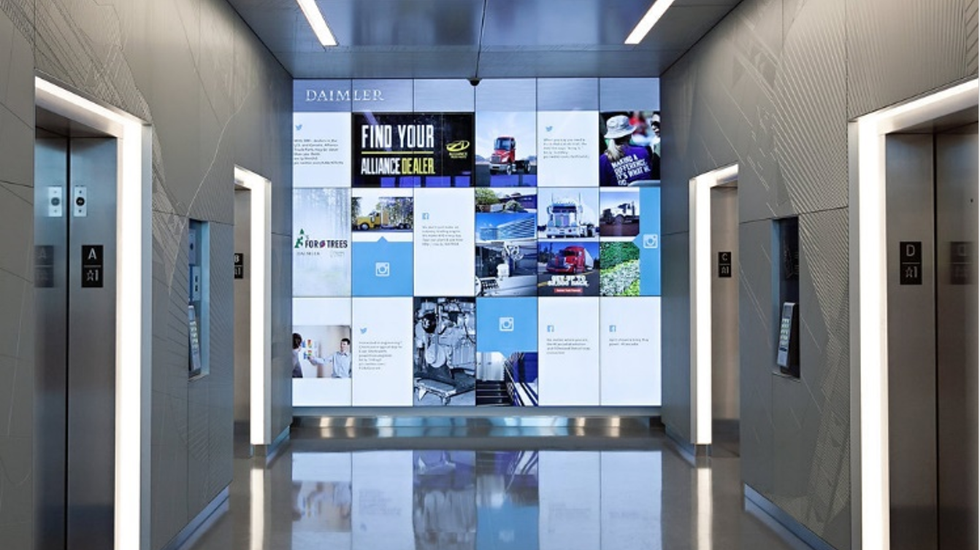
Corporate
Daimler Trucks North America — Portland, OR
View Case Study

Slide 26
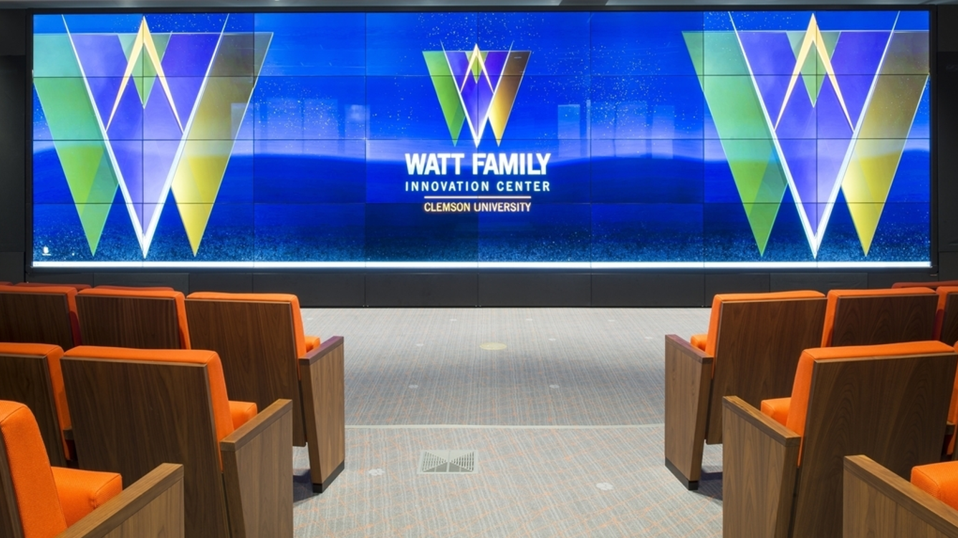
Higher Education
Clemson University — Clemson, SC
View Case Study

Slide 27
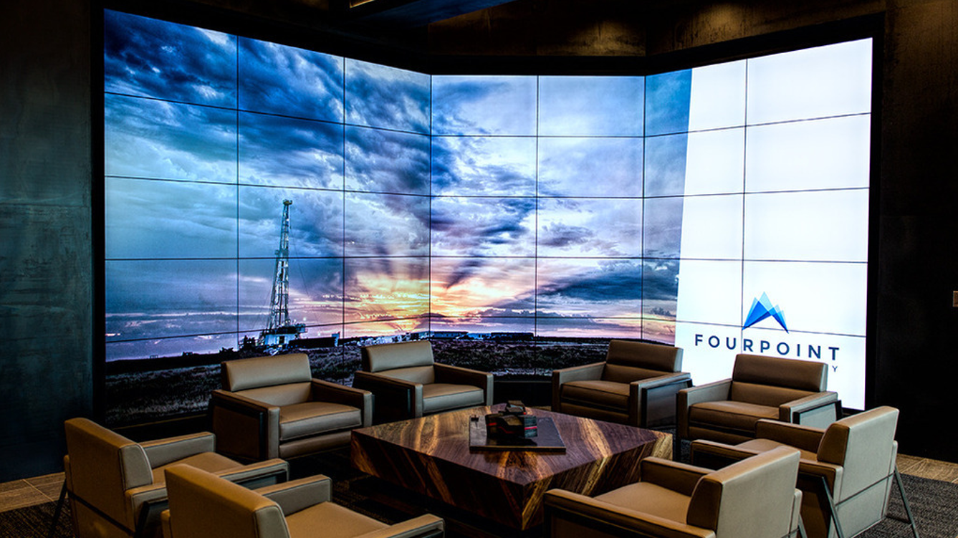
Corporate
FourPoint Energy — Denver, CO
View Case Study

Slide 28
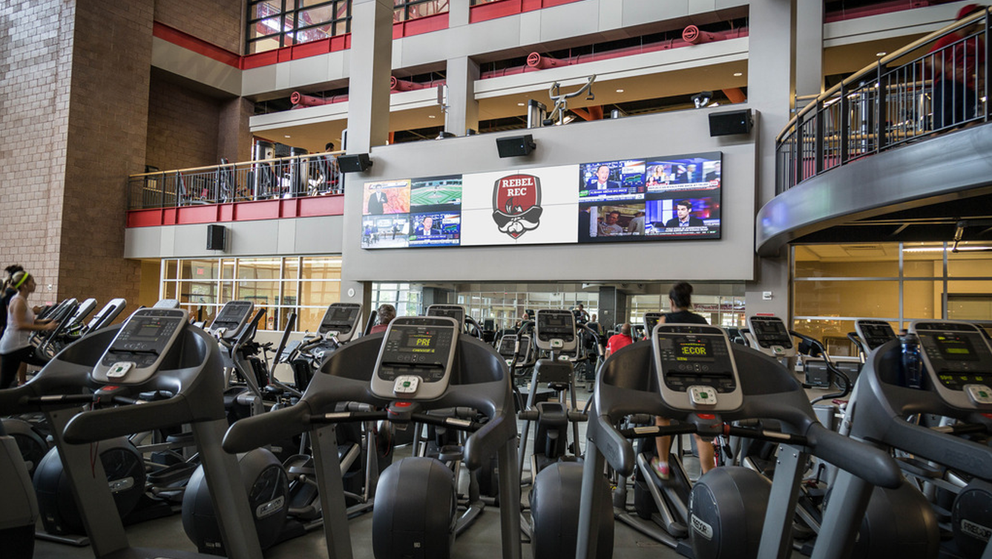
Higher Education
UNLV — Las Vegas, NV
View Case Study

Slide 29
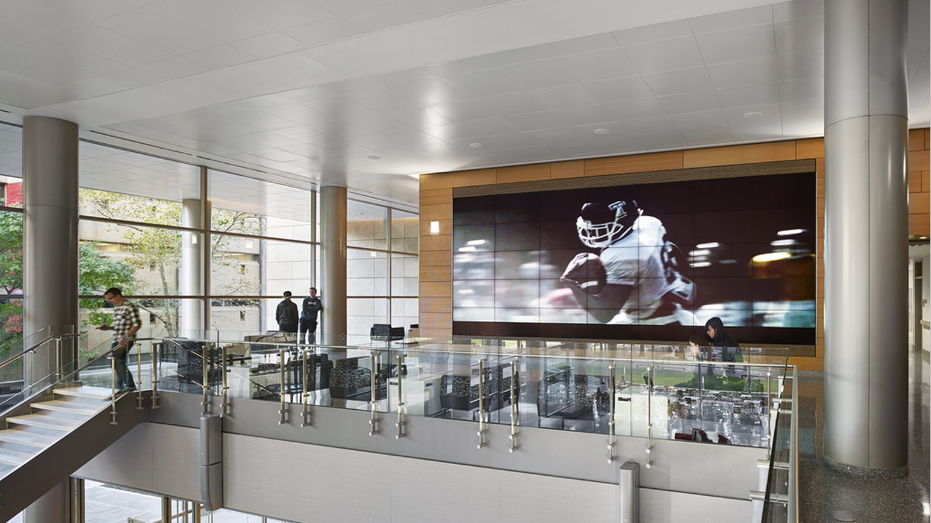
Higher Education
Temple University — Philadelphia, PA
View Case Study

Slide 30
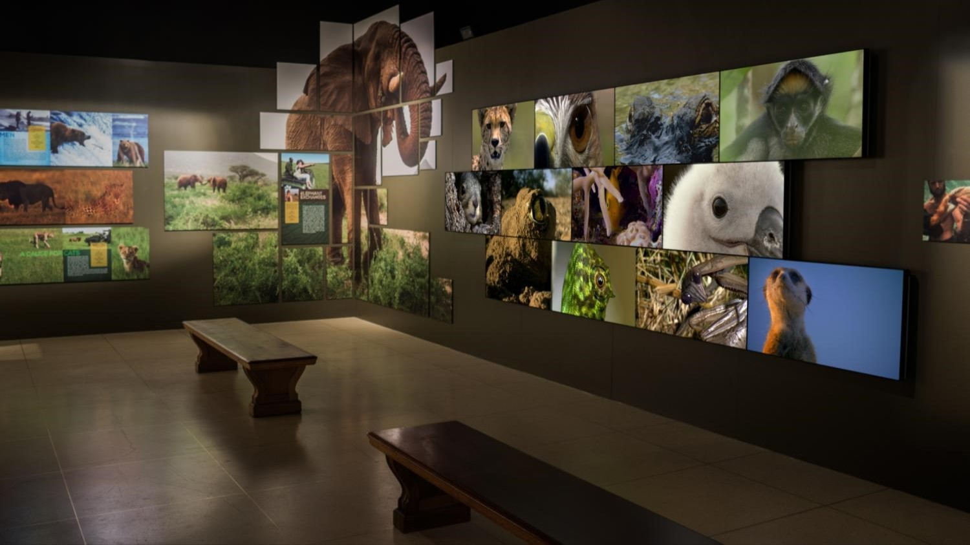
Museum
National Geographic Museum — Washington D.C.
View Case Study

Slide 31
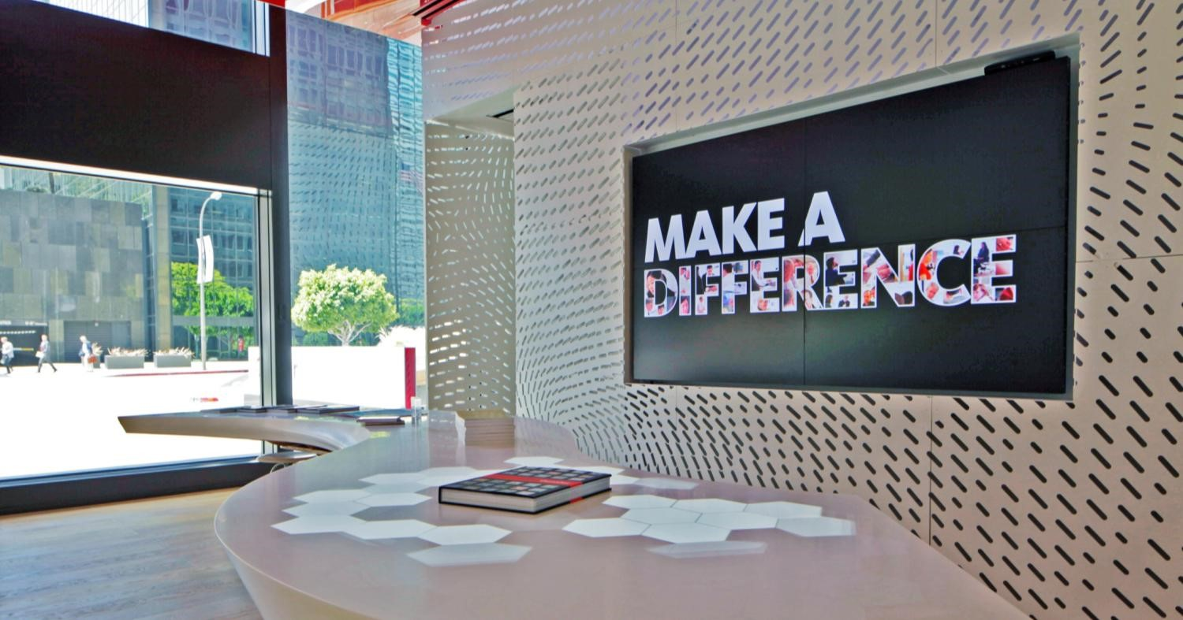
Corporate
Gensler — Los Angeles, CA
View Case Study

Slide 32
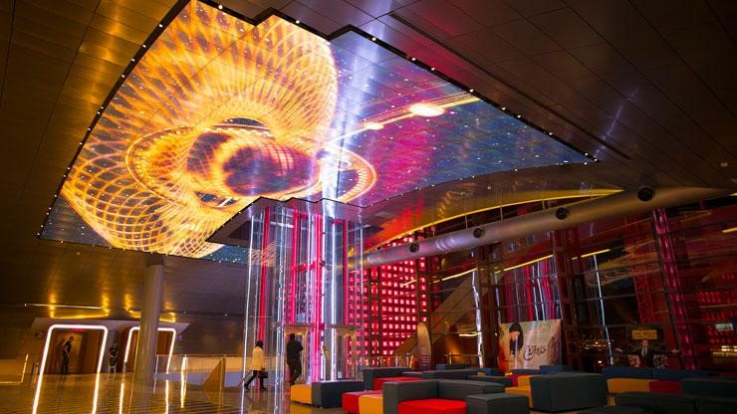
Architecture/Public Venue
CinemaCity — Beirut, Lebanon

Slide 33
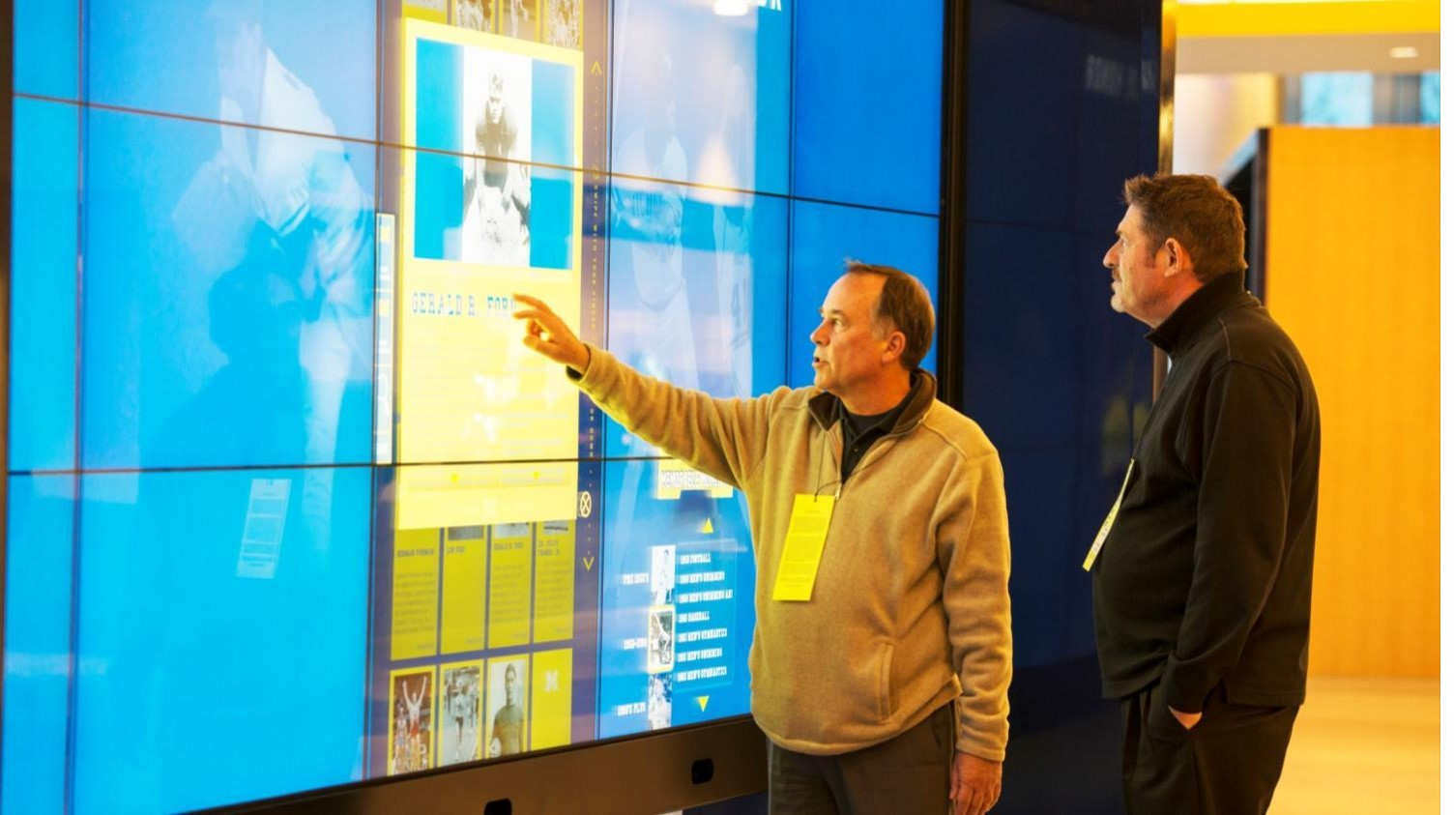
Sports Venue/Higher Education
University of Michigan Crisler Center
View Case Study

Slide 34
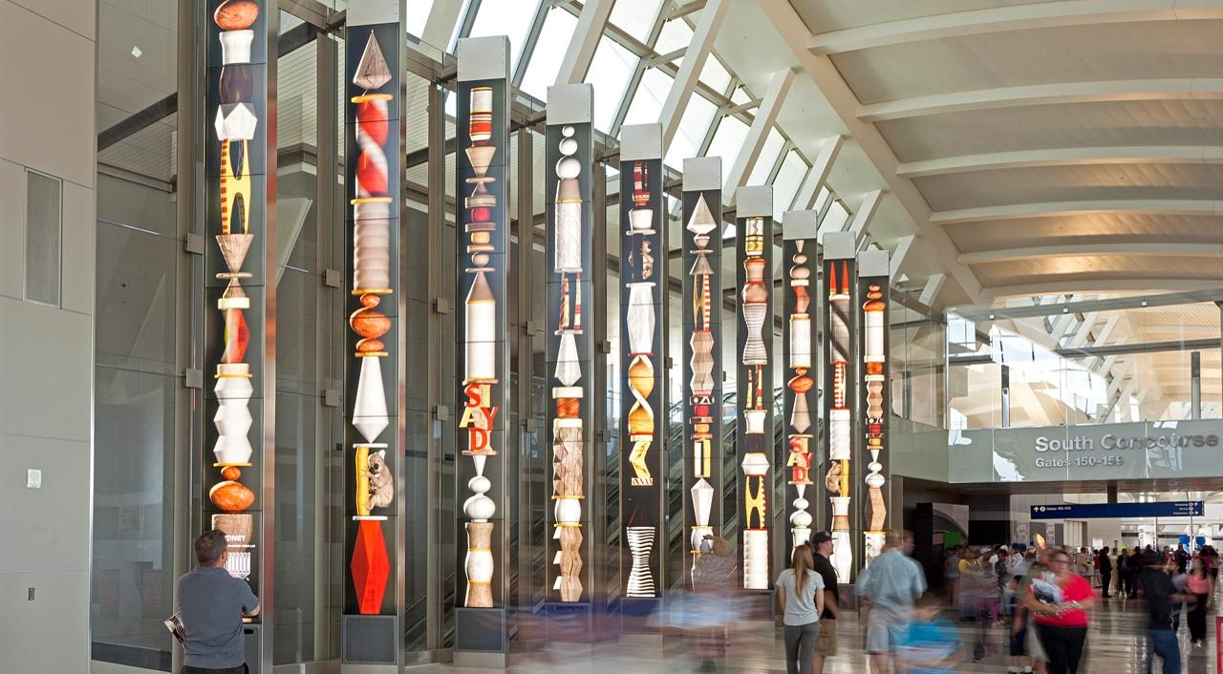
Transportation
LAX Airport — Los Angeles, CA

Slide 35
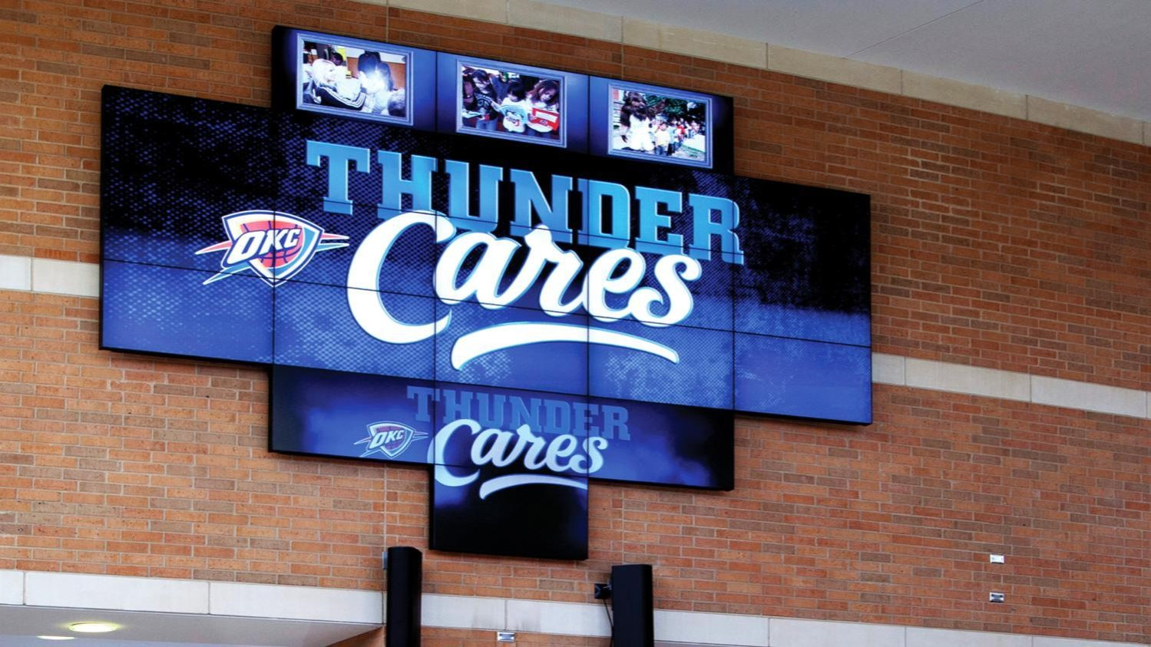
Sports Venue
Chesapeake Energy Arena
Home of the NBA’s Oklahoma City Thunder
View Case Study

Slide 36
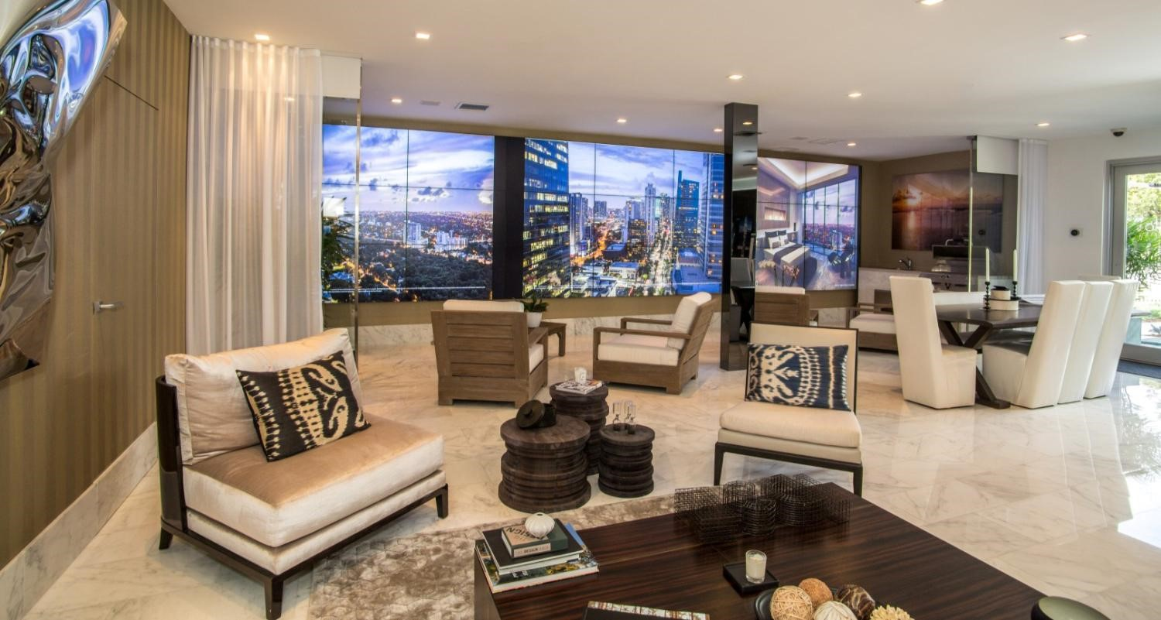
Corporate
Property Markets Group — Miami, FL
View Case Study

Slide 37
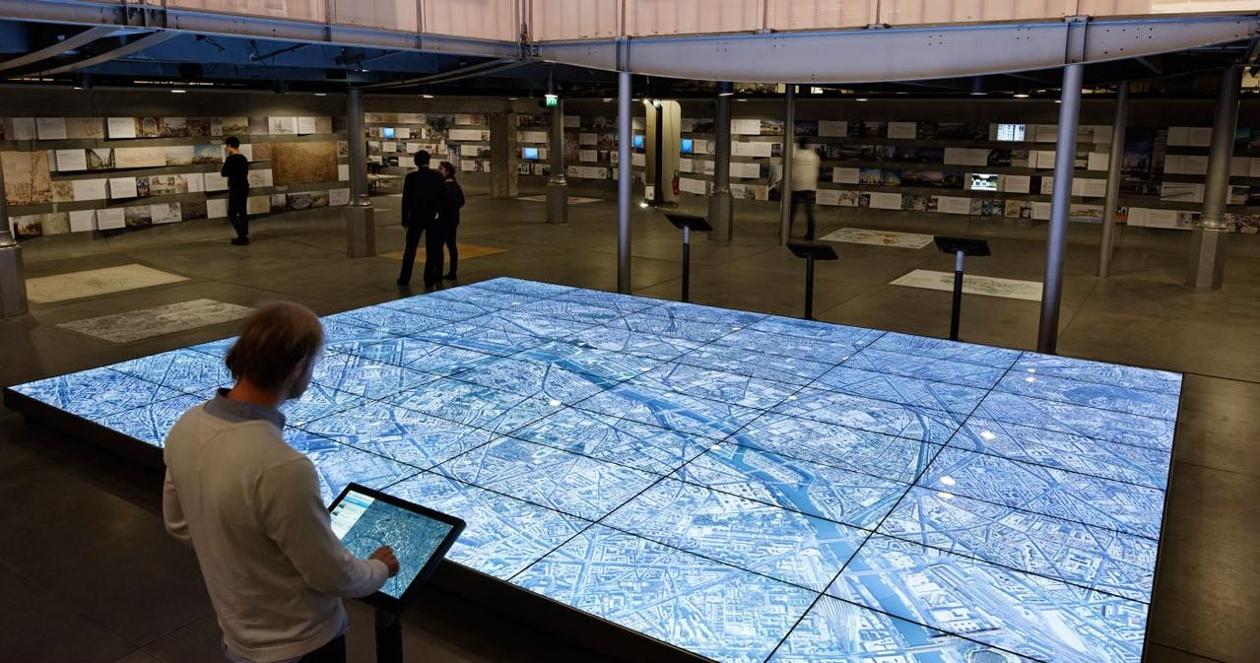
Museum
Pavillon De L’ Arsenal — Paris, France

Slide 38
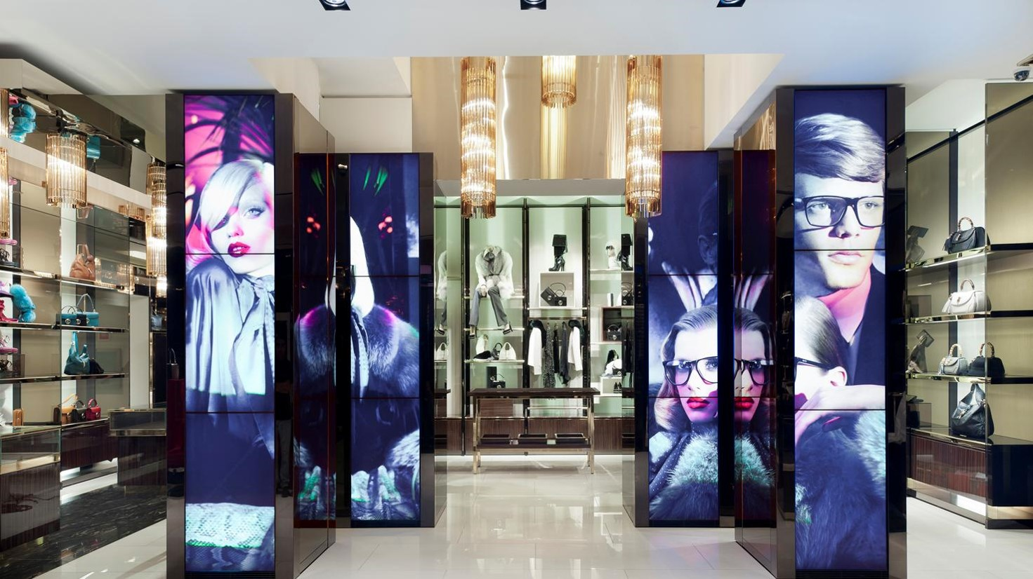
Retail
Gucci Flagship Store — Milan, Italy
View Case Study

Slide 39
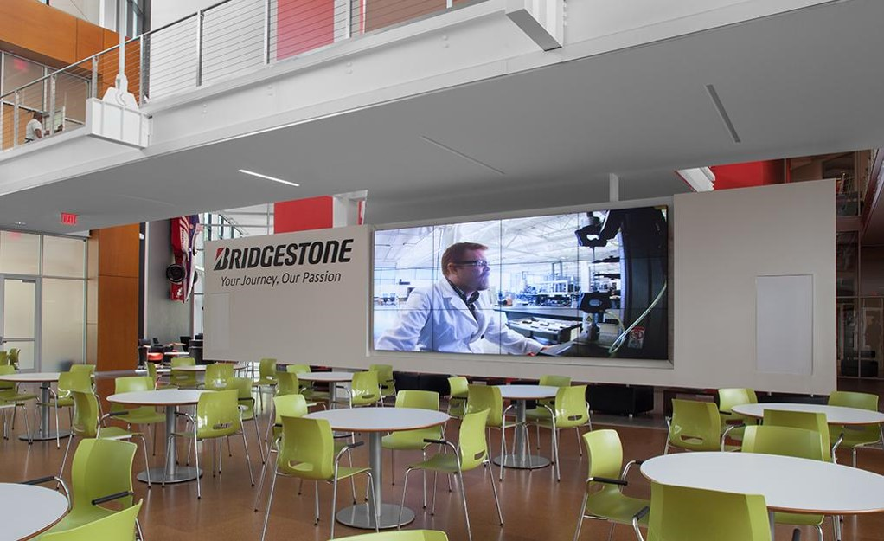
Corporate
Bridgestone Tires

Slide 40
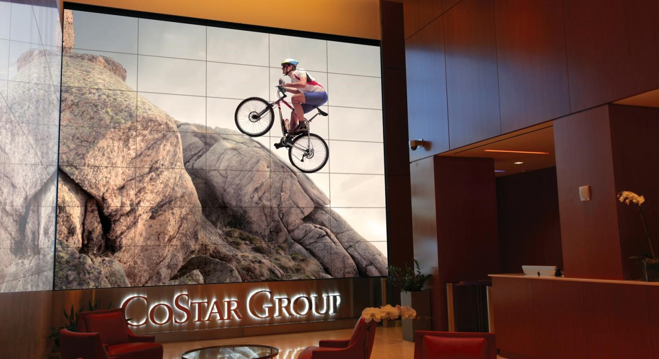
Corporate Lobby
CoStar Group — Washington D.C., USA
View Case Study

Slide 41
Museum
John Deere Pavilion — Moline, IL

Slide 42
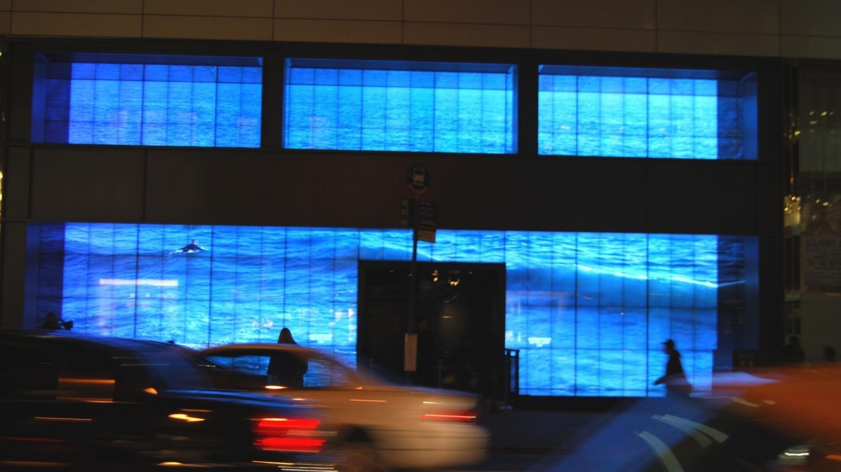
Retail Hollister Co — New York, NY

Slide 43
Museum The National WWII Museum — New Orleans, LA
View Case Study

Slide 44
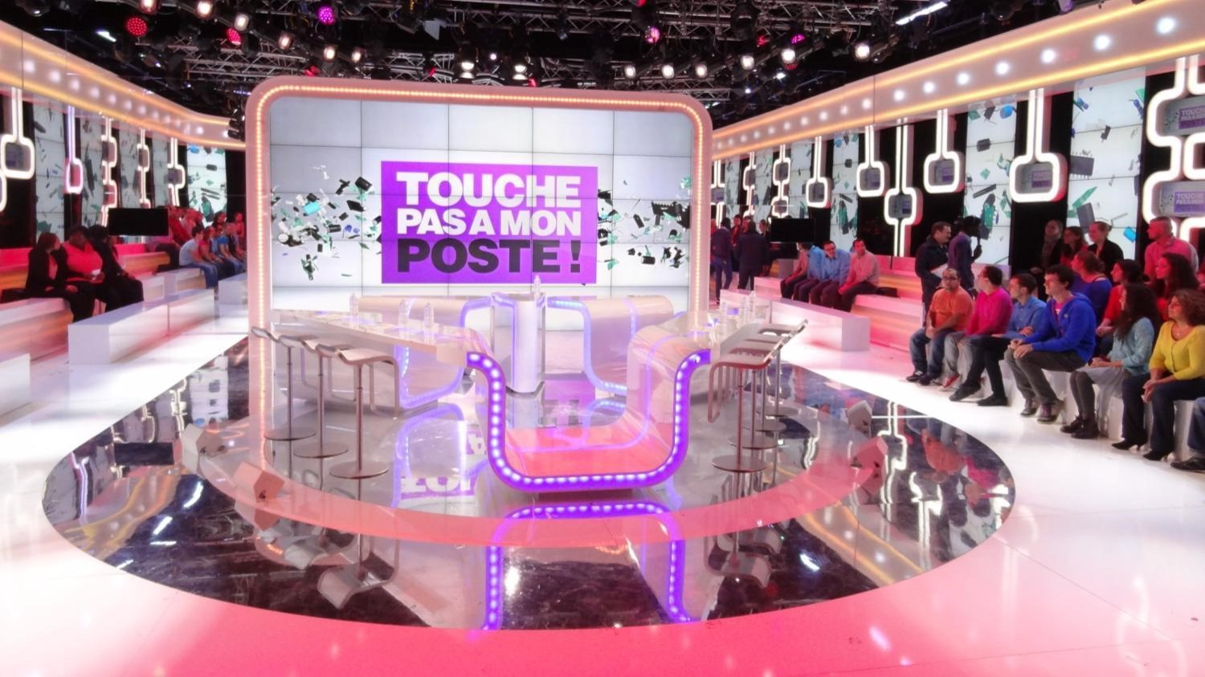
Broadcast Canal+Group — Issy-les-Moulineaux France
View Case Study

Slide 45
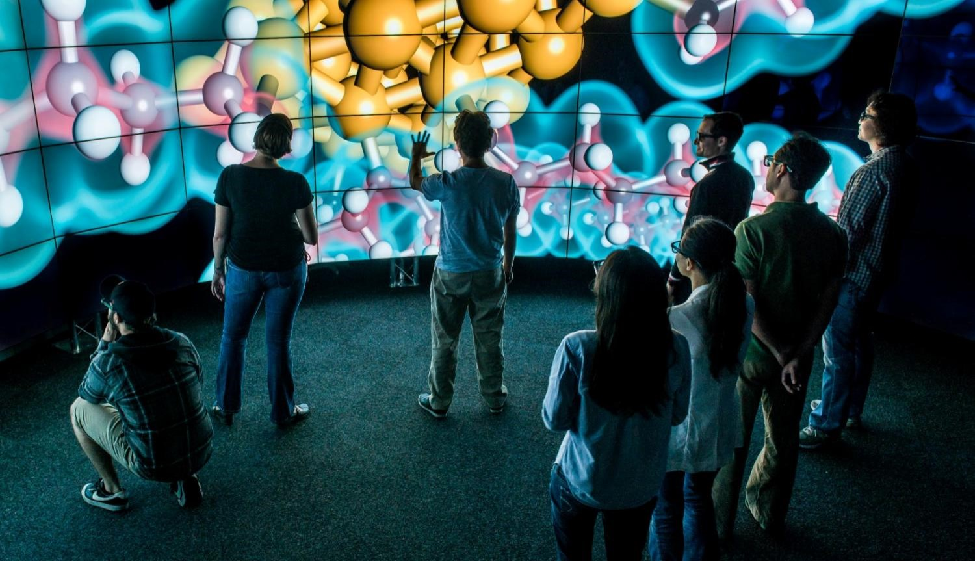
Higher Education/Simulation
University of Illinois Chicago Electronic Visualization Lab (EVL)
View Case Study

Slide 46
Clarity Matrix LCD Video Wall System product details

Slide 47
Clarity Matrix LCD Video Wall System
Product naming
Product Family: Clarity Matrix LCD Video Wall
Product Models: LX, MX, 3D
Product Options:
Brightness | Diagonal | Resolution | Tiled Bezel Width |  | Orientation | ERO | Fiber | Distance (standard 60m)
LX – 500 Nit MX – 800 Nit | 46” 55” | HD – 1080p | S – 5.5 mm U – 3.7 mm X – 1.7mm |  | L – Landscape P – Portrait V – VESA | ERO | F | 100 m

Slide 48
Clarity Matrix LCD Video Wall System
Product models
LX S Models | LX46HDU 3D Models | LX46HDU Models | MX46HDU Models | MX46HDX Models | LX55HDU Models | MX55HDU Models | LX55HDX Models | MX55HDX Models
LX46HDS-L | LX46HDU-3D-L | LX46HDU-L | MX46HDU-L | MX46HDX | LX55HDU-L | MX55HDU-L | LX55HDU-L | MX55HDX-L
LX46HDS-P | LX46HDU-3D-L, Top | LX46HDU-P | MX46HDU-P | MX46HDX-V | LX55HDU-P | MX55HDU-P | LX55HDU-P | MX55HDX-P
LX46HDS-V | LX46HDU-3D-L, Bot | LX46HDU-V | MX46HDU-V | MX46HDX-ERO | LX55HDU-V | MX55HDU-V | LX55HDU-V | MX55HDX-V
LX46HDS-L-ERO |  | LX46HDU-L-F | MX46HDU-L-F | MX46HDX-V-ERO | LX55HDU-L-F | MX55HDU-L-F | LX55HDU-L-F | MX55HDX-L-F
LX46HDS-P-ERO |  | LX46HDU-P-F | MX46HDU-P-F | MX46HDX-F | LX55HDU-P-F | MX55HDU-P-F | LX55HDU-P-F | MX55HDX-P-F
LX46HDS-V-ERO |  | LX46HDU-V-F | MX46HDU-V-F | MX46HDX-ERO-F | LX55HDU-V-F | MX55HDU-V-F | LX55HDU-V-F | MX55HDX-V-F
LX55HDS-L |  | LX46HDU-L-100 | MX46HDU-L-100 | MX46HDX-V-F | LX55HDU-L-100 | MX55HDU-L-100 | LX55HDU-L-100 | MX55HDX-L-100
LX55HDS-P |  | LX46HDU-L-ERO | MX46HDU-P-100 | MX46HDX-V-ERO-F | LX55HDU-L-ERO | MX55HDU-P-100 | LX55HDU-P-100 | MX55HDX-P-100
LX55HDS-V |  | LX46HDU-P-ERO | MX46HDU-V-100 |  | LX55HDU-P-ERO | MX55HDU-V-100 | LX55HDU-V-100 | MX55HDX-V-100
LX55HDS-L-ERO |  | LX46HDU-V-ERO | MX46HDU-L-ERO |  | LX55HDU-V-ERO | MX55HDU-L-ERO | LX55HDU-L-ERO | MX55HDX-L-ERO
LX55HDS-P-ERO |  | LX46HDU-L-ERO-100 | MX46HDU-P-ERO |  | LX55HDU-L-ERO-100 | MX55HDU-P-ERO | LX55HDU-P-ERO | MX55HDX-P-ERO
LX55HDS-V-ERO |  | LX46HDU-L-ERO-F | MX46HDU-V-ERO |  | LX55HDU-L-ERO-F | MX55HDU-V-ERO | LX55HDU-V-ERO | MX55HDX-V-ERO
 |  | LX46HDU-P-ERO-F | MX46HDU-L-ERO-F |  | LX55HDU-P-ERO-F | MX55HDU-L-ERO-100 | LX55HDU-L-ERO-100 | MX55HDX-L-ERO-100
 |  | LX46HDU-V-ERO-F | MX46HDU-P-ERO-F |  | LX55HDU-V-ERO-F | MX55HDU-P-ERO-100 | LX55HDU-P-ERO-100 | MX55HDX-P-ERO-100
 |  |  | MX46HDU-V-ERO-F |  |  | MX55HDU-V-ERO-100 | LX55HDU-V-ERO-100 | MX55HDX-V-ERO-100
 |  |  | MX46HDU-L-ERO-100 |  |  | MX55HDU-L-ERO-F | LX55HDU-L-ERO-F | MX55HDX-L-ERO-F
 |  |  | MX46HDU-P-ERO-100 |  |  | MX55HDU-P-ERO-F | LX55HDU-P-ERO-F | MX55HDX-P-ERO-F
 |  |  | MX46HDU-V-ERO-100 |  |  | MX55HDU-V-ERO-F | LX55HDU-V-ERO-F | MX55HDX-V-ERO-F

Slide 49
Planar LCD Video Wall Line-up
NEW
RA Series
Video Wall Monitor
55”
700 Nit brightness
Big Picture 10x10
12.6 Tiled Bezel Width
Matrix
MX-HDX
Matrix MX-HDU
NEW
High Performance
46” & 55” 800 nits
ADA Compliant
1.7 mm tiled bezel width
Extended distance up to 500 ft.
Matrix LX-HDX
High Performance
46” & 55” 800 nits
ADA Compliant
5.5 tiled bezel width
Extended distance up to 500 ft.
Matrix
LX-HDU
55” 500 nits
ADA Compliant
1.7 mm tiled bezel width
Extended distance up to 500 ft.
Matrix LX-HDU 3D
Matrix
LX-HDS
Standard Performance
46” & 55” 500 nits
ADA Compliant
3.7 mm tiled bezel width
Extended distance up to 500 ft.
3D Video Wall
46” Full HD
500 nits
3.7 mm tiled bezel
Standard Performance
46” & 55” 500 nits
5.5 tiled bezel width
Notes:
MX55HDU
-3.9mm
-ADA Compliant
HX60 Maintains the Matrix 1 architecture
800 Nits for MX
LX Modules are changing
- 500 Nits for LX
Increased Depth (4.6”)
20% lower power consumption
Matrix 3D 46”
PS5580

Slide 50
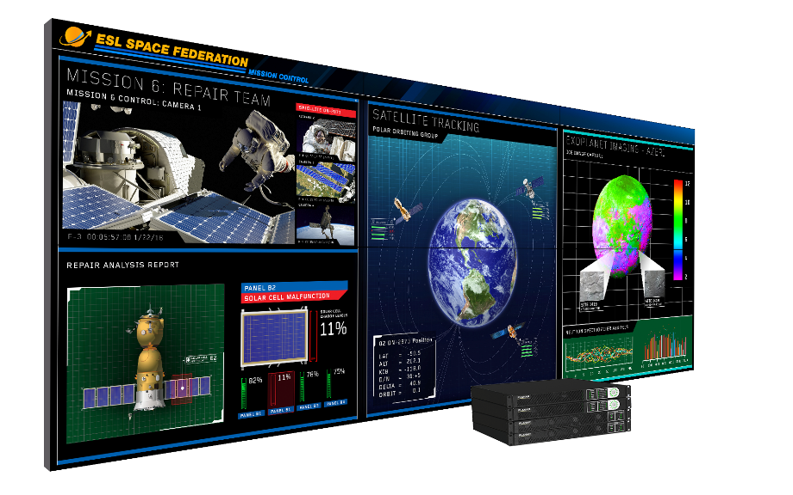
Introducing the New Clarity Matrix MX55HDX
Extending the Clarity Matrix Video Wall Family to the Industries Smallest LCD Bezel Class
55” 800 Nit
Smallest tiled bezel width available- 1.7mm
Updated Planar EasyAxis mounting system-
The only mounting system achieving the extreme bezel width
Superior optical performance
~10% power consumption reduction over ultra narrow bezel equivalent model
Mission-critical 24/7 operation

Slide 51
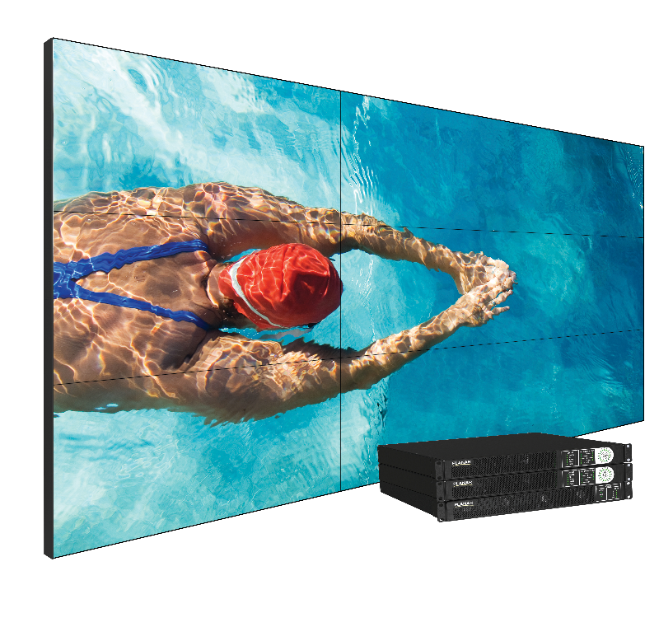
Introducing the New Clarity Matrix MX46HDX
Extending the Clarity Matrix Video Wall Family to the Industries Smallest LCD Bezel Class
46” 800 Nit
Smallest tiled bezel width available- 1.7mm
Updated Planar EasyAxis mounting system-
The only mounting system achieving the extreme bezel width
Superior optical performance
~10% power consumption reduction over ultra narrow bezel equivalent model
Mission-critical 24/7 operation

Slide 52
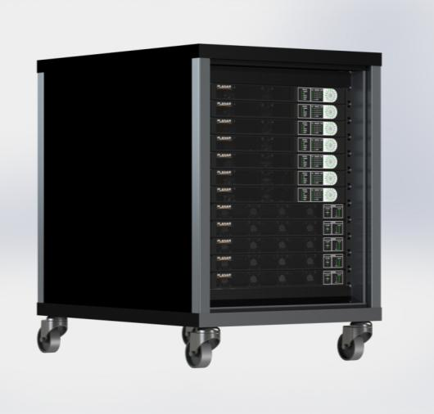
Clarity Matrix LCD Video Wall
Off-board electronics architecture
Benefits of off-board electronics
Removes heat, weight, depth, noise, and points of failure from the video wall
Rack can be co-located with sources and processing for convenient cabling, security, and climate control
Maintenance is easy to access and does not interfere with video wall
Redundant power supply option maintains operation in the case of a power supply failure

Slide 53
Clarity Matrix LCD Video Wall
Quad controller module
Standard cable lengths: 200 ft./ 60 m
Longer distance option: 500 ft./ 150 m
Built-in IR remote extension
1 RU
Integrated WallNet Option | DisplayPort 1.1 input | HDMI input x 4 | One Cat6 cable per Matrix panel | DisplayPort 1.1 loop out

Slide 54
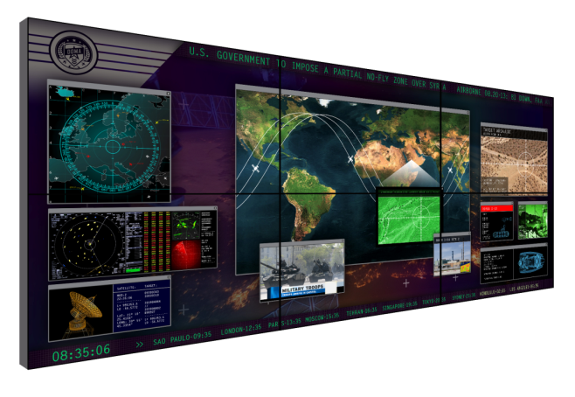
Clarity Matrix LCD Video Wall
Image processing
Supports a wide range of processing options
Planar Big Picture Plus processing
Clarity® Visual Control Station™ (VCS™)
Planar® Indisys® Extensity™ Video Wall Processor support
Support for all leading image processors and digital signage solutions via HDMI, DVI, DisplayPort inputs

Slide 55
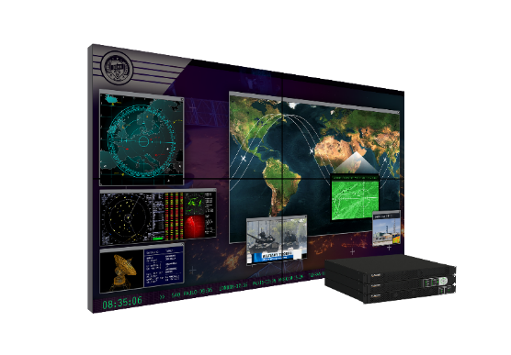
Clarity Matrix Fiber Video Extension Module Option
Highest level of protection for mission-critical information
Fiber Optic cabling is the preferred technology to use in sensitive and secure environments for data transport
Clarity Matrix Fiber Video Extension Option will transmit the video signal over fiber optic cable between the quad and the Matrix LCD Module
Extends the supported distance between the wall and off-board electronics
Multimode (standard): up to 1000 feet
Single mode (compatible): up to 10K
Better integration for Clarity Matrix MultiTouch
Built-in USB Extension and Power
Applications:
Transportation and traffic | Government/military | Utilities | Broadcast | Security

Slide 56
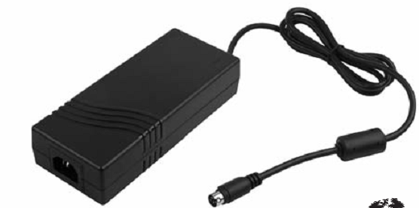
Clarity Matrix Fiber Video Extension Module
SFP fiber transceiver connection output to the panel
USB 2.0 input (Type-B connector)
Fiber module power switch
DC Power (4-pin mini-DIN) for Fiber module
Input from the Quad Controller

Slide 57
Clarity Matrix Fiber Video Extension Option
Panel interface board
IR and Ambient Light Sensor Outputs
USB 2.0 Output- Matrix MultiTouch
Power for Matrix MultiTouch
SFP Input from Fiber Module
Power Input and Loop Through

Slide 58
Clarity Matrix LCD Video Wall System
Power supply module
Supported cable lengths of 500 ft./150 m
Redundant power supply option
1 RU
IEC C20 AC input | Power connector for Quad Controllers | Daisy-chain up to 8 panels with one cable | Health status monitoring

Slide 59
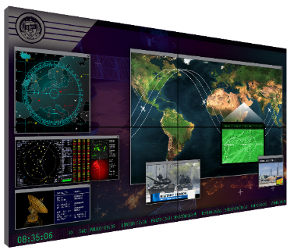
Clarity Matrix LCD Video Wall System
Supported cable lengths
Clarity Matrix Quad Controller Module
Standard length 200 ft / 61 m
Extended length
500 ft / 150m
Third party extenders
Cat 6 Cable Lengths
Bulk cables and connectors support field-terminated lengths
25 ft/7.6 m
50 ft/15.2 m
75 ft/22.8 m
100 ft/30.4m
200 ft/60m
Clarity Matrix Power Supply Module
Standard configuration support – 500 ft / 152 m
Power Cable Lengths
Bulk cables and connectors support field-terminated lengths
25 ft/7.6 m
50 ft/15.2 m
75 ft/22.8 m
100 ft/30.4m
200 ft/60m
Clarity Matrix Fiber Extension Module
MUTLI-MODE 1000 ft / 300 m
SINGLE MODE 10 km
FIBER CABLE LENGTHS
Bulk cables and connectors available to support field-terminated lengths
65.6 ft/20m
98.4 ft/30m

Slide 60
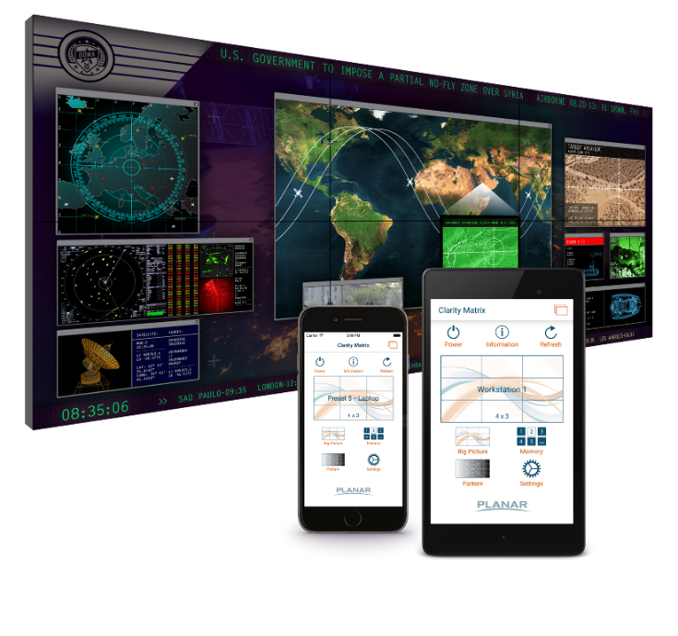
Clarity Matrix App
Flexible control of the Clarity Matrix LCD Video Wall System with your phone or tablet
Power on and off the display
Switch between Planar Big Picture Plus configurations
Recall saved preset configurations
Create custom names for inputs
Quickly access multiple video walls on the same network
Access display information for support
Design to be used with the Planar® WallNet™ option

Slide 61
Clarity Matrix LCD Video Wall System
Mounting system
Planar EasyAxis Mounting System includes added robustness and improved cable access
Reduced space requirements above the panel for service position
Attachment points maintain position of previous EasyAxis mount
Now supports optional VESA mounting

Slide 62
Clarity Matrix LCD Video Wall System options and accessories

Slide 63
Clarity Matrix LCD Video Wall System
Planar ERO (Extended Ruggedness and Optics) technology
The Planar ERO Advantage
Added protection and durability
Improved contrast, clarity, and legibility
Keeps out dust and moisture
Reduced glare and parallax error
Modular touch surface

Slide 64
Clarity Matrix MultiTouch LCD Video Wall System
Interactive LCD Video Wall
Up to 32 simultaneous touch points
Allows multiple people to interact without affecting each other
Pinpoint touch accuracy
Capable of wall sizes up to 500” diagonal
Modular protective touch surface with Planar ERO
Available in 46” or 55” in 1920x1080 resolution

Slide 65
Clarity Matrix 3D LCD Video Wall System
Large Format Professional 3D Visualization
Flicker-free, think profile stereoscopic display
3D optical system with passive glasses
Wide viewing angles for multiple users
Excellent brightness and contrast
Off-board electronics architecture
Spectacular 3D and 2D viewing experience
Clarity Matrix LX46HDU-3D: 46” LCD with 1920x1080 resolution and 3.7mm tiled bezel width

Slide 66
Clarity Matrix LCD Video Wall System
Accessories
Cat6 Cables: 25, 50, 75, 100, 200 ft.
DC Power Cable (Plenum Rated): 8, 25, 50, 75, 100, 200 ft.
Bulk cables, connectors, tools
Redundant power supply option
Floor stands
Edge trim
Color Balance Tool
Stud adapter bracket
Integrated Planar WallNet
Clarity Matrix MultiTouch

Slide 67
Clarity Matrix LCD Video Wall System
Mounting options
400 x 400 mm
Updated Planar EasyAxis Mounting System
Optional VESA mount hole pattern

Slide 68
Clarity Matrix Sales Tools

Slide 69
Clarity Matrix LCD Video Wall System
Sales tools
Clarity Matrix family web pages
Clarity Matrix product family brochure and datasheet
Clarity Matrix 3D brochure
Clarity Matrix MultiTouch brochure
Product presentations
Product renderings
CAD files with more configurations
Product and service videos
Specifications sheets
Bid Specification document
Competitive bubble chart
Clarity Matrix Calculator
Case studies website
BIM files

Slide 70
Clarity Matrix LCD Video Wall System Calculator
Configure your own Clarity Matrix Video Wall System
The Clarity® Matrix® LCD Video Wall Calculator allows users to configure and generate specification data, provides installation cabling diagrams, and simulates a finished custom Clarity Matrix LCD video wall array.

Slide 71
Clarity Matrix LCD Video Wall System Calculator

