Slide 1
CLARITY VISUAL CONTROL STATION (VCS)
Product Overview – January 2018

Slide 2
Clarity® Visual Control Station™ (VCS™)
Video Wall Image Processing Solution
Broad range of source capture and display capabilities
New commercial chassis with Windows® 10 LTSB
Enhanced VCS Control Software

Slide 3
Source Capture Inputs
Clarity VCS

Slide 4
Source Capture & Display Capabilities
Full HD and 4K video sources can be connected via DisplayPort, DVI, HDMI, SDI (SD, HD, 3G), composite and IP Sources.
Signal Type | Video Input Resolution | Compliance
HDMI | 3840 x 2160 @ 30fps 1920 x 1080 @ 60fps | HDCP 1.4
DVI | 3840 x 2160 @ 30fps 1920 x 1080 @ 60fps | HDCP 1.4
DisplayPort | 3840 x 2160 @ 60fps 1920 x 1080 @ 60fps | HDCP 1.4
IP | 3840 x 2160 @ 30fps 1920 x 1080 @ 60fps | H.264
SDI | 1920 x 1080 @ 60fps | n/a
Composite | 720 x 576 | n/a

Slide 5
Improved Clarity VCS Chassis
Clarity VCS

Slide 6
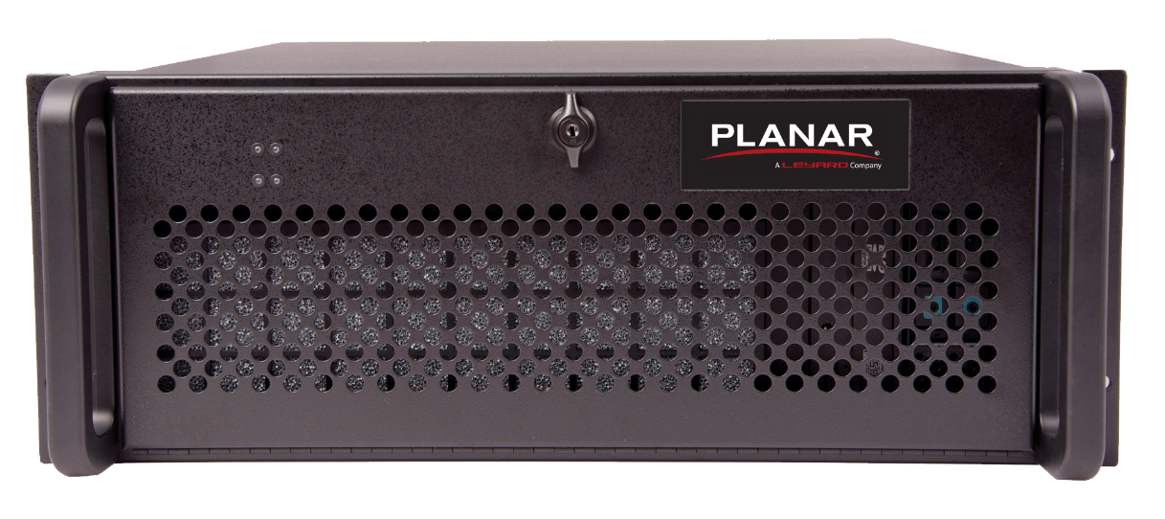
Improved Clarity VCS Chassis
Clarity VCS video wall processor is both powerful and reliable, utilizing:
4U rack-mountable chassis
High-performing, 3rd generation PCIe switched fabric backplane
Powerful server-class CPU
RAID 1 solid state drives
Redundant power supplies

Slide 7
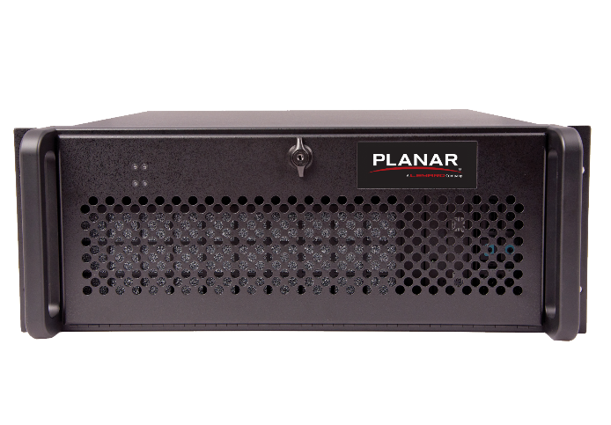
Improved Clarity VCS Chassis
Clarity VCS Specifications
Processor & Memory | Intel® Core™ i7, 32GB DDR4 DRAM
Operating System | Windows 10 LTSB
Size | 500 x 175 x 482mm | 19.7 x 6.9 x 18.9in
Weight | 33kg | 72.7lb
Backplane & Slots | 3rd Generation PCIe switched fabric 11 slots/chassis, 8 lanes/slot
Disk Drive | Dual 250GB SSD in RAID 1 configuration
Ethernet | 2x 10/100/1000 Ethernet
USB Ports | 2x USB 3.0 Back, 6x USB 2.0 (2 Front, 2 back, 2 internal)
Power Supply | 2x 600 watt, Redundant
Power Consumption | 593 watts (max)
Thermal Load | 2024 BTU/hr (max)
Product Approvals | FCC, CE, RoHS, UL

Slide 8
VCS Control Software
Clarity VCS

Slide 9
VCS Control Software
VCS Control Software v6 offers Standard or Enterprise editions. Both editions allow users to:
Create, resize, move windows
Create and save layouts
Sub layout as source
Control multiple VCS from the same interface
Receive IP commands
Source preview

Slide 10
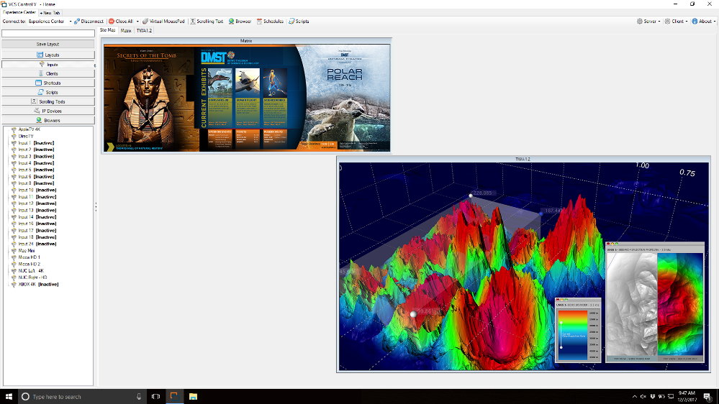
VCS Control Software
VCS Control Software v6 graphical user interface (GUI) allows users to:
Click and drag – One button to close, go to full screen or bring layouts into grid
Automatically fill content on screen or in grid
Create, resize and move windows
Manage multiple Clarity VCS and video walls
Load inputs, applications, web pages, pictures and videos

Slide 11
VCS Control Software, Enterprise Edition
VCS Control Software Enterprise Edition empowers control and collaboration rooms with a full feature video wall processor.
Higher level of functionality with:
IP capture
Scheduling
Scripts
Greater teamwork and control with:
Unlimited licenses
User rights management
Network capture

Slide 12
VCS Control Software, Enterprise Edition
Network Capture
Network Capture enables the ability to share screen content across the local area network and to the video wall.
Client
Controls video wall
Ability to share content and control client computers
Ability to share content
Light-weight
Client

Slide 13
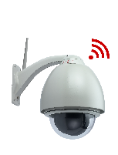
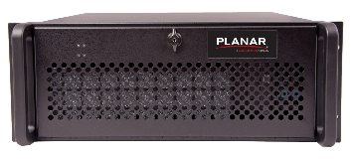
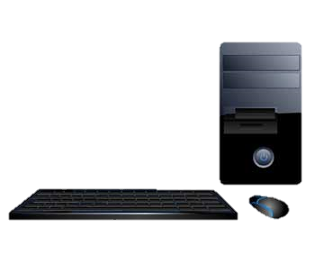
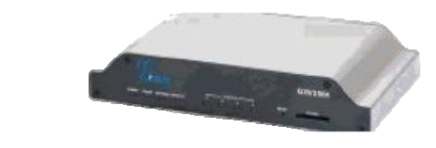
VCS Control Software, Enterprise Edition
IP Stream Capture
IP capture card and Enterprise Edition Software enables video over IP
Customer will have traditional sources and compatible IP sources
Compatible IP Cameras
Clarity VCS Video Wall Processor
Network Infrastructure
Video Walls
Compatible Encoders
Traditional Wired Sources

Slide 14
Enhanced VCS Control Software
Key Features
VCS Control Software V6 – Standard and Enterprise Editions
Create, resize, move windows | Place any source in any location on the video walls at any size without physical limitations of display size or resolutions | Examples— Use the video wall(s) space as desired without any limitation on cabinet position
Create and save layouts | Create, save and recall an unlimited amount of layouts | Examples— First shift, second shift, third shift layouts
Sub layout as source | Select and save a group of sources as a virtual source layout for easy drag-and-drop in other areas of the same video wall or different display. The saved virtual source can be moved and resized as a single unit. | Examples— Group all cameras in one layout and bring them at any place in the video wall
Control multiple VCS from same GUI | Link multiple Clarity VCS processors in the same VCS interface. Each linked Clarity VCS will appear on its own tab so users can switch different Clarity VCS processors easily and quickly. | Examples— Easily manage video walls in different locations or for easier user management
Receive IP commands | Clarity VCS can receive and perform IP commands from an external controller for typical actions | Examples— Loading layouts Changing sources among others

Slide 15
Enhanced VCS Control Software
Key Features
VCS Control Software V6 – Standard and Enterprise Editions
Application sources | Run Windows-based applications as a content source include them in preset layouts | Examples— View emergency procedures and emergency contact list information that are stored in the VCS drives
Input grouping | Ability to create virtual groups of sources that can more easily be assigned access rights to users or groups of users | Examples— Security cameras grouped together for security teams to access Sensors and switches grouped together for engineering teams to access Highly secure sources grouped together for users with a particular security clearance
Source preview | View a physical representation of the video wall in the VCS Control Software | Examples— Be able to see they layout in the wall from the rack room using the VCS Control Client software without having to walk to the video wall
Site Map (multiple video walls) | View and manage multiple walls concurrently in the same GUI | Examples— Ability to manage and share sources across the main control room video wall, as well as the conference room video wall from same VCS unit and software

Slide 16
Enhanced VCS Control Software
Key Features
VCS Control Software V6 – Enterprise Edition Only
Scripting engine | Support for simple scripting language that allows for every UI feature to be invoked via a script with full scheduling capabilities, including programing complex sequence of events performed on a regular base and recall scripts via controller, web page or handheld application | Examples— Program complex sequence of events that are performed on a regular base and recall scripts via controller, web page or handheld application Program a beginning of day screen, end of day screen or an emergency response screen layout
Network capture | Share display content across the local area network and to the video wall | Examples— Security cameras grouped together for security teams to access Sensors and switches grouped together for engineering teams to access Highly secure sources grouped together for users with a particular security clearance
IP camera capture | Decode and display IP camera feeds (H.264, MPEG2, MJPG, other) on Clarity VCS in 1080 x 1920 @ 30fps (minimum) | Examples— Add IP cameras to the video wall without wiring directly to the controller or without adding a decoder between the camera and the controller

Slide 17
Enhanced VCS Control Software
Key Features
VCS Control Software V6 – Enterprise Edition Only
User rights management | Assign and maintain users or groups rights by authorizing and restricting work areas on the video wall, access to sources and to KVM | Examples— Control access to content, viewing sources, changing sources or adjusting image quality Give the teams full access to security cameras and security sensors, but no access to key process parameters
Logging | Logging, organizing and exporting to .xls of every click or movement on a wall, making it helpful for action reports or analysis of emergency responses | Examples— Investigative team can re-create the actions from the control room or audit response
Scheduling | Define events at specific times in a calendar, including loading layouts at specific time of the day | Examples— Load first shift layout at the start of the first shift Load second shift layout at the start of the second shift. Load daily meeting layout at the start of the daily meeting

Slide 18
Enhanced VCS Control Software
VCS Control Software Features | Standard Edition | Enterprise Edition
Create, resize, move windows | Yes | Yes
Create and save layouts | Yes | Yes
Sub layout as source | Yes | Yes
Control multiple VCS from same GUI | Yes | Yes
Receive IP commands | Yes | Yes
Source preview | Yes | Yes
Site Map (Multiple walls) | Yes | Yes
Concurrent Clients | One | Unlimited
Scripting engine | -- | Yes
Network capture | -- | Yes
IP stream capture (cameras, encoders) | -- | Yes
User rights management | -- | Yes
Logging & scheduling | -- | Yes

Slide 19
Available Models
Clarity VCS

Slide 20
Available Models
Standard Edition
Clarity VCS-STD-4DP4
Clarity VCS-STD-8DP8
Clarity VCS-STD-12DP12
Enterprise Edition
Clarity VCS-ENT-4DP4
Clarity VCS-ENT-8DP8
Clarity VCS-ENT-12DP12

