Slide 1
Planar VM Series LCD Video Wall
Product Overview – March 2018

Slide 2
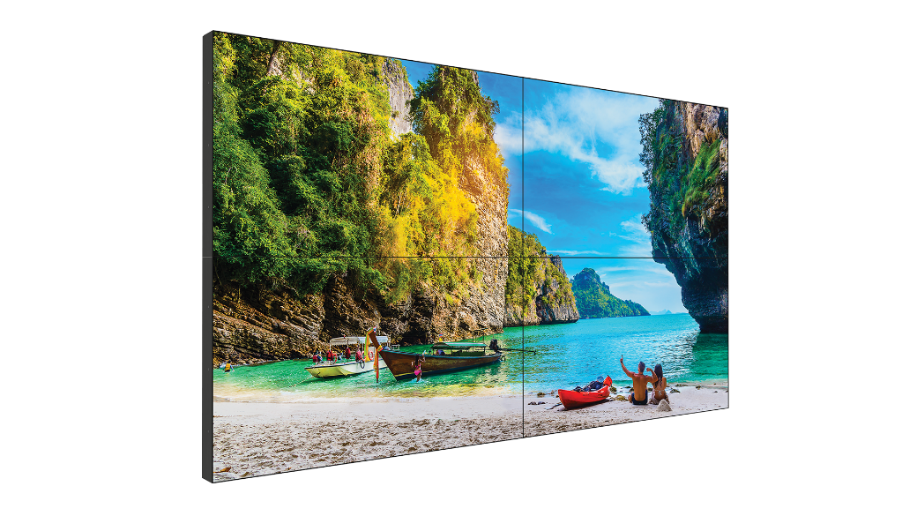
Planar® VM Series LCD Video Wall
55” Extreme and Ultra-Narrow Bezel LCD Video Wall Displays
IPS panel technology
Tiled bezel width as small as 1.8mm
Enhanced brightness up to 700 nits
4K@60Hz loop through
Industry-leading connectivity
24x7 reliability supports extended use
OPS slot for seamless integration
Landscape and portrait support
Price points target cost-conscious installations with limited video wall budgets
VM55MX-X: Extreme Narrow Bezel, 700 nits
VM55LX-X: Extreme Narrow Bezel, 500 nits
VM55LX-U: Ultra-Narrow Bezel, 500 nits

Slide 3
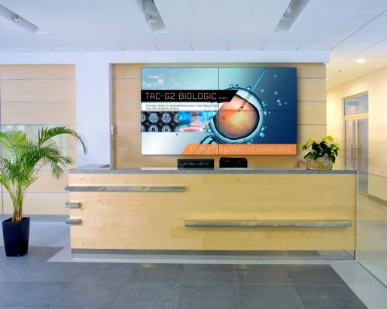
Target Markets For Planar VM Series
Lobbies
Public Spaces
Retail
Corporate
Hospitality
Healthcare
And more!
Resorts/casinos
Airports
Higher education
Arenas
Museums
And more!
In-store
Shopping malls
And more!
Notes:
Focus on:
Corporate
Resorts/casinos
Higher education
Museums

Slide 4
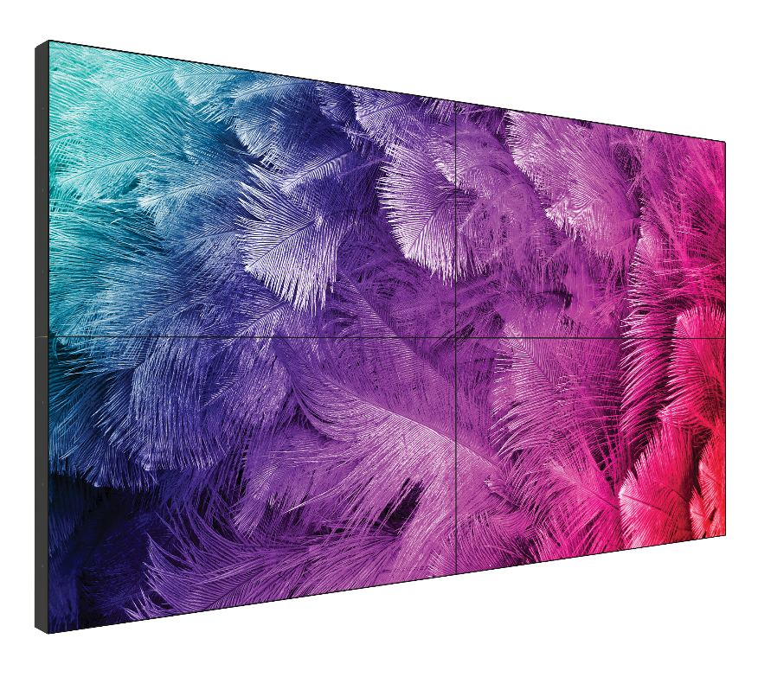
Planar VM Series LCD Video Wall
Features and Capabilities
DisplayPort 1.2 and HDMI 2.0 high bandwidth inputs & loop through
HDCP 2.2 copy protection
Video wall scaling to support up to a 10 x 10 wall
Superior 4K signal processing & upscaling capabilities
Directly upscales 4K content on larger walls
Fanless design
On-screen Display, remote & serial command set
OPS Slot

Slide 5
Planar VM Series LCD Video Wall
Built-in Video Wall Scaling
Built-in software manages up to 10x10 configuration
Frame compensation provides “window pane effect”
DisplayPort loop out
RS-232 and IR loop out

Slide 6
Planar VM Series LCD Video Wall
Warranty
Planar VM Series LCD Video Walls are covered by Leyard and Planar Standard Limited Warranty, which features:
3-year protection
advance replacement
access to 24x7 emergency phone support
Extended warranty and installation services are also available.

Slide 7
Planar VM Series LCD Video Wall
Key Selling Points
XNB and UNB options
700 nit or 500 nit brightness options
4K@60Hz support through both HDMI and DisplayPort
HDCP 2.2 compliance
Capable of looping 4K@60Hz
Audio inputs/outputs
Built in video wall scaling, including support for 4K sources
Internal speakers
OPS slot
Optional bezel trim
Optional Planar Wall Mount KIT
Scheduling capabilities
Carrying handles
Superior performance for extreme- and ultra-narrow bezel
LCD video walls

Slide 8
Planar VM Series LCD Video Wall
Summary
IPS Panel Technology
Built for High Performance
Engineered for Video Wall Versatility
Designed to Meet Any Budget

