Slide 1
CLARITY MATRIX G3 LCD VIDEO WALL SYSTEM
Product Overview – January 2020

Slide 2
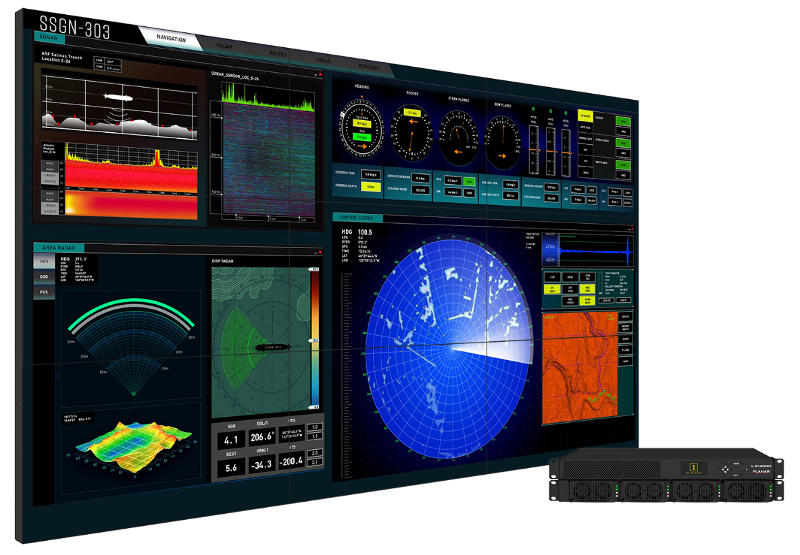
Clarity Matrix G3 LCD Video Wall System
Industry-Leading Performance and Value
Enhanced video wall processing and software
Mission-critical design with off-board electronics, hot-swappable redundant power supply
Industry’s thinnest installed depth as small as 3.5” (88mm)
Intuitive 6-axis mounting system with micro adjustments for perfect alignment and easy serviceability
The most advanced and comprehensive line up of LCD video wall models
46”, 55” and 65” LCD Displays with Tiled bezel widths of 0.88 mm, 1.7 mm and 3.7 mm

Slide 3
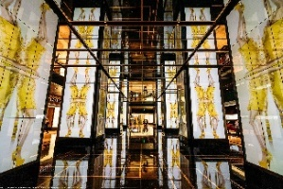
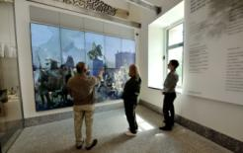
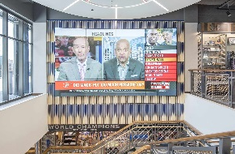
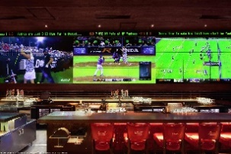
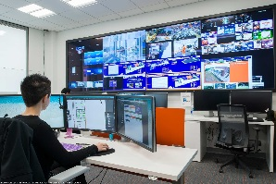
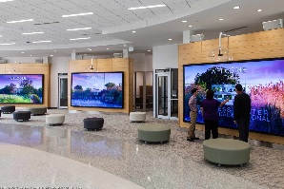
Audiences and Applications
Primary Audiences:
Public venue
Corporate
Higher education
Military
Common Applications:
Digital signage
Command and control
Corporate communications
Entertainment

Slide 4
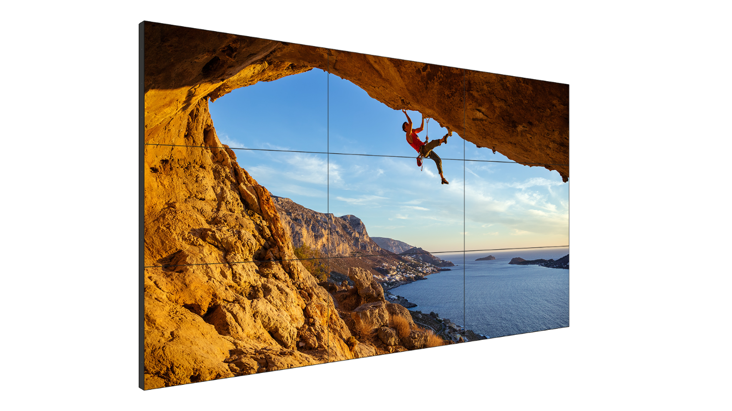
System Components
1
Clarity® Matrix® G3 LCD Video Wall System
46”, 55” and 65” LCD displays
World’s smallest tiled bezel width down to 0.88 mm
Slim, lightweight design
Includes Planar® EasyAxis™ mounting and alignment system
1
2
Planar® Video Controller (VC)
1U rack-mountable controller drives up to 9 Full HD (1920 x 1080) sections
5 4K@60Hz inputs available with each VC
Embedded video and control extension
Planar® Big Picture Plus™ Processing with Planar® WallSync™ genlock technology
3
Planar® Remote Power Supply (RPS)
1U rack-mounted power supply powers complete system (up to 24 LCD displays & video controllers)
Hot-swappable redundant supply option
2
4
Planar® WallDirector™ Software
Tool to setup, monitor and operate your video wall
Web-based browser interface
3
4

Slide 5
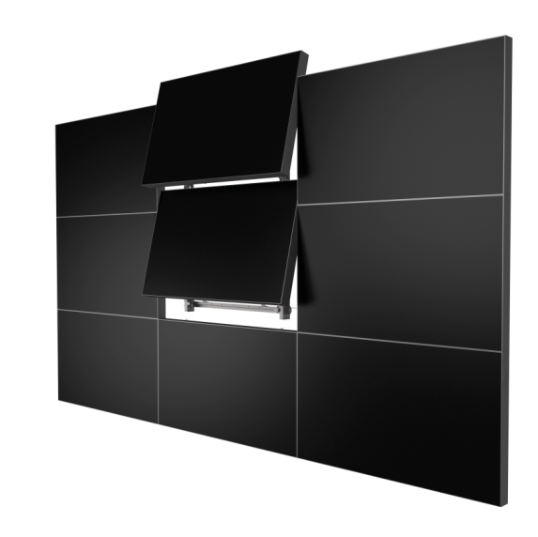
Clarity Matrix G3
Key Features
Advanced off-board video wall processing with Planar Video Controller:
Windowing, scaling, Picture-in-Picture (PiP), layout storage and recall
HDMI 2.0 and DisplayPort 1.2 inputs (4K@60Hz)
DisplayPort 1.2 loop output
Drives up to (9) Full HD (1920 x 1080) display sections
Up to 200ft (61m) transmission distance over Cat6*
Off-board Planar Remote Power Supply:
Redundant hot-swappable power supply module
Compact power density
Low power standby mode
Planar® EasyAxis™ Mounting System offers the industry’s thinnest available mounting depth
*MX65U-4K maximum transmission distance = 40 m over Cat6a
Planar Video Controller
Planar Remote Power Supply
Planar EasyAxis Mounting System

Slide 6
Off-Board Electronics Architecture
Key Benefits
Rack-mountable components keep heat, weight, depth, noise and points of failure away from the video wall
G3 components can be co-located with sources and processing equipment for simplified connectivity, security, and maintenance
Redundant power supply option maintains operation in the case of a power supply failure
Planar Video Controller
Planar Remote Power Supply

Slide 7
Planar WallDirector Software
Intuitive Software Simplifies Configuration, Servicing, Monitoring & Operating
Cross-platform web browser-based software locally hosted on remote equipment
Modern, user-friendly interface controlled from PC or mobile device
Intelligently detects components in the system
Processing and system management capabilities: Windowing layout creation, storage and recall, source scaling and switching, system scheduling and monitoring with customizable email and SNMP alerts
Administrative privileges and control

Slide 8
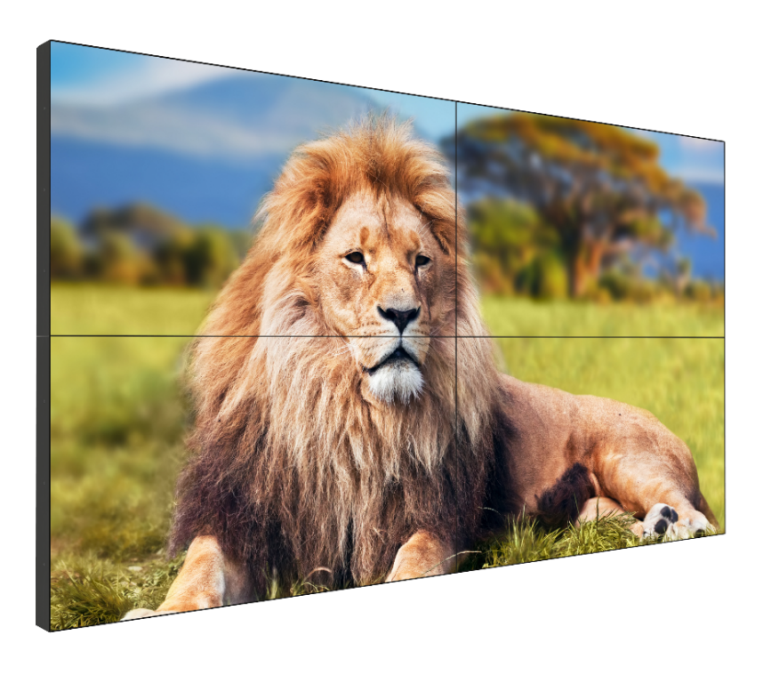
Planar Big Picture Plus Video Processing
Flexibility and Enhanced Capabilities with Clarity Matrix G3
Clarity Matrix G3 supports a variety of different source configurations
Allows scaling an image across the entire video wall or in sections of the video wall
Clarity Matrix G3 adds PiP overlapping of sources
Planar WallSync technology used to eliminate video tearing and deliver genlock synchronization
How your wall is cabled and which VC your source is plugged into can limit where you can place content on the screens
Planar WallDirector software is used to configure and operate the source configuration
Also supports third-party processing solutions

Slide 9
Planar WallSync
Industry’s First Fully Integrated Synchronized Video Wall Technology
Supports video wall synchronization to both customer-selected connected video sources and external house syncs
Incorporates Smart Genlock feature to ensure perfectly synchronized video display without misalignment or tearing
Accessible through Planar WallDirector Software

Slide 10
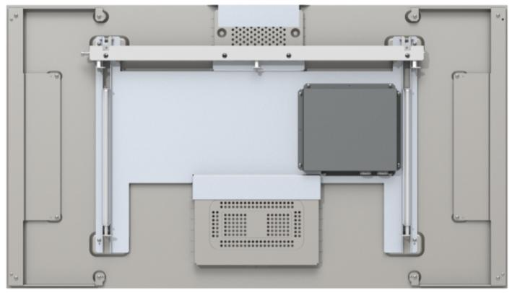
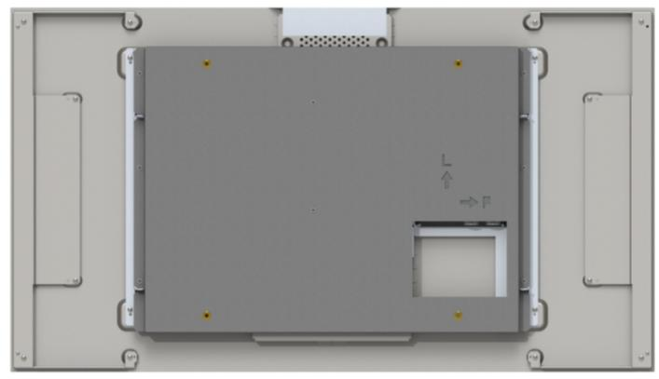
Mounting for Clarity Matrix G3
Mounting Options
400 x 400 mm
Planar EasyAxis Mounting System
VESA mount hole pattern (optional)

Slide 11
Mounting for Clarity Matrix G3
Planar EasyAxis Mounting System
Industry’s thinnest LCD video wall
Perfect display-to-display alignment with alignment cams for 6-axis of adjustment
ADA-compliant mounted depth as small as 3.5” (88mm)
Reduces alignment time
Easy front access ─ All adjustments are done from the top
Built-in service mode
Mounts are included with the displays

Slide 12
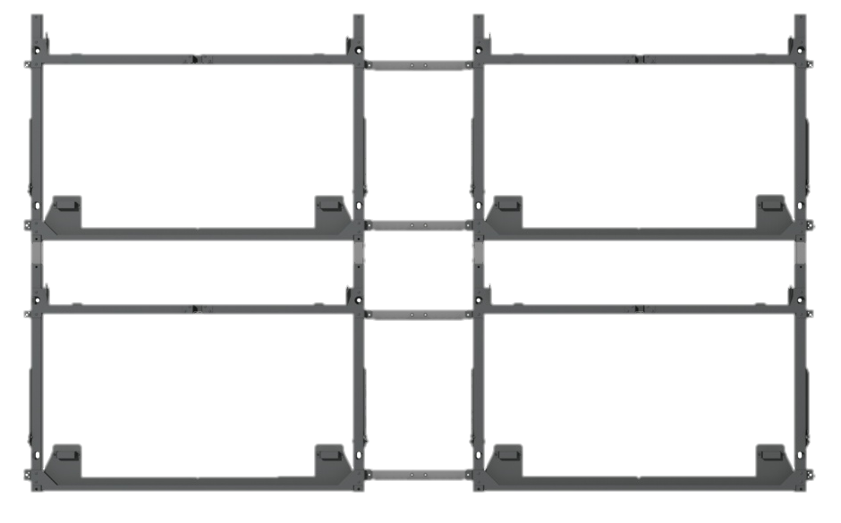
Clarity Matrix G3 LCD Video Wall System
Planar EasyAxis Mounting System
New Interface Board─ Provides shorting protection for improperly terminated power cables
Memory chip─ stores SN, color calibration values for each panel
Same wall brackets and spacers as Clarity Matrix G2

Slide 13
Additional Features and Options for Clarity Matrix G3
Fiber Video Extension
LEDs at display and Video Controller aid diagnostics and troubleshooting
Video extension cable integrity sensing
Mullion compensation
EDID Management
Serial number capture
Configuration and settings export/import
Standard Video Controller now offers 9 outputs to drive up to (9) 1080p displays
6-point and 32-point multi-touch option kits available

Slide 14
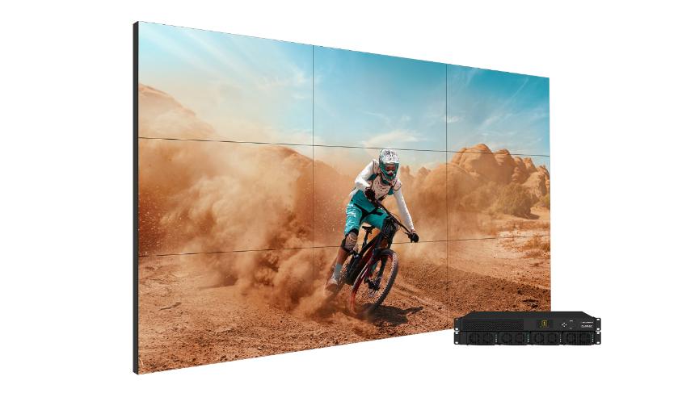
Clarity Matrix G3 Complete
Pre-packaged 2x2, 3x3 or 4x4 LCD Video Walls with Everything
Models:
Clarity® Matrix® G3 Complete™ LX55M-L 2x2
Clarity Matrix G3 Complete LX55M-L 3x3
Clarity Matrix G3 Complete LX55M-L 4x4
Video Wall Display:
55” diagonal
0.88 tiled bezel width
1920x1080 resolution
500 nit brightness
Insert Image

Slide 15
Clarity Matrix G3 Complete
Pre-packaged 2x2, 3x3 or 4x4 LCD Video Walls with Everything
Includes:
55" Clarity Matrix G3 LX55M
4, 9 or 16 Full HD video wall displays
Video controller and power supply electronics with redundancy option
Display interconnect and 200’ homerun cables
Trim
Mounts
Spare displays
2x2 = 1 spare
3x3 = 2 spares
4x4 = 3 spares
Insert Image

Slide 16
Clarity Matrix G3 LCD Video Wall System
Naming & Branding
Naming
Company | Planar
Logo Branding | Planar
Family | Clarity® Matrix® G3 LCD Video Wall System
Models | LX/MX46U, LX/MX46X, LX/MX55U, LX/MX55X, LX/MX55M, MX65U-4K
Electronics | Planar® Video Controller (VC)
Power Supply | Planar® Remote Power Supply (RPS)
Software | Planar® WallDirector™ Software

Slide 17
Clarity Matrix G3 LCD Video Wall System
LCD Model Name Legend
Product Family: Clarity Matrix G3 LCD Video Wall System
Product Models: LX, MX, 3D
Product Options:
Brightness | Diagonal | Tiled Bezel Width |  | 4K | Orientation | ERO | Fiber | 3D
LX – 500 Nit MX – 700 Nit / 800 Nit | 46” 55” 65” | U – 3.7mm X – 1.7mm M – <1 mm |  | 4K – 3840 x 2160 Resolution | L – Landscape P – Portrait V – VESA | ERO | F | 3D
MX55X-L
MX55X-P-ERO
MX46U-L-ERO
LX55U-L-F
LX55X-V
LX46U-P-ERO
LX46U 3D

Slide 18
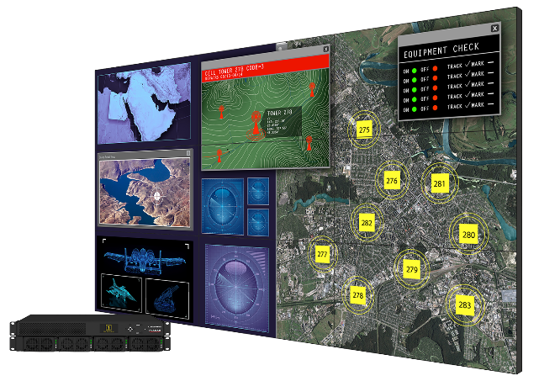
Clarity Matrix G3 Models
MX65U-4K
MX55M
High Performance
65” diagonal
3840x2160
800 nits
ADA-Compliant
3.7mm tiled bezel
MX46X
MX55X
High Performance
55” diagonal
1920x1080
700 nits
ADA-Compliant
0.88 mm tiled bezel
MX46U
MX55U
High Performance
46” & 55” diagonals
1920x1080
800 nits
ADA-Compliant
1.7 mm tiled bezel
LX55M
High Performance
46” & 55” diagonals
1920x1080
800 nits
ADA-Compliant
3.7mm tiled bezel
LX46X
LX55X
High Performance
55” diagonal
1920x1080
500 nits
ADA-Compliant
0.88 mm tiled bezel
LX46U
LX55U
Standard Performance
46” & 55” diagonals
1920x1080
500 nits
ADA-Compliant
1.7mm tiled bezel
Standard Performance
46” & 55” diagonals
1920x1080
500 nits
ADA-Compliant
3.7mm tiled bezel
LX46U 3D
Standard Performance
46” diagonal
1920x1080
500 nits
3.7mm tiled bezel

Slide 19
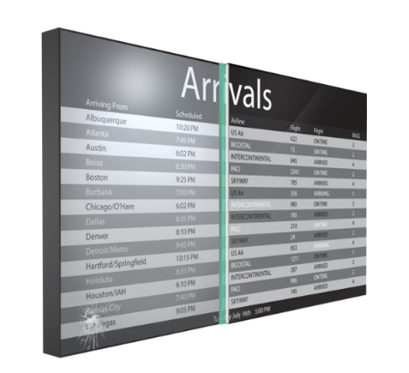
Planar ERO-LCD (Extended Ruggedness and Optics)
Protective Surface Technology for LCD Displays
Protective soda-lime glass optically bonded to the LCD
Improved contrast, clarity, and legibility
Added protection and durability
Reduced glare and parallax error
Keeps out dust and moisture
Modular touch surface, maintains serviceability

Slide 20
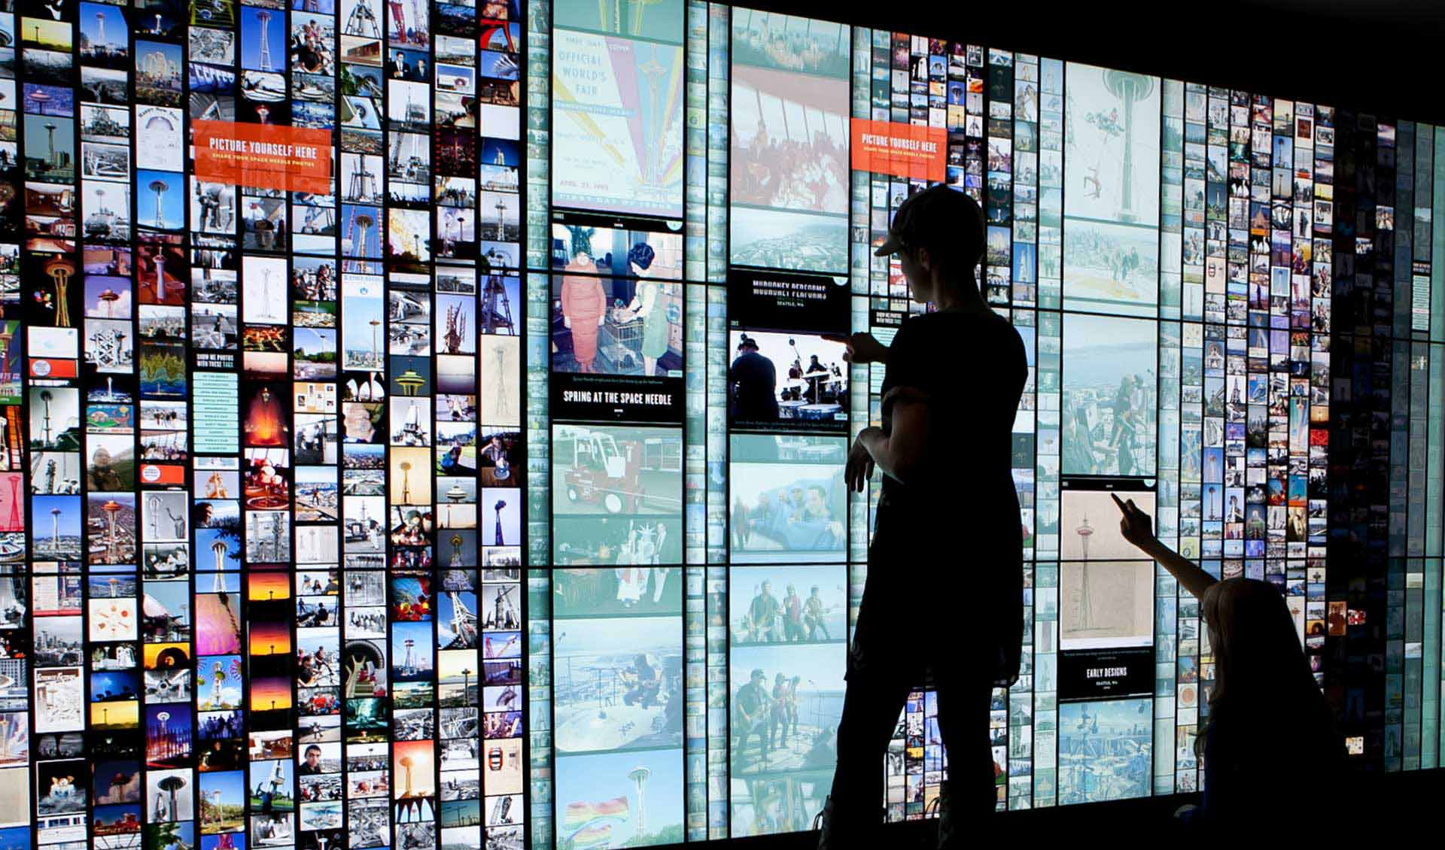
Clarity Matrix G3 MultiTouch
Interactive LCD Video Wall System
Modular impact-resistant touch surface with Planar ERO-LCD technology
Up to 32 simultaneous touch points
Allows multiple users to interact simultaneously
Pinpoint touch accuracy
Capable of wall sizes up to ~500” diagonal
HID-compliant option for walls <150” diagonal
Available with 46”, 55” or 65” Clarity Matrix G3 Models
Mounted depth 4.5” (not ADA compliant)
Power to touch frame provided by LCD display no additional outlets required at wall

Slide 21
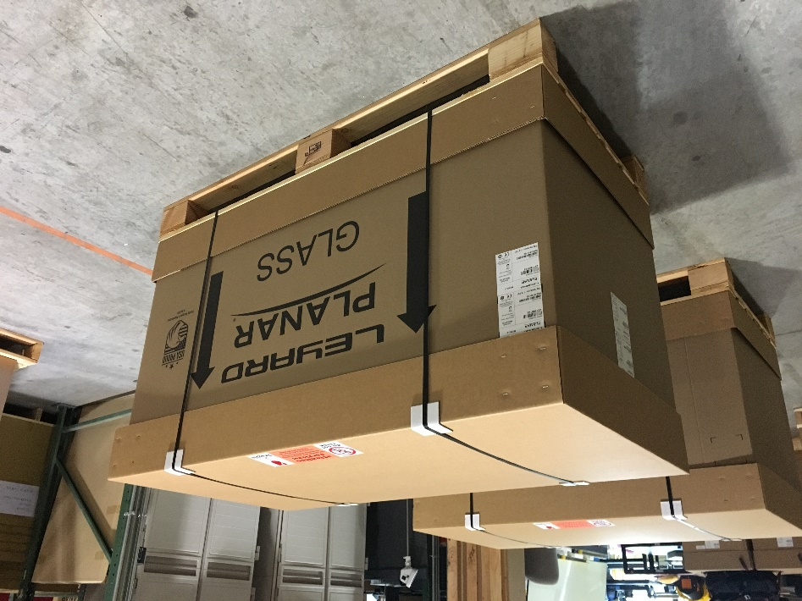
New Clarity Matrix G3 Packaging Carton
The newly designed Clarity Matrix G3 Shipping Carton holds two Clarity Matrix G3 LCD displays and incorporates a number of key features, including:
Additional and redesigned foam inserts to survive impact, drop and tip tests
In-box test process and viewing cutouts to quickly identify and report any shipping damage without removing the display from the packaging
Individual display carriages to easily and safely move each display to a convenient location while keeping it fully protected until mounting to the wall

Slide 22
Off-Board Rack Components
Clarity Matrix G3

Slide 23
Clarity Matrix G3 Off-Board Electronics Architecture
Key Benefits
Components fit in standard racking units
Removes heat, weight, depth, noise and points of service from the video wall
Removing heat allows our displays to be 800 nits vs 700 nits for competitors’ same class displays
Rack can be co-located with sources and processing for convenient cabling, security, and climate control
Maintenance is easy to access and does not interfere with video wall
Redundant power supply option maintains operation in the case of a power supply failure
Planar Video Controller
Planar Remote Power Supply

Slide 24
Planar Video Controller (VC)
Key Features
Purpose built, OS-agnostic video wall processing platform
Built-in video and control signal extension
Modern connectivity
Works with Redundant Remote Power Supply
LEDs and front-panel LCD for system status and easy troubleshooting
Configuration storage and recall
Available Models:
9-Output Model (VC9H-BP+)
4-Output Model (VC4H-BP+)

Slide 25
Available Video Controller Models
VC9H-BP+
9-Output VC (Standard Controller for 1080P displays)
VC4H-BP+
4-Output VC (Optional Controller for 1080P displays, Standard Controller for MX65U-4K)

Slide 26
Video Controller Models
Choosing the Right Model
VC9H-BP+ 9-Output Unit | VC4H-BP+ 4-Output Unit
Best for applications where: Rack space is a concern Planar Big Picture Plus is used Relatively small number of sources are required Matrix switcher is used Video processor with 4K outputs is used | Best for applications where: Rack space is not a concern Larger number of directly-attached sources are required More content zones or windows on the video wall are desired Fiber applications MX65U-4K video walls

Slide 27
Planar Video Controller
Front Panel View
Video Controller ID
Customer or Direct Connection Network Address – Default Address is 196.168.12.12
System Network Address – for that VC
Status LED – Blinks when receiving a command
Keypad Menu
System On/Off
Factory Reset
System Reset
Set IP for VC
System Network Address
3
Status LED
4
1
VC ID
2
Customer Network
Keypad
5
Front of Video Controller is the same for 9-Output and 4-Output models.

Slide 28
9-Output Planar Video Controller
Back Panel View - VC9H-BP+
4
9 Video Outputs (RJ45 8P8C)
5
Built-In Synchronization Board
IR Remote
6
8
Aux USB
9
Network Ports
2
HDMI 2.0 Inputs
3
DisplayPort 1.2 Loop In/Out
Power In/Out
1
7
RS-232 & USB Control
Power In/Out – Can loop up to 2 additional VCs
HDMI 2.0 Inputs – Each input capable of up to 4K at 60Hz
DisplayPort 1.2 Loop In/Out – Input capable of up to 4K at 60Hz
9 Video Outputs (RJ45 8P8C)–
Shielded CAT6 or greater
Up to 200ft / 60m
Built-In Synchronization Board
IR Remote
RS-232 and USB Control
Aux USB- Used for firmware download
Network Ports
System communication

Slide 29
4-Output Video Controller
Back Panel View - VC4H-BP+
4
4 Video Outputs (RJ45 8P8C)
5
Built-In Synchronization Board
IR Remote
6
8
Aux USB
9
Network Ports
2
HDMI 2.0 Inputs
3
DisplayPort 1.2 Loop In/Out
Power In/Out
1
7
RS-232 & USB Control
Power In/Out – Can loop up to 2 additional VCs
HDMI 2.0 Inputs – Each input capable of up to 4K at 60Hz
DisplayPort 1.2 Loop In/Out – Input capable of up to 4K at 60Hz
4 Video Outputs (RJ45 8P8C) –
Shielded CAT6 or greater
Up to 200ft / 60m
Built-In Synchronization Board
IR Remote
RS-232 and USB Control
Aux USB- Used for firmware download
Network Ports
System communication

Slide 30
Video Controller Models
Key Differences
 | VC9H-BP+ 9-Out VC | VC4H-BP+ 4-Out VC
Usage/Implementation | Standard for 1080P Models | Standard for MX65U-4K, Fiber Applications, Optional for 1080P Models
Video Outputs (Full HD sections) | 9 | 4
Inputs | 4x HDMI, 1x DP | 4x HDMI, 1x DP
Zones | 9 | 9
Rack Space | 1RU | 1RU

Slide 31
Planar Remote Power Supply
Efficient, Reliable and Mission-Critical Off-Board Power Solution
Same physical design as Remote Power Supply (RPS) for Planar DirectLight X LD Video Wall System
3-4 times higher power density – fewer RUs
Redundant and hot-swappable modules
110V or 220V support to further reduce circuits used
Ultra-low standby power mode (< 3 Watts)
Added monitoring functionality

Slide 32
Planar Remote Power Supply Models
Two Form Factors, Configured Per Installation
RPS110
100-240V. Maximum 3,600 Watts out. 1 RU – Standard
RPS220
200-240V. Maximum 7,200 Watts out. 1.5 RU - Greater power density - Optional

Slide 33
Planar Remote Power Supply Models
RPS110
RPS module
Redundant module bay
1 RU. 19” Rack
Circuit redundancy
Each plug requires 15a circuit (or 2 on 30a)
RS-232 control
Diagnostics lights
(3)1200w output
Breaker per output

Slide 34
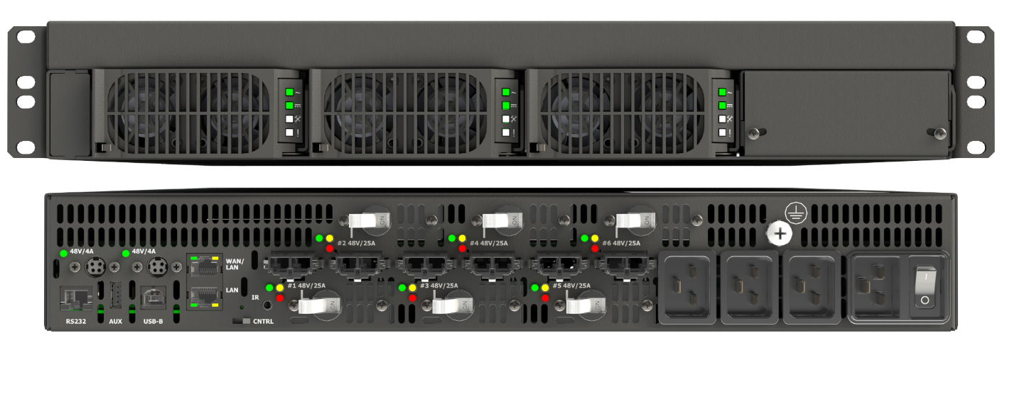
Planar Remote Power Supply Models
RPS220
RPS module
Redundant module bay
1.5 RU. 19” Rack
RS-232 control
Diagnostics lights
(6) 1200w output
Breaker per output
Circuit redundancy

Slide 35
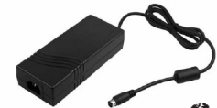
Fiber Video Extension Module
USB 2.0 input (Type-B connector)
SFP fiber transceiver connection output to the display
Fiber module power switch
DC Power (4-pin mini-DIN) for Fiber module powered by RPS or separate AC supply
Fiber Extension Module used in Clarity Matrix G3 & Planar® DirectLight® LED Video Wall System
Input from the Video Controller

Slide 36
Clarity Matrix Fiber Video Extension Module
Display Interface Board
IR and Ambient Light Sensor Outputs
USB 2.0 Output- Matrix MultiTouch
Power for Matrix MultiTouch
SFP Input from Fiber Module
Power Input and Loop Through

Slide 37
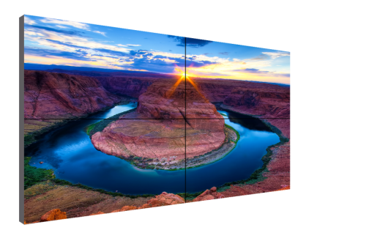
Supported Cable Lengths
Planar Video Controller
Standard length 200ft / 60m
Fiber Extension Module
Cat 6 Cable Lengths
Bulk cables and connectors support field-terminated lengths
25ft / 7.6m
50ft / 15.2m
75ft / 22.8m
100ft / 30.4m
200ft / 60m
Planar Remote Power Supply
Standard configuration support – 500ft / 152m
Power Cable Lengths
Bulk cables and connectors support field-terminated lengths
25ft / 7.6m
50ft / 15.2m
75ft / 22.8m
100ft / 30.4m
200ft / 60m
Fiber Extension Module
Multi-Mode 1000ft / 300m
Single Mode 10km (Requires customization)
Fiber Cable Lengths
Bulk cables and connectors to support field-terminated lengths available
65.6ft / 20m
98.4ft / 30m
Notes:
Reduces heat, etc
MTBF - ?
Co-Located - Short Cables, etc

Slide 38
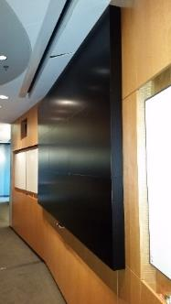
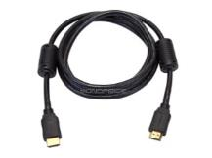
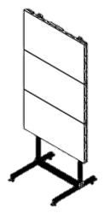
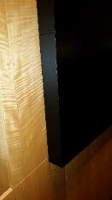
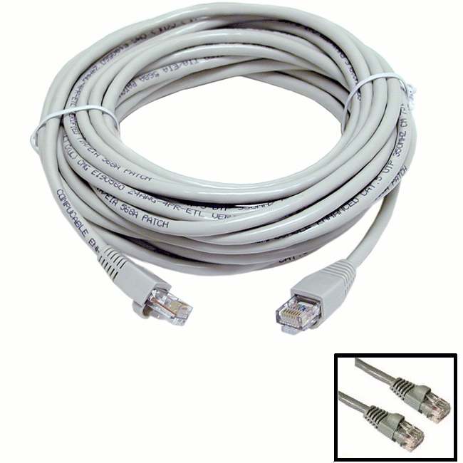
Clarity Matrix G3 Accessories
Cat6 cables: 25, 50, 75, 100, 200ft
DC power cables (plenum rated): 8, 25, 50, 75, 100, 200ft
Bulk cables, connectors, tools
Redundant power supply module
Edge trim
Floor stands
Stud adapter bracket
Clarity Matrix MultiTouch
HDMI 2.0 input cables

Slide 39
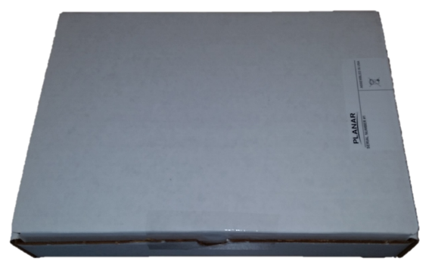
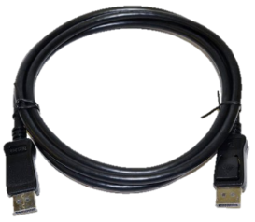
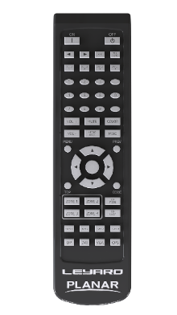
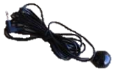
Clarity Matrix G3 Accessories Kit
Accessory Kit
The Accessories Kit contains:
IR receiver
Allen screwdrivers
Remote control
Fabric gloves
Remote off connector
USB drive with manual, etc.
DP loop through cable (1m)
Mini HDBNC cables for genlock

Slide 40
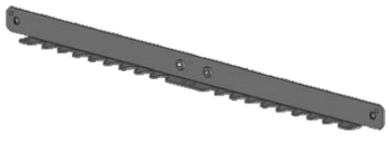
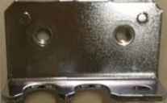
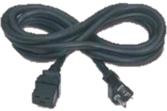
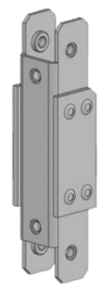
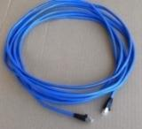
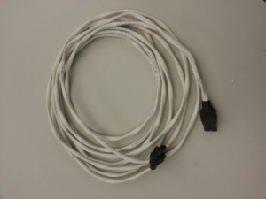
Clarity Matrix G3 Accessory Box
The Accessories Box contains:
Horizontal spacing brackets
Vertical spacing brackets
AC power cord (3 meters)
CAT6 STP video cables (if ordered)
Display power cables (if ordered)
Display power loop cables (if ordered)
Landscape
Portrait

Slide 41
Competition
Clarity Matrix G3

Slide 42
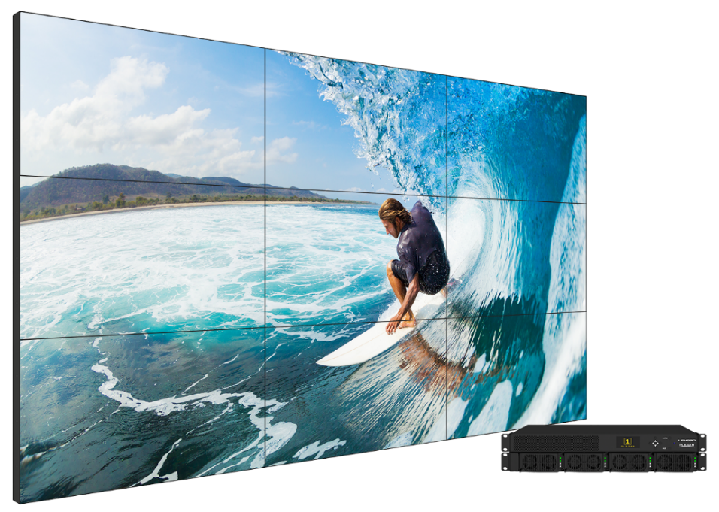
Clarity Matrix G3 Competitive Advantages
The industry’s most advanced and comprehensive video wall system
World’s thinnest tiled bezel width of .88 mm
Off-board rack-mountable electronics architecture with:
Hot-swappable power supply with redundancy option
Cascadable video controller allows for system scaling
Integrated web-based Wall Director control software
Layout management, windowing, PiP, video scaling
system scheduling, monitoring, email and SNMP alerts
HDCP 2.2
4K downscaling
Thinnest ADA-compliant installed depth
Planar ERO-LCD Technology─ protective glass for high-traffic and touch surface protection

Slide 43
LCD Video Wall Comparison
Feature | Benefit
Off-board Electronics | Removes heat, weight, noise, and points of failure from the video wall Quicker to service, no disruption or cost associated with servicing at the video wall
Depth less than ≤ 3.6” / 93mm | Maintain LCDs’ slim profile ADA-Compliant
Protective Glass Option | Provides display protection for video walls placed in public spaces Provides a touch surface that is modular
4K Picture-in-Picture Windowing | Allows for creative layering of content Doesn’t require additional hardware
Fan-less LCD Design | Less noise Less points of failure
Redundant Power Supply | No downtime if power supply failure occurs
4K Resolution Video Wall Scaling | Input sources of 4K (3840x2160) can be daisy-chained and scaled across the video wall
HDMI 2.0 and HDCP 2.2 | Latest in connectivity for Media players, set top receivers, 4K Bluray 4K at 60Hz content
DisplayPort 1.2 Input | Input sources of 4K resolution at 60Hz can be input and display native resolution across 2x2 array
Built-in Video Wall Scaling | No additional scalers or processing needed to stretch an image over the entire video wall
46” and 55” Ultra-narrow and Extreme narrow bezel LCD | Narrow bezel LCD technology for near seamless video walls
Model Meets Specification
Partially Supported
Certain Models
Not Available

Slide 44
Thank you

