Slide 1
Leyard Wallsync
Technology Overview – May 2018

Slide 2
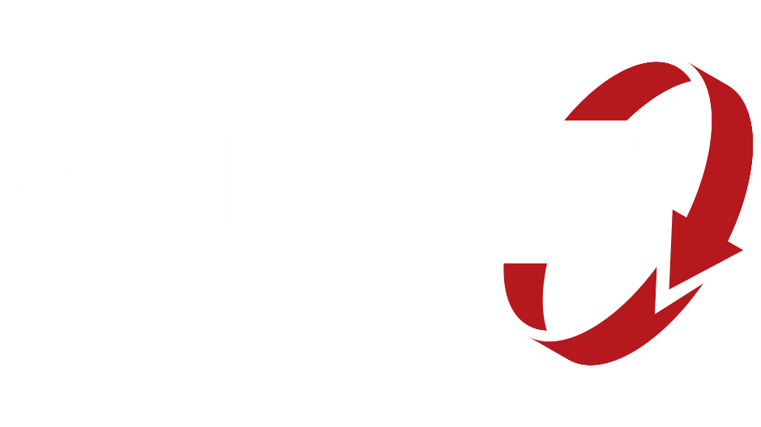
Introducing Leyard® WallSync™
Industry’s First Fully Integrated Synchronized Video Wall Technology
Supports video wall synchronization to a range of customer selectable internal and external sync sources
Ensures perfectly synchronized video display without misalignment or tearing
Includes unique Smart Genlock feature that works in concert with Planar® Big Picture Plus™ scaling technology
Works with select LCD and LED video walls from Leyard and Planar

Slide 3
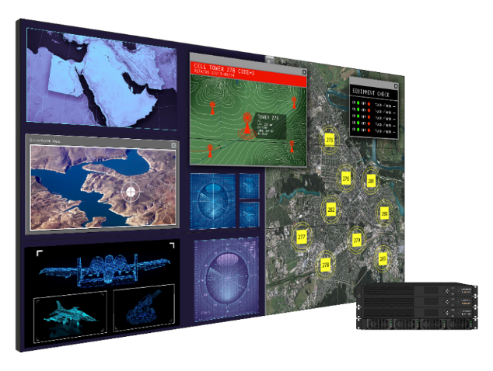
Clarity® Matrix® G3 LCD Video Wall System
Industry-Leading Performance and Value
Enhanced video wall processing and software
Mission-critical design with off-board electronics, hot-swappable redundant power supply
Industry’s thinnest installed depth and micro adjustments and easiest to service
Most advanced and comprehensive line up of LCD video wall models
Now with Leyard WallSync – delivering the industry’s first fully integrated video wall content synchronization
46” and 55” Ultra-narrow and Extreme Narrow Bezel

Slide 4
Leyard® Video Controller
Used in Clarity Matrix G3 and Leyard DirectLight X Video Walls
Built-in Synchronization Board
Sync to external signals – i.e. house sync in Broadcast environments
Sync Video Controllers by cabling Sync Out to Sync In
Genlock to any single input within the video wall
Mini-BNC connector with adapter to BNC

Slide 5
Genlock and Synchronization Critical to Performance
Leyard WallSync Ensures All VCs and Panels are Synchronized
If panel A and B are not genlocked or synchronized:
They begin drawing at different times
Horizontal content with vertical motion can appear to tear where the panels meet along the vertical bezel
A
B
Direction that content is moving down screen
= direction of LCD scanning / drawing

Slide 6
LCD Video Wall Appearance of Video Tearing
Common Artifact Seen In Narrow Bezel Tiled LCD Video Walls
Even with synchronized or genlocked video walls, tearing artifact still appears
Occurs with combination of fast horizontal motion or panning with content that includes vertical content elements
LCD panels draw top to bottom and are synced to start exactly together
Vertical content element in combination with horizontal motion, causes tearing artifact
Even in the latest generation video walls
Stopped Image
Image in motion moving across screen

Slide 7
Example: Horizontal Tearing

Slide 8
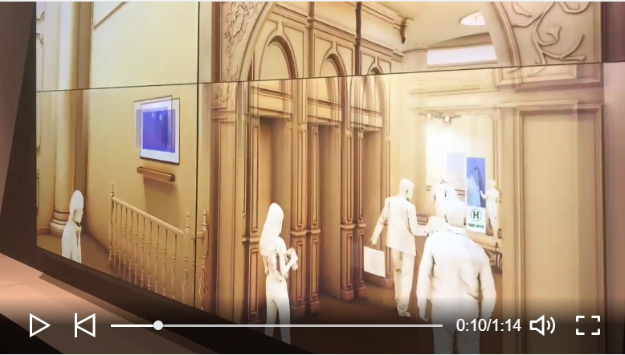
Example: Horizontal Tearing

Slide 9
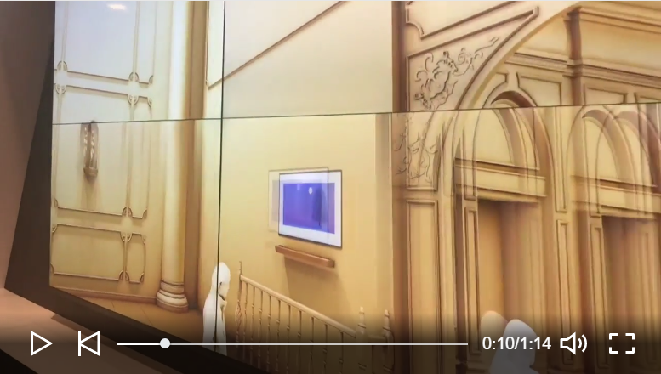
Example: Horizontal Tearing

Slide 10
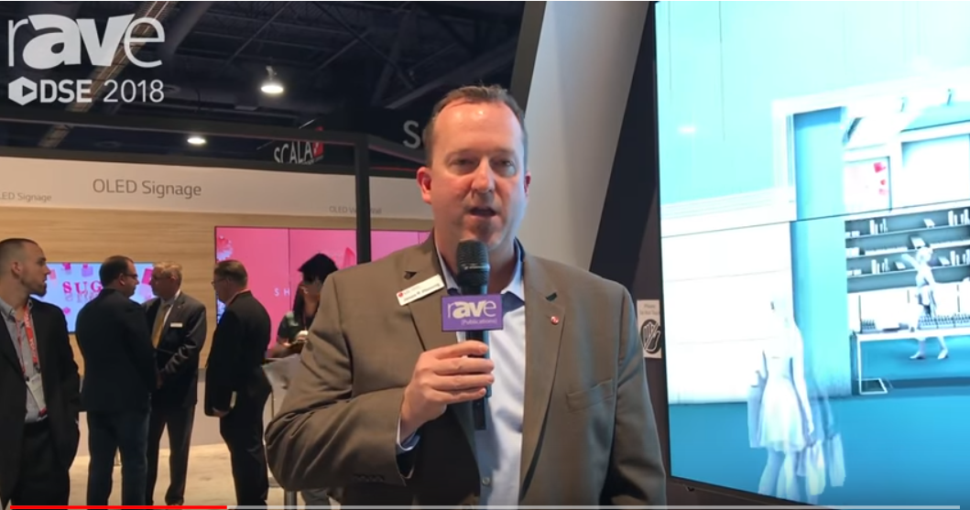
Example: Horizontal Tearing

Slide 11
Leyard WallSync Eliminates Tearing Artifact
Clarity Matrix G3 LCD panels are not only perfectly synchronized to internal sources or external sync clocks, they are driven in a way that eliminates this horizontal tearing artifact.
Leyard WallSync’s scan inversion ensures vertical images “meet” at the horizontal bezel
Tearing artifact is eliminated and eye perceives smooth motion of vertical image across the screen
Makes physical panel alignment with Planar EasyAxis Mounting System even more critical for best visual performance
Stopped Image
Image in motion moving across screen

Slide 12
Addressing Challenges of LED with Leyard WallSync
Accommodating Uncommon Resolutions
Sync or genlock to 1 source
Sync multiple VCs
> 4K video wall with perfectly synchronized video playback and no tearing between 1080 bezel-less sections
Scale 1 video across the video wall
4 x 3
VC 1, OUT 1 (1920 x 810)
4 x 3
VC 1, OUT 2
(1920 x 810)
3 x 3
VC 2, OUT 1
(1440 x 810)
Example:
Leyard DirectLight X
1.2mm pixel pitch
11 x 7 LED cabinet configuration
2 Video Controllers
1890 pixels
4 x 4
VC 1, OUT 3
(1920 x 1080)
4 x 4
VC 1, OUT 4
(1920 x 1080)
3 x 4
VC 2, OUT 2
(1440 x 1080)
VC 1
5280 pixels
1 source
VC 1
VC 2
VC 2

Slide 13
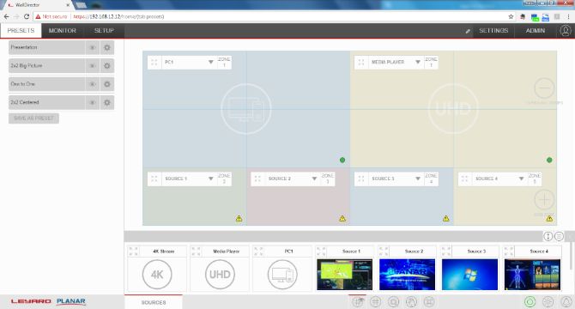
Leyard WallDirector Software
Simple, Comprehensive Interface For Clarity Matrix G3 and Leyard DirectLight X
Allows for user control of all Leyard WallSync features:
Turn on/off Smart (Auto) Genlock
Set sync reference per VC
Turn on/off scan inversion (only applies to LCD)

Slide 14
Configuring Leyard WallSync
Smart (Auto) Genlock (default):
Automatically genlocks video wall to whichever input source is configured as the Planar Big Picture Plus (full screen) source
Set Sync Reference (per Leyard Video Controller):
Smart (Auto) Genlock (default)
Sync In
HDMI 1, 2, 3 or 4 In
DisplayPort In (Loop In)
Scan Inversion (per video wall) – Only applies to Clarity Matrix G3:
On (default) – Self-configures to every even number row of displays
Off

Slide 15
Addressing Challenges of LED with Leyard WallSync
Accommodating Uncommon Resolutions
Sync or genlock to 1 source
Sync multiple VCs
> 4K video wall with perfectly synchronized video playback and no tearing between 1080 bezel-less sections
Scale 1 video across the video wall
4 x 3
VC 1, OUT 1 (1920 x 810)
4 x 3
VC 1, OUT 2
(1920 x 810)
3 x 3
VC 2, OUT 1
(1440 x 810)
Example:
Leyard DirectLight X
1.2mm pixel pitch
11 x 7 LED cabinet configuration
2 Video Controllers
4 x 4
VC 1, OUT 3
(1920 x 810)
4 x 4
VC 1, OUT 4
(1920 x 810)
3 x 4
VC 2, OUT 2
(1440 x 810)
1 source
VC 1
VC 2

Slide 16
How to Apply Leyard WallSync to 1-VC Video Walls
Two Use Cases:
Sync In hardware allows for genlocking to external source
Scan Inversion has value in 2x2 Clarity Matrix G3 LCD video walls with horizontal-motion video performance along horizontal bezel. (Does not require Sync board in VC)
For syncing to a video source connected to the VC, the VC already synchronizes the 4 video outputs to a single clock.
With a multi-VC wall, the sync cable between VCs ensures synchronization
Syncing on DisplayPort In (loop channel) with no sync cable interconnection works well too as a means to sync VCs

Slide 17
Leyard WallSync Launch Timing
Date | Item
May 23 | Press Release for Clarity Matrix G3 with Leyard WallSync Updated Clarity Matrix G3 web pages on Planar.com and Leyard.com sites Updated Clarity Matrix G3 Brochure Updated Clarity Matrix G3 Bid Specs – Partner Portal
In process | Sync Board hardware now being cut into all VC stock
In process | Clarity Matrix G3 in Demo fleet and showroom units updated as necessary – Ron coordinating
In process | Clarity Matrix G3 training materials being updated
June 6-9 | Demonstrate at InfoComm
June end | Leyard WallSync software release – functionality + WallDirector UI updates

Slide 18
Upgrading Existing Clarity Matrix G3 Customers
Upon request by customer
For-fee upgrade service offering
On-site VC upgrades by Leyard / Planar technician

Slide 19
Introducing Leyard® WallSync™
Industry’s First Fully Integrated Synchronized Video Wall Technology
Supports video wall synchronization to a range of customer selectable internal and external sync sources
Ensures perfectly synchronized video display without misalignment or tearing
Includes unique Smart Genlock feature that works in concert with Planar® Big Picture Plus™ scaling technology
Works with select LCD and LED video walls from Leyard and Planar

