Slide 1
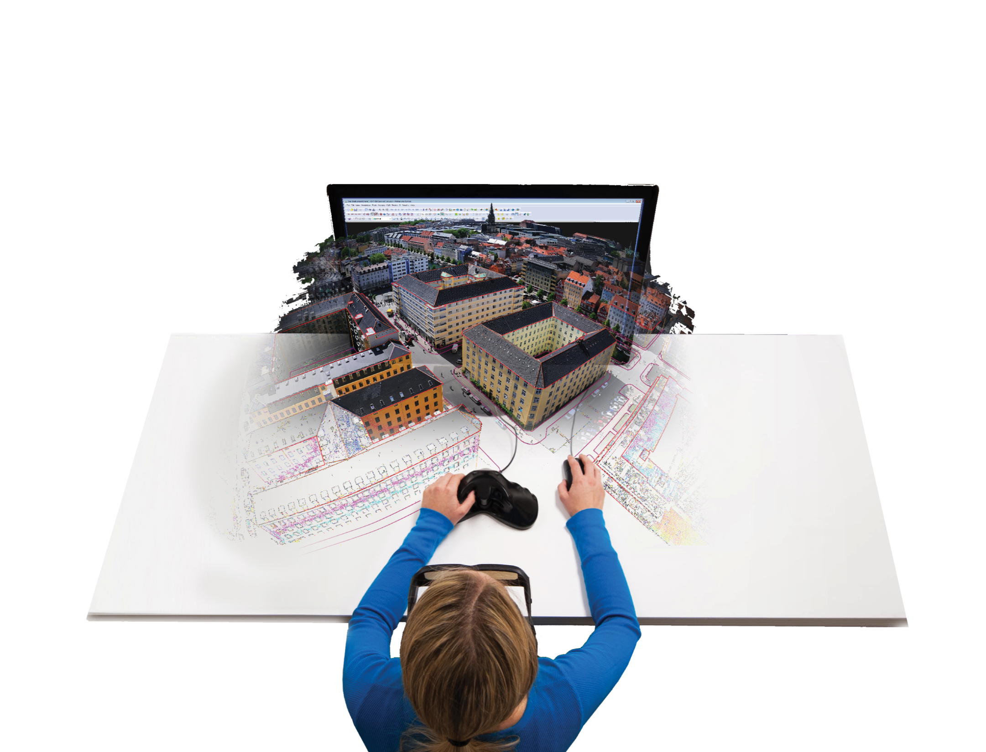

3D Stereo Mapping Solutions

Slide 2
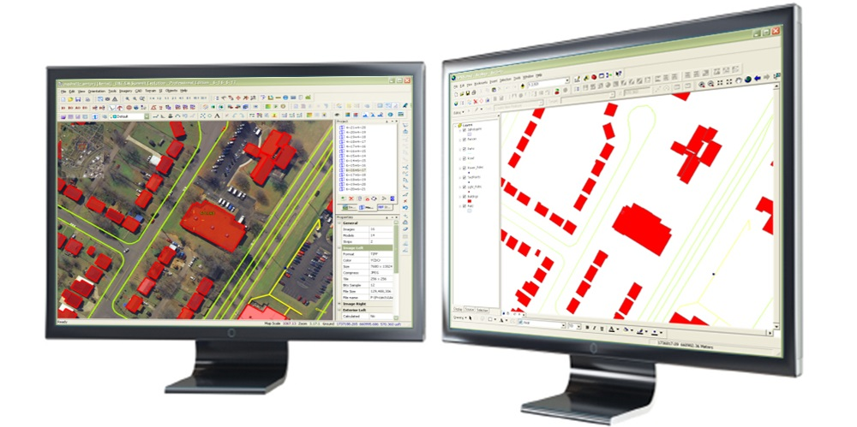
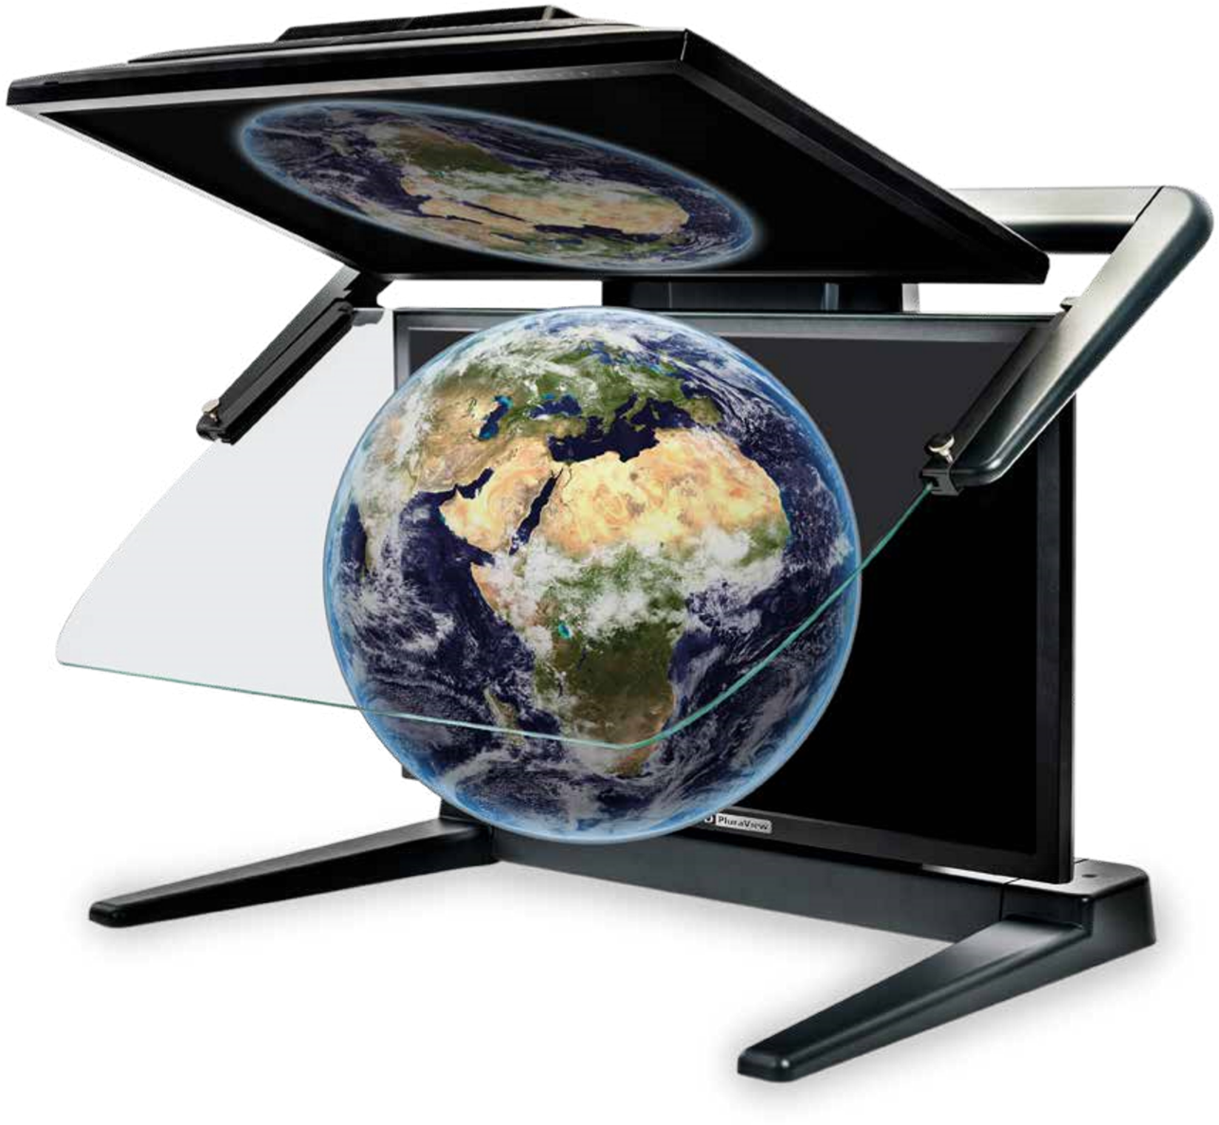
DAT/EM Product Line-Up
Summit Evolution
Software to Extract and Edit 3D Vector Features from Stereo Imagery
Two ways to describe it:
  A Digital Photogrammetric Workstation (DPW)
  A 3D stereo digitizer
It is a Human Interface device, designed to maximize human efficiency
Notes:
This is the Elevator Pitch, boiled down to its barest essentials.
Engineers and users of “survey grade” data will be familiar with (and not frightened by) the term DPW
Non-engineers and users of “resource-grade” data are more comfortable with the term “digitizer”

Slide 3
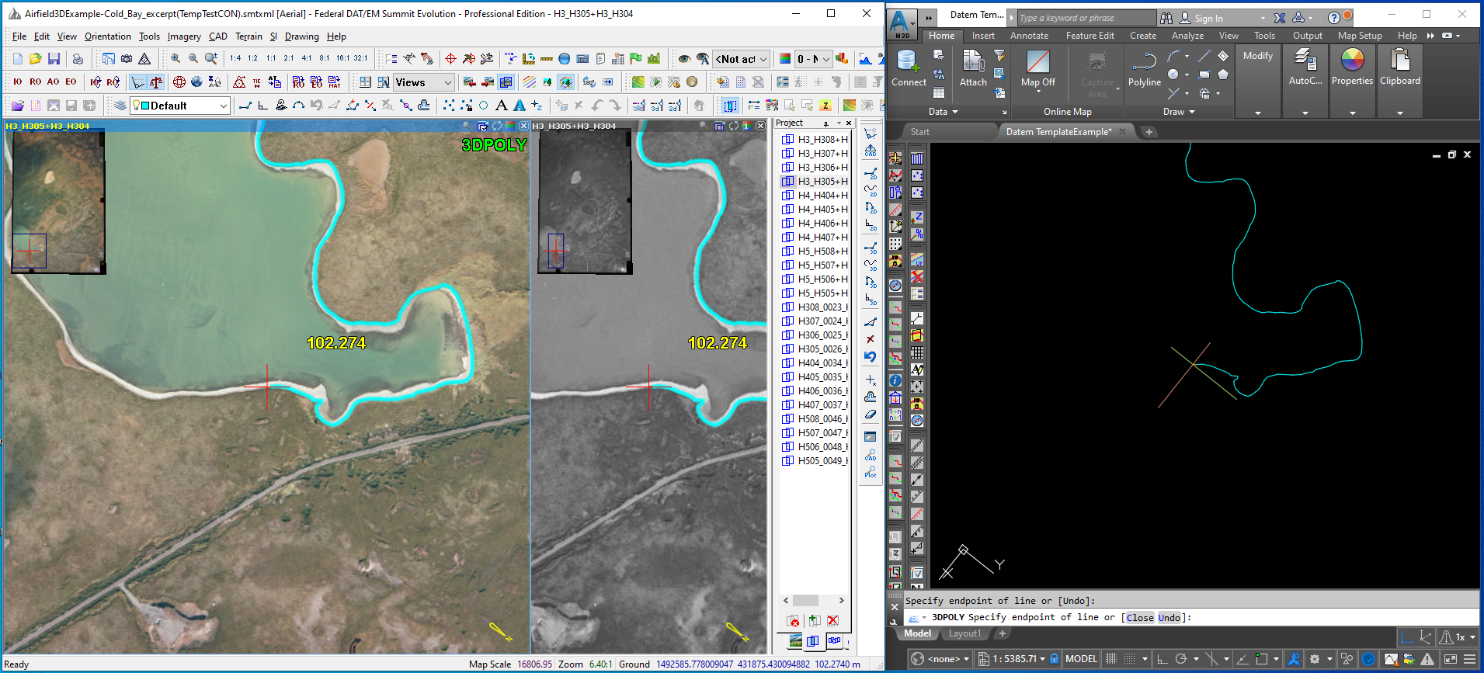


AutoCAD 2004 - 2021
DAT/EM Capture
Summit with a second viewport that has the same model in it, but with a channel map. This might be used to show the 4th band, for example, while the larger viewport shows the RGB bands. It could also show a different imagery set, such as an orthophoto of the same area.

Slide 4
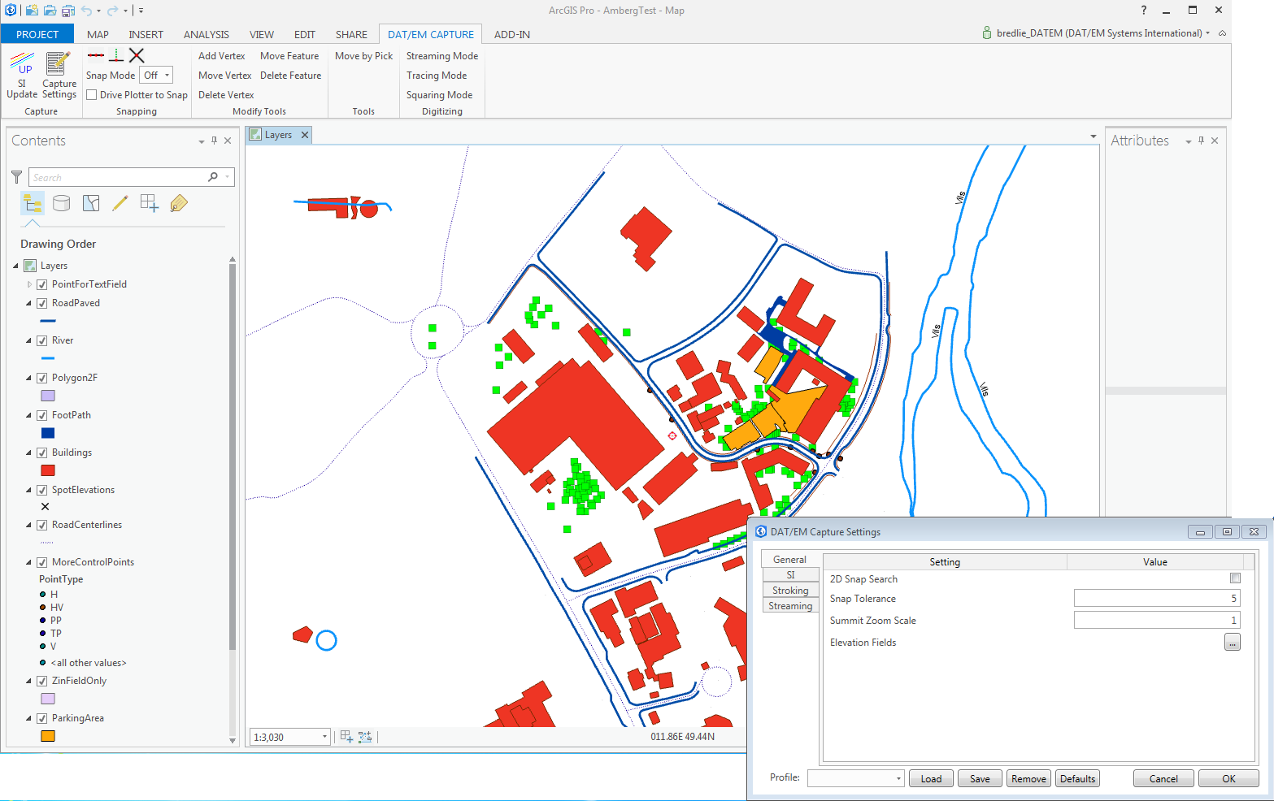
DAT/EM Capture
ArcGIS Pro
Notes:
Elevate Layers for ArcGIS
DAT/EM’s Elevate Layers tool converts 2D shapefiles and Personal Geodatabase feature classes to 3D.
Input a shapefile or Personal Geodatabase feature class
Input a DTM masspoints file (several formats supported)
Output a new shapefile or feature class that has elevation
Easily verify results by viewing superimposed vectors “on the ground” in SUMMIT EVOLUTION

Slide 5
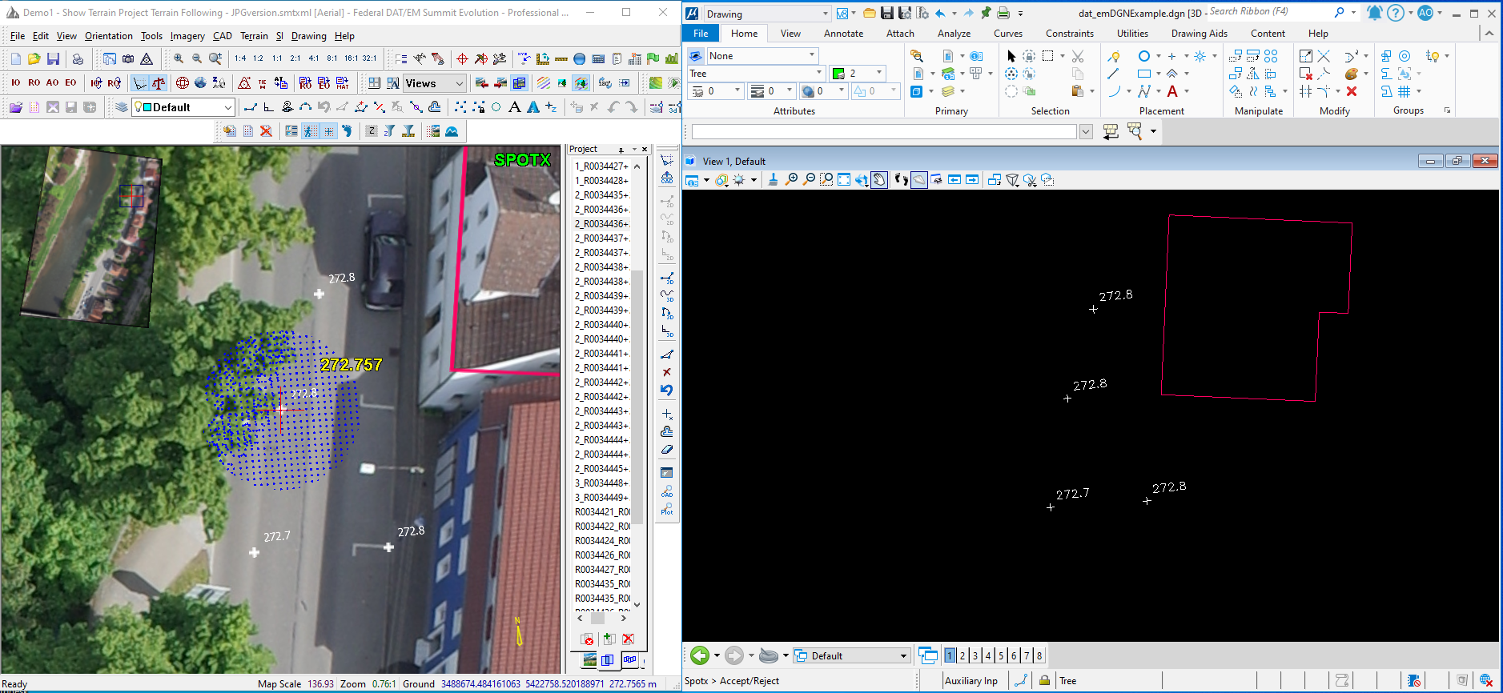
DAT/EM Capture
MicroStation
Summit with a UAS Terrain project open. This Project was made form the point cloud generated from the UAS processing software. Summit is following terrain, that is, automatically setting its elevation to the surface elevation of the Terrain Project. This terrain following can be stopped and started any time.
DAT/EM supplies specialty mapping commands such as building squaring and spot elevation commands (and many more!)
Summit can show the text (upper right corner of the view) of the CAD command, so you don't have to look away from the Summit window.

Slide 6
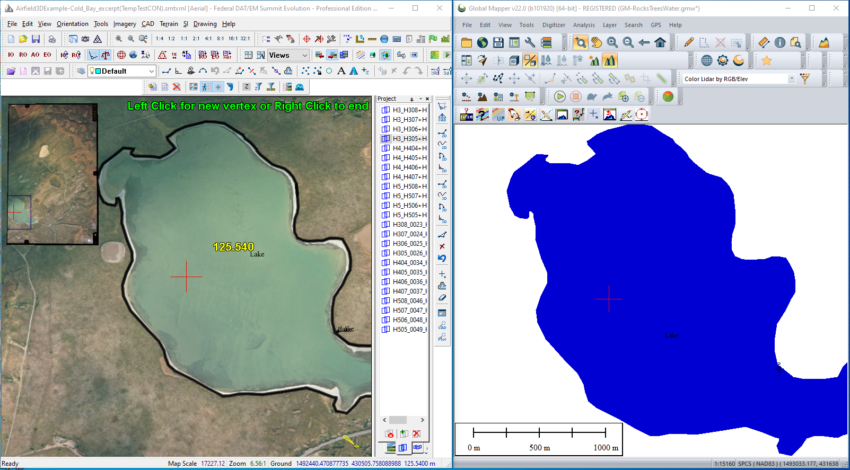
DAT/EM Capture
Global Mapper
Global Mapper is an add-on to your other CAD/GIS choice (AutoCAD, MicroStation, or ArcGIS). It is not as fully featured as the other Captures, but it's a great tool for quality control checks done in a less-expensive GIS environment.

Slide 7
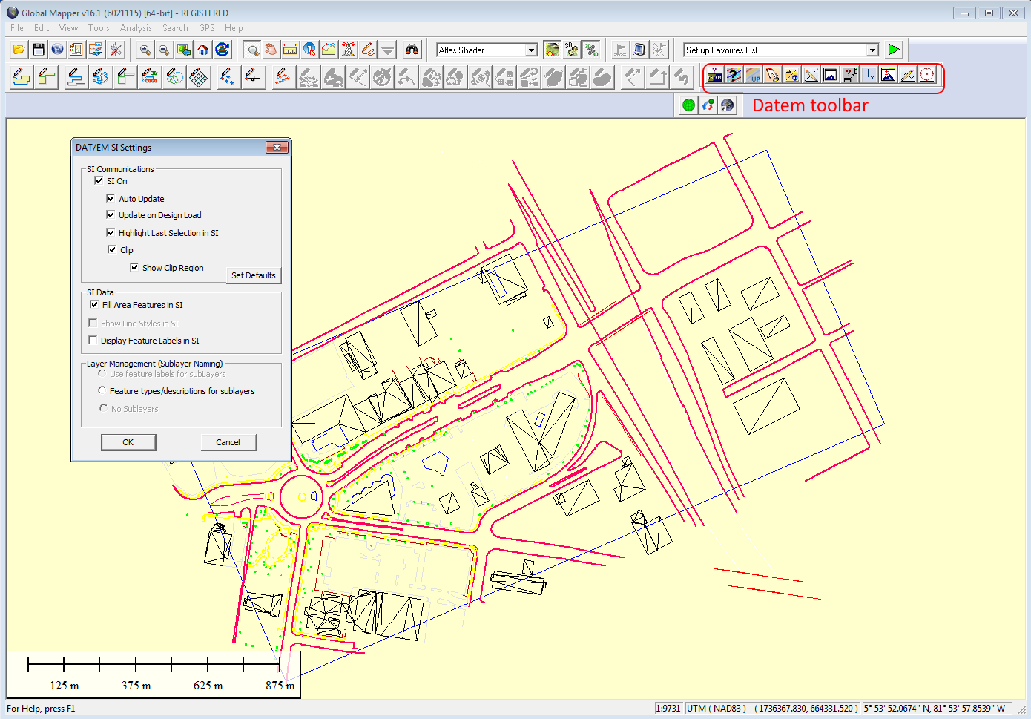
DAT/EM Capture
Global Mapper
Notes:
Elevate Layers for ArcGIS
DAT/EM’s Elevate Layers tool converts 2D shapefiles and Personal Geodatabase feature classes to 3D.
Input a shapefile or Personal Geodatabase feature class
Input a DTM masspoints file (several formats supported)
Output a new shapefile or feature class that has elevation
Easily verify results by viewing superimposed vectors “on the ground” in SUMMIT EVOLUTION

Slide 8
DAT/EM Capture
3D Vector Feature Collection for ArcGIS, AutoCAD, MicroStation, Global Mapper
Visual feedback is immediate and overlays 3D vector data back atop the stereo imagery in Summit Evolution for feature verification.
DAT/EM Capture allows complete interaction as well as adds many important 3D tools.
Notes:
Elevate Layers for ArcGIS
DAT/EM’s Elevate Layers tool converts 2D shapefiles and Personal Geodatabase feature classes to 3D.
Input a shapefile or Personal Geodatabase feature class
Input a DTM masspoints file (several formats supported)
Output a new shapefile or feature class that has elevation
Easily verify results by viewing superimposed vectors “on the ground” in SUMMIT EVOLUTION

Slide 9
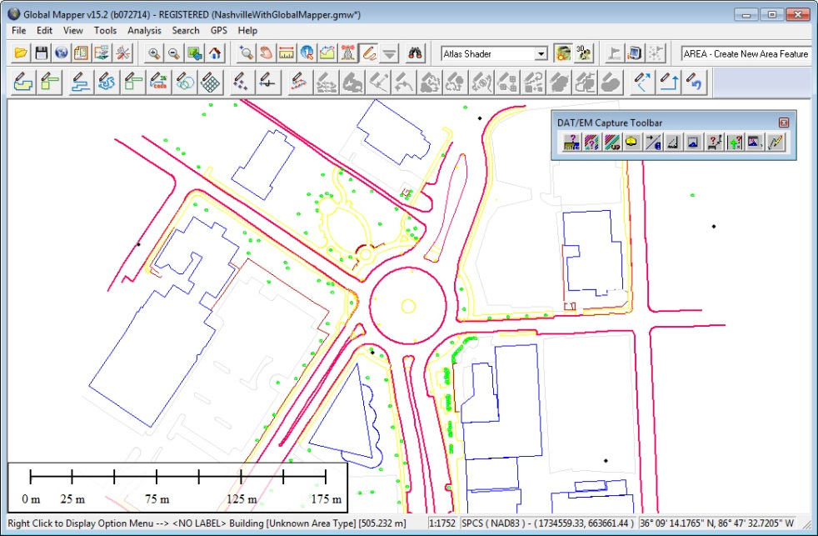
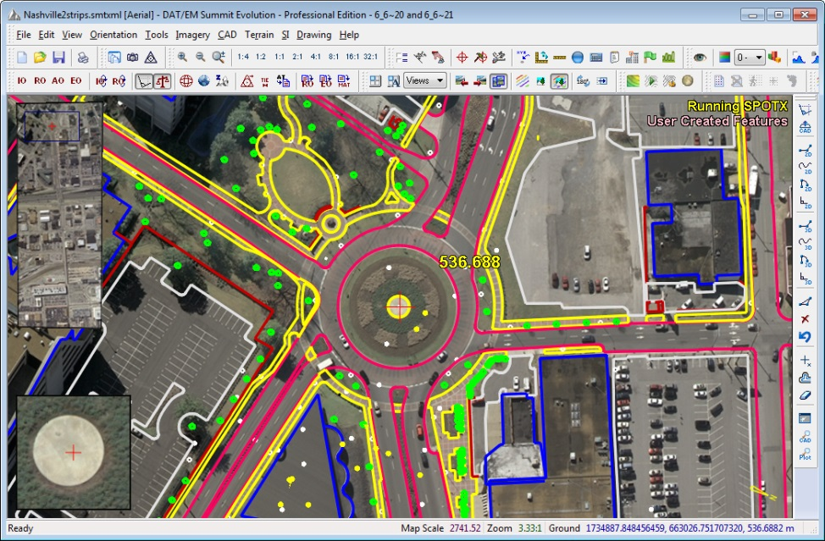
DAT/EM Capture
3D Vector Feature Collection for ArcGIS, AutoCAD, MicroStation, Global Mapper
Digitize 3D vector information from stereo imagery into several CAD or GIS programs
DAT/EM Capture toolbar displays in CAD or GIS program
Notes:
Elevate Layers for ArcGIS
DAT/EM’s Elevate Layers tool converts 2D shapefiles and Personal Geodatabase feature classes to 3D.
Input a shapefile or Personal Geodatabase feature class
Input a DTM masspoints file (several formats supported)
Output a new shapefile or feature class that has elevation
Easily verify results by viewing superimposed vectors “on the ground” in SUMMIT EVOLUTION

Slide 10
DAT/EM Capture
3D Vector Feature Collection for ArcGIS, AutoCAD, MicroStation, Global Mapper
Example of collecting planimetric vectors using
DAT/EM Capture for MicroStation and DAT/EM SuperImposition
Photo courtesy of Gorrondona & Associates, Inc.
Notes:
Elevate Layers for ArcGIS
DAT/EM’s Elevate Layers tool converts 2D shapefiles and Personal Geodatabase feature classes to 3D.
Input a shapefile or Personal Geodatabase feature class
Input a DTM masspoints file (several formats supported)
Output a new shapefile or feature class that has elevation
Easily verify results by viewing superimposed vectors “on the ground” in SUMMIT EVOLUTION

Slide 11
DAT/EM MapEditor
3D Map Editing for AutoCAD and MicroStation
Reduce overall editing time from hours to minutes with DAT/EM MapEditor. Customized MapEditor processing allows features in
AutoCAD and MicroStation to be modified with a batch method.
Photo courtesy of Gorrondona & Associates, Inc.
Above: customized curb process used to modify segments of a
curbed‐road between driveways and saved many hours of manual manipulation.

Slide 12
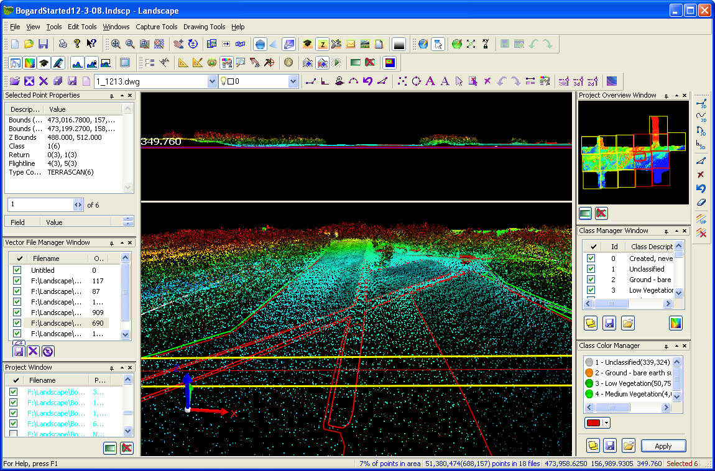
3D Point Cloud Viewing and Editing
Notes:
12

Slide 13
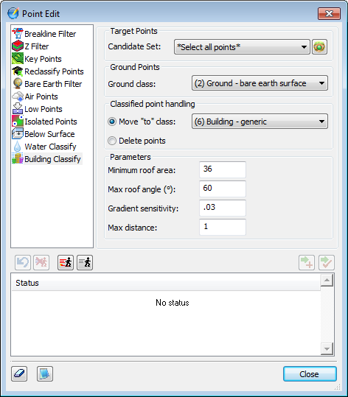
Point Classifications
3D Point Cloud Editing and Classification tools
Building Classify

